Slide 1



Vulnerability of small rivers coastal part due to floods: the case study of Lesvos West - North Coast
7th International Electronic Conference on Water Sciences 2023
15 – 30 March 2023
Papasarafianou, S., Gkaifyllia, A., Iosifidi, A.E., Sahtouris, S., Wulf, N., Culibrk, A., Stamataki, M.D., Chatzivasileiou, T., Siarkos, I., Rouvenaz, C., Koutsovili, E.M., Hasiotis, T. and Tzoraki, O.

Slide 2
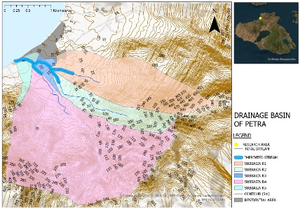
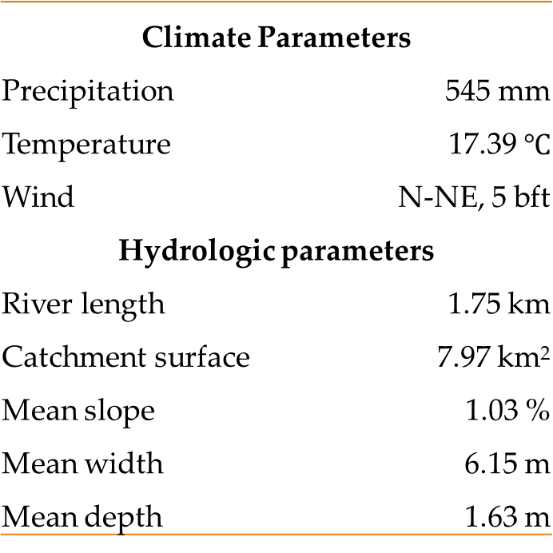
Climate Parameters
Precipitation | 545 mm
Temperature | 17.39 $℃$
Wind | N-NE, 5 bft
Hydrologic parameters
River length | 1.75 km
Catchment surface | 7.97 km²
Mean slope | 1.03 %
Mean width | 6.15 m
Mean depth | 1.63 m

Slide 3
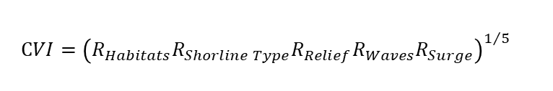
Methods and Materials
coastal vulnerability
Hydraulic processes
InVEST Coastal vulnerability
model
HEC-RAS
Physical characteristics (wind, wave, bathymetry, catchment surface)
Natural habitat (seagrass)
Population data
Topography (DEM)
One steady flow
Climate data (P, T, Q)
Topography (DEM)
$$CVI={\left(R_{Habitats}R_{Shorline Type}R_{Relief}R_{Waves}R_{Surge}\right)}^{1/5}$$
Critical cross sections
The coastal exposure index: very low exposure (rank=1) - very high exposure (rank=5)

Slide 4
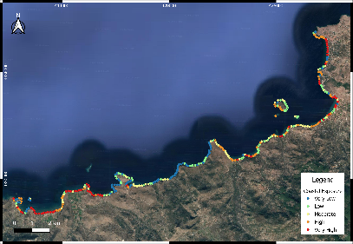

Results
(a) | (b)
Figure 2: Map of Petra – Molyvos exposure to erosion (a) with Habitats variable, and (b) without Habitats variable

Slide 5
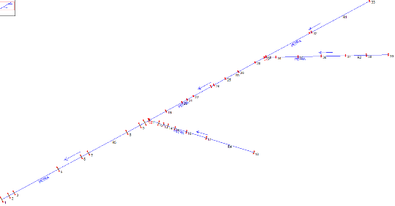
Results
Table 2: Stream flow of Petra.
Reach | Subbasin Surface area (km²) | Subbasin Δη (m) | Reach length (m) | Flow Q (m3/sec) | Overflow section | Froude Value | Velocity (m/s) | E.G. Slope (m/m) | Average Branch Velocity (m/s)
R1 | 2.06 | 560 | 375 | 2.15 | S32 | 0.27 | 0.66 | 0.001856 | 1.42
R2 | 0.87 | 485 | 317 | 1.40 | S37 | 0.43 | 0.99 | 0.006421 | 1.25
R3 | 0.14 | 15 | 399 | 1.55 | S26 | 0.44 | 0.87 | 0.0059 | 0.90
R4 | 4.65 | 345 | 258 | 3.90 | S18 | 0.14 | 0.48 | 0.0005 | 1.10
R5 | 0.20 | 145 | 367 | 8.50 | S2 | 0.15 | 0.57 | 0.0005 | 1.33
Figure 3: The Petra stream plot

Slide 6
Conclusion
This study combines the main results with an analysis of floods and flush rain episodes and the coastal erosion vulnerability of the sandy and rocky beaches. The habitat is an important part of the coastal zone, which reduces coastal exposure to erosion. The vulnerability scenario with habitats gave a 53% of coastal protection, and the CV index gave moderate risk (rank = 2 to 3). Additionally, the results from the CV index showed low exposure (rank = 1 to 2) to rock beaches and high exposure (rank = 4 to 5) to sandy beaches (Figure 2).
The hydraulic analysis of the Petra River, during the rainy events, showed low velocities in geometrically small cross-sections and the simulation results show that under flashy rain events, several cross-sections of the stream are overflooded. Anthropogenic activity in the river's hull negatively affects sediment transport to the coastal zone
Acknowledgments: The authors thank Hasiotis T., Tzoraki O., and Sahtouri S. for the operating costs of the present research which were partly funded by Partner, INTERREG Greece-Cyprus, Coastal erosion due to climate change: assessment and ways of effective treatment in tourist areas of the North Aegean and Cyprus. Koutsovili E.I., Stamataki M.D., Culibrk A., and Chatzivasileiou T. for funded by the Operational Program National Strategic Reference Framework (NSRF) North Aegean 2014-2020. Papasarafianou S. the research was received as part of the Ph.D. program Phenomena and Environmental Risk by the University of Naples, Parthenope, and Wulf N. for the research was received as part of the ERASMUS Plus.

