Slide 1
Quality of Surface and Ground Water: Assessment of Physicochemical Characteristics and Heavy Metal Contamination of Different Water Samples from Three States in Nigeria Francis Olawale Abulude*, Akinyinka Akinnusotu, Ebenezer Alaba Adeoya, Samson Olatunde Mabayoje, Kikelomo Mabinuola Arifalo and Ademola Adamu *Corresponding author: walefut@gmail.com
7th International Electronic Conference on Water Sciences, 15-30 March 2023

Slide 2
INTRODUCTION
The availability and sustainable management of water and sanitation for everybody by 2030 are one of the sustainable development objectives (Goal 6).
For continued population expansion and development, access to a secure and reliable water supply is a crucial requirement.
Groundwater is the most dependable source of drinking water in Sub-Saharan Africa
Due to the scarcity of surface water supplies in some regions, people are forced to use underground water, which presents a problem in those areas.
In Southwest, Nigeria groundwater and surface water are significant natural resources that have an impact on both human and animal health and welfare.

Slide 3
INTRODUCTION contd…
Water quality is a major concern because of the health risks it poses.
Primary research and quality control efforts should be directed at the quality of these resources.
It will not be out of place if the qualities of the water samples are determined.
Although results of studies are published in Southwest water samples, constant monitoring is advocated.
The idea in this work was to perform recent studies on the water samples from Southwest.
The goal of this study was to assess the Physicochemical Characteristics and Heavy Metal Contamination of water samples from Osun, Ondo, and Ekiti, Nigeria.

Slide 4
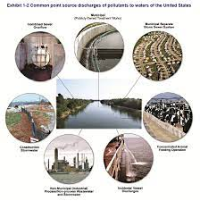
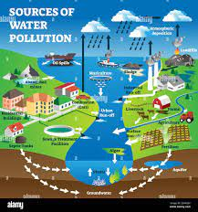
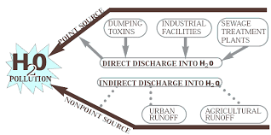
MATERIALS AND METHODS
33 water samples were selected from rivers (10), hand-dug wells (14), boreholes (7), and rain (2). Osun, Ondo, and Ekiti States
pH, temperature, TDS, and electrical conductivity were measured in situ using a portable multi-parameter meter
The elements (Na, Ca, Cu, and Fe) were evaluated utilizing conventional methods (AAS)
The metal index (MI), contamination factor (CF), and enrichment factor (EF) were determined
Excel 2013 and Mintab software were used for the statistical analyses

Slide 5
RESULTS AND DISCUSSION
Table 1: Physicochemical characteristics and elemental results
Variable | Mean | SE Mean | StDev | CoefVar (%) | Min | Q1 | Median | Q3 | Max | Skewness Kurtosis
Temperature (ºC) | 28.17 | 0.28 | 1.67 | 5.93 | 24.80 | 26.90 | 28.60 | 29.30 | 31.20 | -0.38 -0.72
TDS (mg/L) | 130.20 | 15.60 | 89.80 | 68.99 | 27.00 | 71.00 | 118.00 | 162.00 | 511.00 | 2.49 9.39
EC (µS/cm) | 260.00 | 30.70 | 176.40 | 67.86 | 54.00 | 144.00 | 239.00 | 314.50 | 1003.00 | 2.45 9.10
pH | 6.88 | 0.10 | 0.60 | 8.00 | 5.66 | 6.47 | 7.02 | 7.27 | 7.89 | -0.52 -0.46
Na (mg/L) | 14.47 | 0.63 | 3.62 | 24.98 | 9.40 | 11.05 | 14.80 | 17.40 | 23.50 | 0.46 -0.36
Ca (mg/L) | 25.74 | 1.74 | 10.02 | 38.92 | 8.20 | 17.80 | 22.90 | 31.15 | 48.30 | 0.69 -0.18
Fe (mg/L) | 0.49 | 0.05 | 0.30 | 60.14 | 0.18 | 0.29 | 0.40 | 062 | 1.35 | 1.62 2.29
Cu (mg/L) | 0.08 | 0.01 | 0.04 | 41.48 | 0.02 | 0.06 | 0.08 | 0.11 | 0.16 | 0.57 -0.27
WHO (2011) – Temperature (22-29 ºC), TDS (1000 mg/L), EC 1000 (mg/L), pH (6.5-8.5), Na (200), Ca (75), Fe (0..03), Cu (200 mg/L)
NISDQW (2015) – Temperature (22-29 ºC), TDS (1000 mg/L), EC 1000 (mg/L), pH (6.5-8.5), Na (200), Ca (75 mg/L), Fe (0.03), Cu (200 mg/L)

Slide 6
Results and Discussion contd….
Enrichment Factor (EF), Contamination Factor (CF), and Metal Index (MI) Classifications
Contamination Factor (CF)
Classification
The contamination values in increasing order of contaminations are 0=none, 1=none to medium, 2=moderate, 3=moderate to strong, 4=strongly polluted, 5=strong to very strong, 6=very strong
Enrichment Factor (EF) Classification
EF classification: EF < 2 (Deficiency to minimal enrichment), 2 ≤ 5 (moderate enrichment), 5 ≤ EF < 20 (significant enrichment), 20 ≤ EF < 40 (very high enrichment), and EF ≥ (extremely high enrichment).
Metal Index (MI)
The MI classifies the water as low (MI < 10), medium (10 < MI < 20), and highly polluted (MI > 20)
Metal Index Classification
The MI classification for water samples are: <0.3= Very pure (Class I), 0.3-1.0 Pure (Class II), 1.0-2.0 Slightly affected (Class III), 2.0-4.0 Moderately affected (Class IV), 4.0-6.0 Strongly affected (Class V), >6.0 Seriously affected (Class VI)

Slide 7
Results and Discussion contd….
The metal levels in the water samples were over 1.5, which is the threshold value indicated by the EF classifications.
Using the CF classification, all the water samples were not contaminated
The enrichment factors of the elements followed this order:
Ca > Cu > Na > Fe.
The samples fell within very pure and Class I.
Figure 1: The Enrichment Factor, Contamination Factors, and Metal Index of the Water Samples

Slide 8
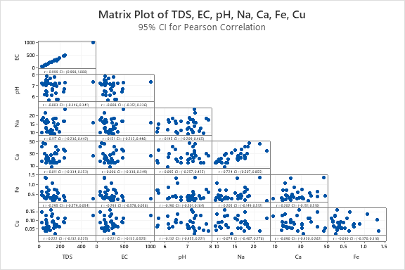
Results and Discussion contd….
There were strong positive correlations between EC and TDS (r=0.99) and Ca and Na (r=0.72) depicting that an increase in EC causes an increase in TDS showing a direct relationship between the variables.
The strong relationship in Ca and Na imply that the elements in the waters samples might occur from same sources
Figure 2: The matrix correlation of the water samples (Pearson correlation).

Slide 9
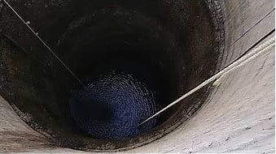
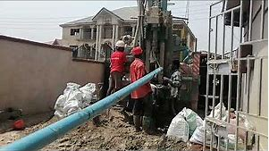
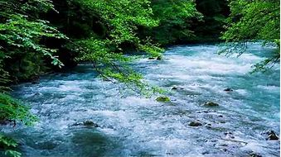
CONCLUSIONS AND RECOMMENDATION
CONCLUSION
The Physicochemical and elemental levels obtained were within the standard limits of WHO and NISDQW.
The EFs of the water samples were moderate to significantly enriched.
All elemental CFs were below the 1-level pollution threshold.
The MI's rating showed that they are pure for human and animal consumption and also for irrigation purposes
RECOMMENDATION
Efforts should be put in place to constantly monitor to avoid being polluted.

Slide 10
END
Thanks for Listening

