Slide 1

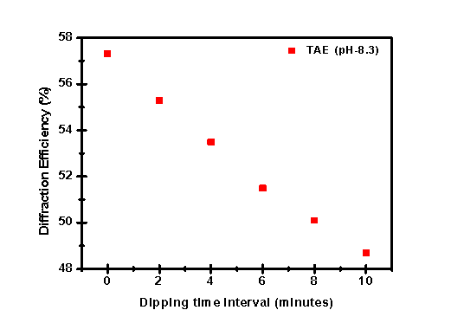
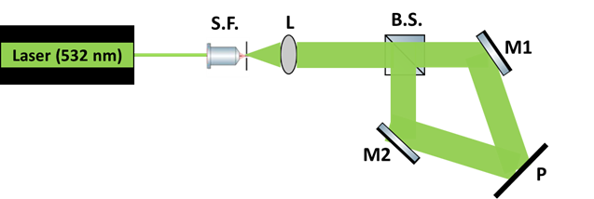
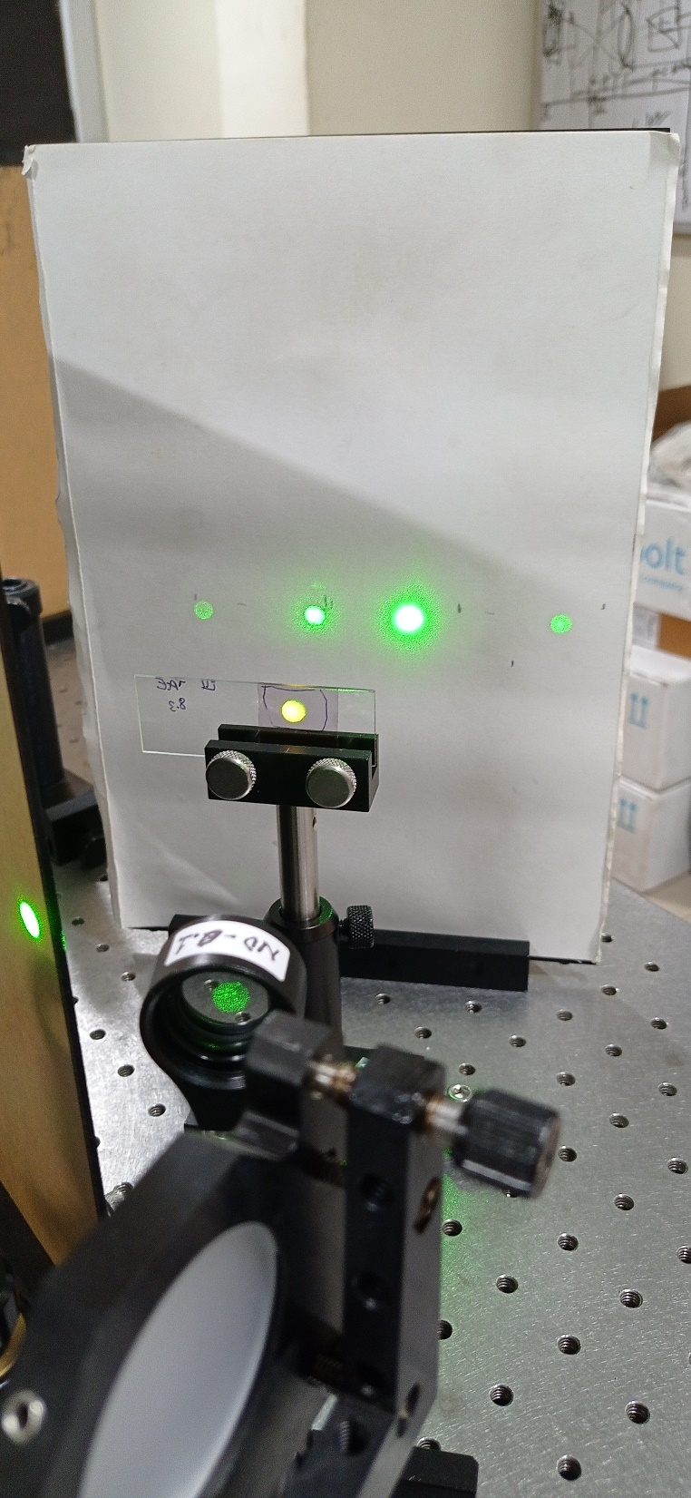
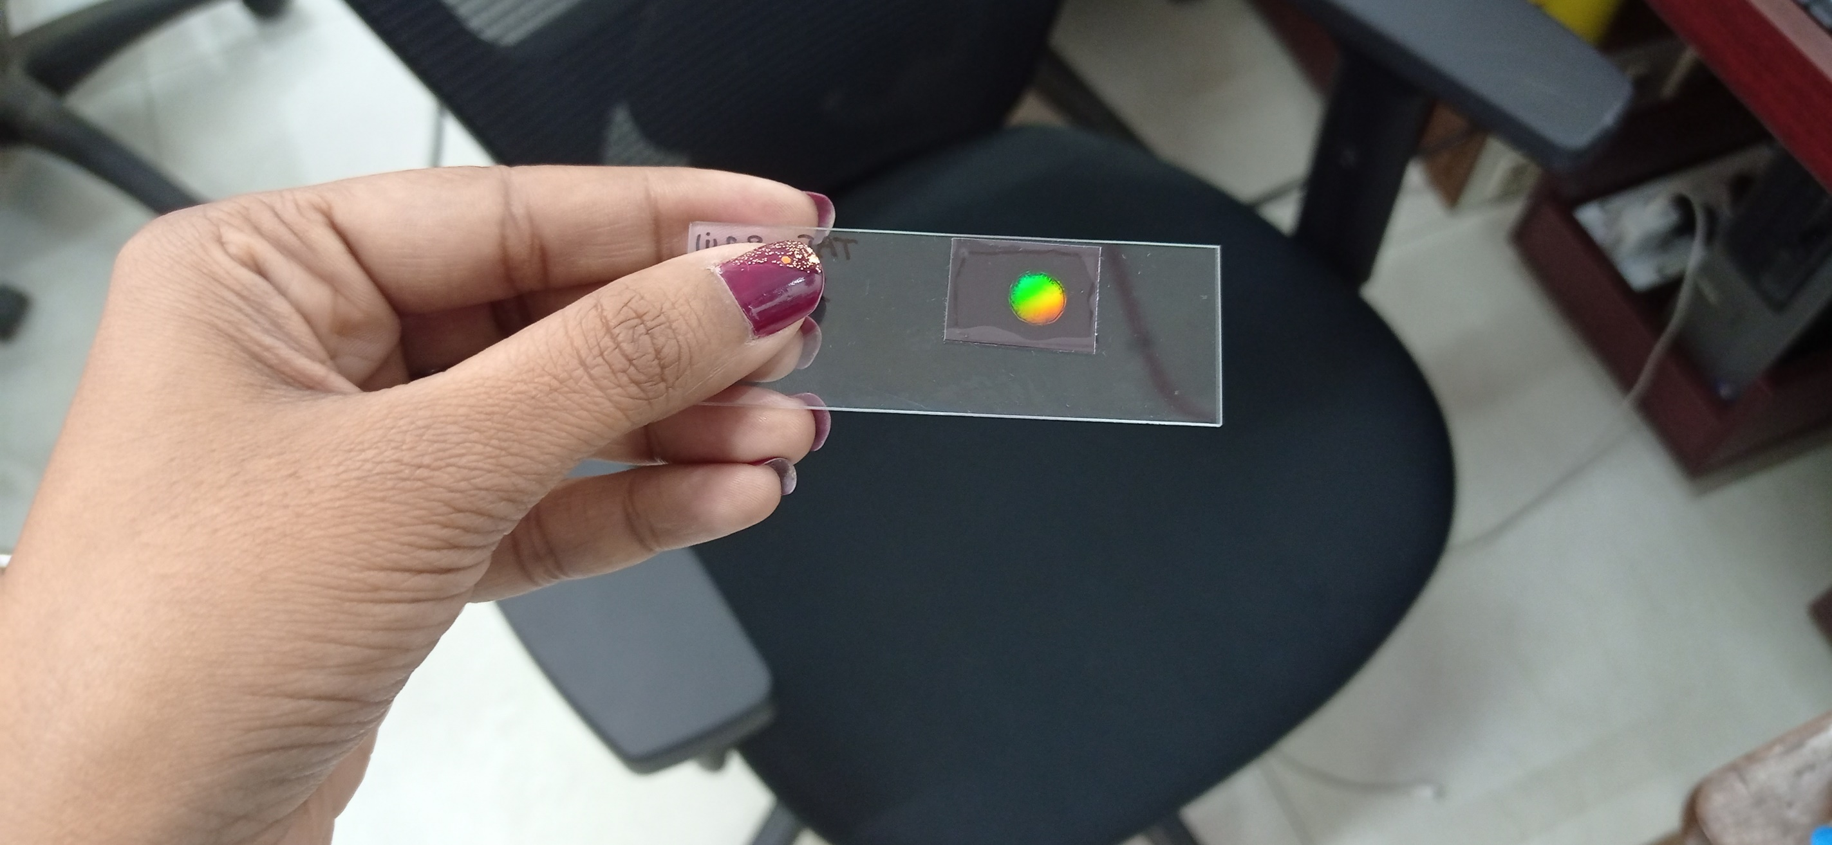
Study of a pH-sensitive Hologram for Biosensing Applications
Komal Sharma,^{1,2} Heena,¹ Girish C. Mohanta,^{1,2,} Raj Kumar^{1,2, *}
¹CSIR-Central Scientific Instruments Organisation, Sector 30C, Chandigarh 160030, India
²Academy of Scientific and Innovative Research (AcSIR), Ghaziabad 201002, India
*Email: raj.optics@csio.res.in
Authors thank Department of Science and Technology( DST–INSPIRE) and CSIR, India for providing financial support under project number MLP2014 to carry out this research work.
Abstract
We Study the effect of pH in photopolymer film for biosensing application. For this, three buffer solutions with different pH are taken and the effect on diffraction efficiency is analyzed. It is observed that with different pH from neutral to alkaline, the diffraction efficiency decreased by variation in dipping time.
Introduction
Results
The measurement of various physical and chemical processes, both quantitatively and qualitatively, is crucial for use in the fields of medicine, agriculture, business, and the environment. One optical approach that allows for the observation of material changes at the physical and chemical levels is holography. For biosensing applications, photopolymer film development is important. Based on an earlier study [1], PVA (Poly Vinyl Alcohol) has been used as a binder in the production of films for a variety of purposes, but it has drawbacks because it is water soluble. A different binder, cellulose acetate is utilized nowadays [2], despite the difficulty of making films.
In this work, we propose to analyze the effect of pH change on the diffraction efficiency of transmission gratings recorded in commercially available photopolymer by dipping it in the three buffer solutions i.e. Phosphate Buffer Saline (PBS) (pH – 7.4), Phosphate Buffer Saline (PBS) (pH – 8.3) and Tris-Acetate-EDTA (TAE) (pH – 8.3) for different time intervals.
Fig. 2 a) PBS (8.3) Fig. 2 b) PBS (7.4)
Fig. 2 c) TAE (8.3)
Fig. 2 Diffraction efficiency versus different pH dipping time
Experimental Details
Conclusion
Through this work, it is observed that holography has a wide range of applications in the bio-sensing industry, including glucose sensors, urea sensors, lactose sensors, and drug detection sensors. The sensitivity of the recorded hologram changed with pH, and by increasing its value from 7.4 to 8.3; the variance in diffraction efficiency decreased substantially as shown in Fig. 2 (a),(b),(c). This is detected by measuring the pH sensitivity of the recorded transmission gratings.
Acknowledgements
Fig. 1 a) Schematic of experimental setup
Authors thank Department of Science and Technology( DST–INSPIRE) and CSIR, India for providing financial support under project number MLP2014 to carry out this research work.
0
+1
References
[1] Gaaz, T., Sulong, A., Akhtar, M., Kadhum, A., Mohamad, A. and Al Amiery, A. Properties and Applications of Polyvinyl Alcohol, Halloysite Nanotubes and Their Nanocomposites. Molecules,2015, 20(12), pp.22833–22847.
[2] Gul, S. -, Cassidy, J. and Naydenova, I. Water Resistant Cellulose Acetate Based Photopolymer for Recording of Volume Phase Holograms. Photonics,2021, 8(8), p.329.
Incident
beam
Fig. 1 b) photograph of diffracted orders and recorded hologram

