Slide 1
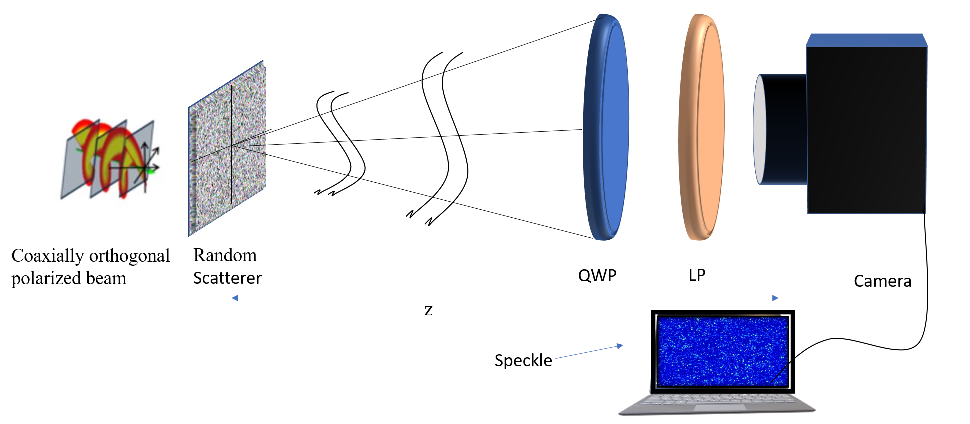
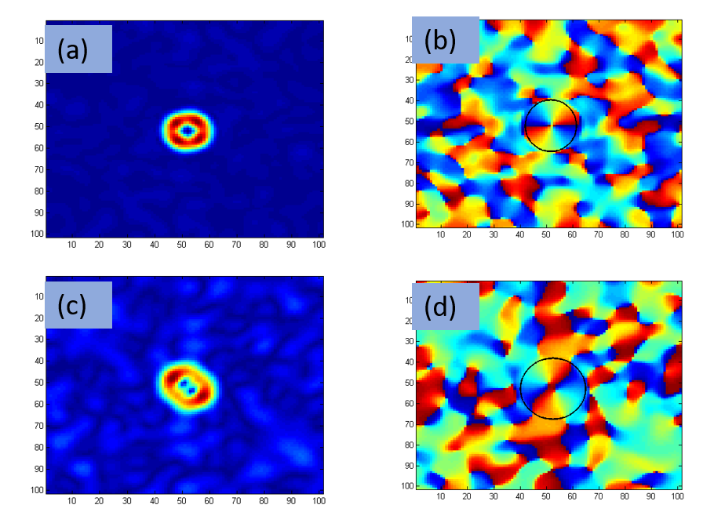
Enhancing phase measurement by a factor of two in the stokes correlation Amit Yadav^{1*}, Tushar Sarkar¹, Takamasa Suzuki² and Rakesh Kumar Singh¹ ¹Laboratory of Information Photonics and Optical Metrology, Department of Physics, Indian Institute of Technology (Banaras Hindu University), Varanasi, Uttar Pradesh, India ²Electrical and Electronic Engineering, Niigata University, Japan *Author e-mail address: yadavamitupac@gmail.com
20-22 Feb. 2023
Phase loss is a typical problem in the optical domain and optical detectors measure only the amplitude distribution of the signal without a phase. We present and examine a technique based on the Stokes correlation for enhancing the phase measurement by a factor of two. Enhancement in phase measurement is accomplished by the evaluation of the correlation between two points of Stokes fluctuations of the randomly scattered light and recovering the enhanced phase of the object by using three steps phase- shifting along with the Stokes correlations. This technique is expected to be useful in the experimental measurement of the phase of a weak signal and in imaging.
Abstract
Introduction
Schematic Setup
Phase is a crucial parameter in optical domain
Several methods have been proposed to quantitatively measure the phase and among them interferometry is a commonly used technique.
We present and examine a highly stable noninterferometric technique to recover and enhance the phase measurement by a factor of two
Recovering the enhanced phase of the object by using three steps phase- shifting along with the Stokes correlations
QWP: quarter wave plate, LP: linear polarizer. The CCD records intensity speckle patterns at the observation plane
Result and Discussion
Theoretical background
.
At the transverse plane z=0, the complex field of coherent-polarized light is given as
$E(\hat{r})=E_{x}(\hat{r}){\hat{e}}_{x}+E_{y}(\hat{r}){ \hat{e}}_{y}$ (1)
where $E_{x}\left(\hat{r}\right)and E_{y}\left(\hat{r}\right)$ represent the x and y polarization component of the beam respectively. Stokes parameter of the scattered field as
${S_{n}=E}^{T}(\hat{r})σ^{n}E^{∗}(\hat{r})$, n $∈$ (0,..3) (2)
σ⁰ is the identity matrix and σ¹, σ², σ³ are the Pauli spin matrices of 2x2 order. The fluctuations of the SPs around their mean value is given as
$$∆S_{n}\left(r\right)=S_{n}\left(r\right)−{<S}_{n}\left(r\right)>$$
Correlation of Stokes fluctuation is given as,
$C_{pq}\left(r_{1},r_{2}\right)=<∆S_{p}\left(r_{1}\right)∆S_{q}\left(r_{2}\right)>$where$p,q∈\left(0,...,3\right)$ (3)
$${C_{Re}(r_{1},r_{2})=C}_{22}{(r}_{1},r_{2})−C_{33}(r_{1},r_{2})$$
$∝ Re\left[W_{xy}\left(r_{1},r_{2}\right)W_{yx}^{∗}\left(r_{1},r_{2}\right)\right]$
$W_{xy}\left(r_{1},r_{2}\right)W_{yx}^{∗}\left(r_{1},r_{2}\right)= <E_{x}^{∗}\left(r_{1}\right)E_{y}\left(r_{2}\right)>$ ${ [<E_{y}^{∗}\left(r_{1}\right)E_{x}{(r}_{2})>]}^{∗}$
$$C_{Re}\left(r_{1},r_{2}\right)∝Re[<E_{x}^{∗}\left(r_{1}\right)E_{y}\left(r_{2}\right)> {\{<E_{y}^{∗}\left(r_{1}\right)E_{x}{(r}_{2})>\}}^{∗ } (4)$$
now combined Eq. (4) with three steps- phase shifting method to obtain CPCF which is given as,
$C\left(∆r\right)=2C_{Re}^{0}\left(∆r\right)− C_{Re}^{2π/3}\left(∆r\right)−$ ${ C}_{Re}^{4π/3}\left(∆r\right)+ √3i[C_{Re}^{2π/3}\left(∆r\right)−C_{Re}^{4π/3}\left(∆r\right)]$ (5)
where $C_{Re}^{4π/3}$($∆r$), $C_{Re}^{2π/3}($ $∆r$) and $C_{Re}^{0}\left(∆r\right)$ indicate the real component
of the CPCF with phase shift of $\frac{4π}{3}, \frac{2π}{3}, 0$respectively.
Figure 2. Simulation results: (a) amplitude distribution and (b) corresponding phase distribution for vortex beam of charge l= -1; Experimental results: (c) amplitude distribution (d) corresponding phase distribution for the vortex beam with l= -1
Conclusion
This method is expected to be helpful in measuring weak phase information. The proposed method's viability is assessed by numerical simulation, which is followed by an experimental demonstration to gain enhanced phase information.
[1] Sarkar T.; R.P.; M.M.B.; R.K.S. Higher-order Stokes-parameter correlation to restore the twisted wave front propagating through a scattering medium. Phys. Rev. A. Volume 104, 013525, 2021
[2] Kuebel D. ; Visser T. D. , Generalized Hanbury Brown- Twiss effect for Stokes parameters, J. Opt. Soc. Am. 2019,Volume 36, 362.
Amit Yadav acknowledges University Grant Commission, India for financial support as Junior Research Fellowship.
References
Acknowledgment

