Slide 1
RUNX1-regulated pathways and biomarkers in Acute Myeloid Leukemia
Deepesh Kumar Verma¹, Akhileshwar Namani²
Department of Biotechnology, GITAM School of Sciences, GITAM
(Deemed to be University), Visakhapatnam, 530045, India
Sri Shankara Cancer Hospital and Research Centre, Bangalore, India

Slide 2
Abstract
Runt-related transcription factor 1 gene (RUNX1), also known as acute
myeloid leukemia 1 protein (AML1), plays a critical role in the pathogenesis
of AML. One of leukemia's most frequently mutated genes is
RUNX1/AML1, which is related to a poor prognosis in AML. Researchers
and clinicians can design personalized medicines and enhance diagnosis by
identifying biomarkers linked to genetic mutations. In the current study, we
used TCGA-Acute Myeloid Leukemia (AML) cohort's genomic and
transcriptome data. We analyzed RUNX1 mutated AML patients to non-
mutated patients using an integrated, multi-omics, multi-database analysis of
exome and transcriptomics data. The mutation landscape of several genes,
including RUNX1 mutations, was revealed by TCGA-AML data from
multi-center high-throughput exome sequencing. Finally, we identified the
gene signature associated with RUNX1 mutations, including prognostic
genes that significantly impacted the overexpression of the RUNX1 pathway
in RUNX1 mutated AML patients. Our findings may help diagnose AML
patients with RUNX1 mutations early.
Keywords: RUNX1, AML, acute myeloid leukemia, biomarkers, multi- omics, blood cancer.

Slide 3
1. Introduction
Acute myeloid leukemia (AML) is a malignant hematological disease affecting the blood and bone marrow. RUNX1 (also known as AML1) is a transcription factor that plays an important role in blood cell development and function [1].
Mutations in the RUNX1 gene have been linked to several blood disorders, including AML, and are associated with a poor prognosis. RUNX1 mutations can lead to the cause of familial platelet disorder (FPD).
Re-searchers are actively studying RUNX1 and its role in blood disorders with the aim of developing more effective treatments [2].
In this study, we used TCGA-AML [3] data in which RUNX1 is mutated in 9% of patients and identified the prognostic biomarkers specific to the RUNX1 mutation.

Slide 4
2. Methods
2.1 Identification of mutational landscape of RUNX1 in TCGA-AML
The cBioportal for cancer genomics website was used to identify the RUNX1 mutational landscape in AML patients from the TCGA study (n =200) [3,4].
2.2. Analysis of differentially expressed genes (DEG’s) in RUNX1 mutated TCGA-AML
Out of 200 TCGA-AML patients, only 173 patients RNA-Seq data are available. Based on the RUNX1 mutations of TCGA-AML, we stratified the total number of patients into two groups and designated them as RUNX1-mutated (n=17) (Table 1) and wild-type (n=156) (without RUNX1 mutations), respectively. The mRNA expression profiles (RNA Seq V2 RSEM) were checked to identify the DEG’s in these two groups.
2.3. Functional annotation and survival analysis
The functional annotation of the DEG’s from RUNX1 mutated patients was performed by a web tool named DAVID [5]. The GEPIA2 tool was used to evaluate the prognostic value of the DEG’s identified in the patients with RUNX1 mutation in the TCGA-AML cohort.

Slide 5
3. Results
In TCGA-AML, RUNX1 mutations occurred in 9% of patients (n=17) out of 200 patients (Figure 1, Figure 2 A) (Table 1). We then performed the DEG’s analysis between RUNX1-mutated vs. wild-type patients by using cBioportal.
As a result, we obtained a total of 210 DEG’s containing 155 upregulated and 55 downregulated genes in RUNX1-mutated patients with a fold change (FC) threshold > 2 and a p-value and q-value < 0.05 (Figure 2 B).
Next, we selected DEG’s and then performed functional annotation analysis with DAVID separately for up- and down-regulated genes. Interestingly, the KEGG analysis of upregulated genes 10 pathways with a stringent p-value cut off < 0.05 (Figure 2 C), (Table 2).
Next, we focused on KEGG pathway analysis of downregulated genes, from which we obtained only one pathway identifying the genes involved in Staphylococcus aureus infection (Table 2).
Using the GEPIA2 web tool, we identified seven poor prognostic biomarkers whose significantly higher expression (p-value < 0.05) results in poor overall survival in TCGA-AML patients (Figure 3 A).

Slide 6
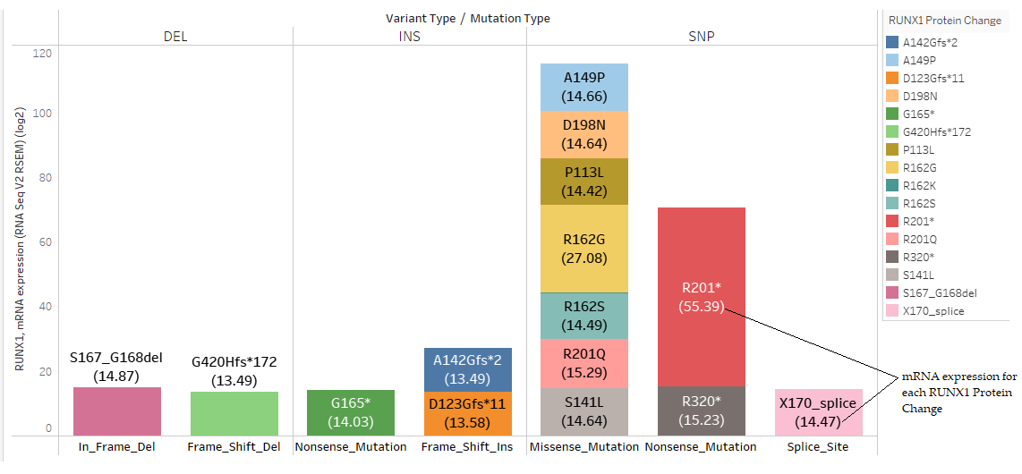
Figure 1: Stacked bars showing the detailed mutation information of RUNX1 and it's mRNA expression in TCGA-AML patients.

Slide 7
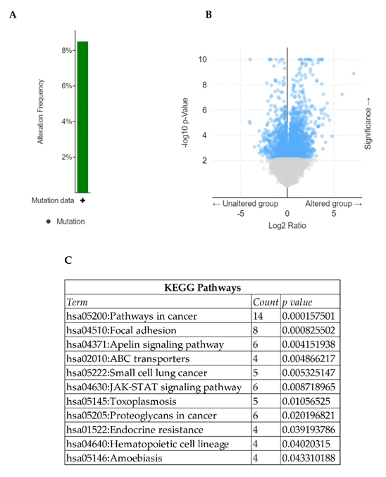
Figure 2. (A) Percentage of RUNX1 mutations in TCGA-AML patients. (B) Volcano plot showing the DEG’s between RUNX1-mutated vs wild-type patients. (C) KEGG pathway analysis of upregulated genes in RUNX1-mutated patients.

Slide 9
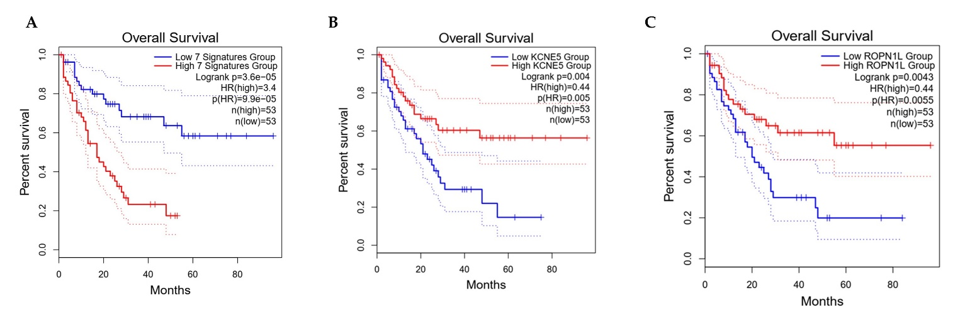
The genes with poor prognosis identified in our study are EGFEM1P, DOCK1, HTR1F, CALCRL, HOPX, TRIM9 and MYLK. These results clearly indicate that increased expression of genes associated with RUNX1 mutations acts as a biomarker in AML patients.
We considered these seven genes to be RUNX1 mutations associated gene signatures (RMAGS) in AML. Notably, higher expression of two downregulated genes such as KCNE5, ROPN1L showed a good prognosis in AML patients (Figure 3 B, C).
Figure 3. The survival plots showing the overall survival analysis of the seven gene signature (RMAGS) (A) highly expressed in the RUNX1-mutated TCGA-AML patients along with the two downregulated genes (B, C).

Slide 10
Table 2 : Functional annotation analysis of upregulated genes associated with RUNX1 mutations
KEGG pathways
Term | Count | % | PValue | Genes
hsa05200:Pathways in cancer | 14 | 9.03226 | 1.58E-04 | NOS2, IL15, LAMA3, IGF2, GNG11, ESR1, GLI3, GNAI1, PTK2, LRP6, AR, CCND1, AKT3, IL12RB2
hsa04510:Focal adhesion | 8 | 5.16129 | 8.26E-04 | CCND1, AKT3, LAMA3, FLNB, DOCK1, PTK2, ITGA9, MYLK
hsa04371:Apelin signaling pathway | 6 | 3.87097 | 0.0041519 | CCND1, NOS2, AKT3, GNG11, GNAI1, MYLK
hsa02010:ABC transporters | 4 | 2.58065 | 0.0048662 | ABCA6, ABCA9, ABCA12, ABCG2
hsa05222:Small cell lung cancer | 5 | 3.22581 | 0.0053251 | CCND1, NOS2, AKT3, LAMA3, PTK2
hsa04630:JAK-STAT signaling pathway | 6 | 3.87097 | 0.008719 | CCND1, IL15, AKT3, AOX1, IFNLR1, IL12RB2
hsa05145:Toxoplasmosis | 5 | 3.22581 | 0.0105653 | NOS2, AKT3, LAMA3, HLA-DOA, GNAI1
hsa05205:Proteoglycans in cancer | 6 | 3.87097 | 0.0201968 | CCND1, AKT3, IGF2, FLNB, ESR1, PTK2
hsa01522:Endocrine resistance | 4 | 2.58065 | 0.0391938 | CCND1, AKT3, ESR1, PTK2
hsa04640:Hematopoietic cell lineage | 4 | 2.58065 | 0.0402031 | CD1E, DNTT, HLA-DOA, CD34
hsa05146:Amoebiasis | 4 | 2.58065 | 0.0433102 | NOS2, LAMA3, CD1E, PTK2
Table 2 : Functional annotation analysis of downregulated genes associated with RUNX1 mutations
KEGG pathways
Term | Count | % | PValue | Genes
hsa05150:Staphylococcus aureus infection | 4 | 7.27273 | 0.0020342 | KRT18, KRT17, C3AR1, DEFB1
hsa04613:Neutrophil extracellular trap formation | 3 | 5.45455 | 0.0910761 | CTSG, AZU1, MPO
hsa05202:Transcriptional misregulation in cancer | 3 | 5.45455 | 0.0935359 | NTRK1, CCNA1, MPO

Slide 11
4. Conclusion
Taken together, our results identified a list of genes that are associated with the RUNX1-altereations in AML patients and we named them as RMAGS.
Increased expression of RMAGS predicts poor survival in AML patients.
These seven genes may act as prognostic biomarkers individully and combindly and can be used to identify the RUNX1 mutation staus in AML patients.
In summary, our identified RMAGS could be possible targets in the treatment of AML, in that the development of combined inhibitors for this gene signature along with RUNX1 could pave the way for the development of personalized/precision medicine to suppress RUNX1 - mediated tumor growth and drug resistance.

Slide 12
References
Mendler, J.H.; Maharry, K.; Radmacher, M.D.; Mrozek, K.; Becker, H.; Metzeler, K.H.; Schwind, S.; Whitman, S.P.; Khalife, J.; Kohlschmidt, J.; et al. RUNX1 mutations are associated with poor outcome in younger and older patients with cytogenetically normal acute myeloid leukemia and with distinct gene and MicroRNA expression signatures. J Clin Oncol 2012, 30, 3109-3118, doi:10.1200/JCO.2011.40.6652.
Bullinger, L.; Dohner, K.; Dohner, H. Genomics of Acute Myeloid Leukemia Diagnosis and Pathways. J Clin Oncol 2017, 35, 934-946, doi:10.1200/JCO.2016.71.2208.
Cancer Genome Atlas Research, N.; Ley, T.J.; Miller, C.; Ding, L.; Raphael, B.J.; Mungall, A.J.; Robertson, A.; Hoadley, K.; Triche, T.J., Jr.; Laird, P.W.; et al. Genomic and epigenomic landscapes of adult de novo acute myeloid leukemia. N Engl J Med 2013, 368, 2059-2074, doi:10.1056/NEJMoa1301689.
Gao, J.; Aksoy, B.A.; Dogrusoz, U.; Dresdner, G.; Gross, B.; Sumer, S.O.; Sun, Y.; Jacobsen, A.; Sinha, R.; Larsson, E.; et al. Integrative analysis of complex cancer genomics and clinical profiles using the cBioPortal. Sci Signal 2013, 6, pl1, doi:10.1126/scisignal.2004088.
Sherman, B.T.; Hao, M.; Qiu, J.; Jiao, X.; Baseler, M.W.; Lane, H.C.; Imamichi, T.; Chang, W. DAVID: a web server for functional enrichment analysis and functional annotation of gene lists (2021 update). Nucleic Acids Res 2022, 50, W216-221, doi:10.1093/nar/gkac194.

