Slide 1
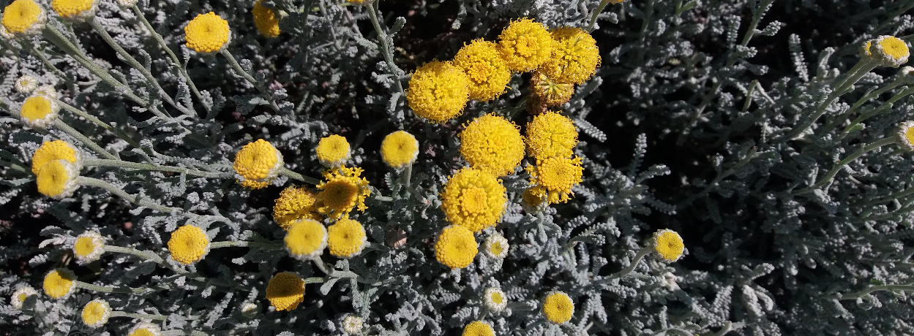
Santolina chamaecyparissus L.: a brief overview of its medicinal properties
Tiago Azevedo, Ana I. Faustino-Rocha, Lillian Barros, Tiane C. Finimundy, Manuela Matos, Paula A. Oliveira

Slide 2
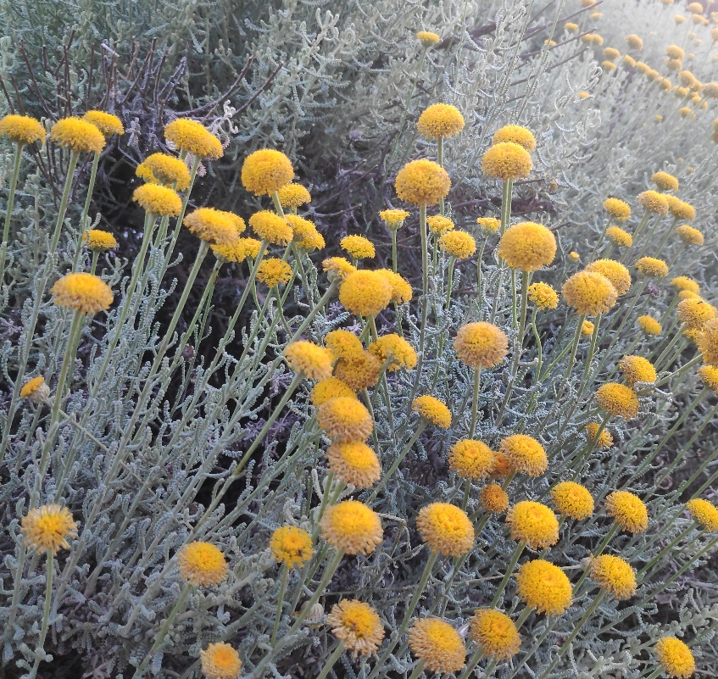
INTRODUCTION
AIM
MEDICINAL PROPERTIES
CONCLUDING REMARKS
Plants have been used for therapeutic purposes for centuries, and many modern drugs are derived from natural compounds
This presentation focuses on Santolina chamaecyparissus, a plant native to the Mediterranean region, and reviews its potential medicinal properties, which have yet to be fully explored
Cotton-lavender (Santolina chamaecyparissus L.) belongs to the Asteraceae family and is a small, compact evergreen plant with greyish leaves and yellow inflorescences
Santolina chamaecyparissus L. growing in the wild, captured in Vila Real, Portugal, in June 2022.

Slide 3
INTRODUCTION
AIM
MEDICINAL PROPERTIES
CONCLUDING REMARKS
Analgesic, anti-inflammatory, antimicrobial, antioxidant, antispasmodic, hepatoprotective, anti-cancer, and antidiabetic properties have been reported in this plant's extracts, giving insights to its uses in folk medicine
Despite its potential, there is a lack of studies exploring the medicinal properties of this plant
To fulfil this, the present work aims to provide the readers with a review of the medicinal properties of S. chamaecyparissus, highlighting their importance as a potential source of compounds with therapeutic properties

Slide 4
INTRODUCTION
AIM
MEDICINAL PROPERTIES
CONCLUDING REMARKS
ANALGESIC
Pain management is a major challenge in modern medicine, and there is a need for novel approaches to treat both acute and chronic pain
Several extracts of S. chamaecyparissus and a lyophilized infusion made from the plant's aerial parts were tested in thermic and mechanical analgesia tests on mice and rats
Hexanic and chloroformic extracts led to a significant increase in response time to both stimulus
Giner et al. (1988)

Slide 5
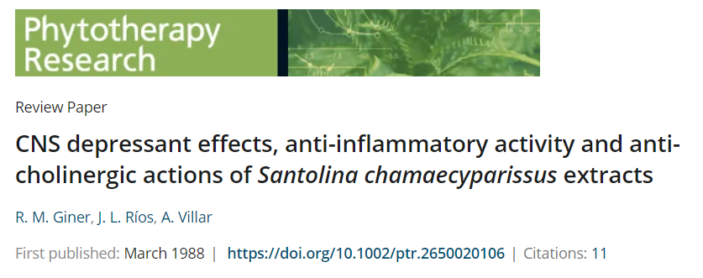
INTRODUCTION
AIM
MEDICINAL PROPERTIES
CONCLUDING REMARKS
ANTI-INFLAMMATORY
Giner et al. (1988); Giner et al. (1989); Ríos et al. (1989); Cuéllar et al. (1998); Sala et al. (1999); Boudoukha et al. (2016); Djarmouni et al. (2018); Meriem et al. (2018)
Inflammation is linked to many diseases like Alzheimer's and rheumatoid arthritis
The extracts were effective in reducing inflammation induced by various methods including injections of carrageenan, PMA, and PLA₂
Chloroformic extract was more effective than phenylbutazone at the highest concentration

Slide 6
INTRODUCTION
AIM
MEDICINAL PROPERTIES
CONCLUDING REMARKS
ANTIMICROBIAL
Suresh et al. (1997); Djeddi et al. (2012); Khubeiz and Mansour (2016); Chirane et al. (2019); AlMotwaa and Al-Otaibi (2022)
Antibiotic resistance and emergence of new disease-causing agents are global health concerns, and so developing new pharmaceuticals or alternative drug sources is necessary
S. chamaecyparissus essential oil strongly inhibited the growth of Klebsiella pneumoniae and C. albicans
The most sensitive bacteria strains were the gram-positive bacteria S. aureus and the methicillin-resistant strain, MRSA

Slide 7
INTRODUCTION
AIM
MEDICINAL PROPERTIES
CONCLUDING REMARKS
ANTIOXIDANT
Reactive oxygen species, like free radicals, can harm both humans and animals
Researchers are searching for compounds that protect against their effects
Restored hepatic superoxide dismutase and catalase activities in CCL₄ intoxicated rats
High inhibition of xanthine oxidase activity
Djarmouni et al. (2018); Messaoudi et al. (2018)

Slide 8
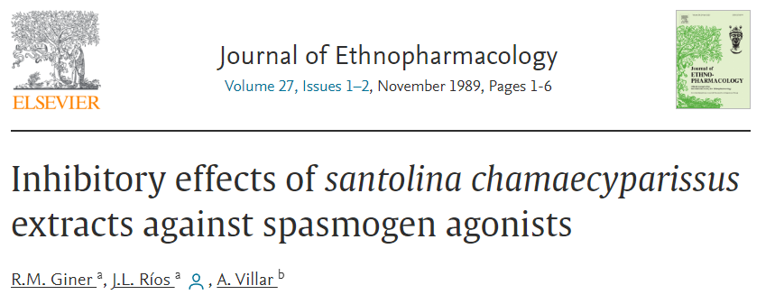
INTRODUCTION
AIM
MEDICINAL PROPERTIES
CONCLUDING REMARKS
ANTISPASMODIC
Giner et al. (1988); Giner et al. (1989)
Antispasmodic drugs are used to manage musculoskeletal tension and anxiety, which can affect quality of life
Antagonized rat duodenum contractions (acetylcholine-induced), guinea-pig ileum (histamine-induced), rat vas deferens (noradrenaline-induced) and rat uterus (serotonin-induced).

Slide 9
INTRODUCTION
AIM
MEDICINAL PROPERTIES
CONCLUDING REMARKS
HEPATOPROTECTIVE
Messaoudi et al. (2018)
The liver is a vital organ that plays numerous important roles, including the metabolism of proteins, lipids, and carbohydrates
Reduced concentration of serum markers, which increase with liver damage induced by CCl₄ and protected against steatosis and hepatocytic necrosis

Slide 10
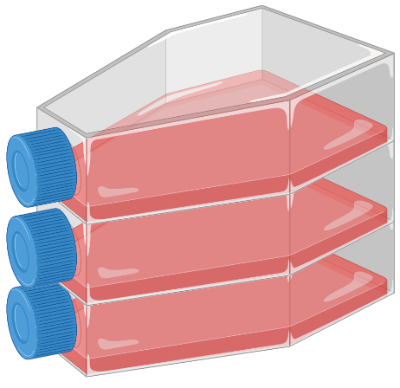
INTRODUCTION
AIM
MEDICINAL PROPERTIES
CONCLUDING REMARKS
ANTICANCER
Finding effective and safe cancer treatments is a major goal in modern medicine, as many traditional treatments are toxic to both cancer and normal cells
S. chamaecyparissus’ extracts and essential oils
High cytotoxicity against cancer cells and no cytotoxicity against normal cells
HepG2, A549, SA7 and MCF-7 cell lines
Elsharkawy (2014); Elsharkawy and Aljohar (2016); Saygideger et al. (2021); Ali et al. (2021); AlMotwaa and Al-Otaibi (2022)

Slide 11
INTRODUCTION
AIM
MEDICINAL PROPERTIES
CONCLUDING REMARKS
ANTIDIABETIC
Ali et al. (2021)
Diabetes, particularly of type 2, is a rapidly increasing global issue, with numerous complications, such as cardiovascular disease, ischemic heart disease, peripheral vascular disease, retinopathy, neuropathy, and nephropathy
In vitro α-glucosidase assay
Significant reduction of α-glucosidase activity

Slide 12
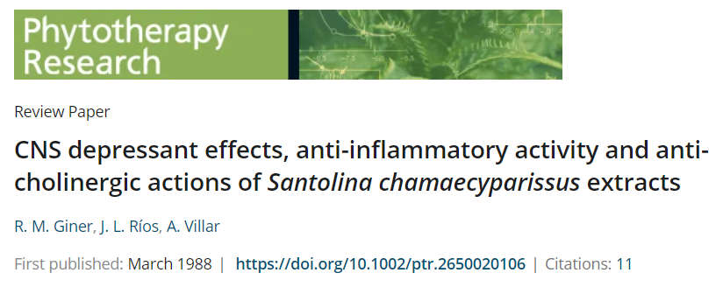
INTRODUCTION
AIM
MEDICINAL PROPERTIES
CONCLUDING REMARKS
OTHERS
Giner et al. (1988)
Anti-ulcerous activity using a stress-induced female Sprague-Dawley rat ulcer model
Reduction of spontaneous activity of female mice using an Animex S counter

Slide 13
INTRODUCTION
AIM
MEDICINAL PROPERTIES
CONCLUDING REMARKS
“Bioactive compounds have the potential to improve human health through regulating biological processes.”
Banwo et al. (2021)
Banwo, K. et al. (2021) ‘Functional importance of bioactive compounds of foods with Potential Health Benefits: A review on recent trends’, Food Bioscience, 43, p. 101320.
Medicinal plants, such as S. chamaecyparissus, have been used for a long time in folk medicine and are known to have a range of beneficial properties
S. chamaecyparissus has shown a range of effects in both in vitro and in vivo studies
More research is needed to understand the mechanisms behind these effects and to determine the potential clinical applications of S. chamaecyparissus for treating human diseases

Slide 14
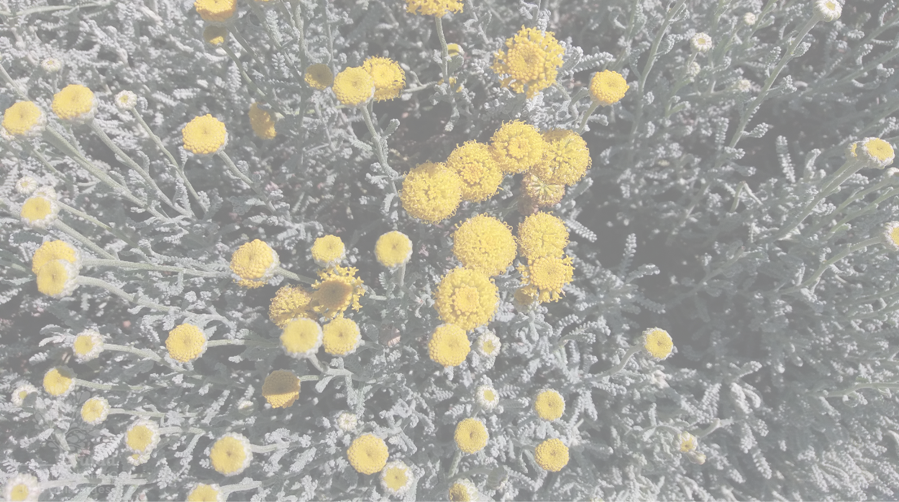
THANK YOU FOR YOUR ATTENTION!
Acknowledgements: This work was supported by National Funds by FCT - Portuguese Foundation for Science and Technology, under the projects UIDB/04033/2020 (CITAB) and LA/P/0126/2020 (Inov4Agro), UIDB/00690/2020 and UIDP/00690/2020 (CIMO) and LA/P/0007/2021 (SusTEC); L.B. thanks FCT through the institutional scientific employment program–contract for her contract.

