Slide 1

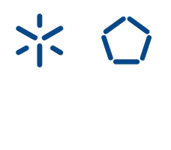

Slide 2

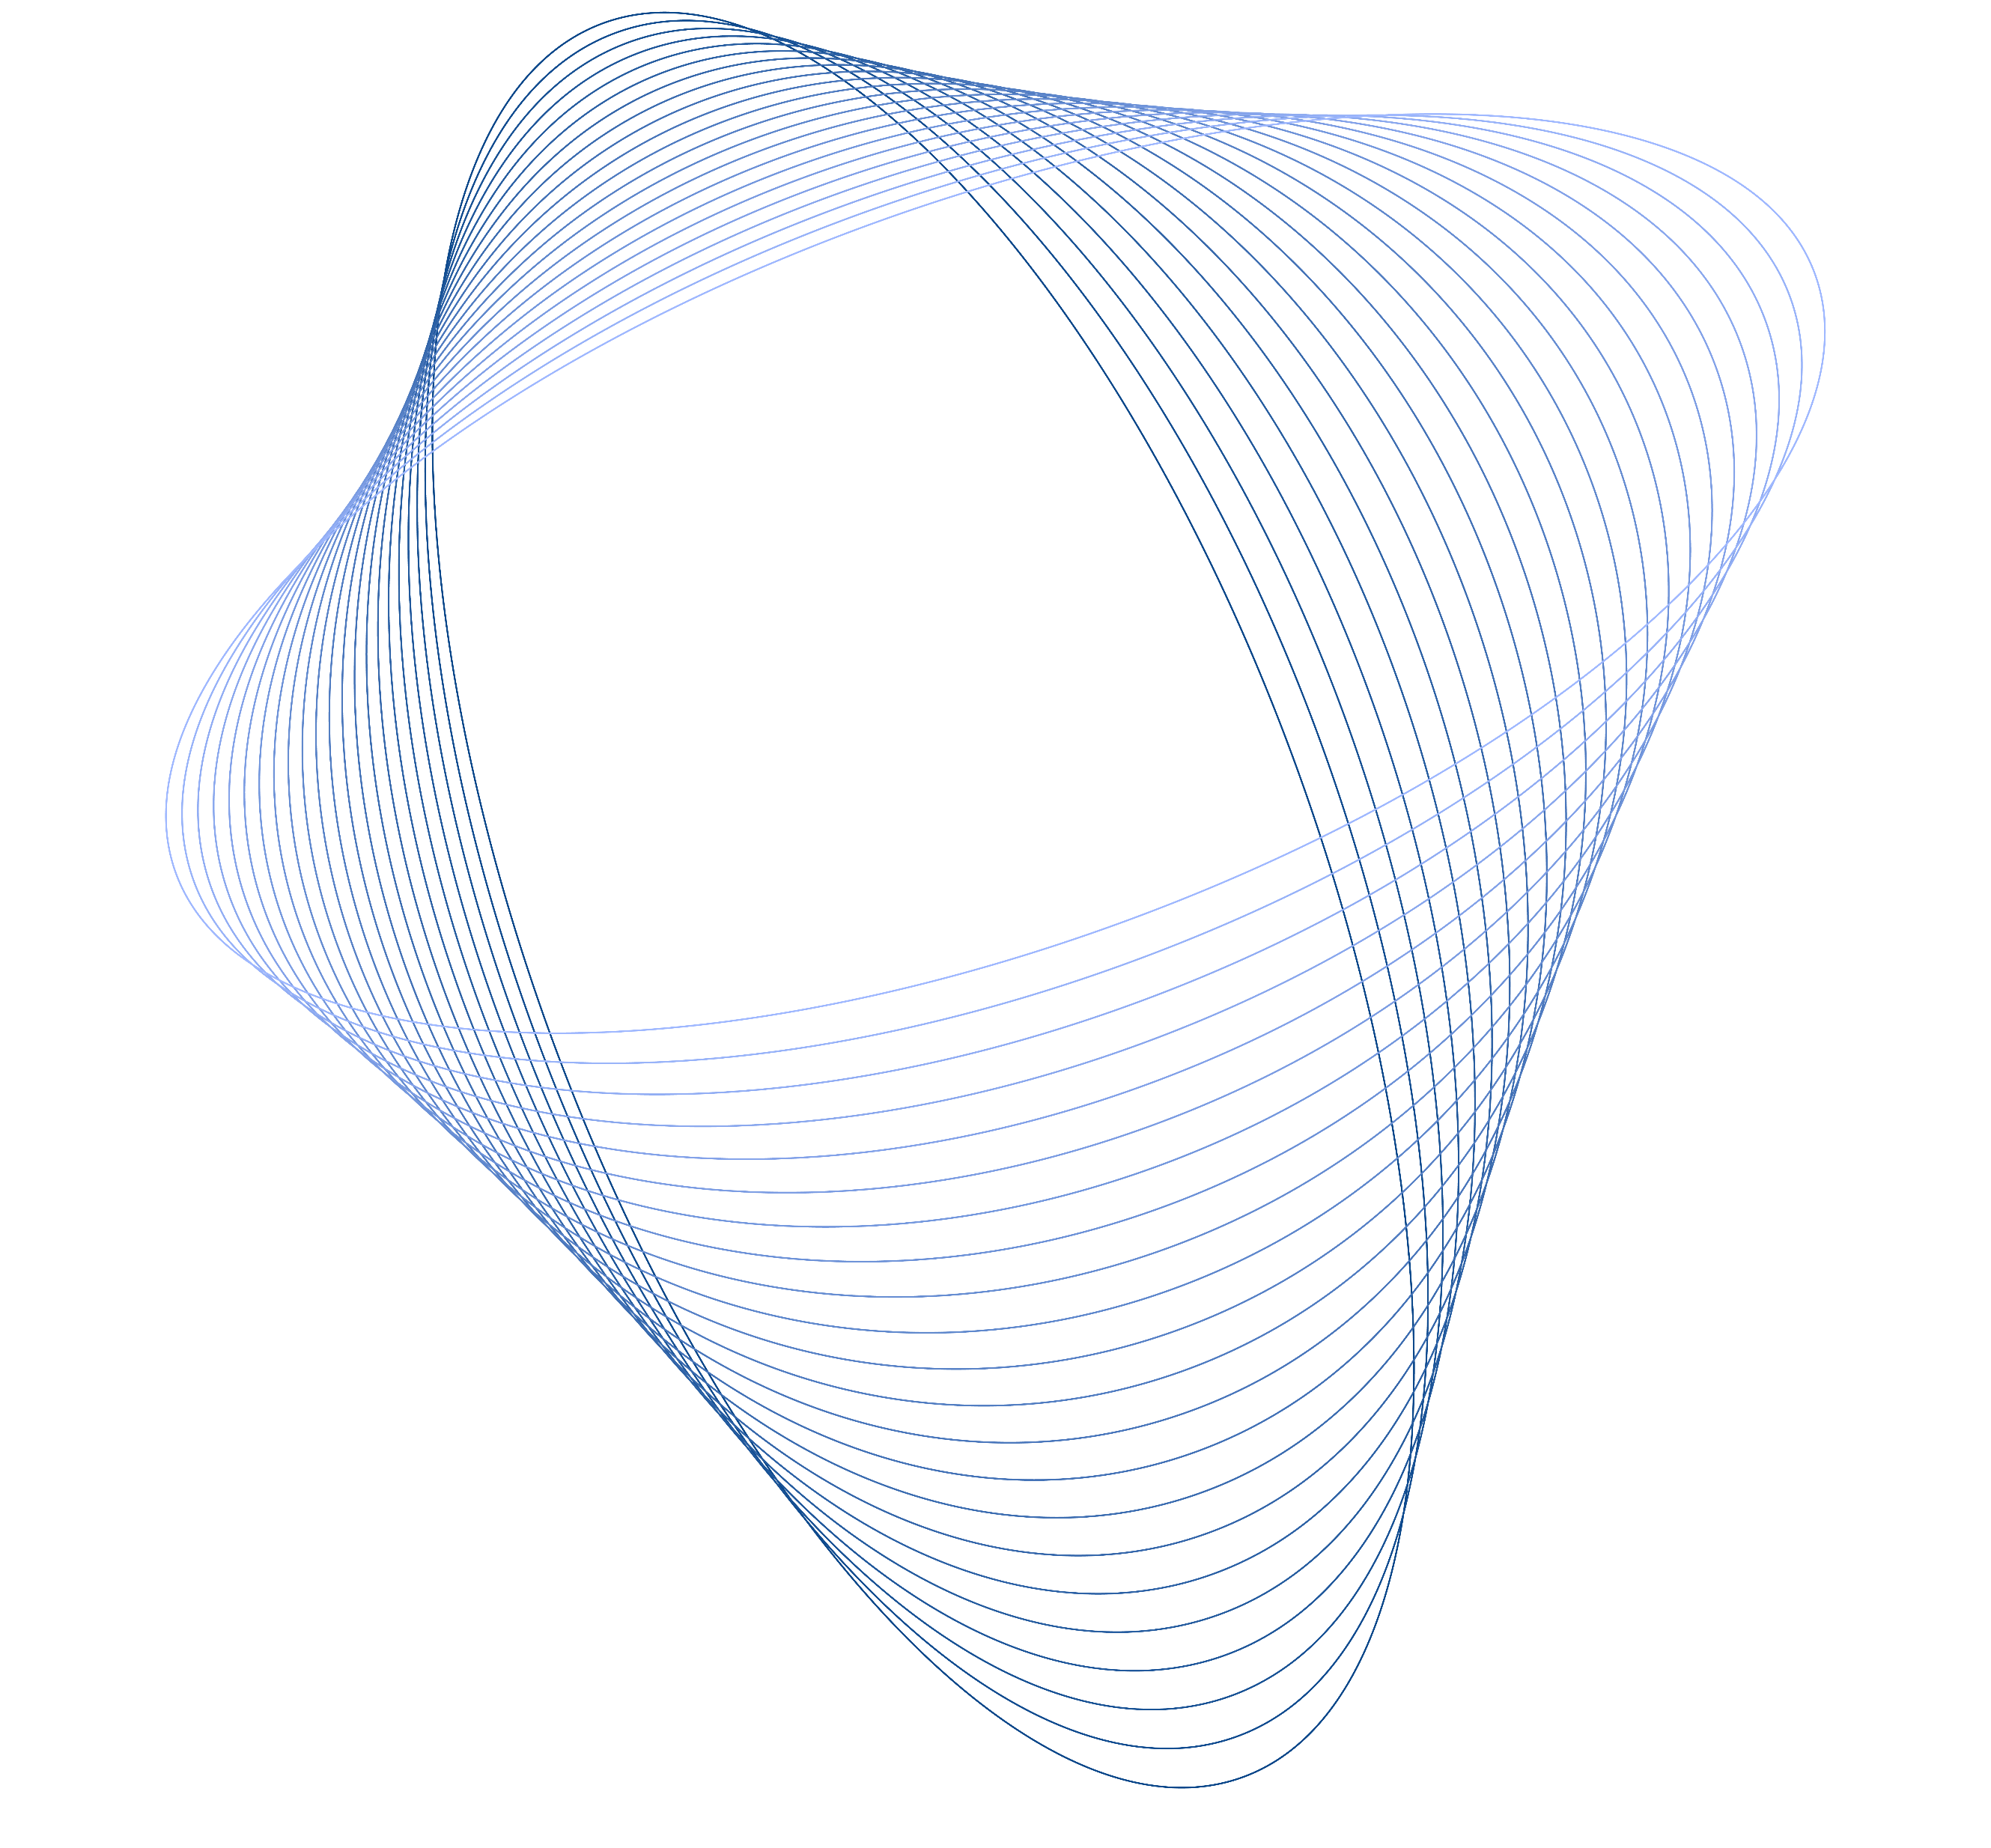
Coaxial wet-spun fibers loaded with enzyme-inhibiting peptide for chronic wound care
Catarina S. Miranda^{1,*}, A. F. G. Silva², S. M. M. A. PereiraLima², S. P. G. Costa², N. C. Homem³, H. P. Felgueiras¹
¹Centre for Textile Science and Technology (2C2T)
²Centre of Chemistry (CQ)
³Digital Transformation CoLab (DTx)
University of Minho, Portugal
*catarina.miranda@2c2t.uminho.pt

Slide 3

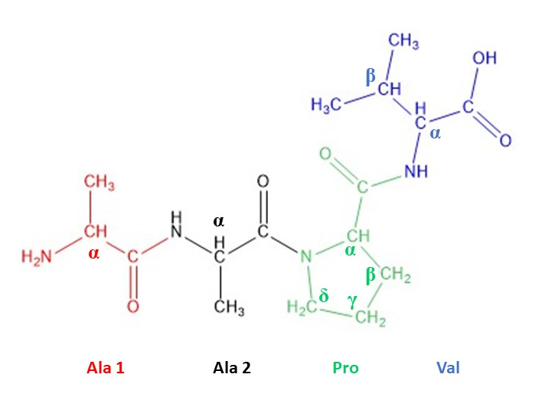
Antimicrobial Peptides
Antimicrobial Peptides
Low MW molecules
Composed of amino acid residues
Control microbial proliferation
Modulate immune response
Alanine-Alanine-Proline-Valine
(Ala-Ala-Pro-Val or AAPV)
Inhibits human neutrophil elastase (HNE), which levels are abnormally high in the case of inflammatory processes related to CWs.
Low stability in physiological media
Incorporation within polymeric structures
Santos, F.C. et al. Amino Acids, 49 (2017).
3

Slide 4
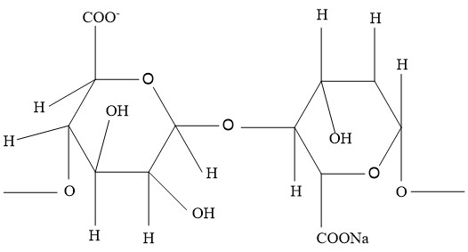
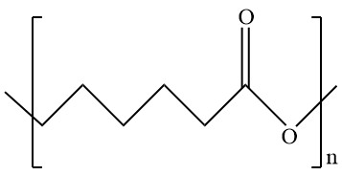
Polymers
Sodium alginate (SA)
Polycaprolactone (PCL)
Biocompatible; Biodegradable
Antiseptic properties;
Water absorbent (elevated swelling capacity);
Creates a moist environment.
Synthetic polymer;
Excellent mechanical properties;
Slow degradation rate.
Plotczyk, M. et al. Elsevier. 1 (2019)
Eskandarinia, A. et al. Scientific Reports. (2020)
4

Slide 5
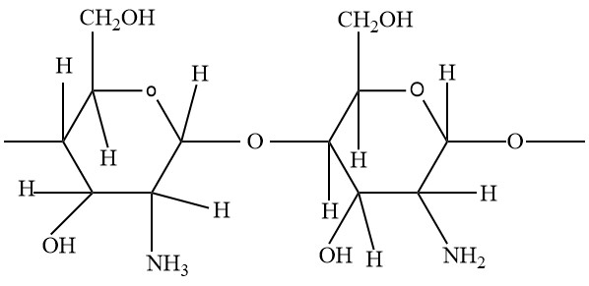
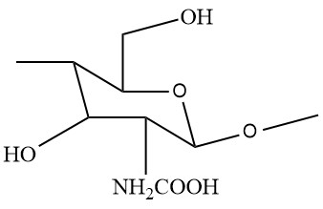
Polymers
Chitosan (CS)
N-carboxymethyl chitosan
(NCMC)
Chemically modified
Biocompatible; Biodegradable
Strong tissue adhesive properties;
Accelerates tissue repair;
Acts as a hemostatic agent.
Non-toxic;
Soluble at neutral to basic pH’s;
Antimicrobial activity.
Plotczyk, M. et al. Elsevier. 1 (2019)
Song, Q.; Zhang, Z.; Gao, J.; Ding, C. J. Appl. Polym. Sci. 2011, 119, 3282–3285
5

Slide 6
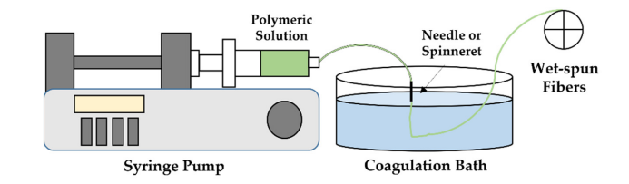
Wet-spinning
Technique based on a non-solvent-induced phase inversion process, in which a polymeric solution is extruded into a coagulation bath composed of a poor solvent or a non-solvent, giving rise to a continuous polymeric fiber, with a diameter of tens to hundreds of micrometers.
Miranda, C. et al. Pharmaceutics, 2022, 14. 164
6

Slide 7
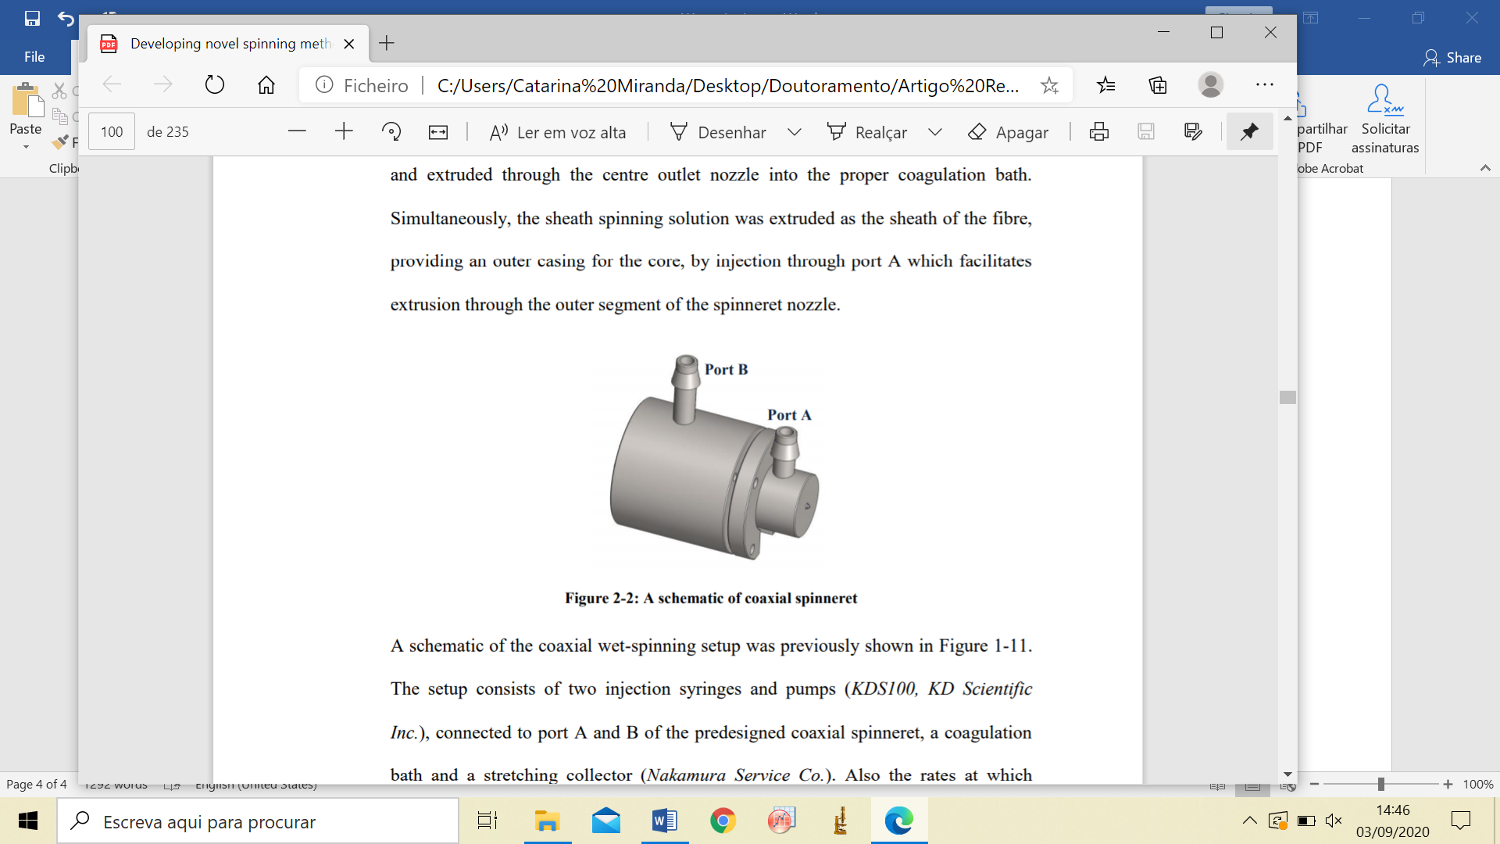
Coaxial wet-spinning
Coaxial spinneret
Core-sheath fibers
Sheath
Core
Coaxial fibers
Hollow fibers
Two polymer solutions are injected together into a co-axial spinneret and co-extruded towards a coagulation bath, generating a core-shell structure. In case of hollow fibers, air or coagulation bath is introduced through the innermost port.
Sheath
Hollow interior
Mirabedini, A. (2017). A thesis submitted in the fulfilment of the. 1–235.
Gao, L., Zhou, Y., Peng, J., Xu, C., Xu, Q., Xing, M., & Chang, J. (2019). NPG Asia Materials, 11(1), 66.
McKeen, L. W. (2012). Permeability Properties of Plastics and Elastomers, 59–75.
7

Slide 8
Goal
Engineer AAPV-loaded microfibers doped with NCMC via wet-spinning for human neutrophil elastase control and Staphylococcus aureus inhibition.
In chronic wounds, neutrophil elastase is 10-40% more abundant than in acute wounds.
According to the World Health Organization, S. aureus is one of the most prevalent bacteria in chronic wounds.
Felgueiras, H. et al. Colloids Surf B Biointerfaces 2017
https://www.who.int/
8

Slide 9
Coaxial wet-spun fibers
Side view
Cross-section view
SA 2% w/v +
NCMC 2xMBC
0.15 mL/min
Sheath
Core
PCL 10% w/v + AAPV IC
0.10 mL/min
Goal of Each Microfiber Component:
AAPV: regulate HNE enzymatic levels
SA: create and maintain a moist environment
PCL: maintain fibers’ structural integrity
NCMC: antimicrobial activity
Produced fibers:
SA hollow (core: coagulation bath; shell: SA);
SA-NCMC hollow (core: coagulation bath; shell: SA combined
with NCMC);
PCL (core: PCL; shell: coagulation bath);
PCL-AAPV (core: PCL combined with AAPV; shell: coagulation
bath);
SA-PCL (core: PCL; shell: SA);
SA-PCL-AAPV (core: PCL combined with AAPV; shell: SA);
SA-NCMC-PCL (core: PCL; shell: SA combined with NCMC);
SA-NCMC-PCL-AAPV (core: PCL combined with AAPV; shell:
SA combined with NCMC)
Coagulation bath: 2% w/v CaCl₂
9

Slide 10
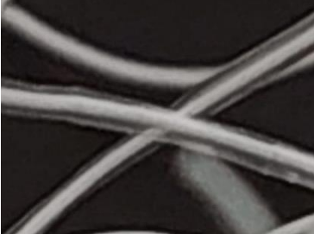
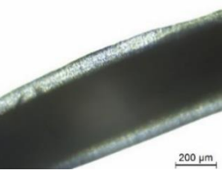
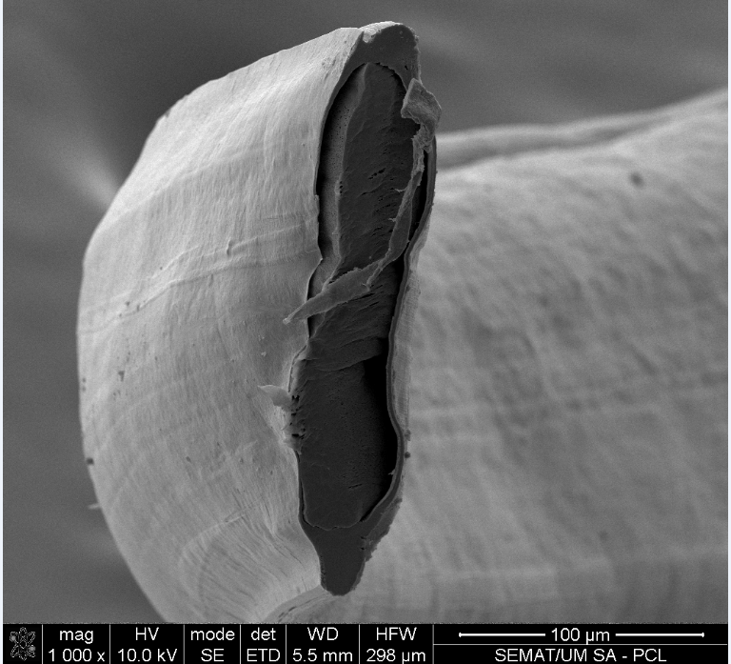
Fibers morphology
Scanning Electron Microscopy (SEM)
Macroscopic view
Microscopic view
10

Slide 11

Degree of swelling
Testing parameters:
10 mg fiber samples incubated in PBS at 37 ºC up to 24 h (measurements were conducted until mass equilibrium was reached)
$$DS \left(\%\right)= \frac{ws−wd}{wd}×100$$
ws – weight of swollen fibers
wd – weight of fibers prior to their incubation in PBS
Fiber | Degree of swelling (%)
SA | 836.38 ± 115.60
SA-NCMC | 1337.90 ± 86.82
PCL | 49.20 ± 18.19
PCL-AAPV | 54.25 ± 9.06
SA-PCL | 172.82 ± 13.24
SA-PCL-AAPV | 277.27 ± 5.96
SA-NCMC-PCL | 283.40 ± 26.27
SA-NCMC-PCL-AAPV | 324.36 ± 68.94
Hollow fibers presented highest degrees of swelling, due to SA’s excellent hydration capacity;
PCL-containing fibers were limited in their interactions with water molecules, due to PCL’s hydrophobic nature.
Homem, N.C. et al. Int. J. Mol. Sci. 2021
11

Slide 12

Degradation in PBS
Testing Parameters:
10 mg fiber samples incubated in PBS at 37 ºC up to 28 days;
Samples were weighted after 1, 4, 7, 14, 21 and 28 days of incubation
$$mass loss \left(\%\right)= \frac{mi−mf}{mi}×100$$
mi – weight of samples at 0 h of incubation
mf – weight of samples after each incubation period
Fibers | Mass loss (%)
 | Day 1 | Day 3 | Day 7 | Day 14 | Day 21 | Day 28
SA | 1.30 ± 0.52 | 11.18 ± 3.99 | 74.37 ± 0.79 | - | - | -
SA-NCMC | 5.62 ± 2.79 | 12.23 ± 7.08 | 81.43 ± 1.97 | - | - | -
PCL | -4.27 ± 11.36 | -6.78 ± 2.26 | -6.22 ± 7.19 | -10.66 ±13.99 | -13.94 ± 10.81 | -30.67 ± 19.90
PCL-AAPV | -6.10 ± 28.12 | -8.64 ± 3.01 | -7.85 ± 15.75 | -20.64 ± 1.33 | -14.48 ± 2.06 | -33.78 ± 12.58
SA-PCL | 14.87 ± 5.85 | 12.42 ± 1.81 | 11.44 ± 4.55 | 16.41 ± 1.24 | 2.71 ± 1.05 | 3.46 ± 1.94
SA-PCL-AAPV | 16.64 ± 9.01 | 16.65 ± 10.53 | 13.80 ± 12.34 | 21.59 ± 1.13 | 2.85 ± 1.77 | 6.11 ± 1.83
SA-NCMC-PCL | 18.08 ± 3.69 | 20.96 ± 5.73 | 14.08 ± 3.24 | 22.91 ± 8.66 | 3.38 ± 2.87 | 6.07 ± 1.84
SA-NCMC-PCL-AAPV | 20.37 ±10.56 | 23.16 ± 11.76 | 16.17 ± 14.35 | 25.34 ± 5.55 | 4.36 ± 3.42 | 6.84 ± 4.07
Fibrous structures were kept intact during 28 days of contact with PBS;
Hollow fibers were completely degraded after 14 days.
12

Slide 13
Mechanical behavior
Testing parameters:
Housefield H5KS dynanometer associated with QMAT Materials Testing & Analysis software;
Standard ASTM D5035;
Speed: 25 mm/min;
Load cell: 2.5-250 N;
Filaments of 10 cm.
Fibers | Breaking strength (N) | Elongation at break (%)
PCL | 0.02 ± 0.02 | 147.83 ± 22.56
PCL-AAPV | 0.06 ± 0.04 | 133.91 ± 23.43
SA-PCL | 0.04 ± 0.04 | 219.57 ± 60.39
SA-PCL-AAPV | 0.06 ± 0.04 | 192.65 ± 54.47
SA-NCMC-PCL | 0.04 ± 0.04 | 163.55 ± 62.14
SA-NCMC-PCL-AAPV | 0.06 ± 0.04 | 156.76 ± 27.33
All fibers presented high maximum elongations, due to the elastic behavior of PCL;
Coaxial fibers presented higher elongations in comparison with monolayer fibers because of the shell protective effect, which delayed fiber rupture;
SA-PCL coaxial fibers presented the highest maximum elongations due to the absence of NCMC and AAPV, which interrupted the SA and PCL polymeric chains, respectively.
Rani, G. U. et al. Reference Module in Materials Science and Materials Engineering 2017
13

Slide 14
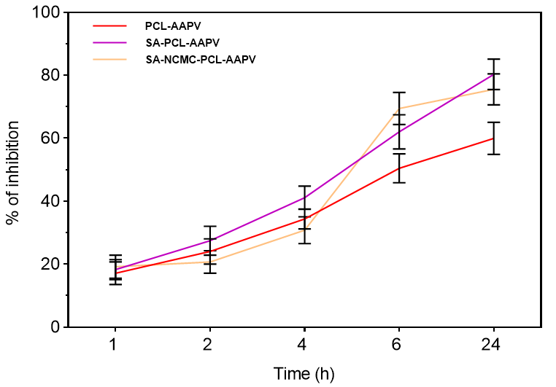
Inhibition of HNE activity
Soybean tripsin inhibitor solution
(to stop the reaction)
Testing Substrate:
- Tris-HCl-buffer
- N-MeO-Suc-Ala-Ala-Pro-Val-p-NA
AAPV
HNE
Spectroscopy readings (405 nm)
45 mU/mL, [HNE] in chronic wounds
SA-NCMC-PCL-AAPV fibers presented the highest HNE inhibition at the 6 h mark.
Santos, F.C., et al. Amino Acids 2017, 49, 1077–108; Castro, V.I.B., et al. Tetrahedron 2016, 72, 1024–1030.
14

Slide 15
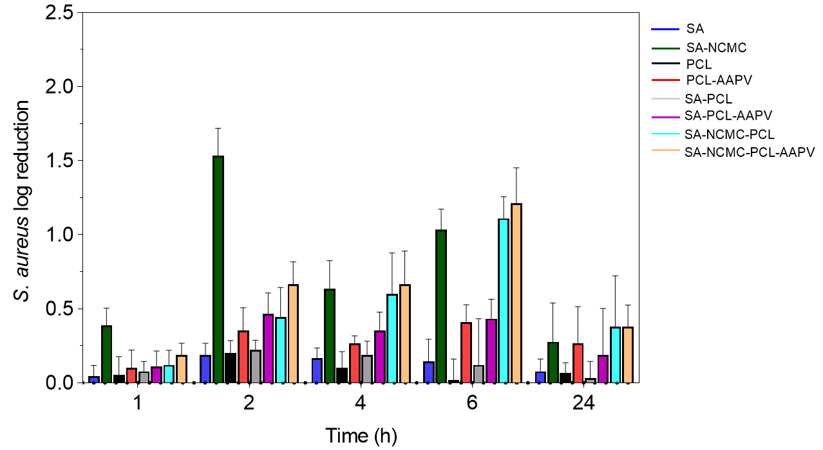
Antimicrobial activity
Testing Parameters:
1 × 10⁵ CFUs/mL S. aureus suspension in Mueller Hinton Broth
Samples of 10 mg immersed in 1 mL of bacteria suspension and incubated at 37 ºC and 120 rpm, for 1, 2, 4, 6 and 24 h;
At each time point, bacteria suspensions were serially diluted in PBS and incubated at 37 ºC for 24 h;
Grown colonies were counted, and results were expressed in log reduction.
NCMC-loaded fibers inhibited the most bacteria growth.
S. aureus activity was reduced by 90-99% at the 6 h mark.
Homem, N.C. et al. Int. J. Mol. Sci. 2021
15

Slide 16
Cytocompatibility
All coaxial wet-spun fibers were put in contact with mouse fibroblast cell lines (L929) and human keratinocytes cell lines (HaCaT) for 24h
Both cell lines maintained their viable and well-defined morphologies after contact with all wet-spun fibers.
16

Slide 17
Conclusions
The potential of the engineered coaxial fibers to serve as controlled release platforms for AAPV was demonstrated, along its inhibitory effect against HNE, particularly after 6 h of incubation.
The NCMC antibacterial activity against S. aureus was also established.
Cytocompatibility evaluations confirmed the safety of the engineered fibers.
Data confirmed the potential of this system to function as a multi-action delivery platform, suitable for prospective wound healing applications.
17

Slide 18



Coaxial wet-spun fibers loaded with enzyme-inhibiting peptide for chronic wound care

