Slide 1
In Vitro Studies May be Useful in Donor Selection and Evaluating the Effectiveness of CD8⁺ T-cell Reprogramming: Experience of a Pilot Study
E.G. Skurikhin^{1,2}, M. Zhukova^{1,*}, N. Ermakova¹, L. Kogai¹, A. Dygai^{1,2}
¹ Laboratory of Regenerative Pharmacology, Goldberg ED Research Institute of Pharmacology and Regenerative Medicine, Tomsk National Research Medical Centre of the Russian Academy of Sciences, 634028 Tomsk, Russia;
² Institute of General Pathology and Pathophysiology, 125315 Moscow, Russia.
* Corresponding author: mashazyk@gmail.com
Goldberg ED Research Institute of Pharmacology and Regenerative Medicine

Slide 2
Abstract: Survival and cytotoxicity of reprogrammed human CD8⁺ T-cells (hrT-cells) were evaluated in a culture of cancer stem cells (CSCs) isolated from a patient with small cell lung cancer (SCLC). T-cells were isolated from the blood of healthy volunteers and patients with lung diseases. Reprogramming with MEK and PD-1 inhibitors increased the survival and cytotoxicity of allogeneic T-cells in vitro. The positive effect of reprogramming is more pronounced in patients with lung diseases that in healthy donors. Autologous hrT-cells showed high effective in eliminating CSCs. Thus, in vitro studies are significant in selection of a potential cell donor and evaluating the effectiveness of their reprogramming.
Keywords: reprogrammed; autologous and allogeneic CD8⁺ T-cells; healthy donors; SCLC; COPD; asthma; cancer stem cells; in vitro study
Abbreviations:
hrT-cells – reprogrammed human CD8⁺ T-cells
nrT-cells – naive human CD8⁺ T-cells
SCLC – small cell lung cancer
COPD – chronic obstructive pulmonary diseases

Slide 3
Results and Discussion
Tumor Cells Isolated from the Blood of Patient with COPD and SCLC Form Spheroids in Vitro which Included Cells Expressing CD87, CD117, CD274, EGF, and Axl
In a culture of the adherent fraction of mononuclear cells isolated from the blood of patient P3, we found spheroids. A spheroid was defined as a three-dimensional cellular structure. The total number of spheroids was 74 per 200,000 cells. Spheroids were divided into three classes by cellularity: class 1 includes spheroids with the number of cells n=10-19; class 2 – n=20-29; class 3 – n=30-39.
In spheroids, 100% staining of cells with dyes in various combinations was revealed: Hoechst/CFSE/EGF, CD87/CD117/EGF, Axl / CD117 / EGF, CD274(PD-L1) / CD117 / EGF. Dead cells were not found in the structure of spheroids (7AAD).

Slide 4
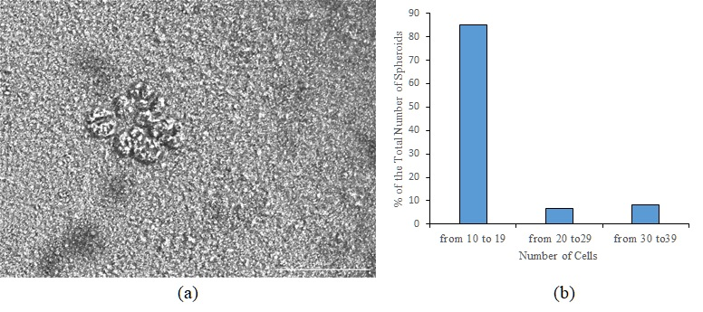
Results and Discussion
Tumor Cells Isolated from the Blood of Patient with COPD and SCLC Form Spheroids in Vitro which Included Cells Expressing CD87, CD117, CD274, EGF, and Axl
Detection of spheroids in culture of the adherent fraction of mononuclear cells isolated from the blood of patient with COPD and SCLC. (a) Representative images of spheroids in culture of the adherent fraction of mononuclear cells after 14 days of culture. Images were obtained using the Cytation 5 Multi-Mode Reader. Native preparations. All scale bars are 100 µm. (b) Spheroids’ differentiation depending on the number of cells.

Slide 5
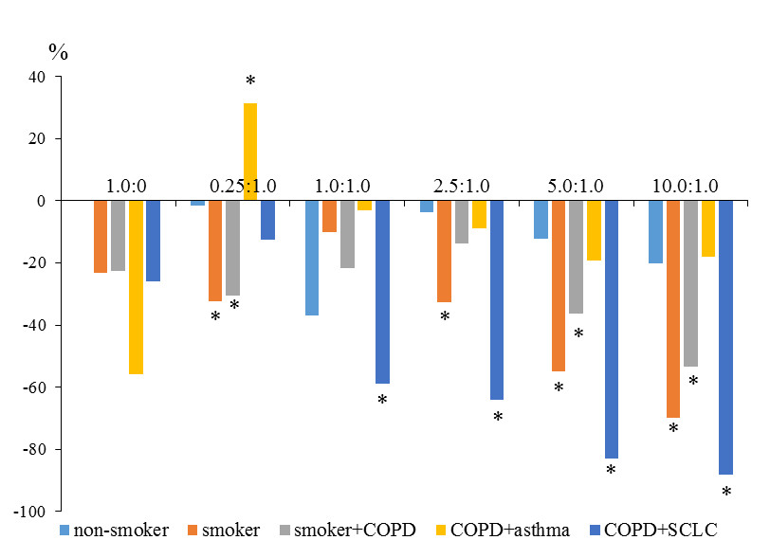
Results and Discussion
Apoptosis of hrT-cells and hnT-cells of the Subjects in the CSCs Culture Isolated From the Blood of Patient with COPD and SCLC
Apoptosis of hrT-cells isolated from the patient P1 was significantly reduced at ratios of 0.25:1.0, 5.0:1.0, and 10.0:1.0. The most pronounced decrease in apoptosis was observed in hrT-cells isolated from the blood of the patient P3. A decrease in apoptosis in this group was noted at a ratio of 1.0:1.0. At ratios of 2.5:1.0, 5.0:1.0, and 10.0:1.0, the number of apoptotic cells decreased more. Apoptosis of hrT-cells obtained from patient P2 did not change significantly
Apoptosis of reprogrammed T-cells of volunteers V1 (non-smoker volunteer) and V2 (smoker volunteer), patients P1 (smoker with COPD), P2 (COPD with asthma), and P3 (COPD with SCLC), in a culture of CSCs isolated from the blood of patient P3 compared to naive T-cells (apoptosis of naive T-cell was taken as 100%). * – for comparison with naive T-cells (p< 0.05).

Slide 6
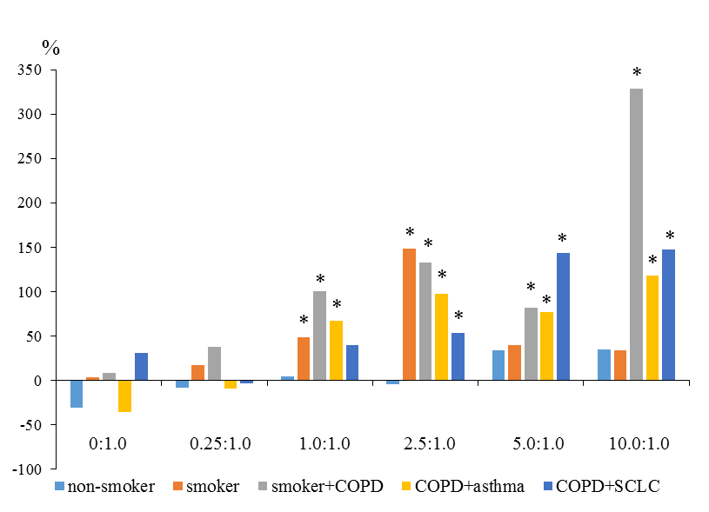
Results and Discussion
Cytotoxic Activity of hrT-cells and hnT-cells of the Subjects in the Culture of CSCs Isolated from the Patient with COPD and SCLC
Cytotoxicity reached the maximum at a T-cells:CSCs ratio of 10.0:1.0. At the same time, a significant increase in the cytotoxicity of hrT-cells in volunteer V2, patients P1, and P2 was observed at a ratio of 1.0:1.0. Cytotoxicity of hrT-cells in patients P1, P2 and P3 increased more significantly relative to hnT-cells in comparison with volunteers V1 and V2
Cytotoxic activity of reprogrammed T-cells (hrT-cells) of volunteers V1 (non-smoker volunteer) and V2 (smoker volunteer), patients P1 (smoker with COPD), P2 (COPD with asthma), and P3 (COPD with SCLC), in a culture of CSCs isolated from the blood of patient P3 to naive T-cells (cytotoxic of naive T-cell was taken as 100%). * – for comparison with naive T-cells (p< 0.05).

Slide 7
Results and Discussion
Cell therapy with modified immune cells is a promising approach for the treatment of SCLC. An unresolved issue of this approach to therapy is the choice of the optimal cell donor whose modified cells could eliminate the given target of CSCs. This issue can be partially resolved by assessing the cells in vitro. In the present pilot study, we evaluated the activity of allogeneic and autologous hrT-cells on a culture of CSCs isolated from the blood of patient with COPD and SCLC. In a culture of CSCs, hrT-cells showed significantly greater cytotoxicity and less apoptosis than corresponding nrT-cells. The most pronounced increase in cytotoxicity was observed in hrT-cells patients with lung disease than in volunteers. In addition, the number of apoptotic hrT-cells in a culture obtained from patients with pulmonary diseases was less. The exception was T-cells isolated from the blood of a patient with COPD and asthma. Reprogramming did not have a significant effect on the change in this indicator.

Slide 8
Supplementary Materials
Table 1. Patient characteristics.

Slide 9
Thank you for attention!

