Slide 1
The 2nd International Electronic Conference on Biomedicines
Presentation
On
Burgeoning nanotechnology for diabetic wound healing: a novel approach towards future[sciforum-069447]
by
Debojyoti Mandal
[Electronic mail: debojyoti2108@gmail.com]
Address correspondence to: Dr. Jeena Gupta
Discipline - Bioengineering and Biosciences

Slide 3
Relevence for wound healing
TRANSLATIONAL RELEVANCE
CLINICAL RELEVANCE
Nanotechnology driven therapeutics can influence a specific biochemical event within the impaired healing process, being able to change one or more wound-healing phases.
This offers unique opportunities compared to dressing-based the conventional wound care products.
A major advantage of these nanoplatforms is their adaptability and tunability. For instance, nanotherapeutics can be used in controlled and sustained released of the active ingredient over a period of days or weeks, while conventional delivery systems such as dressings films or gels can sustain the release of the therapeutic agent over 1 to 2 days [4].
Chronic wounds have an important economic impact in developed countries, and it is expected to increase as the population ages.
Current therapies cannot fully address the impaired healing, provoking wound complications like infections and poorly wound closure.
Thus, new biomolecules and therapies that promote wound healing, prevent wound infections or inflammation, among others, are needed.
Several nanotechnological approaches with multiple functions and different mechanisms have proved their potential in wound animal models, and could be the next generation of wound nanotherapies [5],[6]

Slide 4
Types Of Wounds
Open or Closed
Acute or Chronic
Clean or Contaminated
Internal or External
Pressure Injuries
Diabetic Ulcers
Non-penetrating Wounds
Penetrating Wounds
Stab wounds
Cuts
Lacerations
Bruises
Abrasions
Concussions
Surgical wounds

Slide 5
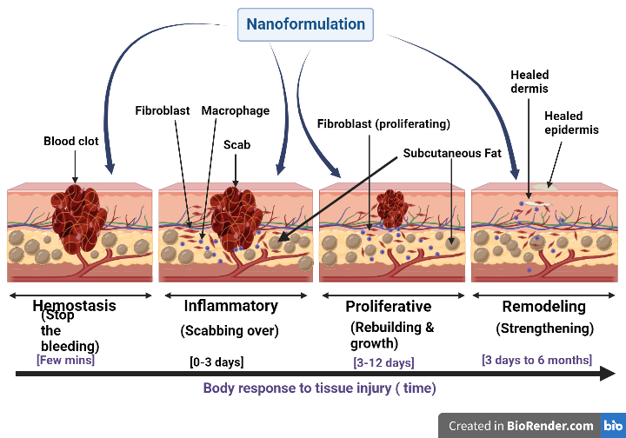
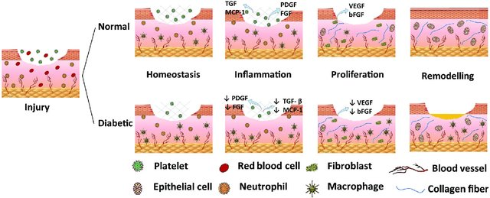
Wound healing vs diabetes
1-B
1-A
1-C
Figure: 1-A) Normal wound: 1-B)Stages of wound healing:1-C)Normal vs Diabetic wound healing

Slide 6
Nanostrategy
Nanoparticle
Nanosphere
Nanogel
Scaffold
Carbon based nanomaterials
Solid-lipid nanoparticles (SLNPs)
Nanoemulsion
Nanocomposite
Peptide nanostructure
Metallic
Polymric
Silver NPs
Fullerene
Carbon nanotube
Gold NPs
Natural NPs
Sythetic NPs
ZnO NPs
Guar gum
Xanthan gum
Chitosan
PGLA
Polyethylene glycol
Iron NPs
TiO2 NPs

Slide 7
Figure 2: Nanomaterials used in wound healing [NPs=nanoparticles]

Slide 8
Advantages of nanostrategies in diabetic wound healing
Tunable physical and chemical properties
Targeted drug delivery
Increase solubility of highly lipophilic drug
Increase bioavailibility

Slide 9
Critical Issues
Future Directions
Despite the development of potential biomaterials and nanotechnology-based applications for wound healing, this scientific knowledge is not translated into an increase of commercially available wound healing products containing nanomaterials.
Further studies are critical to provide insights into how scientific evidences from nanotechnology-based therapies can be applied in the clinical setting
NMs, due to their unique properties open a new array of wound-healing products.
NMs can modify each phase of wound healing as they possess antibacterial and anti-inflammatory activities, proangiogenic and proliferative properties.
NMs are able to correct expression level of some important proteins and signal molecules to enhance wound healing.
Thus, NMs or the combination of materials at both micro and nanoscales, may become beneficial enough to overcome most of the challenges that exist in wound care management.

Slide 10
Conclusion
Development of novel biocompatible and biodegradable NMs, which are able to correct all phases of wound healing, can be a future goal for researchers working in this area.
It is important to note that any outcome of NM therapeutics depends on the NM formulation, doses and methods of application.
As NMs are highly active compared with its bulk, toxicity of NMs must be taken into consideration in every case before its usage in wound care products.

Slide 11
Glimpse of my research work with Nanotechnology on diabetic wound healing
Figure - Optimized Nanoformulation with BBD[Box Behnken Design]
[ A) Optimized zeta potential value; B) Optimized particle size; C) Optimized PDI value; D) Optimized drug loading(%) value ]

Slide 13
Presentation
On
Emerging nano-theraputics for diabetic wound healing: a novel approach towards future
by
Debojyoti Mandal
Discipline - Bioengineering and Biosciences
Lovely Professional University

Slide 14
Thank you

