Slide 1
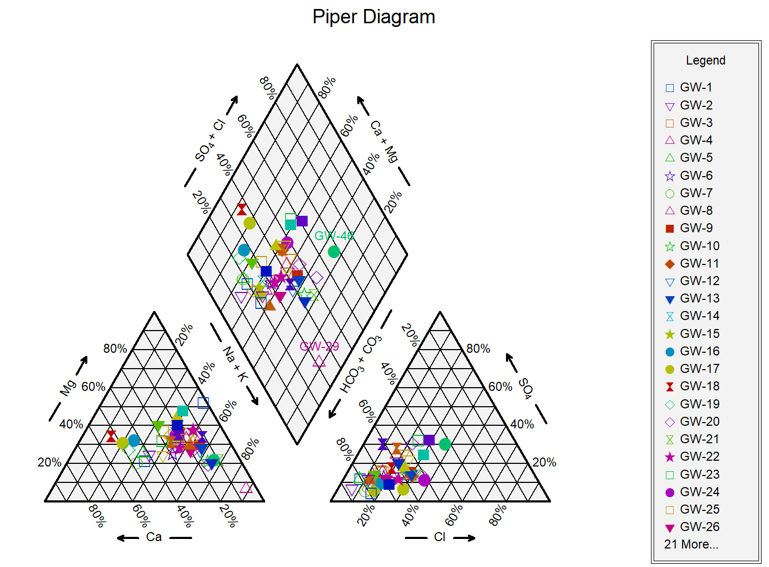
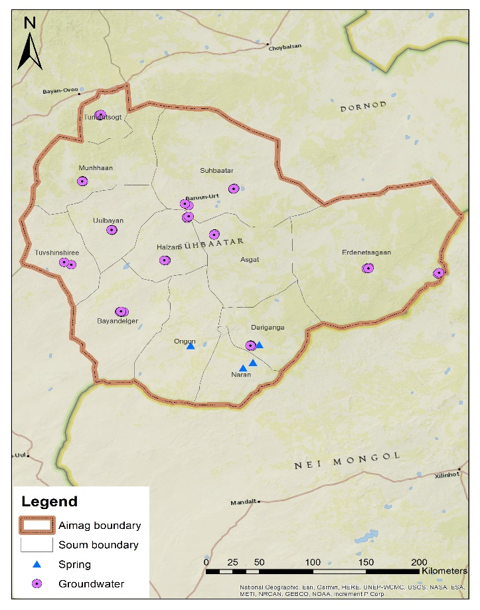
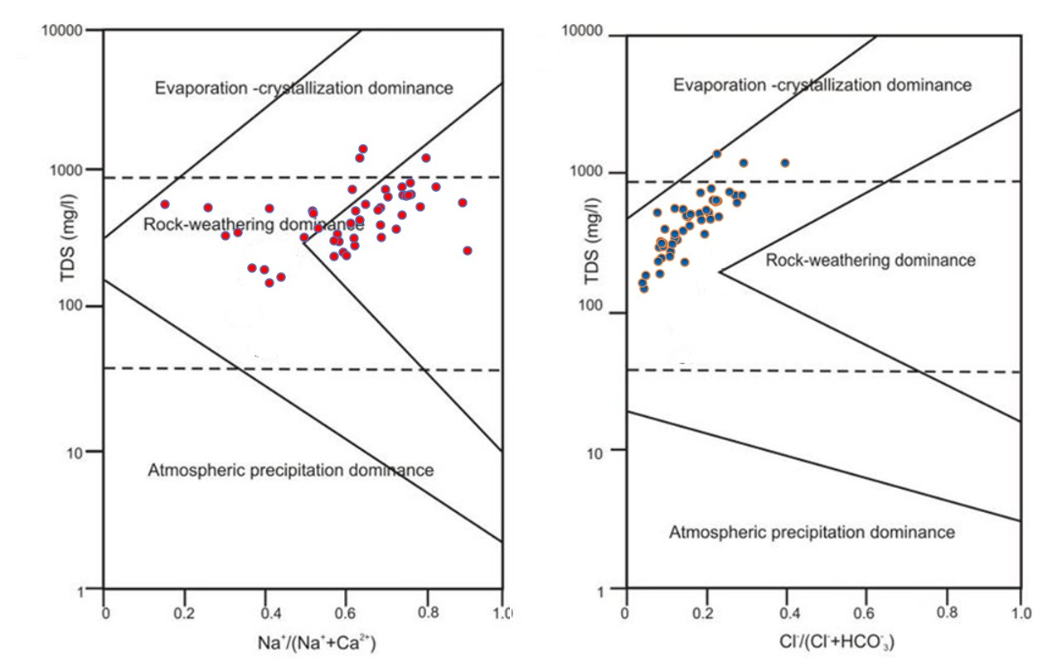
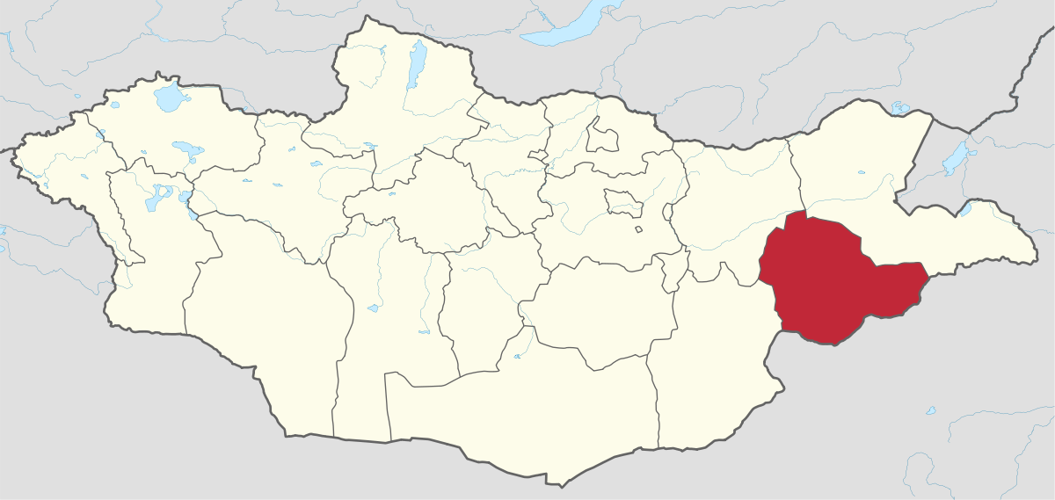
ECWS-7- 2023
^{1*}Odsuren Batdelger (odsurenb@mas.ac.mn),
Enkhjargal Togtokh¹, Oyun-Erdene Boldsaikhan¹, Renchinbud Badrakh¹, Gan-Erdene Enkhbold¹
The Hydrochemical Characteristics of Drinking Water in Central Settlements of Sukhbaatar province, Eastern Mongolia
¹Institute of Geography and Geo-ecology, Mongolian Academy of Sciences, Mongolia
Key words: Groundwater, Hydrochemistry, Semi-arid, Sukhbaatar province
1. Introduction: Issues in semi-arid regions
5.1 Hydro-chemical characteristics
The dominant hydro-chemical facies of groundwater were the Na-HCO₃ type, which represents 46.8% of the total analyzed samples, while HCO₃-Ca, HCO₃-mxed type each represents 17%, HCO₃-Na-Mg, HCO₃-Mg-Na type each represent 8.5%, and mixed-Na-Mg type represent 2.1% of the total samples.
Less precipitation Global warming
Less vegetation Decrease SW
Low infiltration Depending on GW
The water supply wells of Baruun-Urt soum and Asgat, Khalzan, and Erdenetsagaan soums does not meet the requirements of drinking water standards due to the content of magnesium, fluorine, and uranium ions. Also, the fluoride ion content in most wells exceeds the drinking water standard, while the fluoride content of Dariganga soum water was less than the drinking water standard, and Munkhkhaan Sum was suitable. Almost 60% of the water samples exceeds the standard by magnesium.
21 or 44.7% of all samples do not meet drinking water standards due to uranium content, and 11 or 23.4% of all samples have nitrate pollution. These findings suggests that appropriate groundwater management and the protection of public health in the Sukhbaatar province.
Drinking water supply
Groundwater
Poor water quality
A crucial for sustainable water resources management
Need to study the drinking water quality and protect public health in the study area
2. Objective
The main objective of this work was to study drinking water quality of the soum centers in the Sukhbaatar province.
3. Study Field
5.2 Geochemical process
Gibbs diagram used for the geochemical evolution of groundwater as evaluating evaporation, weathering and precipitation in arid and semi-arid regions.
We can see in Gibbs diagram, most of the samples plotted in the field of rock dominance area, indicating that the main geochemical process is rock-water interaction in the study area.
Environmental issues
Water supply-GW
Less precipitation
4. Methods
Field measurement
Laboratory Analysis
Field study:
June-2021
6. Conclusions
T⁰C, pH, EC, TDS , DO, ORP, P, Turbidity
Inorganic Ions
Heavy metals
The Na-HCO₃ type represents 46.8% of the total samples.
11 soum center’s drinking water do not meet drinking water standard by fluoride ion out of 13 soums, Dariganga soum water was less than the standard, and Munkhkhaan soum was suitable
Magnesium, fluoride, uranium and nitrate were among the elements found higher than the standard.
The worst water soum was Baruun-Urt.
The drinking water quality assessments

