Slide 1


The 7th International Electronic Conference on Water Sciences (2023)
Researcher :
Shiny Raj.R (5458)
Bio-Geochemistry Group, NCESS.
Supervising Guide:
Dr. K. Anoop Krishnan, Scientist–E,
Bio-Geochemistry Group, NCESS.

Slide 2



CONTENTS

Slide 3
CONCEPT, AIM & OBJECTIVE
The main aim of the present study is to mitigate acephate using Fe-MMT
Objectives
To study the feasibility of using natural clay as an adsorbent for the removal of acephate

Slide 4
Study area
Figure 2. Pesticides sampling locations in the cardamom plantations over the highlands of Periyar River basin (Idukki District).
Figure 1. Study area showing the location of investigated sampling sites in the highlands of Periyar River basin.

Slide 5
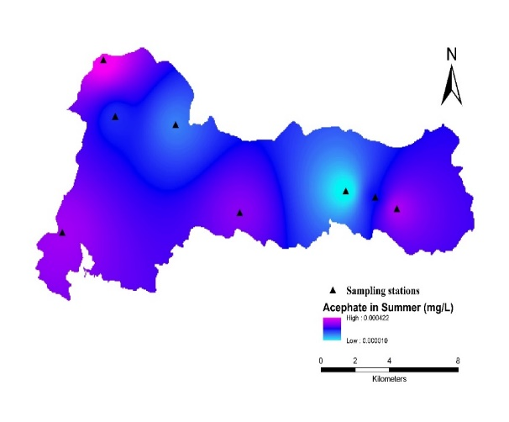
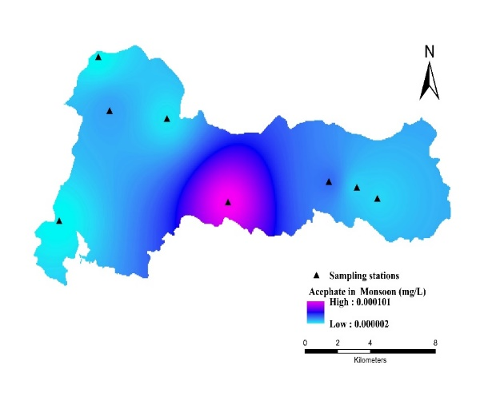
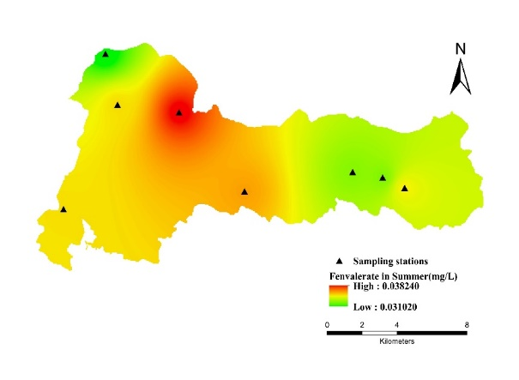
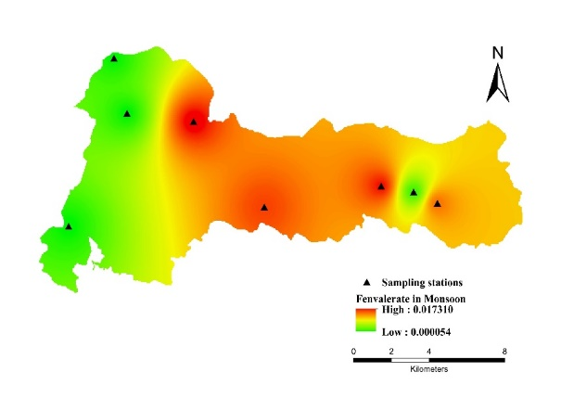
Fig. 3. Spatial distribution map of Acephate (A) Summer (B) Monsoon
Locations | Summer |  |  | Monsoon
 | Acephate (mg/L) | Fenvalerate (mg/L) |  | Acephate (mg/L) |  | Fenvalerate (mg/L)
SL 05 | 3.344×10⁻⁴ | 3.482×10⁻² |  | 0.088×10⁻⁴ |  | 1.357×10⁻²
SL 06 | 2.148×10⁻⁴ | 3.282×10⁻² |  | 1.042×10⁻⁵ |  | 0.112×10⁻²
SL 07 | 9.700×10⁻⁶ | 3.291×10⁻² |  | 0.003×10⁻² |  | 1.667×10⁻²
SL 08 | 2.991×10⁻⁴ | 3.611×10⁻² |  | 1.009×10⁻⁴ |  | 1.540×10⁻²
SL 09 | 1.247×10⁻⁴ | 3.824×10⁻² |  | 0.055×10⁻⁴ |  | 1.731×10⁻²
SL 10 | 1.974×10⁻⁴ | 3.512×10⁻² |  | 1.878×10⁻⁵ |  | 0.054×10⁻³
SL 12 | 4.217×10⁻⁴ | 3.102×10⁻² |  | 2.411×10⁻⁶ |  | 1.312×10⁻⁴
SL 15 | 3.216×10⁻⁴ | 3.511×10⁻² |  | 1.978×10⁻⁶ |  | 0.009×10⁻²
A
B
Fig. 4. Spatial distribution map of Fenvalerate (A) Summer (B) Monsoon
A
B

Slide 6
Batch adsorption incorporating response surface methodology
for
the elimination of acephate
CHARACTERIZATION
Montmorillonite exhibits typical diffraction peaks at 2θ= 19.5, 26.7, and 40.04 and additional peaks at 2θ=26.5 and 47 corresponding to silica and aluminum.
Diffraction peaks at 2θ of 36 and 42 indicates the presence of magnetite suggesting that the modified phase is magnetite.
Fe-MMT exhibited strong characteristic peaks at 536 cm⁻¹, 1438cm⁻¹ and 3377 cm⁻¹. Bands at 520-570 cm⁻¹represent Fe-O symmetrical stretching vibration, peaks at 3377cm⁻¹ are attributed to Fe-OH.
SEM shows cauliflower like image with pore spaces indicating incorporation of Fe ions onto montmorillonite.
Drastic increase in the percentage of Fe by the pillared process and a decrease in the percentage of silicon for Fe-MMT.
BET surface area of MMT is higher and exhibited less hysteresis when compared to Fe-MMT due to the formation of ferric oxide on the surface as well as in the layers of MMT. This might be also due to the blockage of pores of MMT by magnetite thus preventing the adsorption of N₂ molecules on the inner surface of the clay

Slide 7
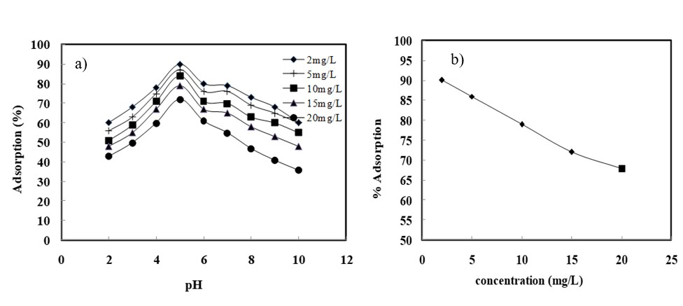
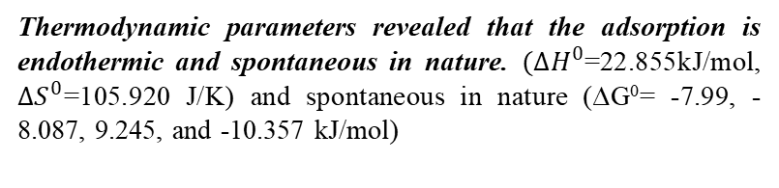
Optimization of parameters for acephate adsorption
Kinetics of adsorption and the model of isotherm obeyed pseudo-first –order (R2 > 0.99) and Langmuir model (adsorbed homogeneously on a monolayer surface of Fe-MMT)
The maximum Langmuir capacity at pH 5 and 303 K is 13.66 mg/g
Thermodynamic parameters revealed that the adsorption is endothermic and spontaneous in nature. $(∆H^{0}$=22.855kJ/mol, $∆S^{0}$=105.920 J/K) and spontaneous in nature (∆G⁰= -7.99, -8.087, 9.245, and -10.357 kJ/mol)
Fig 5. Effect of a) pH and b) initial acephate concentration on the adsorption of acephate onto Fe-MMT
Figure (5a) observed acidic medium favoured the adsorption and the peak of adsorption was achieved at 5. Adsorption increased with an increase in initial acephate concentration (Figure 5b) and dosage. Temperature another parameter effects the adsorption. As temperature increases, adsorption efficiency also enhanced (endothermic nature)

Slide 8
Adsorption mechanism

Slide 9
Dosage and concentration were observed to be the significant parameters that affected the acephate adsorption from the analysis of variance (ANOVA).
A good correlation between the experimental and predicted values was confirmed by the high F value (57.98), very low p-value (< 0.0001), an appropriate coefficient of determination (0.968), and adequate precision (28.40).
The highest removal rate of 83.18 was obtained under optimum conditions. The optimum process value of variables obtained by numerical optimization corresponds to pH 6, an initial acephate concentration of 2 mg/L, and an adsorbent dose of 0.5g/L.
Desirability ramps for the optimization of three independent variables i.e., pH, initial ion concentration, and adsorbent dosage for the adsorption of acephate onto Fe-MMT.

Slide 10
Thank you

