Slide 1
Danio rerio: A sustainable model for monitoring pollutants in the aquatic environments
Hakan Çelebi ^{1*}, Tolga Bahadır ², İsmail Şimşek ³ and Şevket Tulun ⁴
Aksaray University, Department of Environmental Engineering
¹Aksaray University, Department of Environmental Engineering
²Aksaray University, Department of Environmental Engineering
³Aksaray University, Department of Environmental Engineering
⁴Aksaray University, Department of Environmental Engineering
* Corresponding author: hakancelebi@aksaray.edu.tr

Slide 2
Abstract: Since the beginning of humanity, many sectors have continued to produce different chemicals. These chemicals are the main actors of environmental pollution and have become a global problem with irreversible effects in terms of single health. For this, countries have set a target of "a pollution-free planet". We need to determine target-specific strategies to both eliminate pollution and protect only health. To date, traditional methods of monitoring in receiving aquatic environments have been used and do not provide information on toxic levels of pollutants. For this reason, researchers have focused on "bio-indicator" or "bio-monitor" living things. Since organisms are in equilibrium with the aquatic environment, it can also be considered as an integrated sampling tool and may indicate potential contamination. Danio rerio (Zebrafish) is considered a promising model organism for single health studies in terms of its biological structure. This review aims to present Danio rerio's characteristics, susceptibility to environmental pollutants, and risks associated with pollutants in the aquatic environment.
Keywords: Aquatic environment; Bio-indicator; Danio rerio; Environmental pollutants

Slide 3
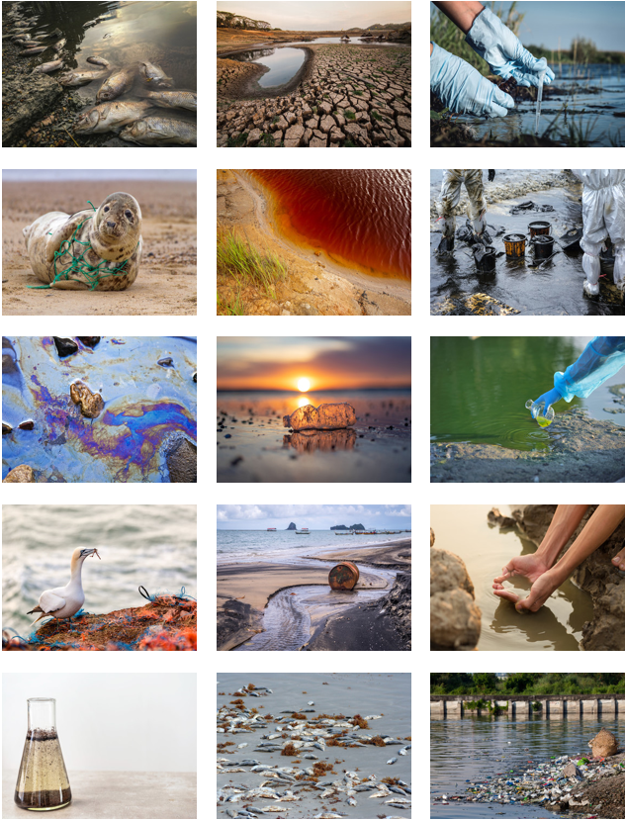
Introduction
Environmental change poses a devastating risk to human and environmental health. Change, that is, environmental pollution is the most difficult test of all countries in the world, as it affects all living things and ecosystems under the concept of one health [1-3]. A rapid study of water conditions is necessary to monitor, assess and address this global health hazard. Bioindicators or biological monitors can monitor water quality changes in real time, Zebrafish (Danio rerio) are ideal bioindicators for detecting environmental changes due to their biomedical equipment, widespread geographic distribution and well-characterized specific properties against environmental pollutants [4,5]. Many chemicals Danio rerio, which has become a viable model in terms of counter-toxicity types has recently emerged as one of the most active models in the detection and research of diseases in experimental studies [6].

Slide 4
Introduction
In general, a good animal model should have all or most of the following characteristics: (i) structural simplicity, but also incorporate the basic cellular processes that more complex organisms have; (ii) easy accessibility for research; (iii) easy and economical to manufacture in the laboratory; (iv) prone to genetic changes; and (v) if possible have a relatively small and stable genome [7]. The most popular fish species preferred in experimental processes are listed as Danio rerio, Carassius auratus, Oryzias latipes, Poecia Reticulata, Gasterosteus aculeatus, Oncorhynchus mykiss, Takifugu rubripes, and Xiphophorus hellerii. Research on zebrafish has become more popular in the last decade. Danio rerio's high fertility rate (ability to fertilize approximately 200-300 eggs every 5-7 days), economic maintenance, and ease of genetic modification make Danio rerio an alternative and valuable vertebrate model compared to other species [8].
The use of zebrafish as a model for all toxicity studies is carried out according to standards. These standards are; Zebrafish Toxicity Test is listed as British standard BS/EN/ISO 7346-3-1998, German standard DIN/EN/ISO 7346-3-1998 and Chinese standard GB/T13267-91, OECD n° 203-236-473-487-489-490 [9,10]. Danio rerio (Cyprinidae family: freshwater teleost) is considered as a model organ-ism in many research areas, especially in health and pollution detection. In this study, we describe the criteria for the use of a fish species as a model for research in environmental toxicology and argue that Danio rerio is an ideal bioindicator for detecting the toxicity of pollutants.

Slide 5
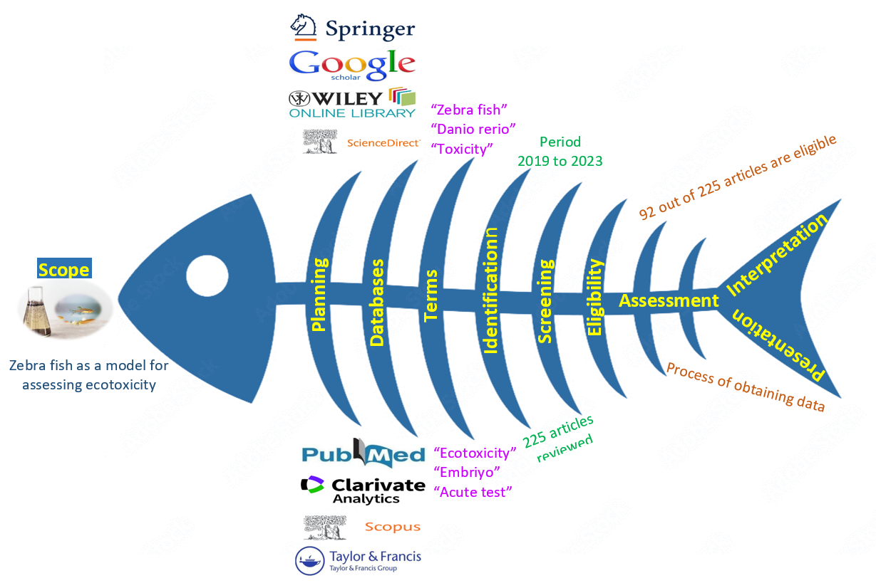
Methodology
Literature search related to zebrafish used as a model in ecotoxicity assessments was made in databases such as Web of Science, Science Direct, Scopus and PubMed. The following keywords were used in the search process: “Zebrafish” and “Ecotoxicity”, “Danio rerio” and “Acute toxicity”, “Zebrafish development” and “Fish assay” and “Zebrafish embryo test” and “Exposure” etc. A total of 225 articles were reviewed in all databases. Studies that did not comply with the study purpose were not included in the evaluation. Of the 225 articles published until January 2023, 92 were thoroughly reviewed. Each article used in the study was compiled according to the following parameters: (i) publication year; (ii) the type of pollutant; (iii) exposure factors; (iv) toxicity; (v) stage of development; (vi) types of tests; and (vii) ecotoxic effects (Figure 1). [1, 11,12].
Figure 1. Systematic review methodology.

Slide 6
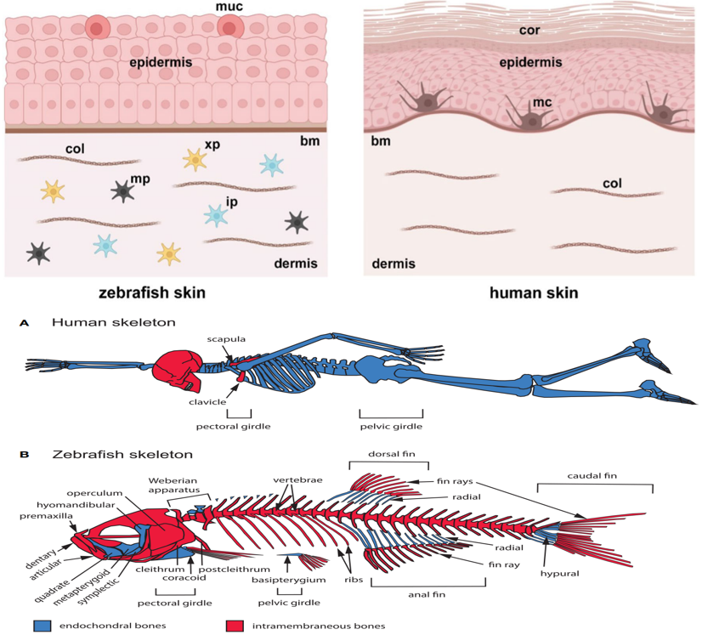
Advantages and disadvantages of zebrafish in ecotoxicity tests
Zebrafish is a successful monitoring model applied in both medicine and environmental pollution [13]. Zebrafish has been widely used in ecotoxicity studies in recent years due to its advantageous features such as reproduction process and developmental stage [14]. One of the main advantages of this model is that experimental studies can be carried out in the embryo process [13]. Rapid development is an excellent feature in all toxicity studies with animal models as it allows instant monitoring of toxic exposure [17]. In addition, 70% of zebrafish genes are similar to human genes [8]. In recent years, zebrafish has been evaluated as an alternative ecotoxicity model to replace mice and other fish species. Among the disadvantages of zebrafish, it can be said that different reactions occur according to the sex type and the embryo development pools are large.

Slide 7
Development and Distribution of Zebrafish
The zebrafish was described in 1882 by Francis Hamilton, who found it near the Ganges River in India [19]. After George Streisinger first used the zebrafish to study verte-brate development in the 1980s, it has become one of the most important laboratory ani-mals with unprecedented speed [8]. Zebrafish are native to most of the Indian subconti-nent, from Pakistan in the west through India, Nepal and Bangladesh to Myanmar in the east. Zebrafish can be found in a wide variety of habitats. The adult zebrafish is 2 to 4 cm long, and its body is characterized by zebra-like stripes (Figure 2).
Figure 2. Adult zebrafish illustration.

Slide 8
Development and Distribution of Zebrafish
In toxicological studies, and especially in order to determine the toxic levels of environ-mental pollutants, parameters close to the natural environment of zebrafish should be provided in the laboratory environment. In this context, water quality parameters come to the fore (Table 1) [20-23].
Table 1. Physico-chemical properties of water for lab-raised zebrafish
Parameters | Unit | Permisible Limits | Optimum Limits
Temperature | ⁰C | 6.5-42 | 26
Hardness | mg/L | 72-198 | 100
pH | - | 5.5-9.0 | 7.7
NaCl | ppt | 0.1-14 | 0.65
Ammonia (NH⁺₄) | mg/L | 0-0.05 | 0.02
Nitrite (NO⁻₂) | mg/L | 0-0.5 | 0.2
Nitrate (NO⁻₃) | mg/L | 15-200 | 50
Phosphate (PO⁻³₄) | mg/L | 150-300 | 250
Dissolved Oxygen | mg/L | 5.5-8.0 | 7.5
Conductivity | µS | 200-4000 | 1250

Slide 9
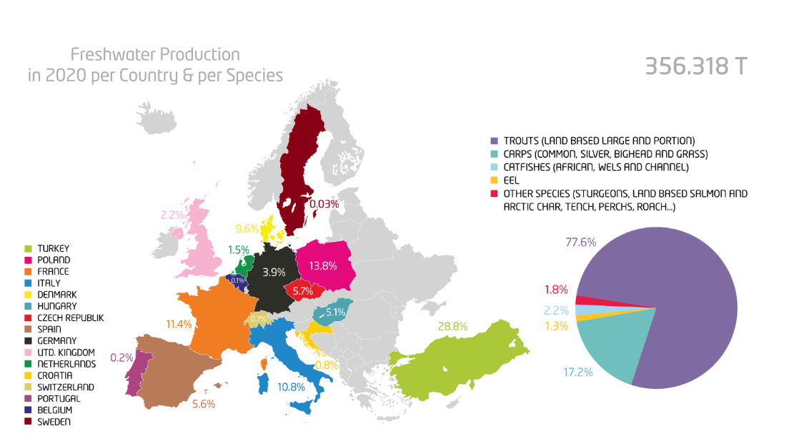
Development and Distribution of Zebrafish
Zebrafish are found in rivers, streams, canals and rice fields of India, Pakistan, Bangladesh, Nepal, Myanmar and Bhutan [22]. Wild zebrafish distribution includes Brazil, Colombia, Malaysia, Sri Lanka, Thailand and the United States [21,23]. Native zebrafish is found in more than 3000 institutions in more than 100 countries and is a popular aquarium fish [22,24]. In research studies with zebrafish in the literature, China (26.7%), Brazil (14.8%), France (12.5%), Germany (8.5%), India (6.3%) and Italy (5.1%) take the lead [1]. Also, the University of Oregon in the United States is home to the Zebrafish International Resource Center (ZIRC), the world's first and largest zebrafish resource center located on the Zebrafish Information Network (ZFIN). According to the data of the Federation of European Aquaculture Producers (FEAP), this type of fish is produced at a rate of 1.8% (https://feap.info/)

Slide 10
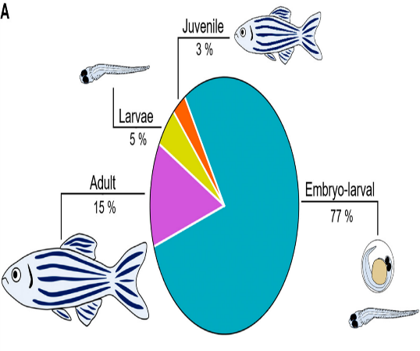
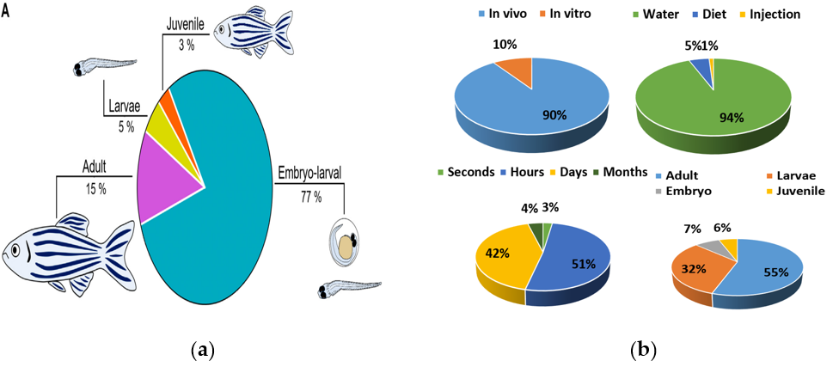
Zebrafish Based Experimental Applications
Experimental design is an important factor besides fish species in ecotoxicity studies. The type of exposure (in vivo or in vitro), exposure route, exposure times, and stage of development are considered experimental parameters in data generation [13]. The majority of tests were performed in vivo (90.3%) compared to in vitro tests (9.7%) (Figure 3). Embryos (7.3%) and larvae (32.1%) were used less frequently than adults (55.8%) in ecotoxicity evaluation according to the development process (Figure 3). In terms of exposure route and duration, water (94.9%) and hour (51.1%) were evaluated at the highest rates, respectively (Figure 3). In Table 2, toxicity studies for which zebrafish are models are given.
Figure 3. Danio rerio development (a), type of studies in vivo and in vitro; zebrafish exposure route; exposure time; developmental stages (b) [1, 11].
Tablo 2. Different toxicity studies in literature
Test Type | Exposure-Pollutant | References
Zebrafish embriyo test | Crude oil component | [25]
Danio rerio long-term exposure | Metformin | [26]
Zebrafish antagonistic test | Deltamethrin | [27]
Adult zebrafish behavioural test | Cannabinoids | [28]
Early life stage zebrafish assay | Sediment | [29]
Acute-Chronic test | Lead | [30]
Early life stage zebrafish assay | Sodium Hypochloride | [31]
Combined toxicity test | Agrochemicals | [32]
Adult zebrafish behavioural test | Triclosan | [33]

Slide 11
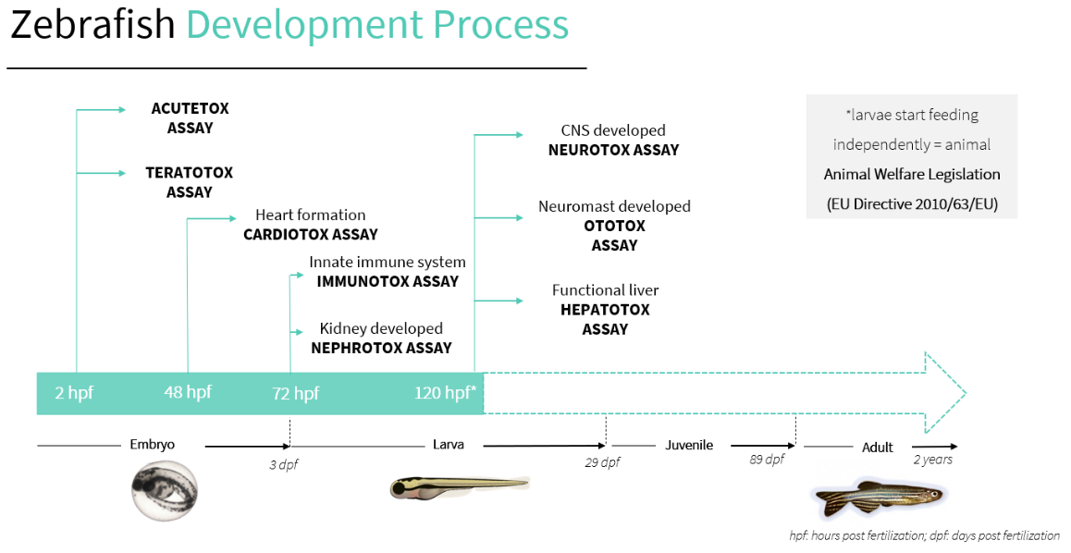
CONCLUSIONS
Zebra fish; Small size, being resistant to biotic and abiotic conditions, rapid development process, short reproduction period, being compatible with laboratory conditions, easy supply, being economical, high fertility, being open to manipulation of embryos, genetic similarity with humans increase the importance of this species for toxicity studies. Thanks to these advantages, zebrafish can be used instead of other living models in scientific research and can support the 3R rule. As a result of studies researched in international databases, it is thought that different uses of this species will be widespread and it will be a key model organism in the future.
Infographics
Infographics
Infographics
Infographics
https://biobide.com/

Slide 12
Thank You

Slide 13
Danio rerio: A sustainable model for monitoring pollutants in the aquatic environments
Hakan Çelebi ^{1*}, Tolga Bahadır ², İsmail Şimşek ³ and Şevket Tulun ⁴
Aksaray University, Department of Environmental Engineering
¹Aksaray University, Department of Environmental Engineering
²Aksaray University, Department of Environmental Engineering
³Aksaray University, Department of Environmental Engineering
⁴Aksaray University, Department of Environmental Engineering
* Corresponding author: hakancelebi@aksaray.edu.tr

