Slide 1


Groundwater quality assessment and evaluation of scaling and corrosiveness potential of drinking water samples
Aftab Alam and Saurabh Kumar
The 7th International Electronic Conference on Water Sciences
15-30 Mar 2023

Slide 2
Content
Introduction
Objective
Study Area
Material and Methods
Results and Discussion
Conclusion
References
The 7th International Electronic Conference on Water Sciences
15-30 Mar 2023

Slide 3
Introduction
Groundwater is an essential source for domestic and industrial purposes.
Population growth has resulted in a massive increase in groundwater demand .
WQI method is widely used around the world for groundwater quality assessment.
Water corrosion and scaling can be predicted with analytical terminology such as Ryznar stability index (RSI), Aggressive index (AI), Langelier saturation index (LSI), Larson-Skold index (LS), and Puckorius scaling index (PSI).
The 7th International Electronic Conference on Water Sciences
15-30 Mar 2023

Slide 4
Objective
To assess the groundwater quality and corrosive potential of drinking water samples. Which help in managing future sustainable groundwater management approaches in the Aurangabad District, Bihar (India).
The 7th International Electronic Conference on Water Sciences
15-30 Mar 2023

Slide 5
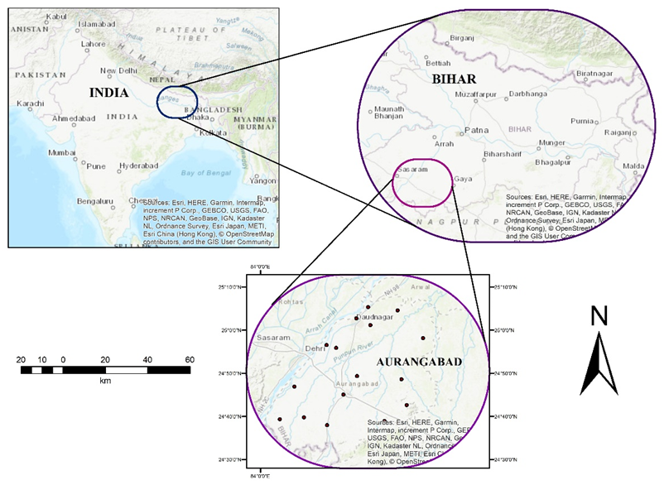
Study Area
Longitudes 84º00' - 84º45’E
Latitudes 24º30' - 25º15' N.
The 7th International Electronic Conference on Water Sciences
15-30 Mar 2023

Slide 6
Materials and Methods
Sampling and Data Analysis | Water Quality Index | Corrosiveness Indices
All the procedures followed as per APHA 2017. | WQI is a rating that assesses the impact of several parameters on water quality. the calculation of WQI, all stages were performed as described by Horton et. Al. 1965. | LSI, RSI, PSI, Ls, and AI were used to assess the corrosion potential of water samples. There were seven physicochemical parameters that were used in calculating these indices: pH, temperature, TDS, alkalinity, calcium hardness, chloride, sulfate.
The 7th International Electronic Conference on Water Sciences
15-30 Mar 2023

Slide 7
Contd..
Equations and classification of Corrosiveness indices.
The 7th International Electronic Conference on Water Sciences
15-30 Mar 2023

Slide 8
Results and Discussion
Statistical analysis results on the study area groundwater data
The 7th International Electronic Conference on Water Sciences
15-30 Mar 2023

Slide 9
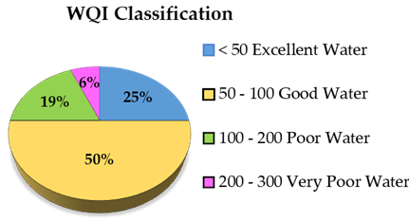
Contd…
The 7th International Electronic Conference on Water Sciences
15-30 Mar 2023

Slide 10
Corrosiveness indices
All water samples were corrosive
87.5% of water samples were strong corrosive potential.
93.75% of water sample were moderately corrosive.
The 7th International Electronic Conference on Water Sciences
15-30 Mar 2023

Slide 11
Corrosiveness indices
All water samples were corrosive
75% of the water samples have a strong corrosive tendency
The 7th International Electronic Conference on Water Sciences
15-30 Mar 2023

Slide 12
Conclusions
WQI of groundwater samples revealed that 75% had excellent or good water, and 25% either had poor or very poor water.
LSI and RSI are the main indicators that are utilized for corrosion monitoring in iron and steel pipes. LSI indicates that all water samples had a corrosive tendency, and RSI indicates 87.5% high corrosive tendency.
Chloride and sulfate ions corrode iron and steel pipes and degrade water quality. Ls is also a good tool for monitoring corrosion in iron and steel pipes. In water samples, Ls indicates a 75% high corrosive tendency, an 18.75% corrosive tendency, and a 6.25% scaling tendency.
All these indices indicate that water has a corrosive tendency, which can degrade materials and affect water quality.
The 7th International Electronic Conference on Water Sciences
15-30 Mar 2023

Slide 13
References
Wekesa, A. M. Assessment of Groundwater Quality Using Water Quality Index from Selected Springs in Manga Subcounty, Nyamira County, Kenya. The Scientific World Journal 2022.
Adimalla, N.; Qian, H. Groundwater quality evaluation using water quality index (WQI) for drinking purposes and human health risk (HHR) assessment in an agricultural region of Nanganur, south India. Ecotoxicology and Environmental Safety 2019, 126, 153–161.
K. Pietrucha-Urbanik, D. Skowrońska, and D. Papciak, “Assessment of corrosion properties of selected mineral waters,” Coatings, vol. 10, no. 6, pp. 1–13, 2020, doi: 10.3390/COATINGS10060571.
Kumar, S.; Singh, R. Qualitative assessment and corrosiveness of the Ganga water: A comparative assessment. Materials Today: Proceedings, 2021 45, 5695–5701.
APHA 2017, Standard Methods for the Examination of Water and Wastewater, 23rd Ed., 2017 American Public Health Association Washington. DC, USA.
Horton, R. K. An index number system for rating water quality, J Water Pollut Control fed, 1965, 3, 300-306.
Asadi, E.; Isazadeh, M.; Samadianfard, S.; Ramli, M. F.; Mosavi, A.; Nabipour, N.; Shamshirband, S.; Hajnal, E.; Chau, K. W. Groundwater quality assessment for sustainable drinking and irrigation. Sustainability (Switzerland), 2020, 1, 1–13.
WHO. (2006). WHO guidelines for drinking-water quality. Vol. 11, Issues 3–4, p. 515.
Langelier, W. F. The Analytical Control of Anti-Corrosion Water Treatment. American Water Works Association, 1936, 10, 1500–1521.
Ryznar, J. W. (1944). A New Index for Determining Amount of Calcium Carbonate Scale Formed by a Water. American Water Works Association, 1944, 4, 472–483.
Kumar, S.; Singh, R.; & Maurya, N. S. Water Quality Analysis and Corrosion Potential in the Distribution Network Patna, Bihar. Journal of Environmental Engineering and Science, 2022, 4, 164-174.
Kumar, S.; Singh, R.; & Maurya, N. S. Assessment of Corrosion Potential Based on Water Quality Index in the Distribution Network of urban Patna, Bihar, India. Journal of Nature Environment and Pollution Technology, 2022, 5, 2117-2127.
The 7th International Electronic Conference on Water Sciences
15-30 Mar 2023

Slide 14

The 7th International Electronic Conference on Water Sciences
15-30 Mar 2023

