Slide 1


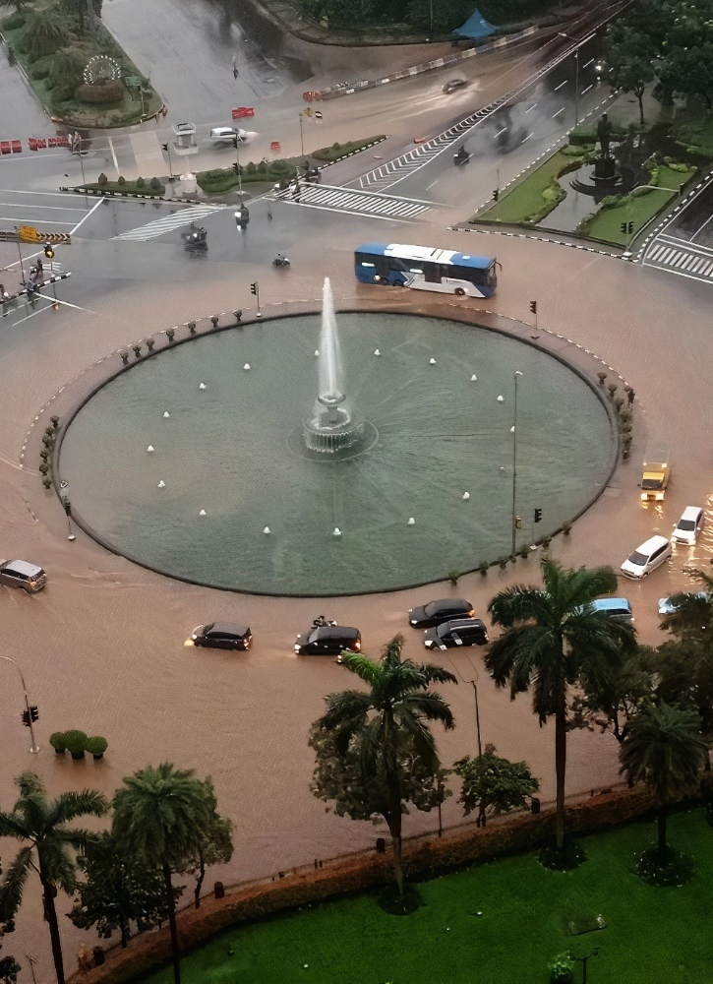
Jakarta’s 2020 New Year Flood Assessment by Rainfall-Runoff-Inundation (RRI) Model
Yeremia Immanuel Sihombing ¹, Akbar Rizaldi ¹, Mohammad Farid ¹, N. Fajar Januriyadi ², and Idham Riyando Moe ^{3,*}
¹ Center for Coastal and Marine Development, Institute for Research and Community Services, Institut Teknologi Bandung, Jalan Ganesha No.10, Kota Bandung 40132, Indonesia, yeremia.sihombing97@gmail.com, akbar@ftsl.itb.ac.id, mfarid@ftsl.itb.ac.id
² Department of Civil Engineering, Pertamina University, Jalan Teuku Nyak Arief, RT.7/RW.8, Simprug, Kec. Kby. Lama, Kota Jakarta Selatan 12220, Indonesia, nurul.fj@universitaspertamina.ac.id
^{3,*} Directorate General of Water Resources, Ministry of Public Works and Housing, Jalan Pattimura No. 20, Kebayoran Baru, Jakarta Selatan 12110, Indonesia, idham.moe@gmail.com
† Presented at the title, place, and date.

Slide 2
1
INTRODUCTION
2
DATA
TABLE OF CONTENT
3
RRI MODEL
4
CALIBRATION
5
RESULT

Slide 3
INTRODUCTION

Slide 4

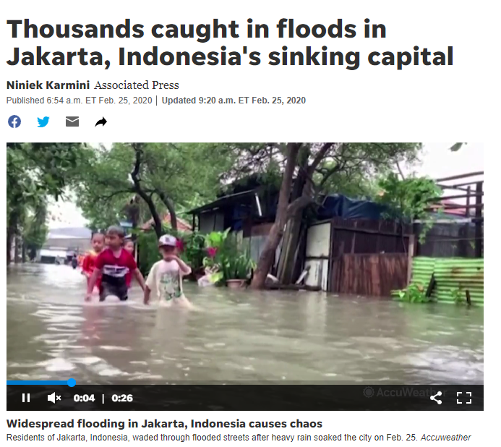
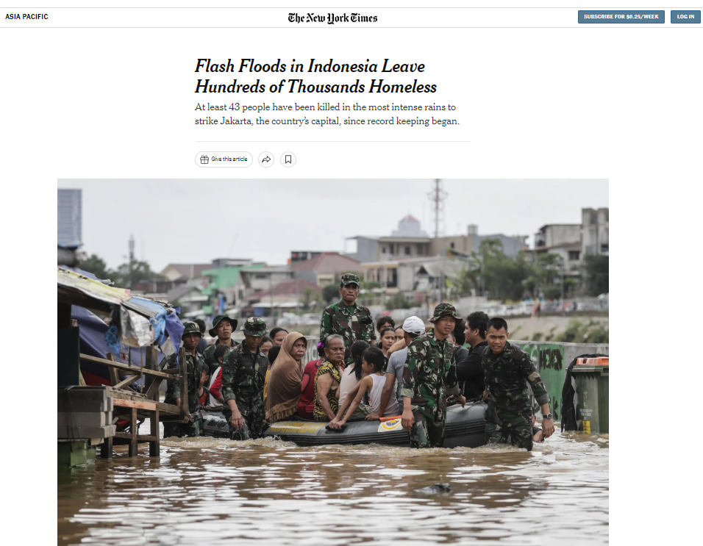
JAKARTA FLOOD JANUARY 2020

Slide 5
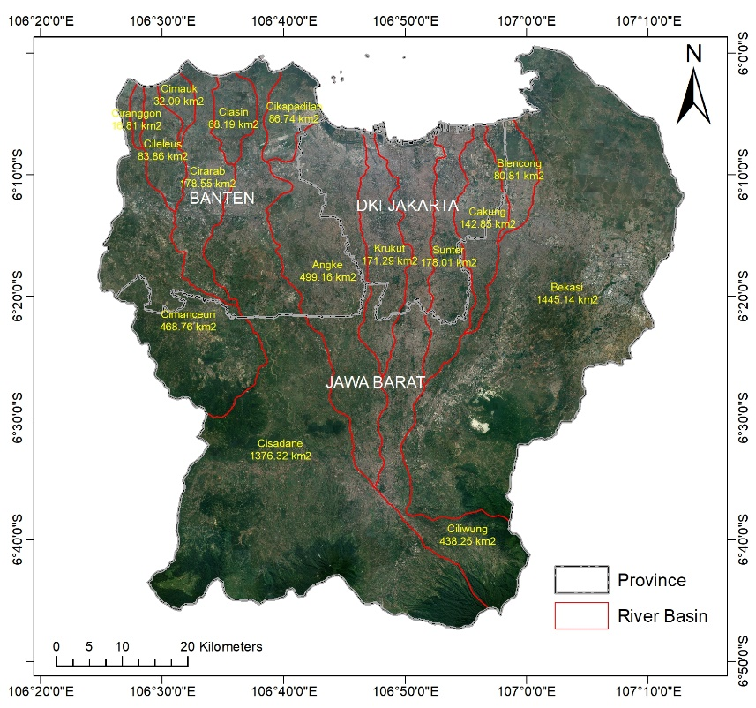
Ciliwung-Cisadane River Basin
River Basin: | 15 river basins
Total Area: | 5269.84 km²
Administrative area: | 3 Provinces, 9 cities/municipalities as follow Province of DKI Jakarta (5 cities), Bogor, Depok, Bekasi, and Tangerang.
CILIWUNG CISADANE RIVER BASIN AREA
Figure 1 Study Area

Slide 6
DATA

Slide 7
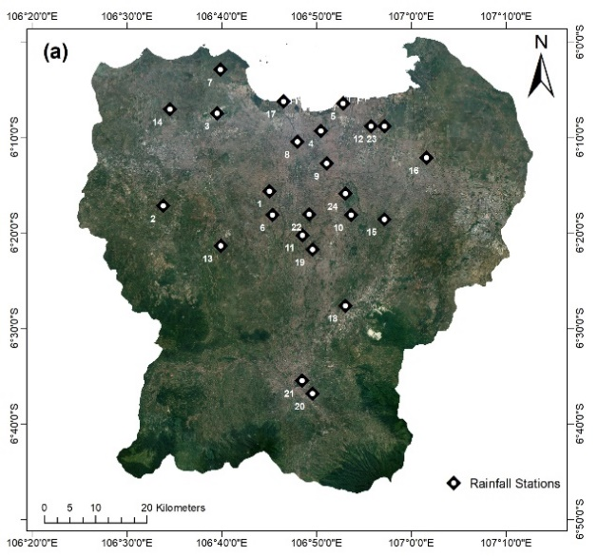

The precipitation data were collected from 24 rainfall stations in Ciliwung – Cisadane Watershed during the flood event. All of the rain stations are located around the study area as shown in Figure 2 (a) and in Figure 2 (b) presents the rainfall distribution throughout the river area using Inverse Distance Weighted Interpolation (IDW) method.
PRECIPITATION DATA
Figure 2 Rainfall datasets in the study area: (a) Rainfall station locations;
Figure 2 Rainfall datasets in the study area: (b) Rainfall distribution on January 1st, 2020

Slide 8
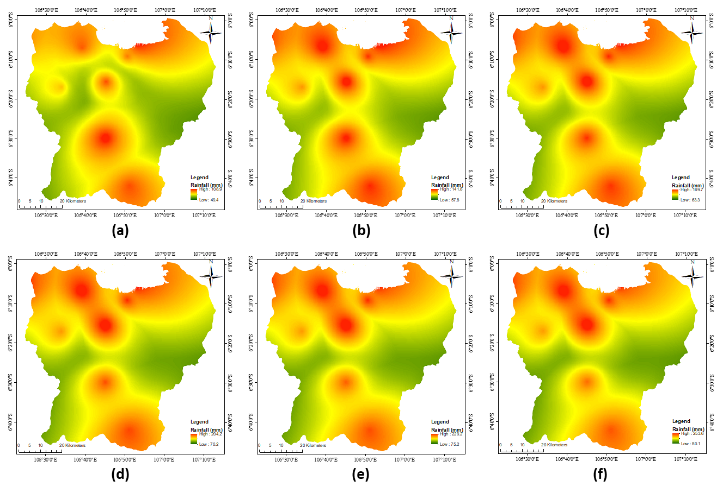
The forecasting of return period rainfall used BMKG (Meteorological and Geophysical Institution of Indonesia) rainfall dataset in a period of 1986-2010 as a reference. The data was distributed throughout study area as presented in Figure 3. Compared with the rainfall was occurs on January 1st, maximum rainfall on that event exceeded the maximum data in 100-years period which has good corresponding with the previous study.
PRECIPITATION DATA
Figure 3 Rainfall return period datasets (a) Rainfall return period of 2 years, (b) Rainfall return period of 5 years, (c) Rainfall return period of 10 years, (d) Rainfall return period of 25 years, (e) Rainfall return period of 50 years and (f) Rainfall return period of 100 years

Slide 9
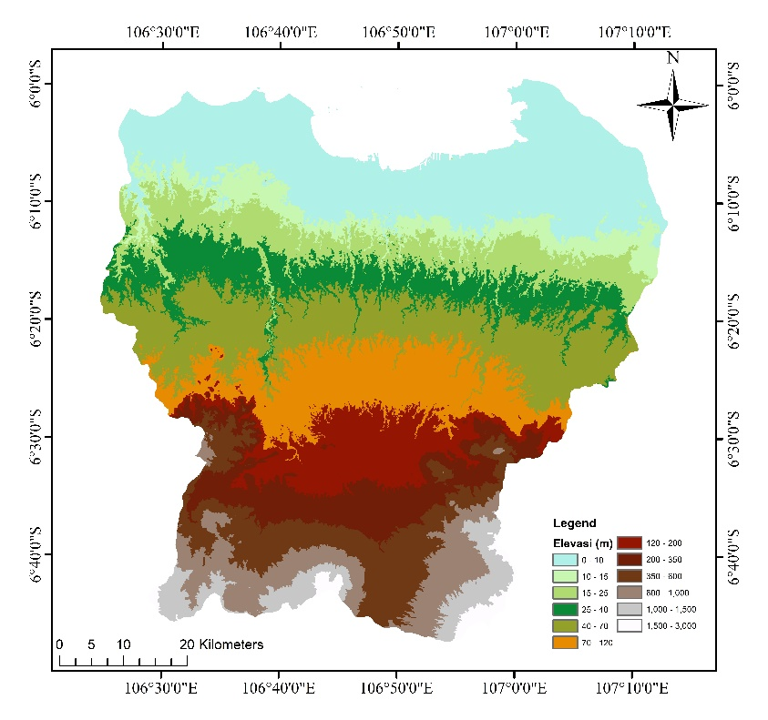
The topography data is derived from the Digital Elevation Model (DEM) obtained from the Shuttle Radar Topography Mission (SRTM). The data was open-source data provided by the United States Geological Survey (USGS). For the SRTM, the vertical accuracy is 16 m for 90% confidence level [45].
TOPOGRAPHY
Figure 4 Digital Elevation Model (DEM) of Ciliwung-Cisadane Watershed

Slide 10
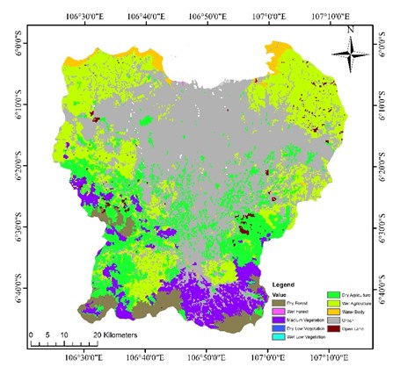
LAND COVER
Land over was obtained from Global Land Cover Characterization Version 2 (GLCC-V2). This database has been developed by The U.S. Geological Survey (USGS), the University of Nebraska-Lincoln (UNL), and the European Commission's Joint Research Centre (JRC) since 1992. The land cover projection has 1-km nominal spatial resolution and unique geographic elements. The land classification for this model has been simplified from GLCC-V2 for calculation purpose (Figure 5).
Figure 5 Land cover of Ciliwung-Cisadane Watershed

Slide 11
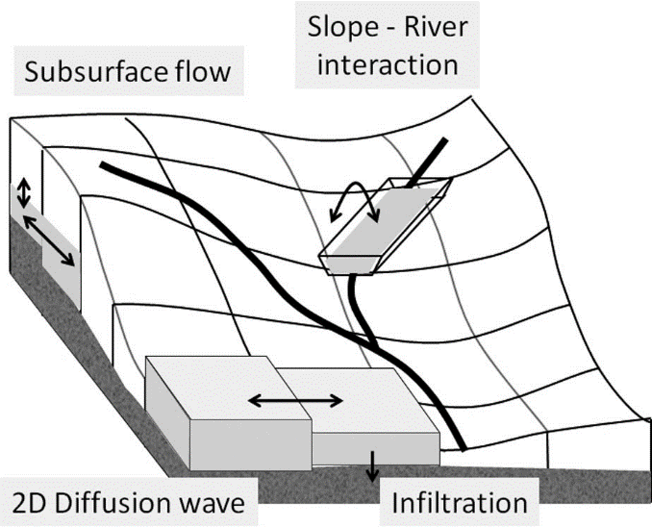
RRI MODEL
Figure 6 Rainfall-runoff-inundation (RRI) model schematic diagram (Source: Sayama et al., 2012)

Slide 12
CALIBRATION

Slide 13
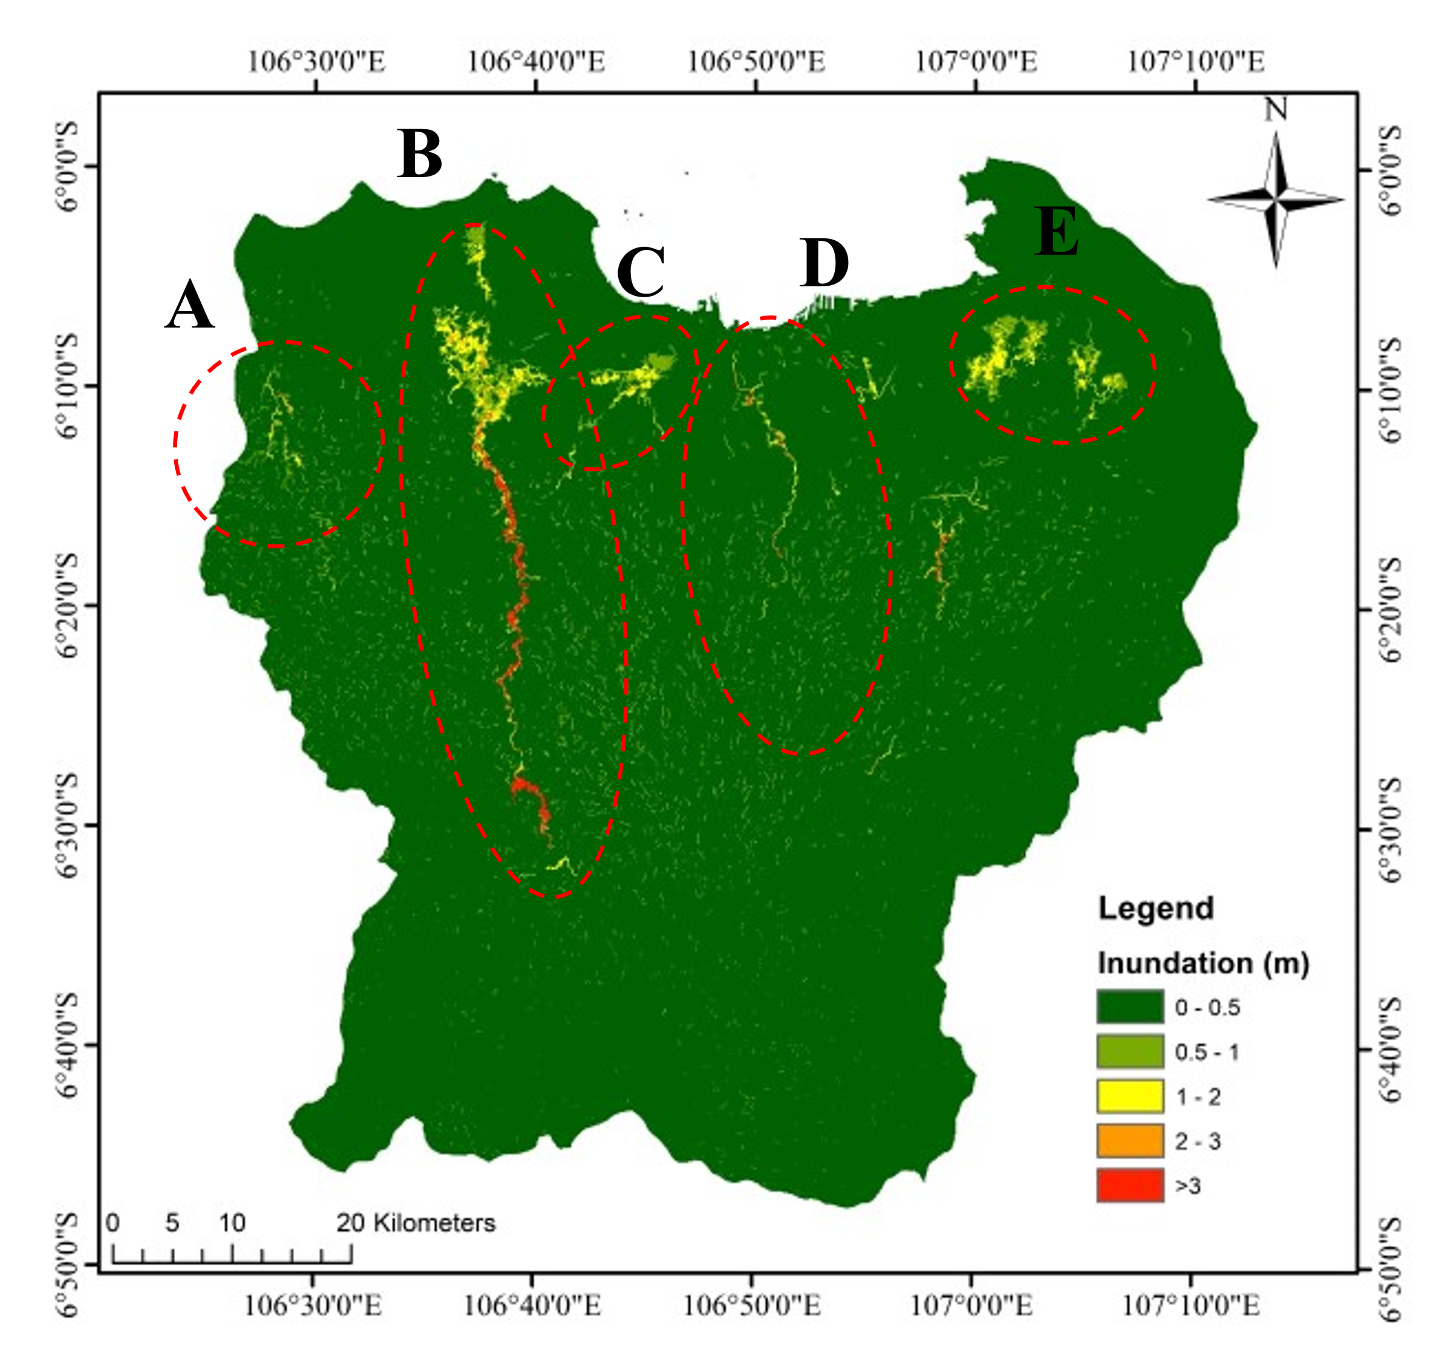
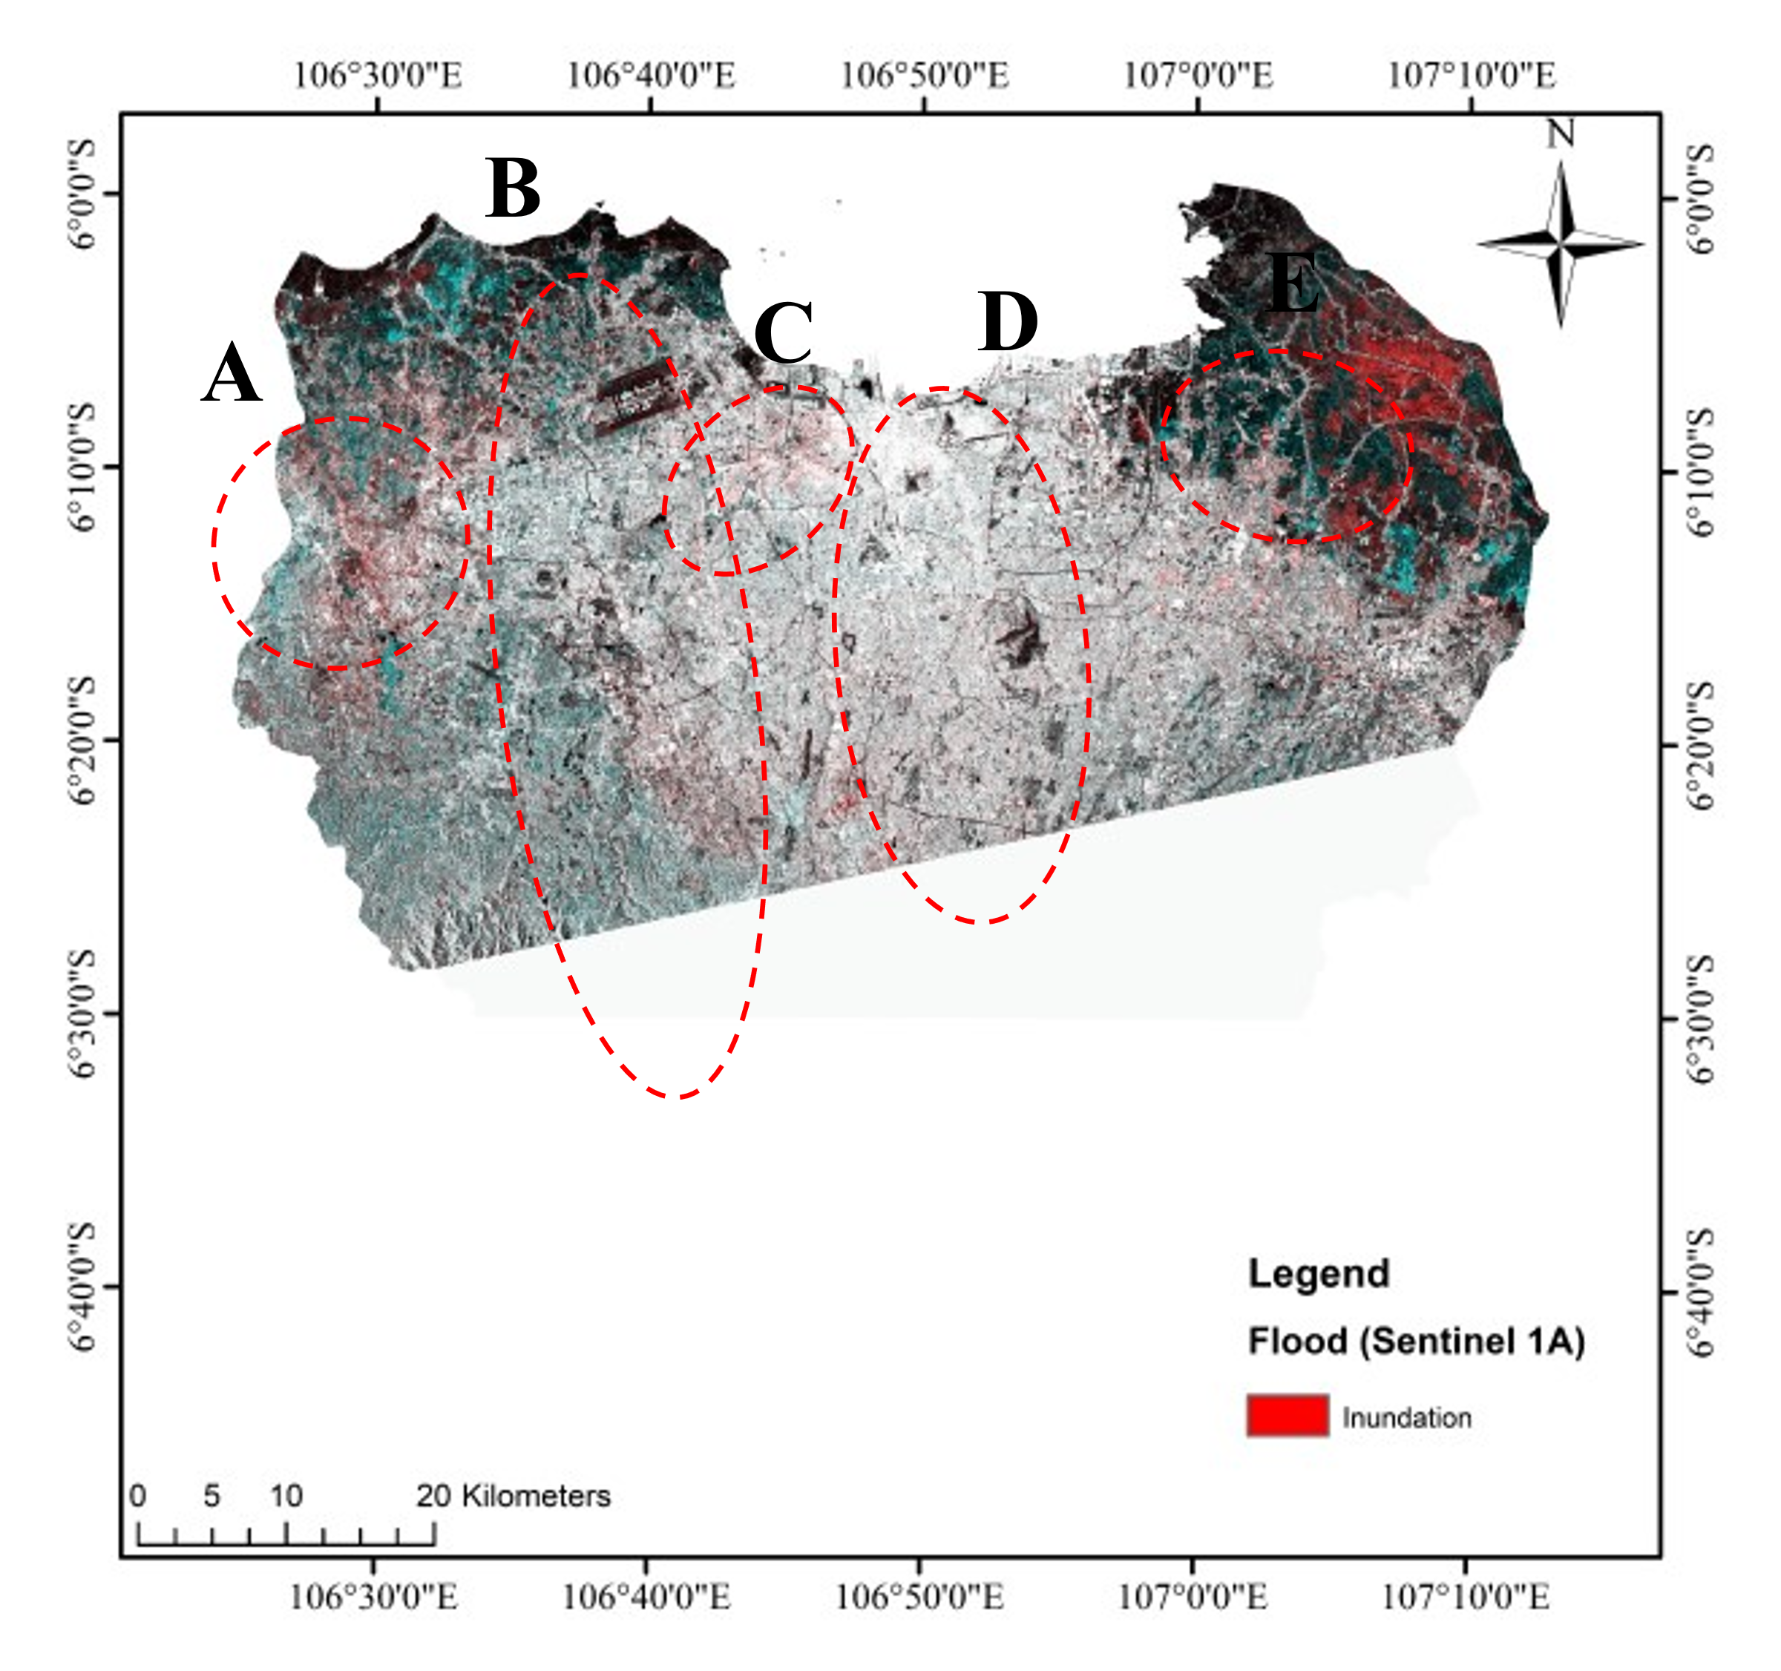
MODEL CALIBRATION
The model was calibrated before being used to simulate the return period flood. It was calibrated with a flood event that occurred on January 1st, 2020. The simulation has calculated the distribution of flood inundation in the condition of maximum water depth and compared by the inundated area from satellite data at the same event (Figure 7). Figure 7 shows the comparison of simulated flood inundation and flood inundation of sentinel 1A acquired on January 2nd, 2020. The flood inundation of sentinel 1A generated using an algorithm that proposed by Chini et al [48]. The algorithm can detect the flood water not only on bare soil but also on the urban regions. Even though the Sentinel 1-A acquired a day after flood event, some inundation still remains on the land. Figure 7 shows a similar inundation on the north-east part between simulation and satellite data. Whereas in the middle part near ocean, the figure shows that the simulated inundation areas are larger than the satellite data. Because the flood waters in urban area of Jakarta receded on January 2nd, 2020.
Figure 7 Rapid Assessment of Jakarta Flood Inundation: (a) simulated 1st January flood inundation (b) flood inundation of sentinel 1A acquired on January 2nd, 2020

Slide 14
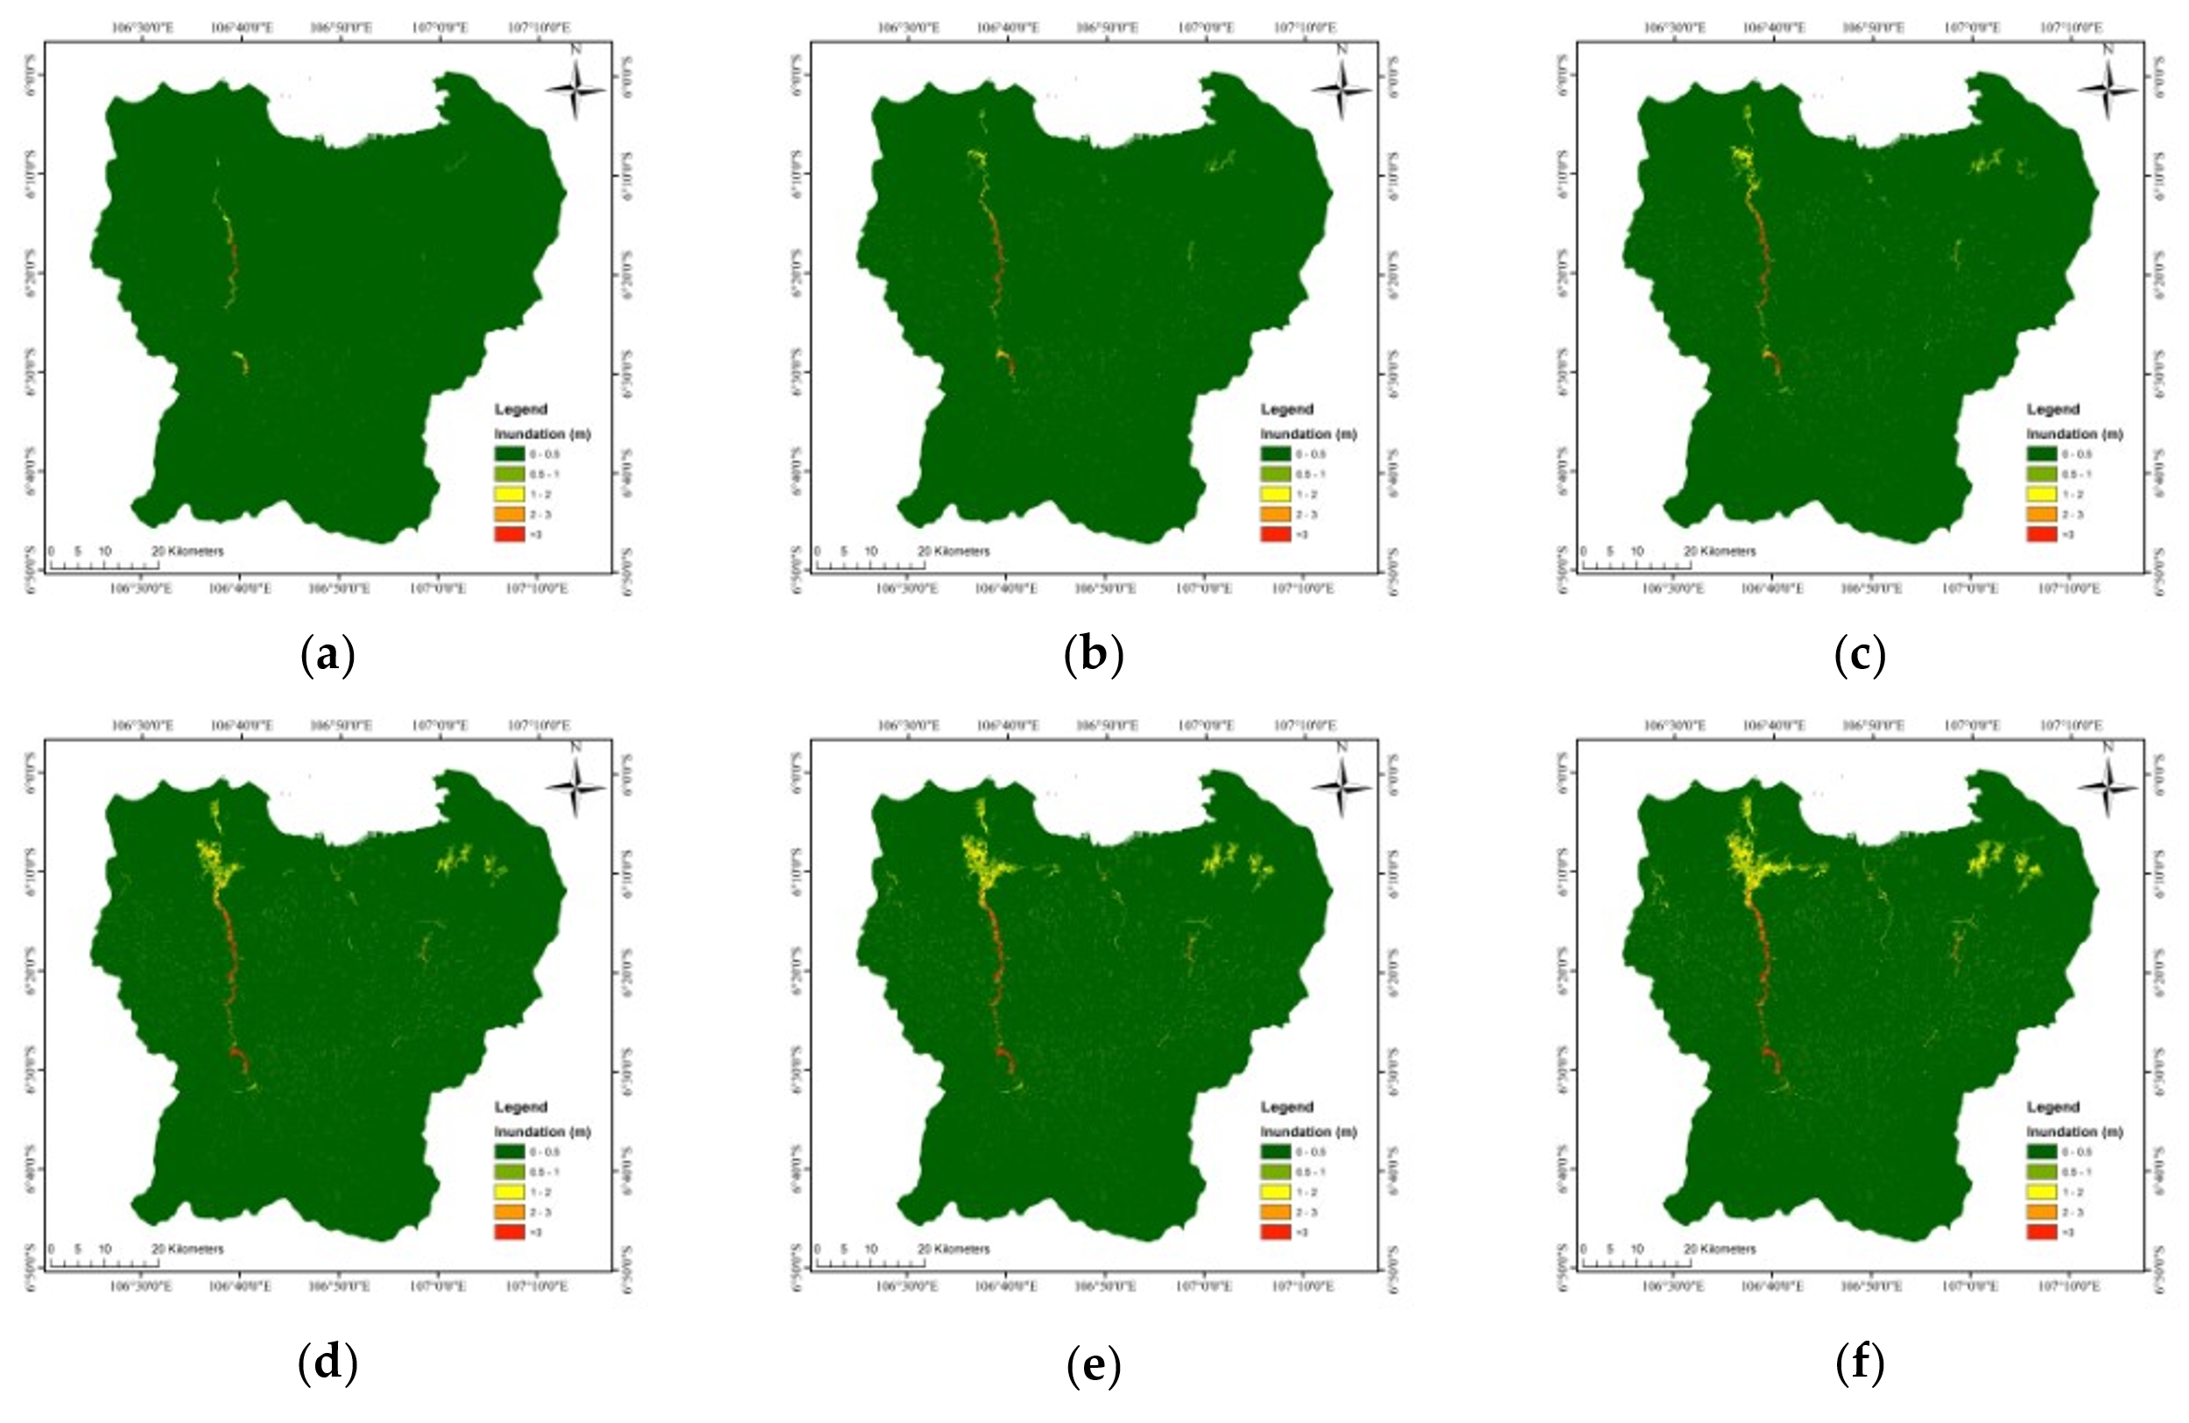
MODEL APPLICATION
Figure 8 The inundation of flood return period (a) Flood return period of 2 years, (b) Flood return period of 5 years, (c) Flood return period of 10 years, (d) Flood return period of 25 years, (e) Flood return period of 50 years and (f) Flood return period of 100 years

Slide 15
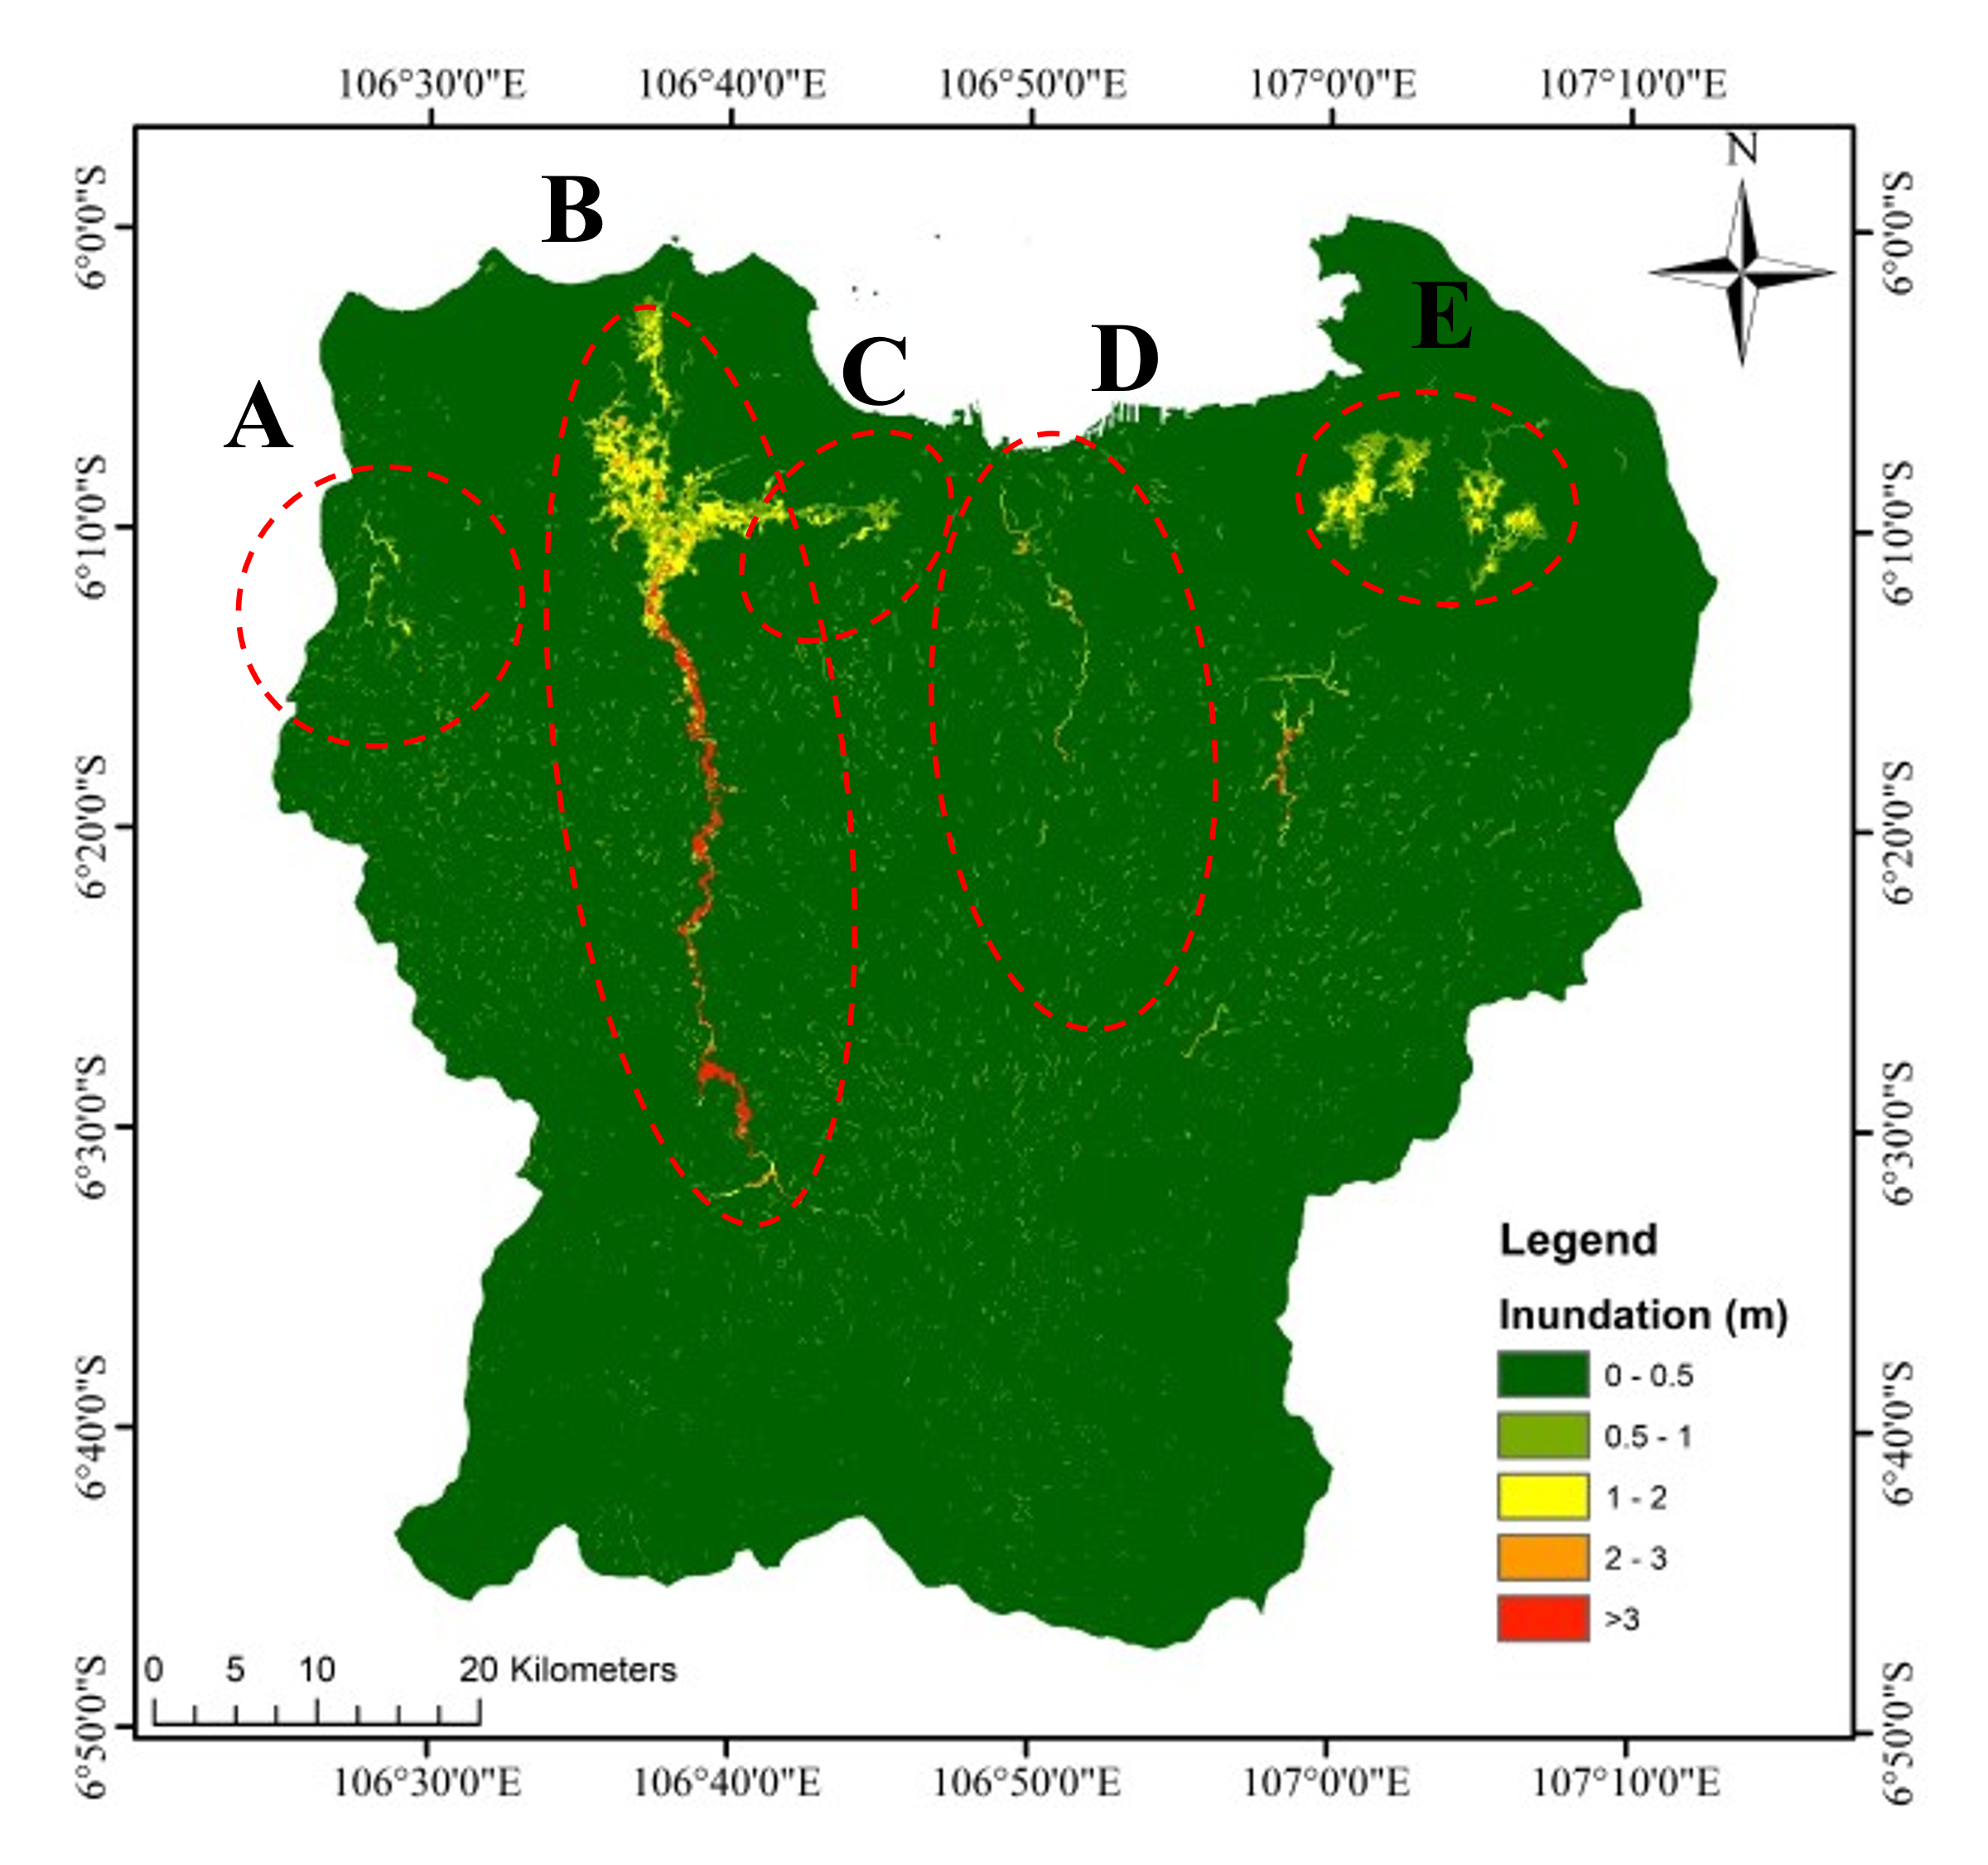
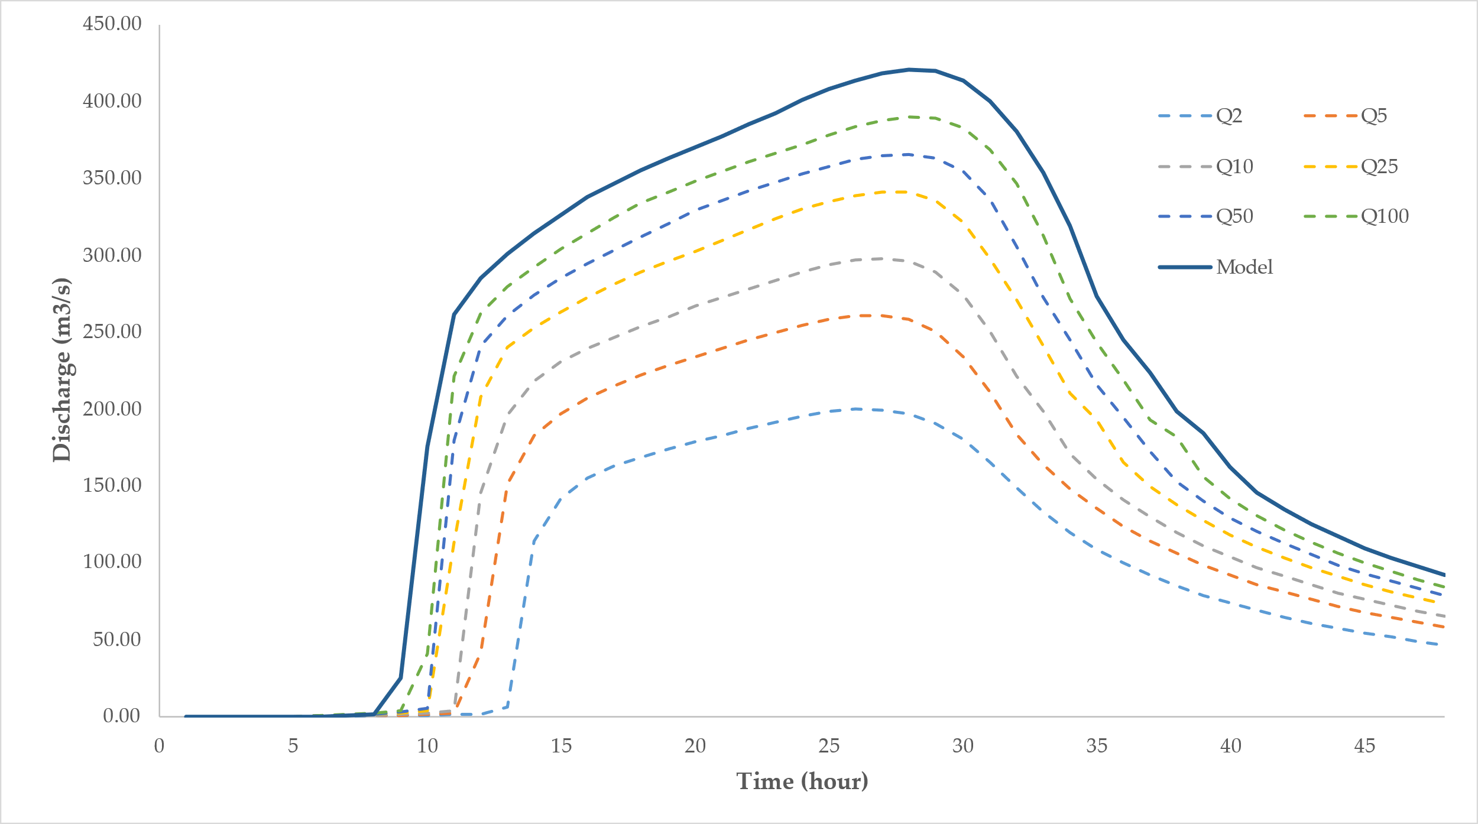
Figure 9 The comparison between : (a) 100 yearly flood and (b) Flood on January 1st, 2020
MODEL APPLICATION
Figure 10. Discharge on Water Gate Manggarai

Slide 16
SUMMARY AND CONCLUSION

Slide 17
This study attempts to do a rapid assessment of flood on January 1st, 2020, in Ja-karta and several areas of the Ciliwung-Cisadane Watershed. The study was conduct-ed to find out the return period of the flood that occurred. Rainfall-Runoff-Inundation (RRI) is a distributed model that is able to simulate rainfall-runoff and flooding simul-taneously. The model based on the inundation map from remote sensing satellite was calibrated with ground station rainfall. The resolution of Digital Elevation Model (DEM) that too high hindered the simulation process, it made the resolution of DEM should be decreased. The DEM is upscaled, then the grid size is changed from 30 m to 100 m. After the model has been calibrated, a return period flood model is performed with a return period rainfall input. There are six return periods of rainfall are being simulated, there are 2, 5, 10, 25, 50, and 100 years of the return period of rainfall.
The discharge and inundation area of all return periods is compared with the simulation of flood on January 1st. The comparison showed that the discharge extent on January 1 is exceeded the discharge with a return period of 100 years. This result corresponds with the rain recorded at several rainfall stations which surpassed the 100-year rainfall return period. Thus, there are several conclusions. First, the flood that occurred on January 1st, 2020, is superior than a 100-year return period of flood. Sec-ond, the rainfall, which is the biggest in the history, is the main effect of the flood of this flood because it exceeded the 100-year return period of rainfall.
In this study, the DEM implemented in this model has low resolution because the limitation of data sources. In addition, the model need to be compared with the existing discharge during the flood. This conditions need to be considered in future research.
SUMMARY AND CONCLUSION

Slide 18
REFFERENCE

Slide 19
Chow, V. Te; Maidment, D. R.; Mays, L. W. Applied Hydrology (Letters); 1988.
Penning-Rowsell, E. C.; Ward, R. Floods: A Geographical Perspective. Geogr. J. 1980. https://doi.org/10.2307/634110.
Webster, T. L.; Forbes, D. L.; Dickie, S.; Shreenan, R. Using Topographic Lidar to Map Flood Risk from Storm-Surge Events for Charlottetown, Prince Edward Island, Canada. Can. J. Remote Sens. 2004. https://doi.org/10.5589/m03-053.
Merz, B.; Hall, J.; Disse, M.; Schumann, A. Fluvial Flood Risk Management in a Changing World. Nat. Hazards Earth Syst. Sci. 2010. https://doi.org/10.5194/nhess-10-509-2010.
Zhou, Q.; Mikkelsen, P. S.; Halsnæs, K.; Arnbjerg-Nielsen, K. Framework for Economic Pluvial Flood Risk Assessment Considering Climate Change Effects and Adaptation Benefits. J. Hydrol. 2012. https://doi.org/10.1016/j.jhydrol.2011.11.031.
Ganguli, P.; Merz, B. Extreme Coastal Water Levels Exacerbate Fluvial Flood Hazards in Northwestern Europe. Sci. Rep. 2019. https://doi.org/10.1038/s41598-019-49822-6.
Ferreira, S.; Ghimire, R. Forest Cover, Socioeconomics, and Reported Flood Frequency in Developing Countries. Water Resour. Res. 2012. https://doi.org/10.1029/2011WR011701.
Li, F.; Wang, L.; Zhao, Y. Evolvement Rules of Basin Flood Risk under Low-Carbon Mode. Part I: Response of Soil Organic Carbon to Land Use Change and Its Influence on Land Use Planning in the Haihe Basin. Environ. Monit. Assess. 2017. https://doi.org/10.1007/s10661-017-6101-5.
Maes, J.; Molombe, J. M.; Mertens, K.; Parra, C.; Poesen, J.; Che, V. B.; Kervyn, M. Socio-Political Drivers and Consequences of Landslide and Flood Risk Zonation: A Case Study of Limbe City, Cameroon. Environ. Plan. C Polit. Sp. 2019. https://doi.org/10.1177/2399654418790767.
Mahmoud, S. H.; Gan, T. Y. Urbanization and Climate Change Implications in Flood Risk Management: Developing an Efficient Decision Support System for Flood Susceptibility Mapping. Sci. Total Environ. 2018. https://doi.org/10.1016/j.scitotenv.2018.04.282.
Blume, T.; Zehe, E.; Bronstert, A. Rainfall-Runoff Response, Event-Based Runoff Coefficients and Hydrograph Separation. Hydrol. Sci. J. 2007. https://doi.org/10.1623/hysj.52.5.843.
Baker, V. R.; Pickup, G. Flood Geomorphology of the Katherine Gorge, Northern Territory, Australia. Geol. Soc. Am. Bull. 1987. https://doi.org/10.1130/0016-7606(1987)98<635:FGOTKG>2.0.CO;2.
Baker, V. R.; Kochel, R. C.; Patton, P. C. Flood Geomorphology. Flood Geomorphol. 1988. https://doi.org/10.2307/215322.
Texier, P. Floods in Jakarta: When the Extreme Reveals Daily Structural Constraints and Mismanagement. Disaster Prev. Manag. An Int. J. 2008. https://doi.org/10.1108/09653560810887284.
Lee, M. H.; Bae, D. H. Climate Change Impact Assessment on Green and Blue Water over Asian Monsoon Region. Water Resour. Manag. 2015. https://doi.org/10.1007/s11269-015-0949-3.
REFERENCES

Slide 20
Baker, V. R. Stream-Channel Response to Floods, with Examples from Central Texas. Bull. Geol. Soc. Am. 1977. https://doi.org/10.1130/0016-7606(1977)88<1057:SRTFWE>2.0.CO;2.
Dasanto, B. D.; Pramudya, B.; Boer, R.; Suharnoto, Y. Effects of Forest Cover Change on Flood Characteristics in the Upper Citarum Watershed. J. Manaj. Hutan Trop. (Journal Trop. For. Manag. 2014. https://doi.org/10.7226/jtfm.20.3.141.
FARID, M.; MANO, A.; UDO, K. MODELING FLOOD RUNOFF RESPONSE TO LAND COVER CHANGE WITH RAINFALL SPATIAL DISTRIBUTION IN URBANIZED CATCHMENT. J. Japan Soc. Civ. Eng. Ser. B1 (Hydraulic Eng. 2011. https://doi.org/10.2208/jscejhe.67.i_19.
Rosso, R.; Rulli, M. C. An Integrated Simulation Method for Flash-Flood Risk Assessment: 2. Effects of Changes in Land-Use under a Historical Perspective. Hydrol. Earth Syst. Sci. 2002. https://doi.org/10.5194/hess-6-285-2002.
Lane, S. N.; Reid, S. C.; Tayefi, V.; Yu, D.; Hardy, R. J. Reconceptualising Coarse Sediment Delivery Problems in Rivers as Catchment-Scale and Diffuse. Geomorphology 2008. https://doi.org/10.1016/j.geomorph.2006.12.028.
Rizaldi, A.; Riyando Moe, I.; Farid, M.; Mulia Aribawa, T.; Bayuadji, G.; Sugiharto, T. Study of Flood Characteristic in Cikalumpang River by Using 2D Flood Model. MATEC Web Conf. 2019. https://doi.org/10.1051/matecconf/201927004010.
Zaghloul, M. S.; Ghaderpour, E.; Dastour, H.; Farjad, B.; Gupta, A.; Eum, H.; Achari, G.; Hassan, Q. K. (2022). Long Term Trend Analysis of River Flow and Climate in Northern Canada. Hydrology, 9(11), 197
Karim, M. F.; Mimura, N. Impacts of Climate Change and Sea-Level Rise on Cyclonic Storm Surge Floods in Bangladesh. Glob. Environ. Chang. 2008. https://doi.org/10.1016/j.gloenvcha.2008.05.002.
Hallegatte, S.; Ranger, N.; Mestre, O.; Dumas, P.; Corfee-Morlot, J.; Herweijer, C.; Wood, R. M. Assessing Climate Change Impacts, Sea Level Rise and Storm Surge Risk in Port Cities: A Case Study on Copenhagen. Clim. Change 2011. https://doi.org/10.1007/s10584-010-9978-3.
Darsan, J.; Asmath, H.; Jehu, A. Flood-Risk Mapping for Storm Surge and Tsunami at Cocos Bay (Manzanilla), Trinidad. J. Coast. Conserv. 2013. https://doi.org/10.1007/s11852-013-0276-x.
Buchanan, M. K.; Kopp, R. E.; Oppenheimer, M.; Tebaldi, C. Allowances for Evolving Coastal Flood Risk under Uncertain Local Sea-Level Rise. Clim. Change 2016. https://doi.org/10.1007/s10584-016-1664-7.
Du, J.; Qian, L.; Rui, H.; Zuo, T.; Zheng, D.; Xu, Y.; Xu, C. Y. Assessing the Effects of Urbanization on Annual Runoff and Flood Events Using an Integrated Hydrological Modeling System for Qinhuai River Basin, China. J. Hydrol. 2012. https://doi.org/10.1016/j.jhydrol.2012.06.057.
Aich, V.; Liersch, S.; Vetter, T.; Fournet, S.; Andersson, J. C. M.; Calmanti, S.; van Weert, F. H. A.; Hattermann, F. F.; Paton, E. N. Flood Projections within the Niger River Basin under Future Land Use and Climate Change. Sci. Total Environ. 2016. https://doi.org/10.1016/j.scitotenv.2016.04.021.
BNPB Editorial. Hujan Ekstrem Penyebab Banjir Jakarta https://bnpb.go.id/berita/hujan-ekstrem-penyebab-banjir-jakarta (accessed May 16, 2020).
Biro Komunikasi Publik Kementrian PUPR. Menteri Basuki Siapkan Langkah Penanganan Banjir di Jakarta dan Sekitarnya https://pu.go.id/berita/view/17794/menteri-basuki-siapkan-langkah-penanganan-banjir-di-jakarta-dan-sekitarnya (accessed May 16, 2020).
Caljouw, M.; Pratiwo, M.; Nas, P. J. M. Flooding in Jakarta : Towards a Blue City with Improved Water Management. Bijdr. tot taal-, land- en Volkenkd. / J. Humanit. Soc. Sci. Southeast Asia 2009. https://doi.org/10.1163/22134379-90003704.
REFERENCES

Slide 21
Kurniawan, B. E.; Corps, M. ADAPTING CITIES TO CLIMATE VARIABILITY AND CHANGE: BALANCE BETWEEN COMMUNITY ENGAGEMENT AND SUPPORTING FACILITATION ROLES OF THE LOCAL GOVERNMENT TO REDUCE THE IMPACT OF CLIMATE CHANGE. In HUMAN (E) SETTLEMENTS: THE URBAN CHALLENGE CONFERENCE; p 194.
Octavianti, T.; Charles, K. The Evolution of Jakarta’s Flood Policy over the Past 400 Years: The Lock-in of Infrastructural Solutions. Environ. Plan. C Polit. Sp. 2019. https://doi.org/10.1177/2399654418813578.
Miceli, R.; Sotgiu, I.; Settanni, M. Disaster Preparedness and Perception of Flood Risk: A Study in an Alpine Valley in Italy. J. Environ. Psychol. 2008. https://doi.org/10.1016/j.jenvp.2007.10.006.
Petry, B. Keynote Lecture: Coping with Floods: Complementarity of Structural and Non-Structural Measures. Flood Def. 2002, 60–70.
Hadihardaja, I. K.; Kuntoro, A. A.; Farid, M. Flood Resilience for Risk Management : Case Study of River Basin in Indonesia. Glob. Asp. 2013, 3 (4), 16–19.
Budiyono, Y.; Aerts, J. C. J. H.; Tollenaar, D.; Ward, P. J. River Flood Risk in Jakarta under Scenarios of Future Change. Nat. Hazards Earth Syst. Sci. 2016. https://doi.org/10.5194/nhess-16-757-2016.
Mishra, B. K.; Rafiei Emam, A.; Masago, Y.; Kumar, P.; Regmi, R. K.; Fukushi, K. Assessment of Future Flood Inundations under Climate and Land Use Change Scenarios in the Ciliwung River Basin, Jakarta. J. Flood Risk Manag. 2018. https://doi.org/10.1111/jfr3.12311.
MOE, I. R.; KURE, S.; JANURIYADI, N. F.; FARID, M.; UDO, K.; KAZAMA, S.; KOSHIMURA, S. EFFECT OF LAND SUBSIDENCE ON FLOOD INUNDATION IN JAKARTA, INDONESIA. J. Japan Soc. Civ. Eng. Ser. G (Environmental Res. 2016. https://doi.org/10.2208/jscejer.72.i_283.
Moe, I. R.; Kure, S.; Januriyadi, N. F.; Farid, M.; Udo, K.; Kazama, S.; Koshimura, S. Future Projection of Flood Inundation Considering Land-Use Changes and Land Subsidence in Jakarta, Indonesia. Hydrol. Res. Lett. 2017. https://doi.org/10.3178/hrl.11.99.
Emam, A. R.; Mishra, B. K.; Kumar, P.; Masago, Y.; Fukushi, K. Impact Assessment of Climate and Land-Use Changes on Flooding Behavior in the Upper Ciliwung River, Jakarta, Indonesia. Water (Switzerland) 2016. https://doi.org/10.3390/w8120559.
Januriyadi, N. F.; Kazama, S.; Moe, I. R.; Kure, S. Evaluation of Future Flood Risk in Asian Megacities: A Case Study of Jakarta. Hydrol. Res. Lett. 2018. https://doi.org/10.3178/hrl.12.14.
Moe, I. R.; Rizaldi, A.; Farid, M.; Moerwanto, A. S.; Kuntoro, A. A. The Use of Rapid Assessment for Flood Hazard Map Development in Upper Citarum River Basin. In MATEC Web of Conferences; 2018; Vol. 229. https://doi.org/10.1051/matecconf/201822904011.
Bronowicka-Mielniczuk, U.; Mielniczuk, J.; Obroślak, R.; Przystupa, W. A Comparison of Some Interpolation Techniques for Determining Spatial Distribution of Nitrogen Compounds in Groundwater. Int. J. Environ. Res. 2019. https://doi.org/10.1007/s41742-019-00208-6.
Liu, J.; Doan, C. D.; Liong, S. Y.; Sanders, R.; Dao, A. T.; Fewtrell, T. Regional Frequency Analysis of Extreme Rainfall Events in Jakarta. Nat. Hazards 2015. https://doi.org/10.1007/s11069-014-1363-5.
Jarvis, A.; Rubiano, J.; Nelson, A.; Farrow, A.; Mulligan, M. Practical Use of SRTM Data in the Tropics – Comparisons with Digital Elevation Models Generated from Cartographic Data. Trop. Agric. 2004.
REFERENCES

Slide 22
Zhang, H.; Li, Z.; Saifullah, M.; Li, Q.; Li, X. Impact of DEM Resolution and Spatial Scale: Analysis of Influence Factors and Parameters on Physically Based Distributed Model. Adv. Meteorol. 2016. https://doi.org/10.1155/2016/8582041.
Sayama, T.; Ozawa, G.; Kawakami, T.; Nabesaka, S.; Fukami, K. Rainfall–Runoff–Inundation Analysis of the 2010 Pakistan Flood in the Kabul River Basin. Hydrol. Sci. J. 2012. https://doi.org/10.1080/02626667.2011.644245.
Chini, M.; Pelich, R.; Pulvirenti, L.; Pierdicca, N.; Hostache, R.; Matgen, P. Sentinel-1 InSAR Coherence to Detect Floodwater in Urban Areas: Houston and Hurricane Harvey as a Test Case. Remote Sens. 2019. https://doi.org/10.3390/rs11020107.
Ogden, F. L.; Sharif, H. O.; Senarath, S. U. S.; Smith, J. A.; Baeck, M. L.; Richardson, J. R. Hydrologic Analysis of the Fort Collins, Colorado, Flash Flood of 1997. J. Hydrol. 2000. https://doi.org/10.1016/S0022-1694(00)00146-3.
Arnaud, P.; Bouvier, C.; Cisneros, L.; Dominguez, R. Influence of Rainfall Spatial Variability on Flood Prediction. J. Hydrol. 2002. https://doi.org/10.1016/S0022-1694(01)00611-4.
REFERENCES

