Slide 1
Variances in the Expression of mRNAs Related to the Histaminergic System in Endometrioid Endometrial Cancer
Michał Czerwiński ^{1*}, Emilia Morawiec ², Dariusz Boroń ¹, Marcin Opławski ³, Beniamin Oskar Grabarek ^{2, 4*}

Slide 2
Introduction
Endometrioid endometrial cancer (EC) is one of the most common malignant tumors in women in developed countries
Type I—endometrial adenocarcinoma (80–90% of all diagnosed cases)
Type II—non-endometrial adenocarcinoma, which includes serous carcinoma, clear-0 cell carcinoma, non-differentiated tumors, as well as malignant mixed Mullerian tumors
Research has indicated higher concentrations of histamine and polyamine in endometrioid tissue in comparison with healthy tissue

Slide 3
Objective
The aim of this study was to evaluate changes in the expression pattern of genes related to the histaminergic system in endometrial samples and whole blood.

Slide 4
Patients
All patients enrolled in the study were qualified for hysterectomy. The control group consisted of 45 patients without cancer who underwent surgery for uterine prolapse. A total of 45 patients diagnosed with endometrioid endometrial cancer (EEC) constituted the study group. The collected cancer tissue samples were divided into three subgroups (grades) based on histopathological evaluation: G1, 15 samples; G2, 15 samples; G3, 15 samples. The exclusion criteria included the diagnosis of cancer different than EEC, the coexistence of another cancer, endometriosis, the use of hormone therapy 24 months prior to surgery.

Slide 5
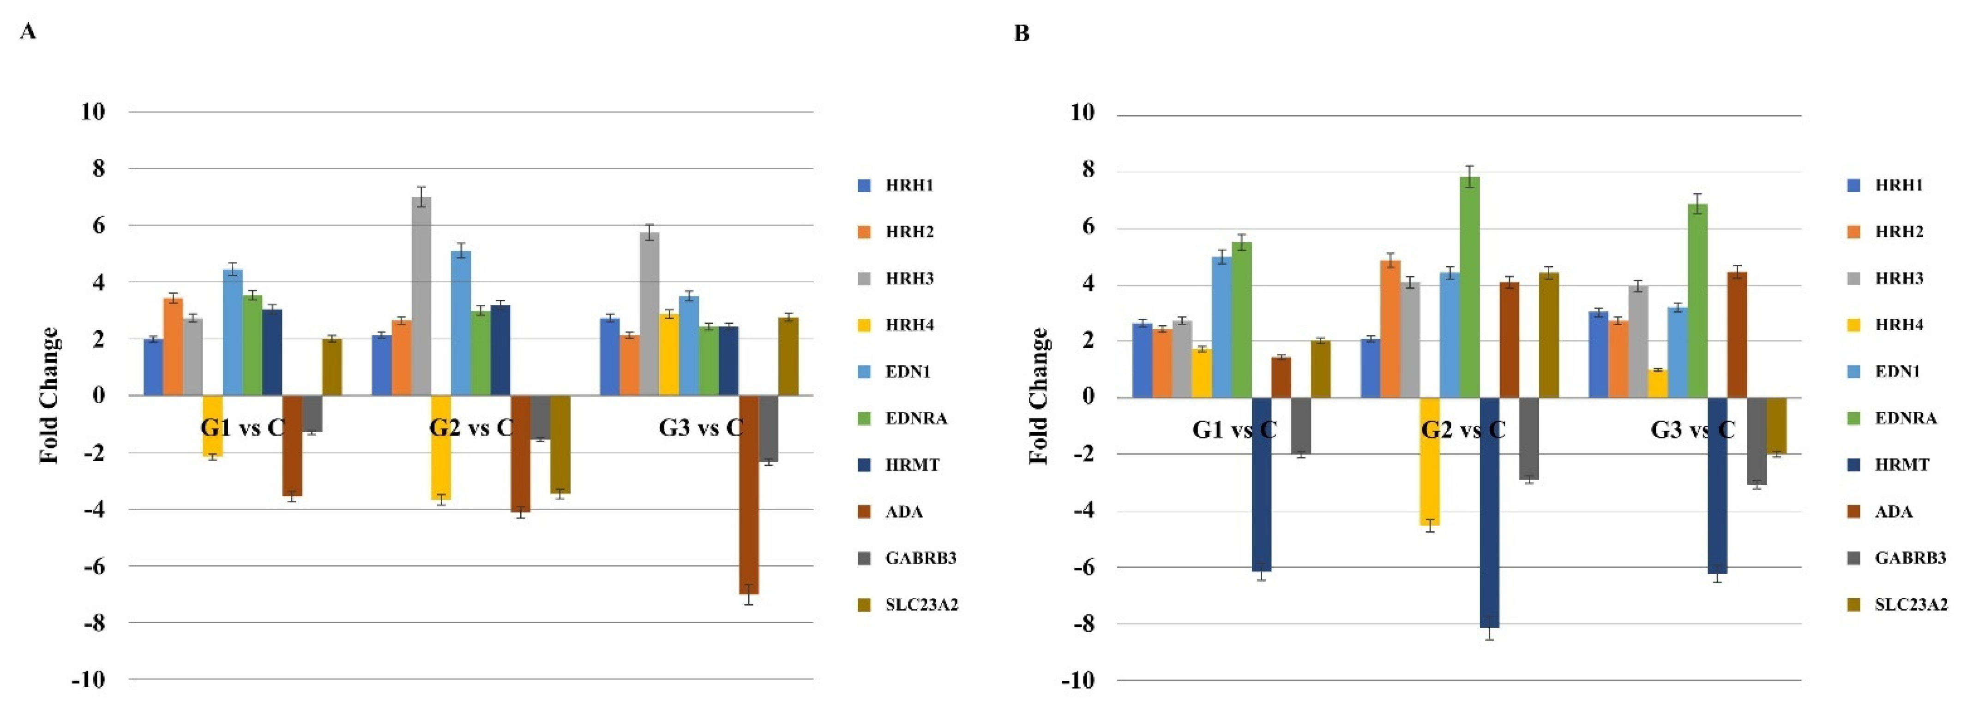
Results
Changes in the expression pattern of genes related to the histaminergic system in endometrial cancer samples (A) and whole blood (B) in comparison to the control obtained via RTqPCR (p < 0.05). (+)—overexpression in comparison to the control; (-)—downregulated in comparison to the control; G—grading; C—control; HNMT—histamine N-methyltransferase; HRH1-3—histamine receptor 1-3; GABRB3—gamma-aminobutyric acid (GABA) A receptor, alpha 3; EDN1—endothelin 1; EDNRA—endothelin receptor type A; SLC223A2—solute carrier family 22 member 3.

Slide 6
Conclusion
Out of 65 mRNAs connected with the histaminergic system, 10 differentiate the samples of tissue and blood obtained from patients with endometrioid endometrial cancer in comparison with the control group (p < 0.05).
mRNA histamine receptor 1,3 (HRH1, HRH3), and solute carrier family 22 member 3 (SLC23A2) differentiating samples of endometrioid endometrial cancer independent of either G or control.
The selected mRNA transcripts seem to be promising for molecularly targeted therapies in the context of endometrioid endometrial cancer.

