Slide 1
In vitro and in vivo effects of conventional and chitosan nanoparticles encapsulated miltefosine drug for treatment of cutaneous leishmaniasis ¹Institute of Pathology and Diagnostic Medicine, Khyber Medical University Khyber Pakhtunkhwa, Peshawar, Pakistan ²University of Agriculture, Khyber Pakhtunkhwa, Dera Ismail Khan, Pakistan Prepared for the 2nd international electronic conference on biomedicine March 2023
Rahat Ullah Khan¹, Momin Khan¹, Qudrat Ullah², Muhammad Zahoor Khan² and Aamir Sohail¹

Slide 2
About me..
Rahat Ullah Khan from Pakistan
PhD Student Microbiology
Khyber Medical University, Peshawar, Pakistan
Advisor Dr. Momin Khan
Research: In Vitro and In Vivo efficacy of polymer coated antileishmanial drugs for the treatment of cutaneous leishmaniasis in Pakistan
Representative Publications:
1.Khan, R.U., Khan, M., Sohail, A., Ullah, R., Iqbal, A., Ahmad, B., Khan, I.U., Tariq, A., Ahmad, M., Said, A. and Ullah, S., 2022. RESEARCH ARTICLE Efficacy of pentamidine-loaded chitosan nanoparticles as a novel drug delivery system for Leishmania tropica. Tropical Biomedicine, 39(4), pp.1-7.1.
2. Khokhar M, Shereen MA, Khan M, Khan RU, Sohail A, Khan IU, Khan IU, Khattak S. In vitro efficacy of polymer coated miltefosine drug against leishmania tropica. Journal of Parasitic Diseases. 2021 Sep 23:13.
3. Sohail A, Khan RU, Khan M, Khokhar M, Ullah S, Ali A, Bilal H, Khattak S, Khan M, Ahmad B. Comparative efficacy of amphotericin B-loaded chitosan nanoparticles and free amphotericin B drug against Leishmania tropica. Bulletin of the National Research Centre. 2021 Dec; 45(1):1-9

Slide 3
Abstract
This study aimed to formulate polymer-based chitosan nanoparticles as a drug (miltefosine) delivery system for treating leishmaniasis. Miltefosine-loaded chitosan nanoparticles (MLCNPs) have been synthesized and then characterized by the use of UV-Visible spectroscopy, Scanning electron Microscopy (SEM), Transmission electron microscopy (TEM), zeta potential, drug loading content (DLC), encapsulation efficacy (EE) and dynamic light scattering technique (DLS). Further, the in vitro anti-leishmanial activity of the characterized chitosan nanoparticles was assessed by Microculture Tetrazolium (MTT) assay, and in vivo efficacy was evaluated in infected BALB/c mice. The lesion healing was statistically analyzed using Wilcoxon signed-rank and Mann–Whitney tests. The MLCNPs were spherical shaped (97.5 nm), which presented efficient encapsulation (97.56%), drug loading content (91.5 µg/mL), and positive surface charge (+1.04 mV). MLCNPs were less hemolytic (6%) when compared to conventional miltefosine. MLCNPs (50 µg/ml) showed potential antileishmanial effect (mean viability; 10±0.3%) on promastigotes in comparison to conventional miltefosine (mean viability; 18±1.3%). The IC50 value for MLCNPs and miltefosine was 0.0218 µg/mL and 0.3548 µg/mL, respectively. In vivo study proved that lesions of mice treated with oral and intralesional-injected MLCNPs heal significantly (P = 0.01). MLCNPs have a significant antileishmanial effect and could be utilized as an alternative treatment for CL.

Slide 4
INTRODUCTION:
Leishmaniasis: Vector borne parasitic disease
Transmission and Morphology: Tsetse fly, promastigote and amastigote forms
Clinical Forms: Cutaneous leishmaniasis, Mucocutaneoues leishmaniasis and Visceral leishmaniasis
Scenario in Pakistan:
Most prevalent type: Cutaneous leishmaniasis
Many outbreaks in KPK: Distract Karak, South Waziristan, DI Khan and Bajour epidemics in 2022
Treatment options for CL in Pakistan: Pentavalent antimonials
Problem: Not available in the country in most of the cases
Notes:
KPK; Khyber Pakhtunkhwa

Slide 5
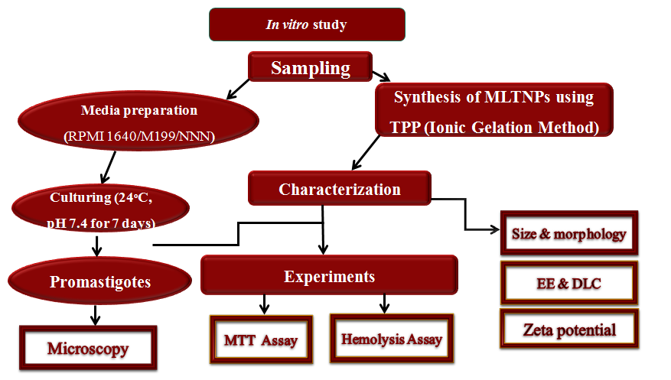
Methods and Materials:
Flow diagram of In vitro experimental study

Slide 6
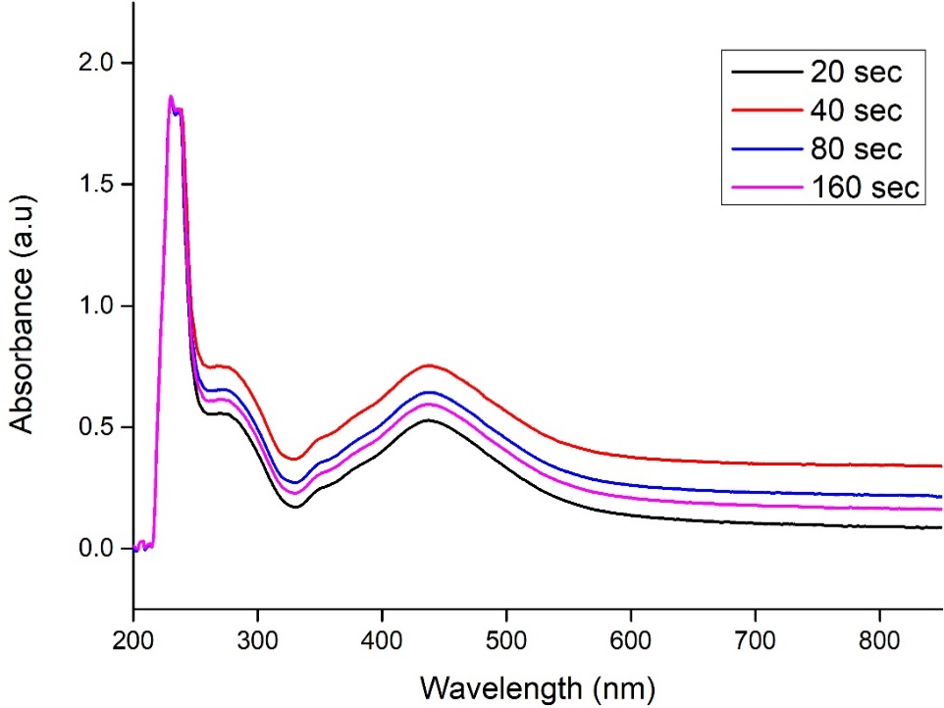
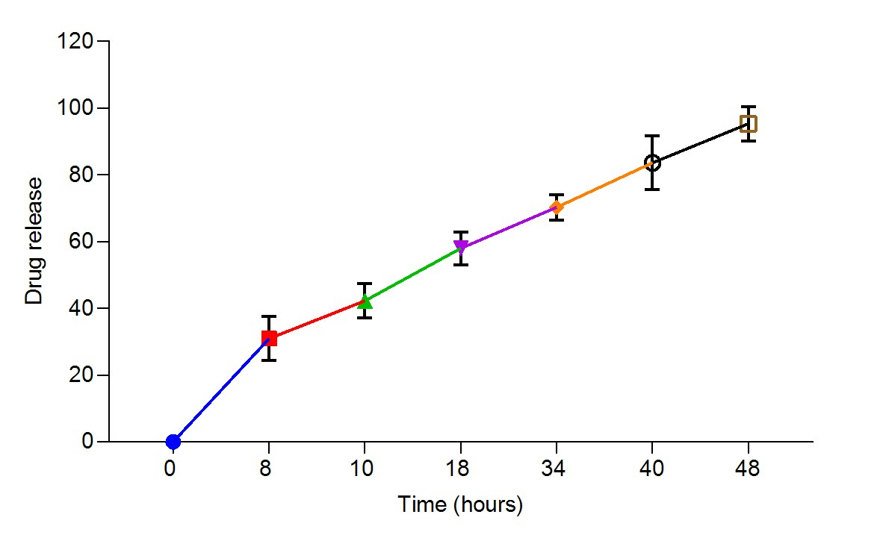
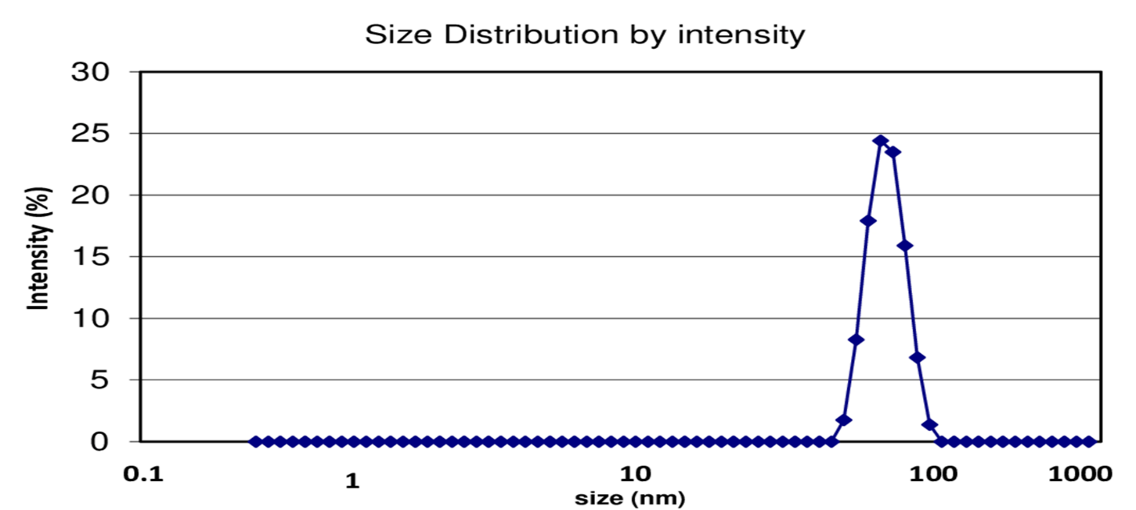
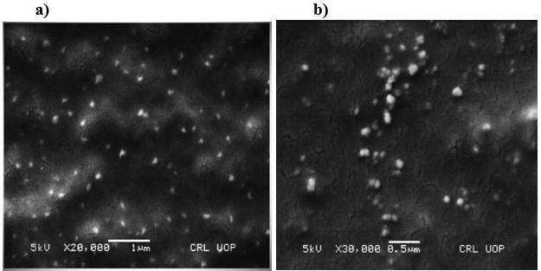
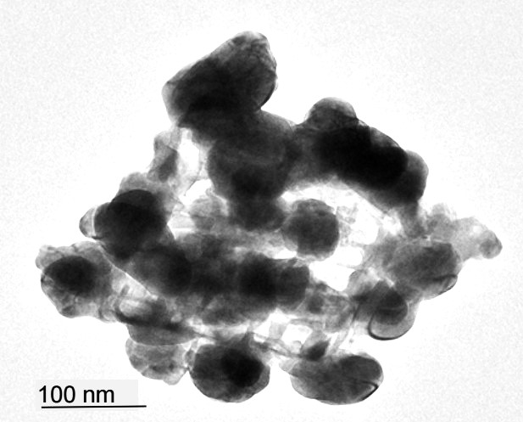
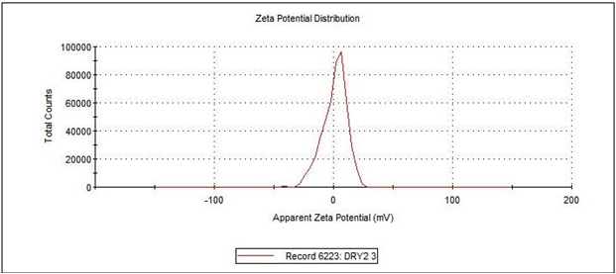
Results And Discussion:
Characterization of NPs:
Notes:
The MLCNPs were characterized by using UV-Visible spectrophotometer, SEM, TEM, Drug release assay and Zeta potential

Slide 7
The synthesis of chitosan nanoparticles was confirmed through UV-Visible spectroscopy. The reported UV-Visible spectrum showed an absorption peak at 434 nm The SEM analysis revealed that MLCNPs displayed a spherical shape and irregular surface morphology while DLS showed a mean particle size was 97.5 nm. From the TEM micrograph of the nanoparticles It is clear that MLCNPs are spherical with a smooth surface. Zeta potential was used to characterize the surface charge of the MLCNPs. The synthesized particles possessed a substantial zeta potential of +1.04 mV . The percentage of drug-loaded chitosan was DLC of 91.5 µg/ mL, and the encapsulation efficiency was 97.56%.

Slide 8
In Vitro Study:
Concentrations | 24 h |  | 48 h |  | 72 h
 | MLCNPs | Con MFS | MLCNPs | Con MFS | MLCNPs | Con MFS
50 µg/mL | 16 ± 4.2 | 28 ± 1.1 | 14 ± 0.7 | 21 ± 0.7 | 10 ± 0.3 | 18 ± 1.3
40 µg/mL | 17 ± 2.5 | 30 ± 2.05 | 16 ± 0.3 | 25 ± 1.8 | 12 ± 0.8 | 20 ± 2.0
30 µg/mL | 20.5 ± 4.5 | 33 ± 3.08 | 18 ± 1.1 | 30 ± 0.9 | 15 ± 1.8 | 25 ± 1.5
20 µg/mL | 24 ± 4.1 | 44 ± 1.8 | 21 ± 1.5 | 40 ± 1.5 | 23 ± 2.5 | 30 ± 0.5
10 µg/mL | 31.5 ± 3.4 | 52 ± 1.6 | 26 ± 1.6 | 45 ± 1.4 | 25 ± 2.1 | 41 ± 1.3
The cytotoxicity of conventional miltefosine and MLCNPs was assessed at six different concentrations (50, 40, 30, 20, 10, 5 µg/mL) for 24, 48, and 72 h. The mean viability percentage of promastigotes exposed to different MLCNPs and conventional miltefosine concentrations is illustrated in the table.

Slide 9
Hemolysis assay:
Solutions | Concentrations | OD at 570 nm (Mean ±SD) | Hemolysis (%)
MLCNPs | 150 µg/mL | 0.032 ±0.0025 | 1.60%
 | 200 µg/mL | 0.043 ±0.0015 | 2.45%
 | 250 µg/mL | 0.051 ±0.0010 | 3.20%
Con MFS | 150 µg/mL | 0.062 ±0.0020 | 5.96%
 | 200 µg/mL | 0.075 ±0.0015 | 6.92%
 | 250 µg/mL | 0.082 ±0.0030 | 7.40%
PBS | - | 0.003 ±0.0005 | 0%
Triton 100X | - | 1.223 ±0.0251 | 100%
The hemolysis activity of MLCNPs and conventional miltefosine were compared. The result showed that MLCNPs have 6% less hemolytic activity than conventional miltefosine. The OD values and hemolysis (%) are presented.

Slide 10
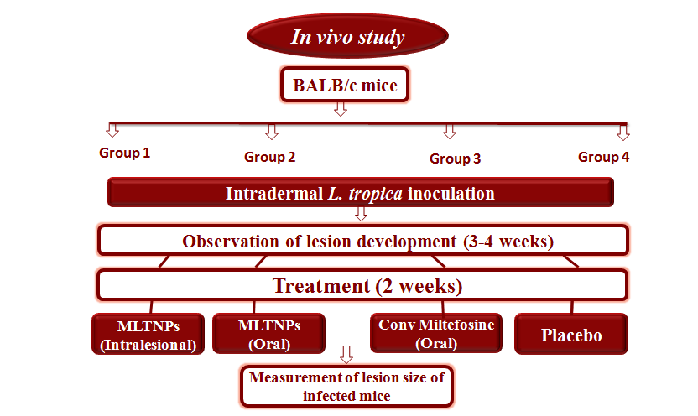
In Vivo Study: Flow chart of in vivo experiments

Slide 11
Topical treatment of mice with MLCNPs:
After lesions development the mice were treated with both forms of miltefosine drug
We found significant lesions reduction in MLTCNPs treated mice group as compared to conventional miltefosine drug using different statistical tests.

Slide 12
Conclusion:
The current study describes a potential novel therapy for curing CL caused by L. tropica in the form of MLCNPs
The chitosan nanoparticles encapsulate the miltefosine efficiently.
The overall results revealed that MLCNPs have higher efficacy than conventional miltefosine, which is proved both in vitro and in vivo
Regarding the route of administration, the efficacy of MLCNPs given orally was more significant than intralesional injection
Moreover, the hemolysis assay showed significantly less hemolysis activity of MLCNPs than conventional miltefosine

Slide 13
Thank You FOR YOUR ATTENTION & PATIENCE

