Slide 1
Imaging pitfalls and diagnostic inhibitions in various head and neck imaging modalities – Diagnostician’s perspective
Dr. Durgadevi B
Senior Lecturer, Department of Oral Medicine and Radiology,
Indira Gandhi Institute of Dental Sciences,
Sri Balaji Vidyapeeth (Deemed to be) University
Pondicherry

Slide 2
WHY THIS?
In the various imaging modalities of head and neck, we can divide them into –those indicated for
i) Odontogenic pathology / hard tissue imaging (predominantly Cone Beam Computed Tomography) and
ii) Non – odontogenic: Trauma and malignancy (Computed Tomography, Magnetic Resonance Imaging and Contrast imaging, PET scans).
There have been innumerable amount of research and reviews on advantages of imaging modalities in head and neck region. This review is intended to explore the other side – few disadvantages and diagnostic inhibitions, with an attempt to bring up solutions, rectifications for significant increase in quality of imaging.

Slide 3
CONE BEAM COMPUTED TOMOGRAPHY (CBCT)
CBCT is used in case of effective imaging and treatment planning for dental implants, maxillofacial trauma and assessment of odontogenic pathologies.
Random artifacts greatly decreases the diagnostic ability.
Types of CT artifacts :
Noise,
Beam hardening,
Scatter,
Pseudoenhancement,
Motion, cone beam, helical, ring, and metal artifacts.
Manufacturers minimize beam hardening by using filtration, calibration correction, and beam hardening correction software.

Slide 4
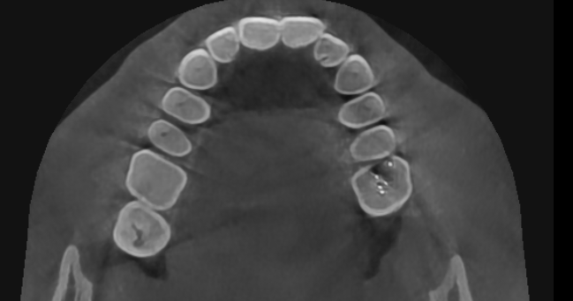
IMAGING PITFALL – CASE SCENARIO
Case of chronic sinusitis
Root canal treated teeth irt 26
Beam hardening streaking artefacts (black lines) present in the volume

Slide 5
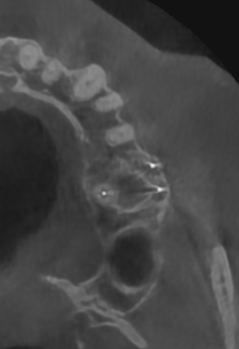
On assessing the axial section at the root end- maxillary sinus floor interface, the streaking artefact had mimicked destruction of sinus floor and communication between sinus and periapical pathology
The artifacts in CBCT are similar to CT but they are more pronounced in CBCT due to the fact that heterochromatic X-ray beam present in CBCT and lower mean kilovolt (peak) energy compared with conventional CT.

Slide 6
Diagnostic inhibitions
CBCT also doesn’t give us a differential density value for soft tissues and fluid. The Hounsfield unit and CBCT gray values are highly correlating.
Identifying radicular cysts or apical granulomas using CBCT was attempted in recent studies.
There was no relationship between the histopathological diagnosis of lesions and CBCT gray scale values.
Etöz M, Amuk M, Avci F, Yabaci A. Investigation of the effectiveness of CBCT and gray scale values in the differential diagnosis of apical cysts and granulomas. Oral Radiol. 2021 Jan;37(1):109-117. doi: 10.1007/s11282-020-00459-6. Epub 2020 Jul 1. PMID: 32613300.

Slide 7
Diagnostic inhibitions
A clinical provisional diagnosis of radicular cyst. Aspiration of the lesion revealed a straw coloured fluid.
On CBCT, the pathology in the anterior mandible was evident with buccal cortical bone destruction and internal structure revealed thin septae not extending throughout the lesion.
This posed a diagnostic dilemma of tumour or a cystic lesion. The gray scale value did not give an insight of internal structure. The histopathological diagnosis was plexiform ameloblastoma, an odontogenic tumor with centric cystic degeneration.

Slide 8
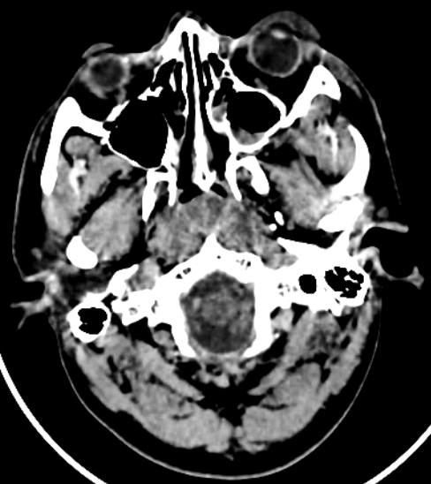
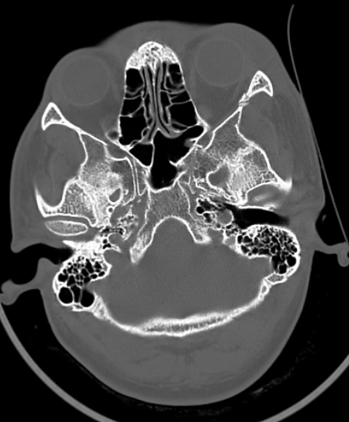
Computed Tomography (CT)
A case of zygomatic complex fracture, orbital involvement revealed linear minimally displaced fracture noted involving the left zygomatic arch, lateral wall of left orbit. Comminuted displaced fracture involving the lateral wall of left maxillary sinus with fracture fragments lying inside associated with hemosinus.
Soft tissue window failed to reveal further details in regard to pterygoid muscles and orbital volume. Other than the displacement and type of fractures, the extent of orbital involvement will also determine surgical treatment in this case.

Slide 9
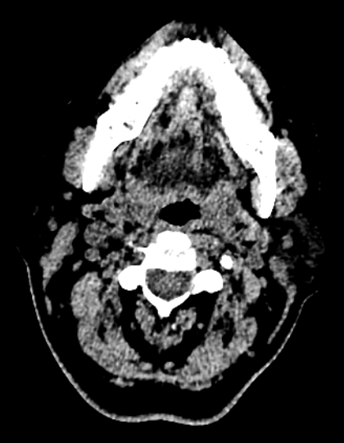
CT artefacts hindering the diagnostic quality
Photon starvation or quantum mottle has greatly hindered the diagnostic quality of the image. This results from insufficient X-ray photons reaching the sensor from the patients.
Eventhough techniques such as Tube current modulation (TCM), vendor specific and iterative reconstruction algorithms can reduce this effect, this type of artefacts still pose considerable hindrance in diagnosis and assessment.

Slide 10
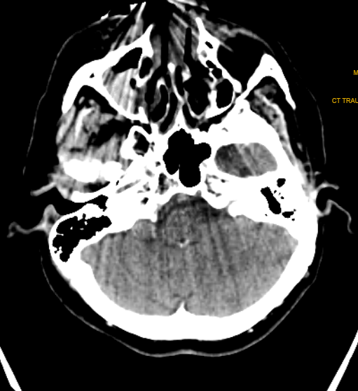
Streak and windmill artefacts greatly affect the scan images in CT. Windmill artefacts occur due to under sampling along the Z axis, which usually occurs in the clavicle region and base of the skull region where drastic anatomical changes and differential Hounsfield Unit is present.
Black streak artefact of beam hardening effect greatly disrupting the diagnostic quality
Can be confused with metal artefact.

Slide 11
Magnetic Resonance Imaging (MRI)
Most common artefact present in MRI is motion blurriness (due to long scan time) and metal artifacts.
Motion blurriness happens due to patient motion, swallowing, even breathing in case of head and neck region.
A pediatric MRI image which has severe motion blurness and distorton of image is presented in sagittal section.

Slide 12
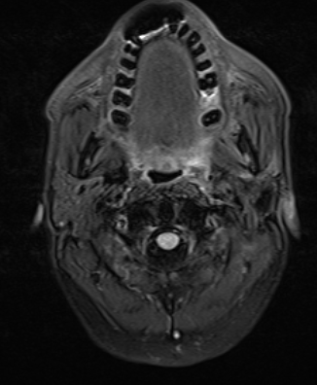
Metal artifacts manifests in multiple forms - a complete signal loss may be observed around the metallic object; a rim of high signal intensity may be present around the metallic devices. Metal induced artifacts are still a challenging aspect of imaging.
The porcelain fused to metal placed in the mandibular anterior teeth have greatly caused a no signal artefact, present anterior and extending to the level of maxillary teeth. This particularly is an inconvenient problem since the MR imaging was done to check any malignant spread in a recurring cancer patient. Although different technical alteration gave us a clue of the region in one plane, it was not sufficient.

Slide 13
Positron emission Tomography (PET)
PET-CT is used to identify, locate and assess the anatomy and function of hypermetabolitic tissue. It uses 18-FDG (fluorodeoxyglucose) as medium. The signals are then read on the system.
The specificity of PET-CT for identifying inspection-occult oropharyngeal SCC has been measured as being over 90%.
It is widely used as a recall – review imaging modality for post-treatment follow up cases. The false positive of PET-CT poses a major diagnostic inhibition and a major pitfall. This is the reason why PET-CT has been avoided for post radiation and therapy patients for at least upto 8-12 weeks (to avoid post inflammatory effects)

Slide 14
A 58 year old male patient who was previously diagnosed and treated for salivary gland ductal carcinoma by surgery and radiotherapy one year before. In the review CT, brain metastasis was evident. A PET-CT was advised immediately and PET-CT revealed lung nodules metastasis also.
In addition to the signals in the metastatic nodules, a well defined positive signal was evident in the submental region (figure 8). On clinical correlation there was no evidence of sign of metastasis in submental region. This might be confused with a metastatic involvement, thus a pitfall.

Slide 15
This briefly compiles the artifacts and diagnostic inhibitions/restrictions in head and neck imaging.
Few softwares have been developed to reduce metal induced artifacts but their usage is limited and not accessible.
Metal artifact reduction software (MARs) have been tested in phantom with dental implants using mono energy (MonoE) CT images and found that combination of MonoE and MARs reconstruction was the best method for reducing metal artifacts. This study had some major limitations.

Slide 16
Conclusion – Take away !
The advanced imaging in head and neck region has greatly lifted the quality and efficiency of diagnosis and treatment planning of pathologies. As new techniques and software are being introduced, their availability and accessibility is considerably less. Even after advancement in imaging, the modalities have their pitfalls and diagnostic inhibitions. This paper attempts at addressing those from the maxillofacial physician and radiodiagnosis point of view, which can be used by the physicists for development of more accessible softwares and technical alterations to reduce them.

Slide 17
Thank you !

