Slide 1
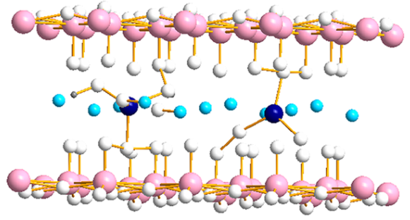
Introduction
The rechargeable aqueous zinc ion batteries hold great promise but are extremely limited by the lack of suitable cathodes.
The structural instability and sluggish ion diffusion kinetics of
NH4V4O10 need to be solved.
The phosphate groups at interlayers of host materials and oxygen defects introduced by phosphate process is an effective modification strategy.

Slide 2
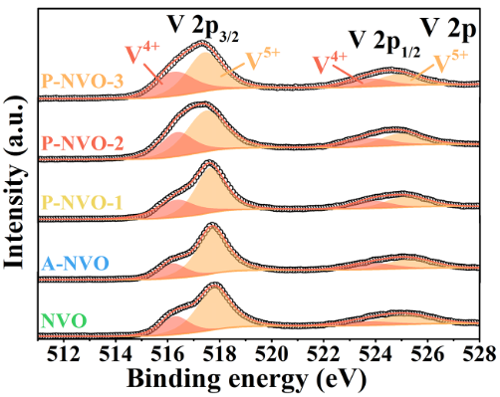
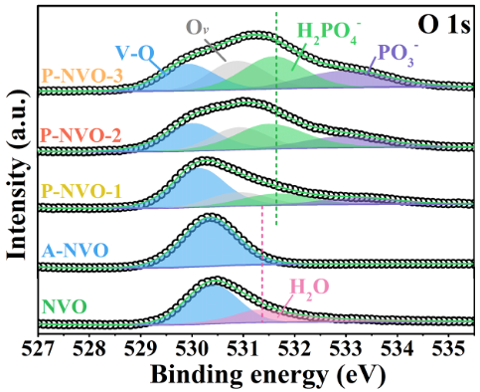
Experiment and Materials
Scheme 1. Schematic diagram of preparation of NH4V4O10 (NVO) and phosphate to P-NVO-2.
Fig 1. V 2p and O 1s spectra of P-NVO, A-NVO and NVO.

Slide 3
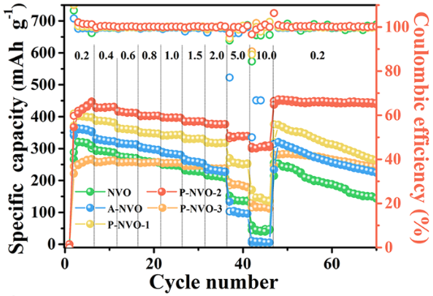
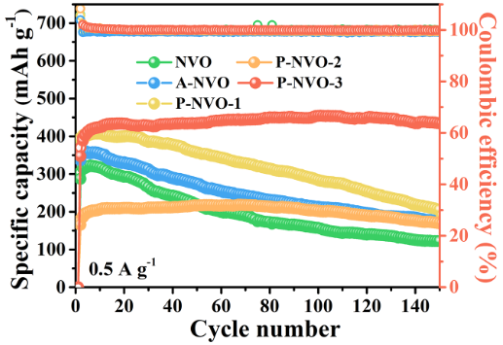
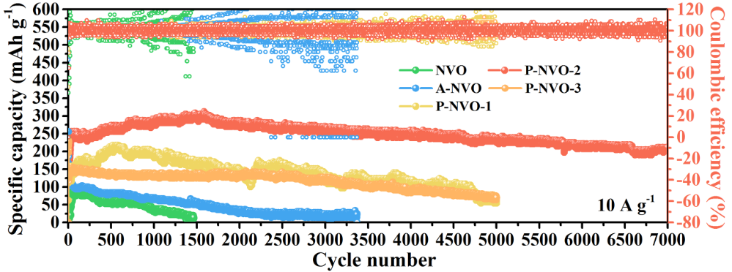
Experiment and Materials
Fig 2. Electrochemical properties of P-NVO, A-NVO and NVO. (a) Rate performance of P-NVO, A-NVO and NVO.(b) Cyclability of P-NVO, A-NVO and NVO at 0.5 A g⁻¹. (c) Cyclability of P-NVO, A-NVO and NVO at 10 A g⁻¹.

Slide 4
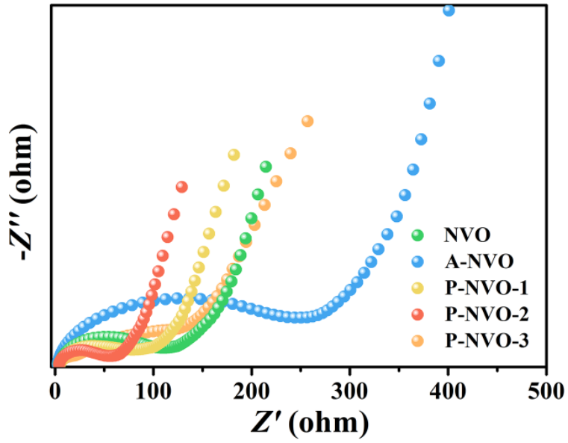
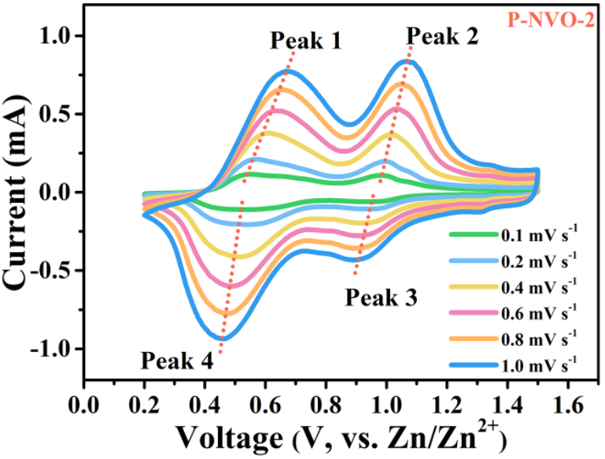
Electrochemical properties
Fig 3. EIS patterns of all samples (a), CV profiles of P-NVO-2 at different scan rates (b), the contribution ratio of capacitive capacities in P-NVO-2 (c), and the GITT profiles (d).

Slide 5
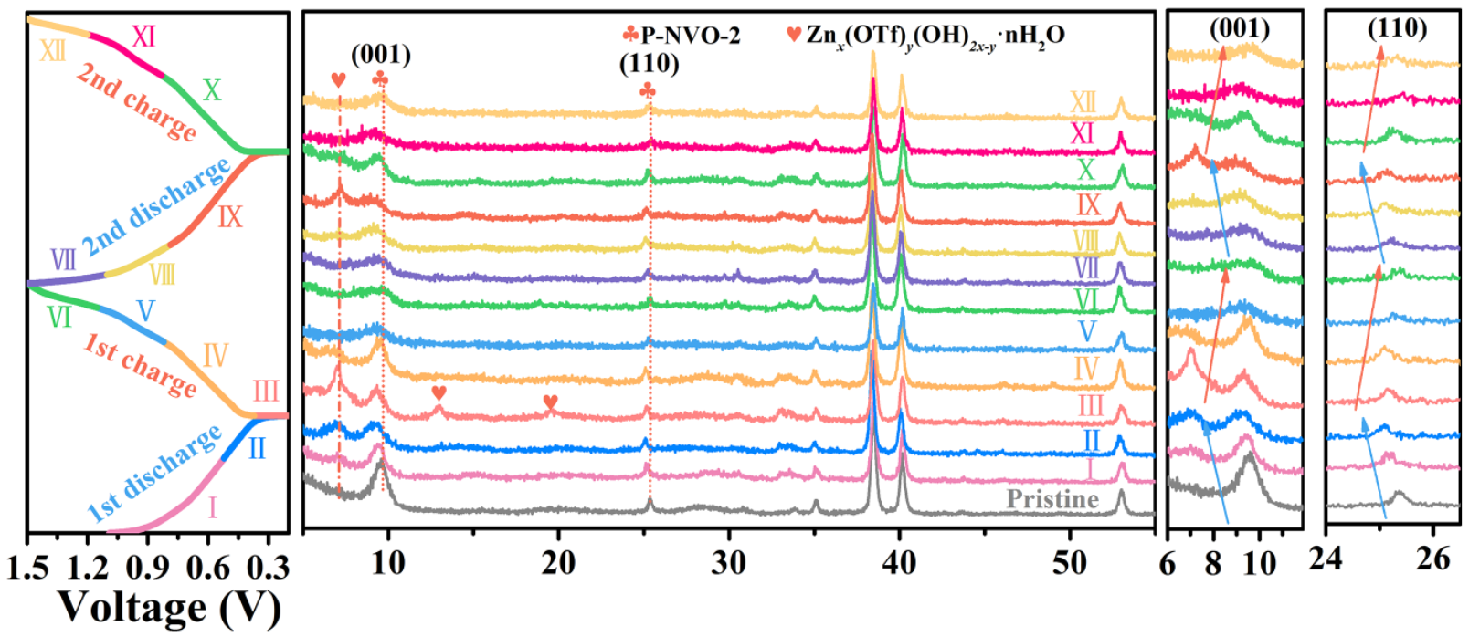
Electrochemical properties
Fig 4. Ex-situ XRD patterns of P-NVO-2.

Slide 6
Thank you!
Email:1019208029@tju.edu.cn
sunxh@tju.edu.cn

