Slide 1
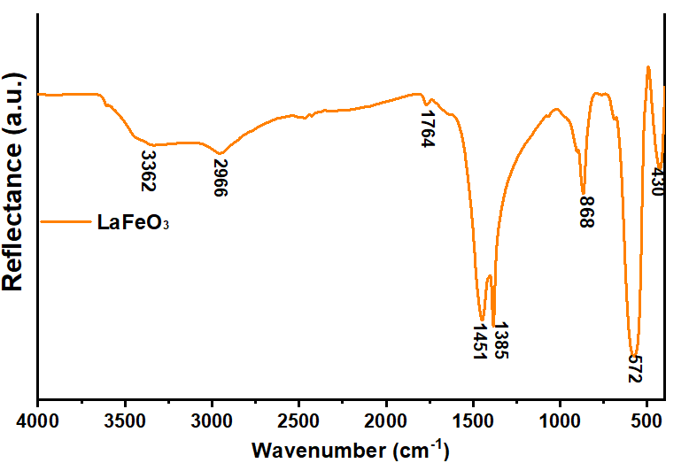
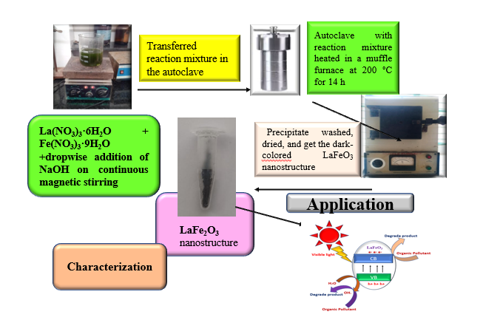
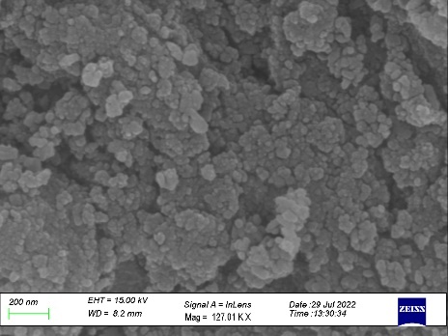
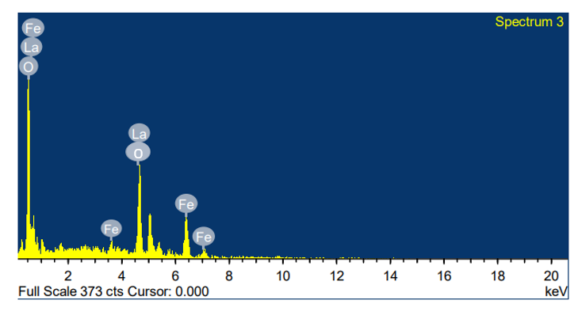
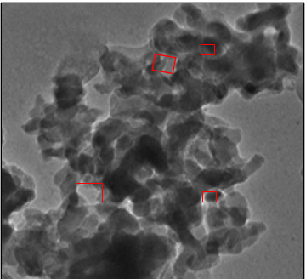
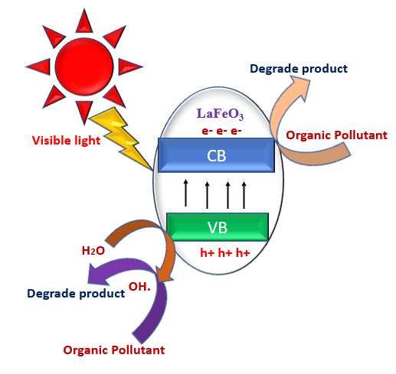
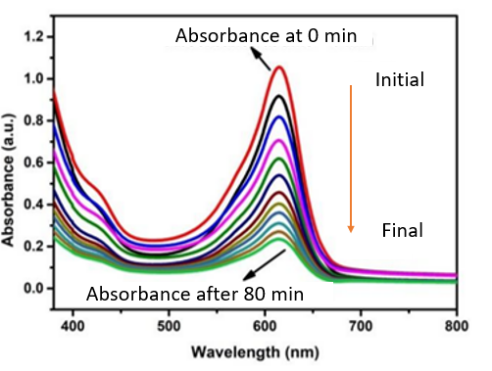
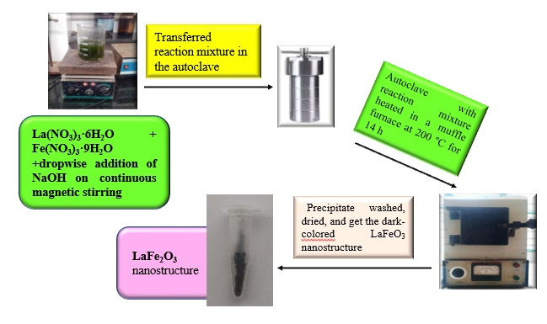
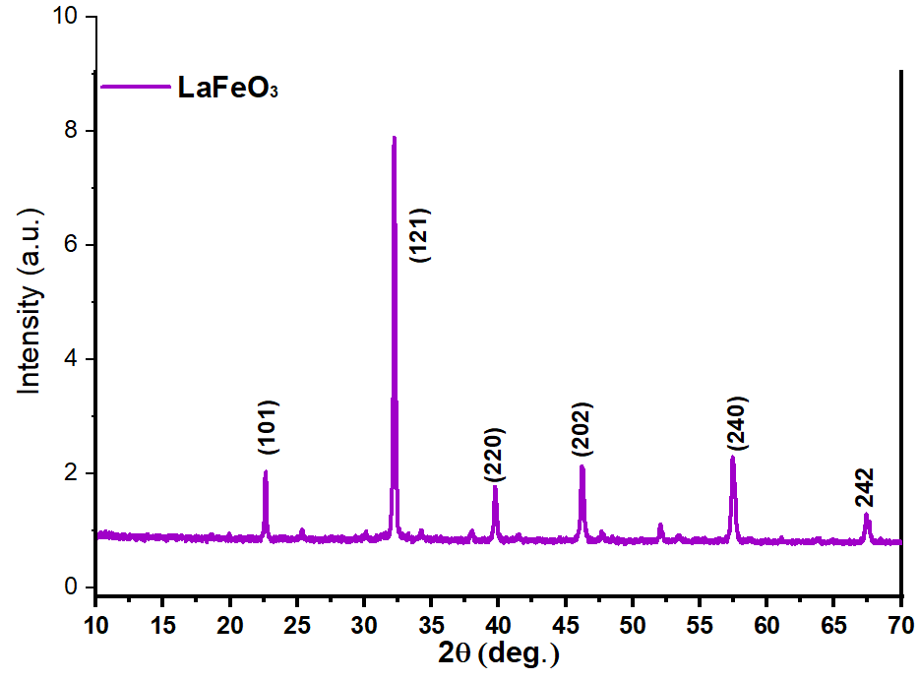
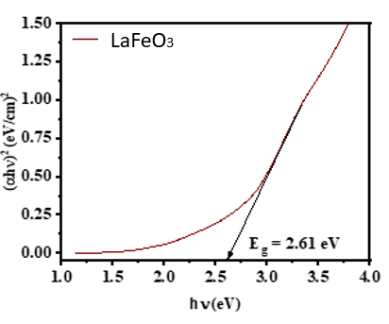
Photocatalytic degradation of malachite green dye via an inner transition metal oxide-based nanostructure fabricated through a hydrothermal route
Sabeeha Jabeen ^{1,2}, Adil shafii³, Shashi Bala ², Tahmeena Khan ¹*
¹ Department of Chemistry, Integral University, Lucknow- 226026, Uttar Pradesh, India
² Department of Chemistry, Lucknow University-226007, Uttar Pradesh, India
³ Department of Chemistry, University of Kashmir, Hazratbal-190006, Jammu & Kashmir, India
Corresponding email: tahminakhan30@yahoo.com
Abstract
FT-IR
This experimentation focuses on, an inner transition metal oxide-based nanostructure LaFeO₃ which was fabricated by hydrothermal route for photocatalytic degradation of dye under visible light irradiation. The fabricated nanostructure was characterized by various techniques X-ray diffraction (XRD) depicts the crystalline nature and size of the synthesize nanostructure which is 45nm, Field emission scanning electron microscopy (FE-SEM) which determined the overall morphology of the nanocomposite and energy dispersive X-ray (EDAX) analysis which established the presence of La, O, and Fe in the sample. The photocatalytic activity of the samples was checked for the decolorization of malachite green (MG) dye. It was observed that the nanostructure showed maximum response with 82% degradation of MG in 80 minutes.
Fig. 4 .FTIR spectrum of the nanostructure
Microscopic Studies
Fig. 1.Pictorial representation of the work
Fig. 5. SEM images , EDX spectra and TEM image of the nanostructure
Environmental problems associated with toxic organic pollutants due to rapid advancement and industrialization have become enormous. There is an immediate need to control water pollution by reducing unwanted materials [1-3].
Due to the stability of these pollutants against chemical and biological remediation, removing them from an aqueous medium has now become a tough task.
Photocatalytic degradation in the presence of visible light has become the most efficient way for organic pollutants[4,5].
Inner transition elements with their properties can enhance the photocatalytic activity for the degradation of the Malachite green dye[6,7].
LaFeO₃ semiconductor material has been used as a visible light photocatalyst due to its direct bandgap (Eg=2.61 eV) and high absorptivity[8,9].
Introduction
Mechanism
Fig. 6. (a) Probable mechanism of photodegradation, (b) UV-Vis spectrum exhibiting dye degradation, (c) Dye degradation mechanism using hydroxyl radical
Synthesis
Conclusion
Synthesis of LaFeO₃ nanostructure has been successfully performed by the Hydrothermal method. The LaFeO₃ nanostructure composite has high photocatalytic activity in the removal and degradation (82%) of the dye in 80 minutes, due to the large surface area, small band gap, and fast charge transference character.
In the interpretation of promising LaFeO₃ nanostructure, it could be utilized as a nano photocatalyst for wastewater remediation.
References
Rezanezhad, A.; Rezaie, E.; Ghadimi, L. S.; Hajalilou, A.; Abouzari-Lotf, E.; Arsalani, N. Electrochimica Acta, 2020, 335, 135699.
Vidyarajan, N.;Alexander, L. K. 3. Mater Res Express.2018,6(1), 015610.
Thirumalairajan, S.; Girija, K.; Mastelaro, V. R.; Ponpandian, N.. J. Mater. Sci. Mater. Electron. 2015, 26, 8652-8662.
Khan, I.; Sun, N.; Wang, Y.; Li, Z.; Qu, Y.; Jing, L.. Mater. Res. Bull., 2020,127, 110857.
Yulizar, Y.; Apriandanu, D. O. B.; Ashna, R. I. Chem. Phys. Lett.2020, 755, 137749.
Collu, D. A.; Carucci, C.; Piludu, M.; Parsons, D. F.; Salis, A. Int. J. Mol. Sci..2022, 23(10), 5422.
Nakhostin Panahi, P.; Rasoulifard, M. H.; Babaei, S. t. Rare Metals.2020,39, 139-146.
Deshmukh, V. V.; Ravikumar, C. R.; Kumar, M. A.; Ghotekar, S.; Kumar, A. N.; Jahagirdar, A. A.; Murthy, H. A. Toxicol. Chem. 2021, 3, 241-248.
Jabeen, S., et al (2022). International Journal of Nano Dimension 2023,14(1), 1-28.
Fig. 2. Complete reaction scheme of the synthesis of nanostructure
Results
UV-DRS Analysis
XRD
Acknowledgements
Fig. 3. XRD and Tauc plots of the nanostructure
The authors are thankful to Prof. A.R. Khan, Head, Department of Chemistry, Integral University, Lucknow, and the R&D cell of the University.
[IOCN 2023] The 4th International Online Conference on Nanomaterials,5–19 May 2023

