Slide 1
MnO collaboration
Lanzhou University of Technology
g cycle
Ultra-Long cycle performance of NC-VN/MnO
cathode for AZIBs based on relay type collaboration
Name : Yang Li
College of Petrochemical Technology

Slide 2
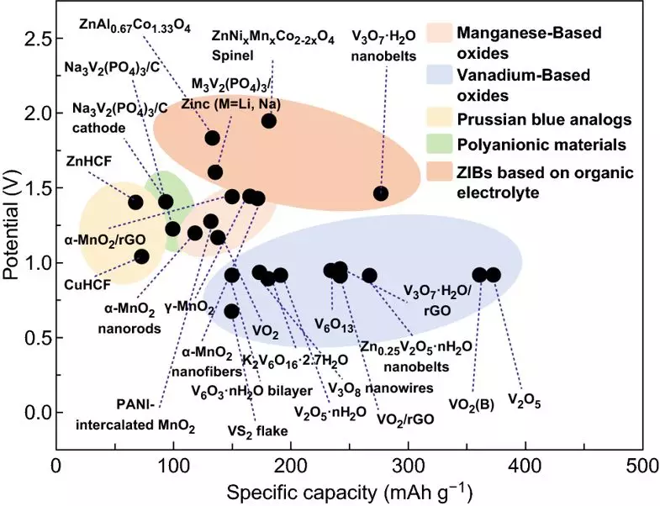
Introduction
P1

Slide 3
Results
Preparation and micro-structure of the materials
P2

Slide 4
Energy Storage Mechanism
P3

Slide 5
Characterization of structure and properties of materials
(a)
(b)
(c)
(d)
(e)
(f)
P4

Slide 6
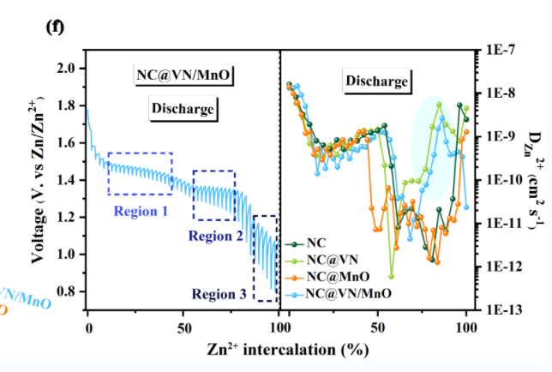
Electrochemical performance
(a)
(b)
(c)
(d)
(e)
(f)
P5

Slide 7
References
[1] P. He, Q. Chen, M. Yan, etc., Building better zinc-ion batteries: A materials perspective, EnergyChem. 1 (2019) 100022.
[2] D. Selvakumaran, A. Pan, S. Liang, G. Cao, A review on recent developments and challenges of cathode materials for rechargeable aqueous Zn-ion batteries, J. Mater. Chem. A 7 (2019) 1829-18236.
[3] C. Zhu, G. Fang, S. Liang, etc., Zhou, Electrochemically induced cationic defect in MnO intercalation cathode for aqueous zinc-ion battery, Energy Stor. Mater. 24 (2020) 394-401.
[4] J. Ji, H. Wan, B. Zhang, etc., H. Wang, Co^{2+/3+/4+}-Regulated Electron State of Mn-O for Superb Aqueous Zinc-Manganese Oxide Batteries, Adv. Energy Mater. 11 (2021) 2003203.
Contact information
First author: Yang Li (LY18648536139@163.com)
a Key Laboratory of Low-Carbon Energy and Chemical Engineering of Gansu Province, Lanzhou University of Technology, Lanzhou, 730050, China
b College of Petrochemical Technology, Lanzhou University of Technology, Lanzhou, 730050, China
P6

Slide 8
Lanzhou University of Technology
Thank you !
Name : Yang Li
Major : Chemical Engineering
College of Petrochemical Technology

