Slide 1
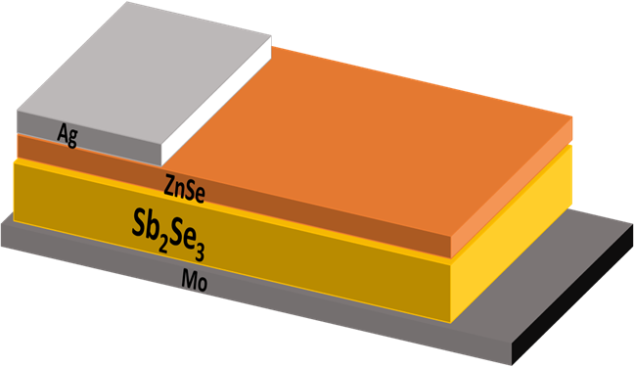
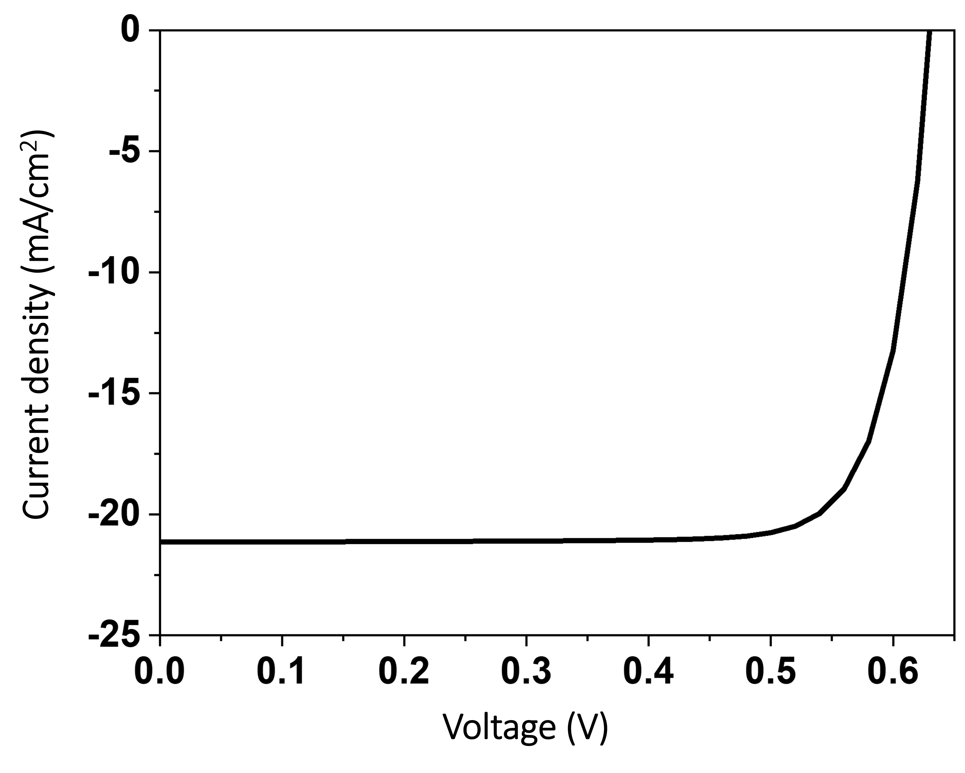
Synthesis, Characterizations and application of Sb₂Se₃ in solar cell with ZnSe as buffer layer
Raman Kumari, Vidya Nand Singh
Academy of Scientiﬁc and Innovative Research (AcSIR), Ghaziabad- 201002, India
Indian Reference Materials (BND) Division, CSIR-National Physical Laboratory, Dr. K. S. Krishnan Marg,
New Delhi-110012, India
INTRODUCTION
Sb₂Se₃ is non-toxic and earth abundant material.
It is a p-type material having a high absorption coefficient (>10⁵cm⁻¹) [1] and optimal band gap (~1.2 eV) [2].
Sb₂Se₃ is a very promising solar absorber material because of its optical and electrical properties.
OBJECTIVE
The films were deposited using thermal vapor deposition technique and are generally amorphous. So, heat treatment was used to enhance its crystallinity. XRD, UV-Vis, and Raman characterizations were done.
With the help of numerical simulation by SCAPS-1D, the performance of the Sb₂Se₃/ZnSe structure is studied.
The parameters of p-Sb₂Se₃ such as thickness, and bandgap, obtained experimentally, were used in the numerical study.
EXPERIMENTAL AND NUMERICAL RESULTS
XRD of as-deposited and annealed Sb₂Se₃ films
UV-Vis data of as-deposited and annealed Sb₂Se₃ films
Raman data of as-deposited and annealed Sb₂Se₃ films
Pictorial representation of simulated Sb₂Se₃/ZnSe solar cell
(a)
(b)
(c)
(e)
(d)
(f)
I-V and PV performance of Sb₂Se₃/ZnSe
V_{OC} (V) | J_{SC} (mA/cm²) | FF (%) | PCE (%)
0.63 | 21.14 | 80.81 | 10.78
CONCLUSION
A direct bandgap of 1.7 eV and thickness of 520 nm is achieved when Sb₂Se₃ film is annealed at 200 ℃. Using these properties of Sb₂Se₃ from experimental data, we simulated the p-Sb₂Se₃/n-ZnSe solar device with the help of SCAPS numerical software. After optimizing all the parameters (ZnSe thickness and bandgap are 60nm and 2.8 eV), the efficiency of 10.78 % is achieved.
REFERENCES
Zhou, M., Xia, Z., Zhong, J., Song, H., Liu, X., Yang B., Jhang J., Han J., Chang Y., & Tang, J. (2014). Advanced Energy Material, 1301846.
Kamruzzaman, M., Liu, C., Farid UlIslam, A.K.M., (2017). Semiconductors, 1615–1624.

