Slide 1
Investigation of the Dielectric Response of PPy/V₂C MXene – ZnO using Quantum Mechanical Calculations
By:
Anthony Chidi Ezika
Co-Authors: Sadiku, E. R., Adekoya G. J., Ray S.S., and Hamam, Y.
CONFERENCE ON NANOMATERIALS
tonero2017@gmail.com

Slide 2
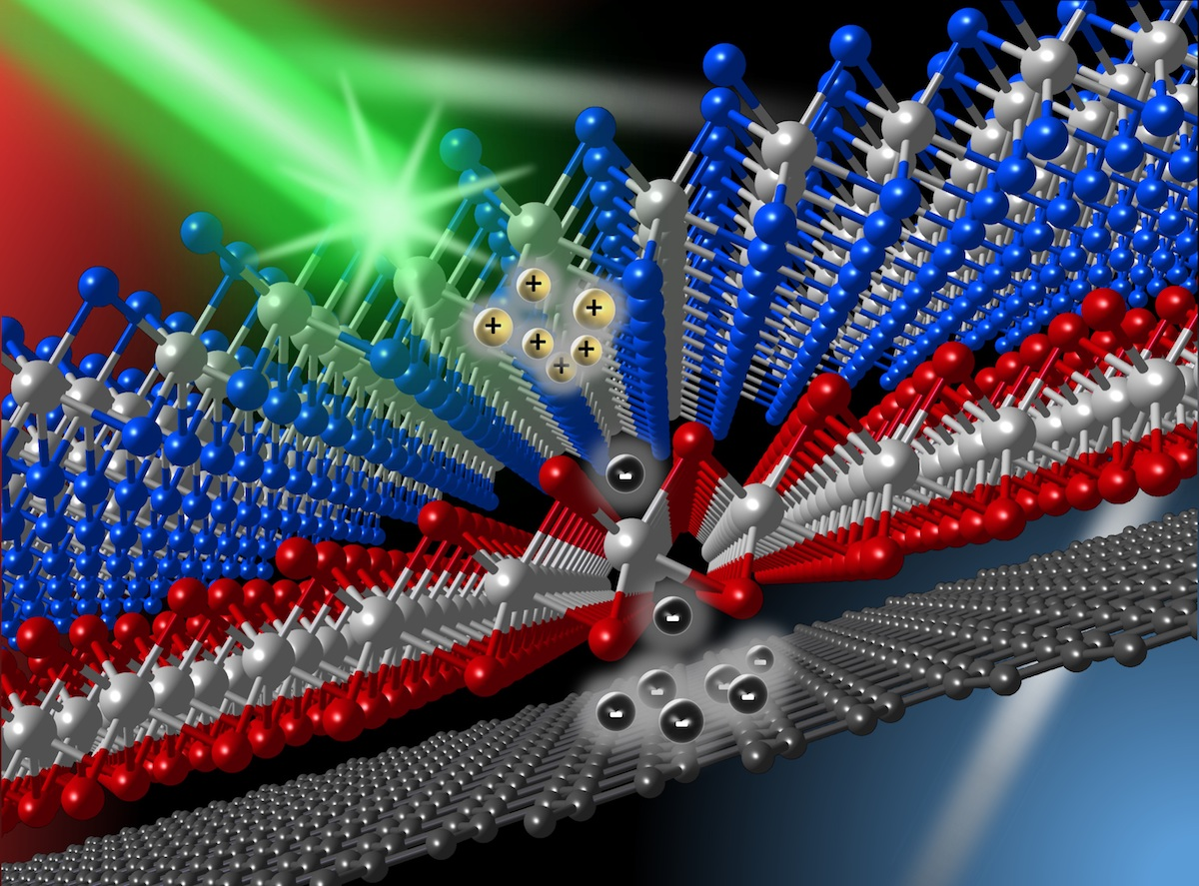
Outline
1
Introduction
2
Research Goals
3
Methodology
4
Results and Discussion
5
Conclusion

Slide 3
Introduction
Background
1
Polymer-based dielectric film
Polymer-based dielectric film are a type of energy storage device that has become important for advanced electronic devices and electric power systems.
(Li et al., 2021)
Dielectric materials are used to separate and insulate conductive materials from each other, such as in capacitors, transistors, and other electronic components.
Polymer-based dielectric films are used in a variety of electronic applications, such as in capacitors, flexible printed circuit boards, and flat panel displays. They are also used in energy storage devices, such as batteries and supercapacitors.
Kim, 2022

Slide 4
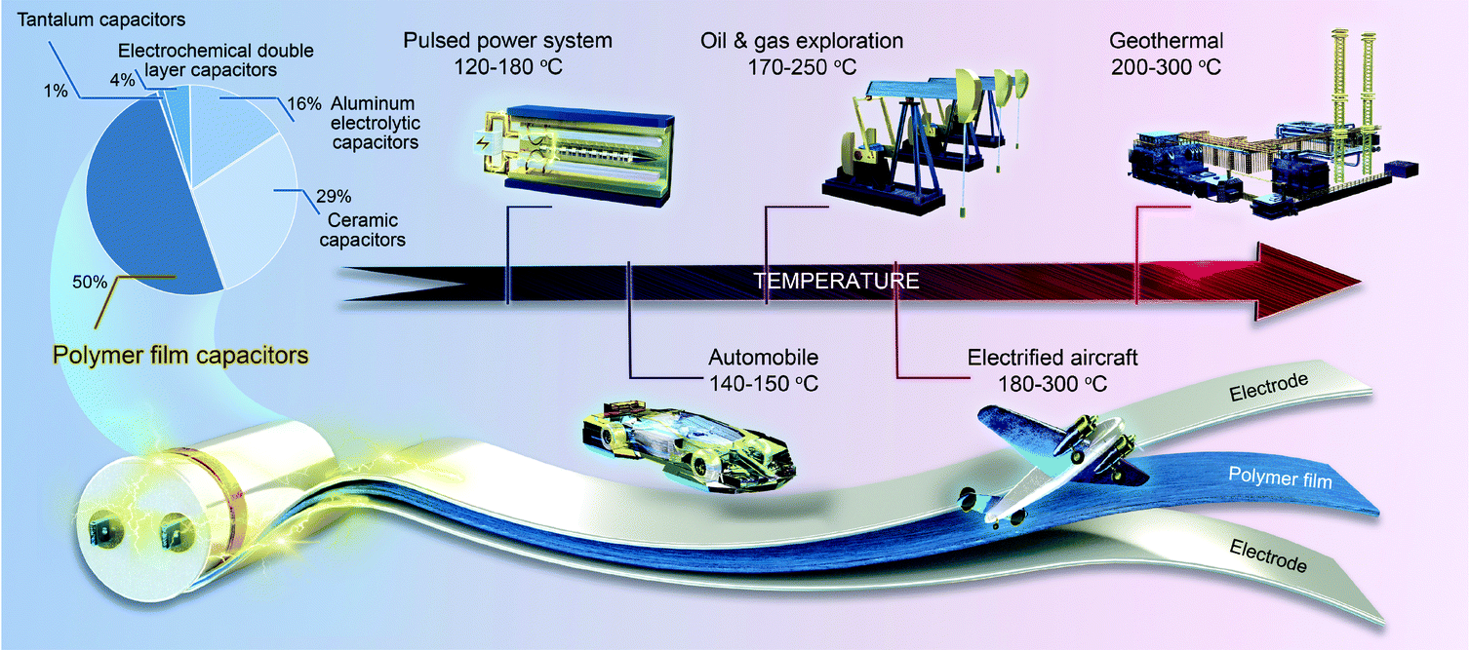
Introduction
Background
2
(Li et al., 2021)
Figure 1: Applications of high-temperature dielectric polymer film capacitors and market share of the world's high-voltage capacitors

Slide 5
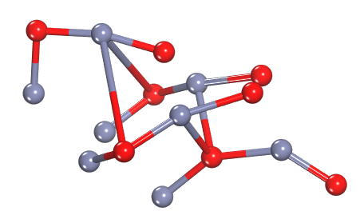
Introduction
Background
3
ZnO
Zinc oxide (ZnO) is a well-known dielectric material with excellent electrical properties, making it a promising candidate for energy storage applications. Dielectric materials like ZnO can store electrical charge through polarization of their internal electric field, making them useful for capacitive energy storage.
Deng, 2021, Feng, 2021
Production: ZnO can be synthesized through a variety of techniques, including chemical vapor deposition, sol-gel, and hydrothermal methods, making it possible to produce high-quality ZnO films with tailored properties.
Properties: ZnO is a wide-bandgap semiconductor, which means it has a large energy gap between its valence and conduction bands. This property makes it an excellent candidate for use in high-temperature and high-power electronic devices, including energy storage devices.
Deng, 2021
Figure 2: An illustrative of the 3D chemical structure of ZnO.
Deng, 2021

Slide 6
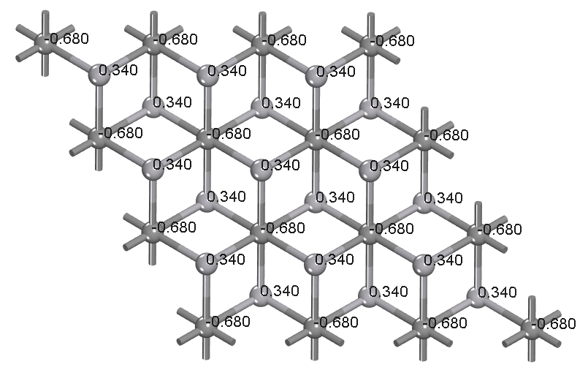
Introduction
Background
4
V2C-MXene
V2C MXene is a two-dimensional transition metal carbide with excellent electrical and mechanical properties, which make it a promising candidate for various energy storage applications, including dielectric energy storage.
Yao, 2022, Mohammed, 2022
Properties: V₂C MXene has high thermal stability, excellent mechanical strength, and can be synthesized in large quantities through a scalable process.
Applications: V₂C MXene a promising candidate for various energy storage applications, including high-energy-density capacitors, electrochemical capacitors, and other dielectric energy storage devices.
Mohammed, 2022
Figure 3: An illustration of V₂C MXene material.
Yao, 2022,

Slide 7
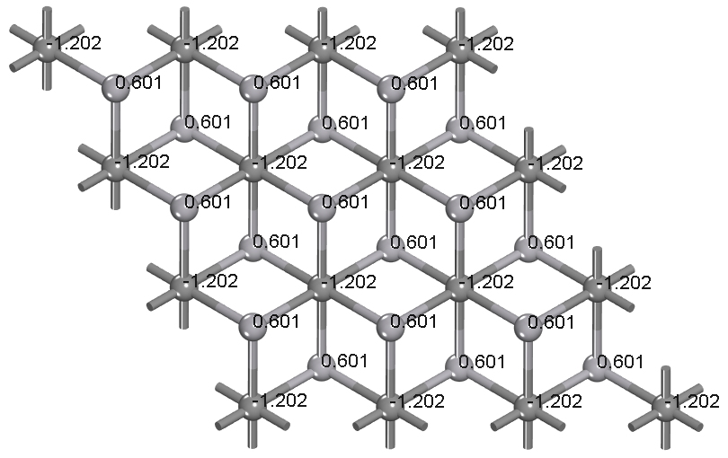
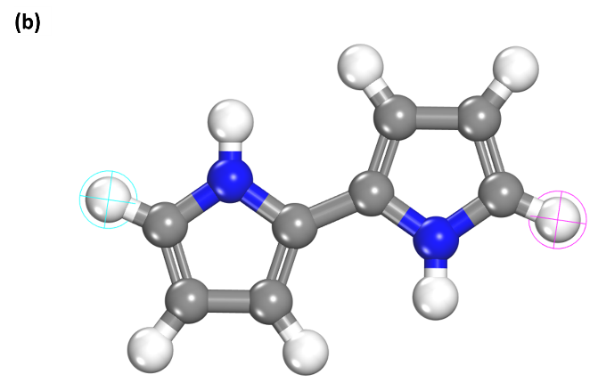
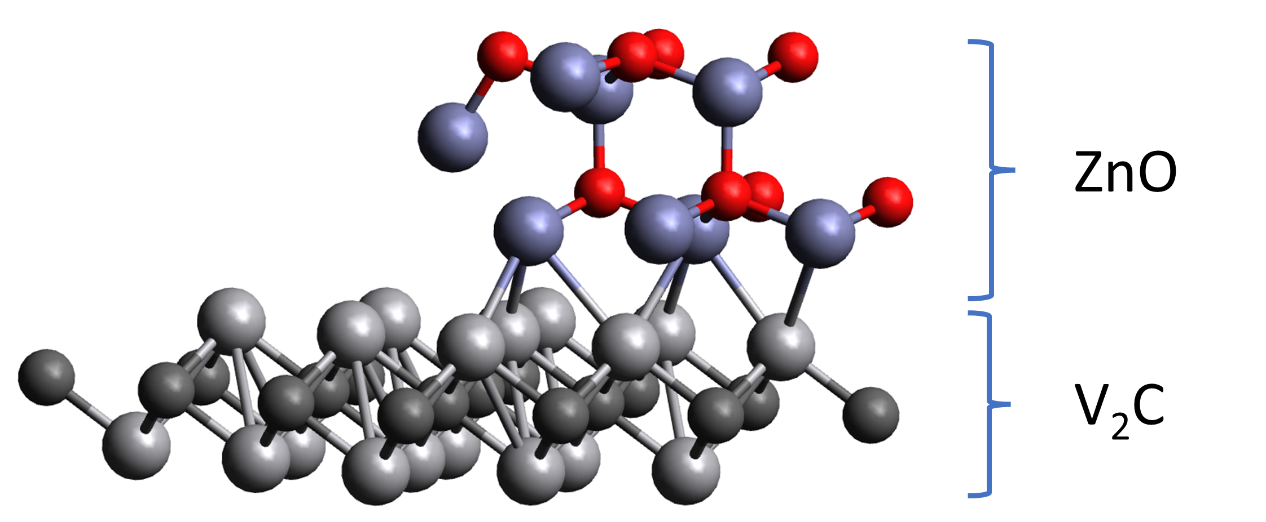
Introduction
5
DFT
Density Functional Theory- First principle / Ab-initio / Quantum mechanical Calculation
MC
Monte Carlo classical calculation
Adsorption Locator identifies possible adsorption configurations by carrying out Monte Carlo searches of the configurational space of the substrate-adsorbate system as the temperature is slowly decreased.
(a)
(b)
Key:
Vanadium
Carbon
Nitrogen
Oxygen
Hydrogen
Side view
Figure 4: (a) PPy molecule and (b) ZnO-V2C MXene hybrid.

Slide 8
Research Goals
09
6
1
Study the molecular interaction of V₂C with ZnO using Density Functional Theory (DFT) and Monte Carl (MC).
2
Obtain insight into the electron localization function of the ceramic-ceramic systems.
3
Analyze the resulting charge distribution and electronic properties.
4
Conclude on the suitability of the nanocomposite for dielectric application.

Slide 9
Methodology
17
Computational procedure
7
01
Molecular Model Development
Construction of the PPy molecule, ZnO, and MXene structure were done with polymer and crystal builder.°.
Builder
03
Geometry Optimization/Equilibration
Relaxing and optimizing the structures of the system to minimize the energy of the system.
DFT
100,000 loading steps at 10 heating cycles with 50,000 steps per cycle. The energy window and maximum adsorption distance chosen were 100Kcal/mol and 10A
Monte Carlo
03
Adsorption Locator and Annealing
04
Energy Calculation: Structural and electronic
Simulate the electronic properties using plane wave DFT
DFT
05
A generalized gradient approximation (GGA) functionals, coupled with by Perdew, Burke, and Ernzerhof (PBE) scheme
Functional and Basis set
06
Post-processing
/Analysis
Elucidation of properties from simulation output

Slide 10
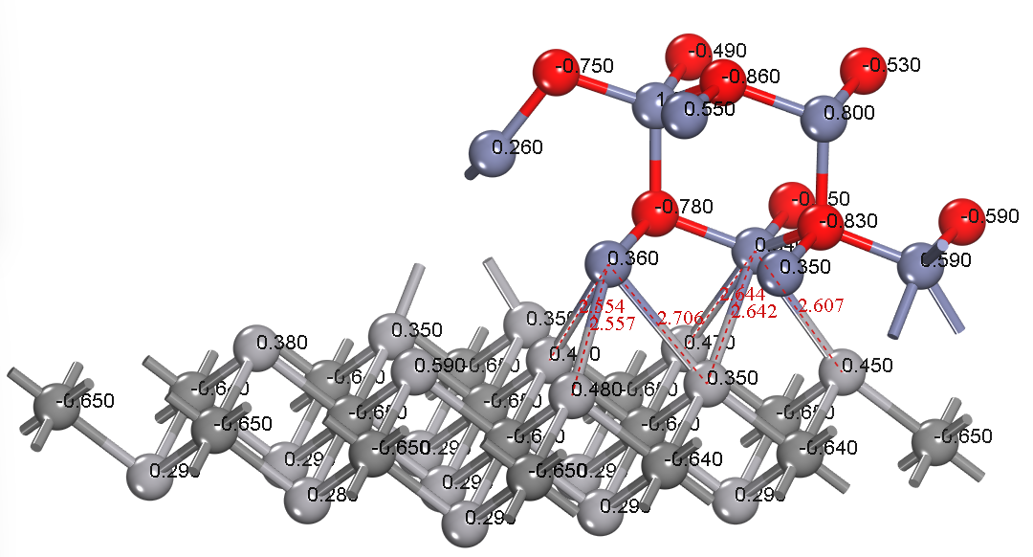
Results and Discussion
Adsorption Analysis
8
15
$$P_{mn}=min\left(1, \frac{ρ_{n}}{ρ_{m}} \right)$$
equation 1
Where $ρ_{m}$is the frequency of sampled m configurations, $ρ_{n}$ is frequency of proposed n configurations and $P_{mn}$ is the probability of transition of configuration from m to n.
$$E_{ads}= E_{V2C+ZnO}− \left(E_{V2C} + E_{ ZnO}\right)$$
equation 2
Where $E_{ads}$ is the adsorption energy of ZnO on V₂C.
$E_{V2C+ZnO}$ is the total energy of the ZnO - V₂C system, and
$E_{V2C}$and $E_{ ZnO}$are the single point energies of the sorbate and substrate
𝐴𝑑𝑠𝑜𝑟𝑝𝑡𝑖𝑜𝑛 distance: At the V₂C/ZnO contact area, the average ZnV bond length is 2.62 Å.
Figure 5: Optimized 3D structural configuration of V₂C/ZnO hybrid with charge distribution

Slide 11
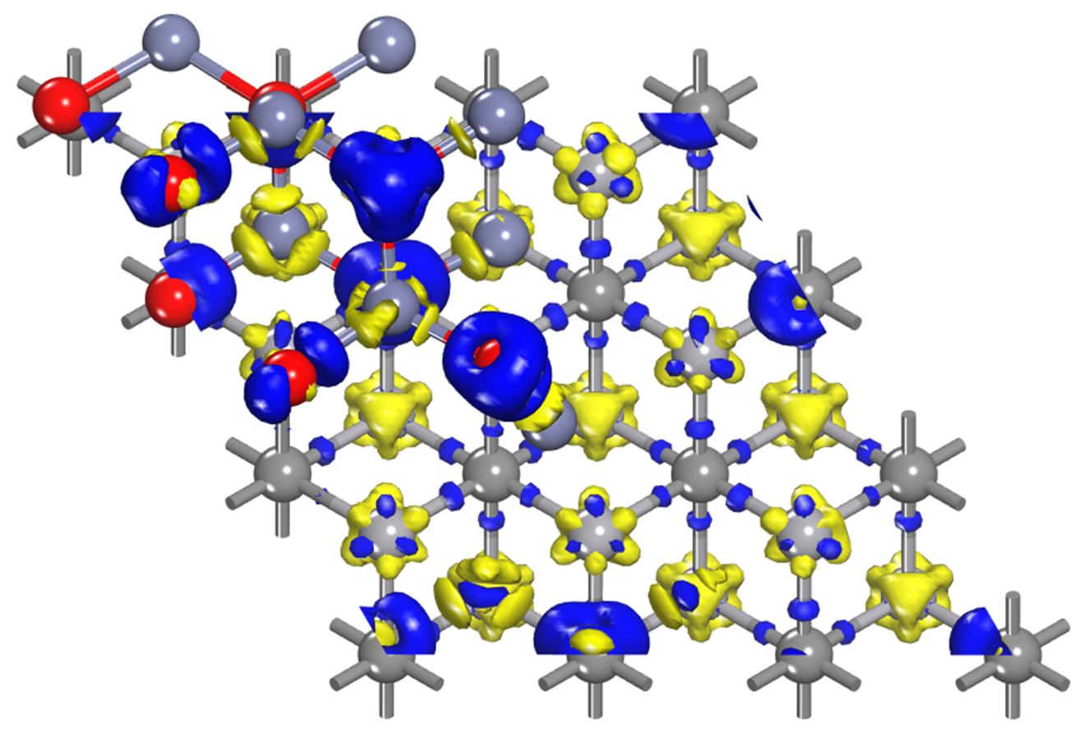
Results and Discussion
Charge transfer (Electron Density Difference)
9
$$∆ρ =ρ_{V2C+ZnO}− \left(ρ_{V2C} + ρ_{ ZnO}\right)$$
equation 4
where $∆ρ$ is the charge density difference
$ρ_{V2C+ZnO}$is the electron density of the total ℎ𝑜𝑠𝑡+Na system, and
$ρ_{V2C}$and $ρ_{ ZnO}$are the unperturbed electron densities of the substrate (V₂C) and sorbate (ZnO), respectively.
The isosurface value is ± 0.01e/Å³
Figure 6: Electron density difference of V₂C/ZnO hybrid
The yellow region denotes depletion of charge density, while the blue region represents charge density accumulation

Slide 12
Results and Discussion
Electronic analysis
10
01
Figure 7:(a), The top-surface ELF result, and (b) The side-surface ELF result

Slide 13
Results and Discussion
Electronic analysis
11
01
Figure 8: (a) The DOS diagrams for the s, p, and d-orbital atoms in the V2C-ZnO, (b) The results of the DOS of the atoms for the structure
The nanocomposite is semi-conductive, many of the states arise from each type of orbital, s, p, or d

Slide 14
Conclusion
12
we used first-principles calculations to investigate the dielectric response of the ceramic-ceramic interface in PPy/V2C-ZnO ternary composite.
11
1
V2C-ZnO ceramic-ceramic contact area display a strong dielectric response.
Charge transfer study, a rise in the charge quantity at Zn may signify an improved dielectric response
2
DOS study showed that the contribution of V2C electrons to the Fermi level increased when ZnO was added to V2C.
3
the electron localization function (ELF) test show that the electrical breakdown strength of the ternary composites is well-maintained and high.
4
It would be interesting to investigate the frequency dependent dielectric response and the effect of different factors
5

Slide 15
Selected References
Liu, Y., Y. Liu, and X. Zhao, The influence of dopant on the dielectric properties of flexible polypyrrole composites. The Journal of The Textile Institute, 2017. 108(7): p. 1280-1284.
Li, H., Zhou, Y., Liu, Y., Li, L., Liu, Y., & Wang, Q. (2021, April 13). Dielectric polymers for high-temperature capacitive energy storage. Dielectric Polymers for High-temperature Capacitive Energy Storage - Chemical Society Reviews (RSC Publishing). https://doi.org/10.1039/D0CS00765J
Deng, Q., et al., Improving electric insulation characteristics of PVA/V2C MXene composite high-dielectric-constant films by blending cellulose. Journal of the Australian Ceramic Society, 2021. 57(3): p. 819-824.
Feng, Y., et al., Remarkably Elevated Permittivity Achieved in PVDF/1D La2TiO5 Composite Film Materials with Low-Level Dielectric Loss by Adding 2D V2C MXene Phase. Journal of Electronic Materials, 2021. 50(4): p. 2182-2189.
Deng, Q., et al., Interfacial fluorine migration-induced low leakage conduction in PVA based high-k composites with V2C MXene-SWCNT switchboard-like ceramic via ab initio MD simulations. Journal of Materials Chemistry C, 2021. 9(3): p. 1051-1061.
Deng, Q., et al., Reinforced dielectric response in polymer/V2C MXene composite high-insulation films enabled through dispersing ionic liquid. Journal of Electroceramics, 2021. 46(3): p. 124-130.
Roy, A.S., et al., Dielectric properties of novel PVA/ZnO hybrid nanocomposite films. Composites Part B: Engineering, 2013. 47: p. 314-319.
Yao, T., et al., Insights into concomitant enhancements of dielectric properties and thermal conductivity of PVDF composites filled with core@double-shell structured Zn@ZnO@PS particles. Journal of Applied Polymer Science, 2022. 139(44): p. e53069.
Mohammed, M.I., Dielectric dispersion and relaxations in (PMMA/PVDF)/ZnO nanocomposites. Polymer Bulletin, 2022. 79(4): p. 2443-2459.
13

Slide 16
Acknowledgement
14
Prof. Sadiku E.R.
Prof. Suprakas S.R.
Supervisor
Supervisor
ttt
Prof. Hamam Y
Supervisor

Slide 17
15
Thank you for listening

