Slide 1


The 4th International Online Conference on Nanomaterials
5–19 May 2023
NATURAL CLINOPTILOLITE NANOPLATELETS PRODUCTION BY A FRICTION-BASED TECHNOLOGY
Loredana Schiavo ^{1,*,} Vincenzo Boccia ², Lucrezia Aversa³, Roberto Verucchi ³, Gianfranco Carotenuto ^{1,} Teodoro Valente ¹
¹ CNR-IPCB, Institute for Polymers, Composites and Biomaterials, Napoli/Portici, Italy.
² LUISS GUIDO CARLI University, Roma, Italy.
³ CNR-IMEM, Institute of Materials for Electronics and Magnetism, Trento, Italy.
loredana.schiavo@cnr.it

Slide 2
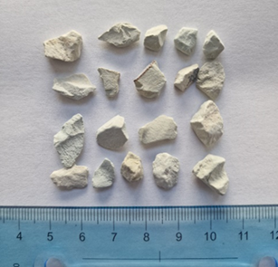
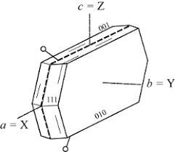
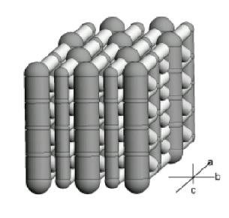
The 4th International Online Conference on Nanomaterials
5–19 May 2023
NANOSTRUCTURED TEXTURE OF NATURAL CLINOPTILOLITE
Geomorphic clinoptilolite is made of single lamellar crystals very compactly stacked together. These aggregates can be mechanically exfoliated in order to achieve the single units. Since these crystals have a thickness of only 40 nm, they could be considered as 2D nanomaterials.
Natural clinoptilolite in granular form.
Nanostructured texture of geomorphic clinoptilolite.
The channels form a two-dimensional network parallel to the lamella basal planes (010). Consequently, the porosity of the supported lamellas is fully accessible.
Clinoptilolite lamellar crystal.
Channels orientation in the single lamellar crystals.

Slide 3
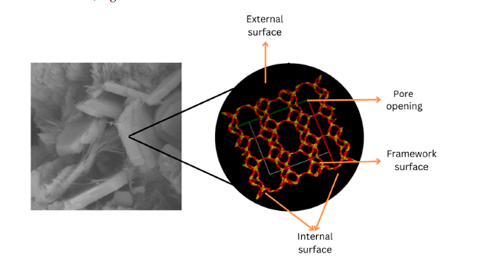
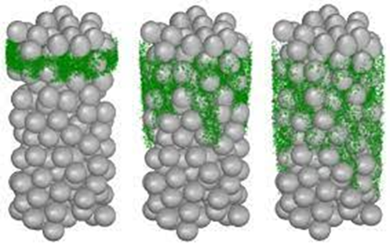
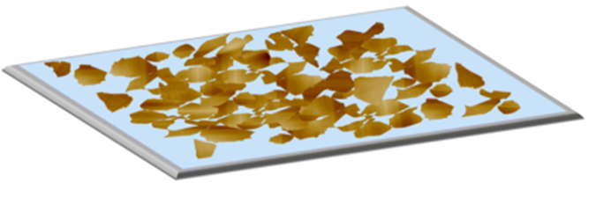
The 4th International Online Conference on Nanomaterials
5–19 May 2023
2D CLINOPTILOLITE NANOPLATELETS AS MOLECULAR TRAPS FOR VOCs
Clinoptilolite nanoplatelets can be technologically exploited as molecular traps for VOCs. Owing to their planar lamellar shape, these nanostructures can be easily supported on an adequate substrates (e.g., plastic films, paper sheets, etc.);
Since the two-dimensional system of channels, that are running parallel to (010) plane, has a length of a few hundred microns, the platelets can operate as a diffusive molecular trap;
The clinoptilolite porosity of a few angstroms allows a facile access to small gaseous molecules as VOCs. During the trap exposition to the contaminated environments, VOCs permeate the zeolite porosity by diffusion. However, the reverse process takes place very slowly, because of the large channel length.
1
2
3
Strong adhesion to the substrate due to the high surface contact.
VOCs diffusion in clinoptilolite channels.
Channels oriented along the c axes.

Slide 4
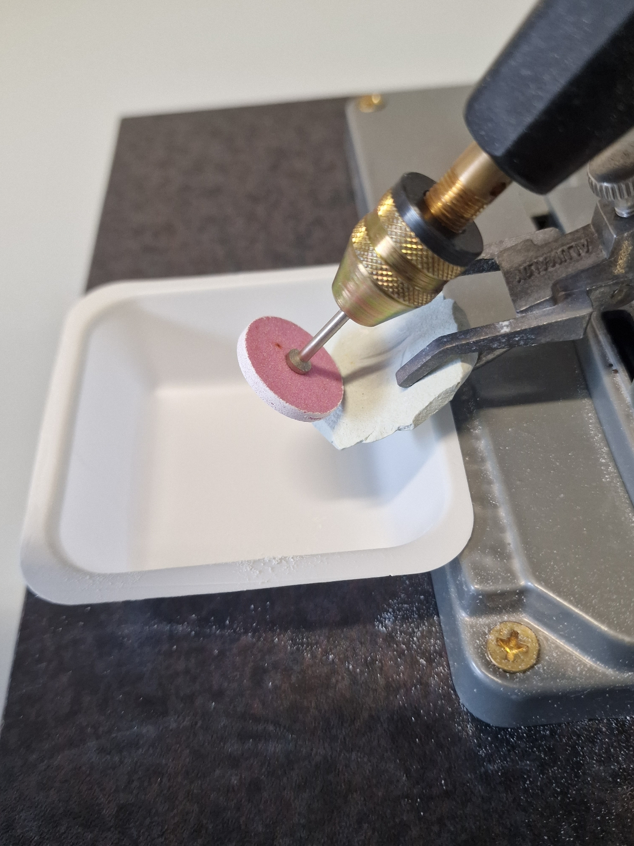
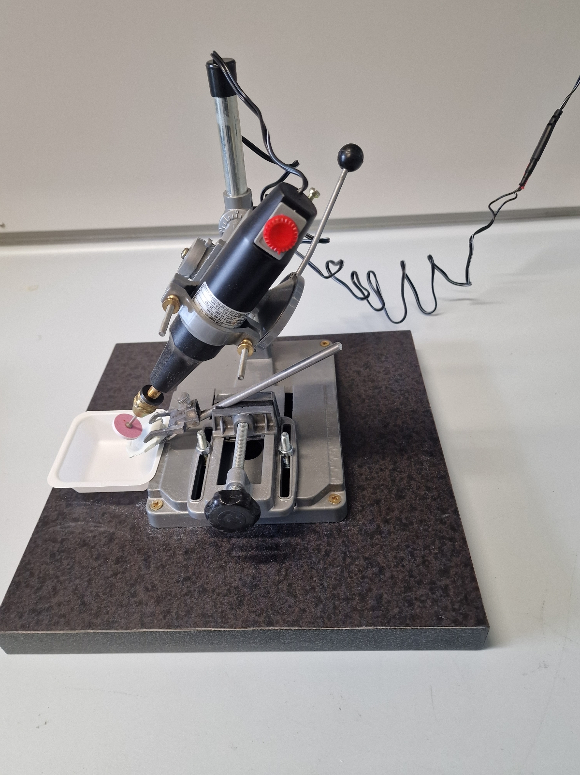
The 4th International Online Conference on Nanomaterials
5–19 May 2023
ABRASION DRILL TECHNOLOGY FOR NATURAL CLINOPTILOLITE NANOPLATELETS PRODUCTION
The abrasive drill has been put in contact with one edge of the stone in order to apply a friction force to the sample surface. The exfoliation was performed at a constant speed (ca. 3,000 rpm) and at under minimum applied load.
Abrasion drill apparatus used for the powders production.

Slide 5
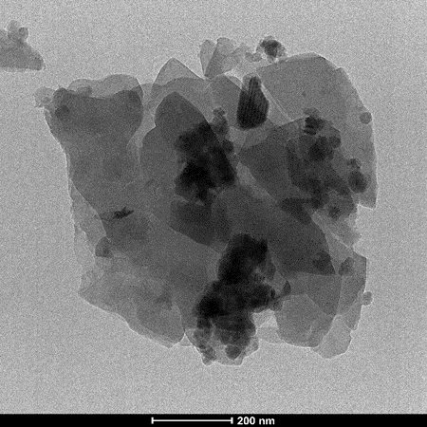
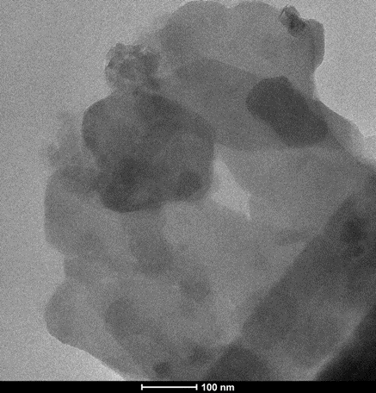
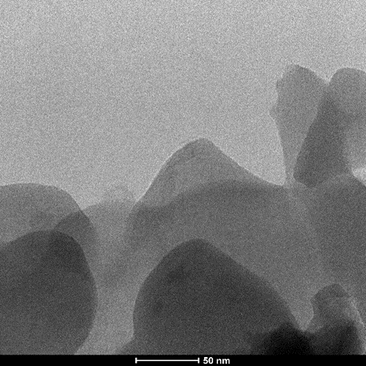
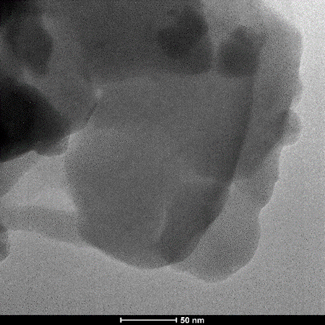
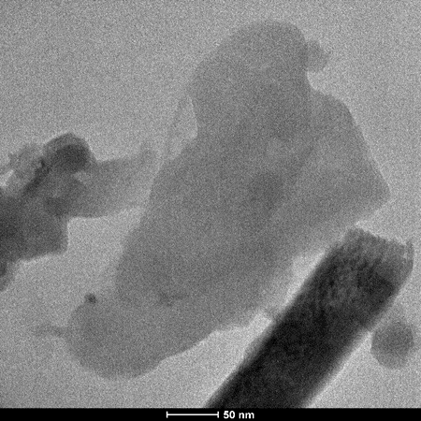
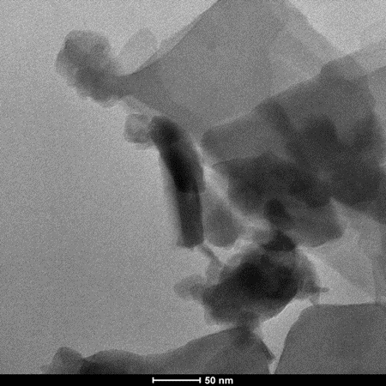
The 4th International Online Conference on Nanomaterials
5–19 May 2023
TEM CHARACTERIZATION OF CLINOPTILOLITE AGGREGATES
200 nm
100 nm
50 nm
50 nm
TEM micrographs of micro-aggregates of clinoptilolite produced by the abrasion-drill technology
The obtained micro-aggregates have been morphologically analyzed by TEM. Lamellas can be distinguished on the basis of their different gray-scales. These aggregates show a brittle-type fracture and the absence of defects.
50 nm
50 nm

Slide 6
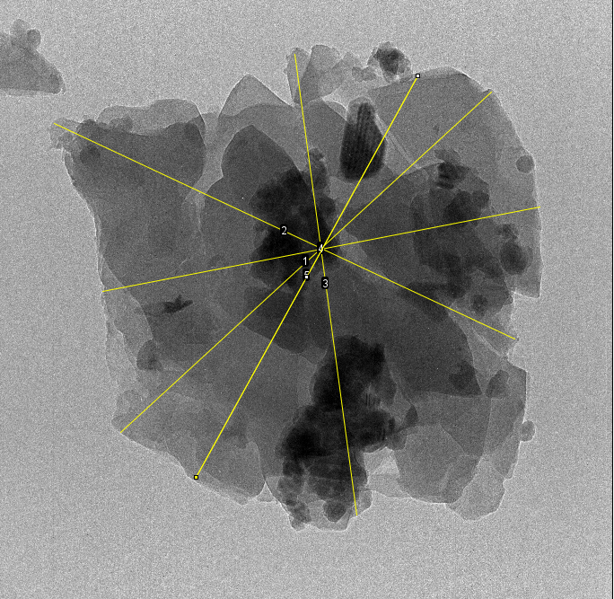
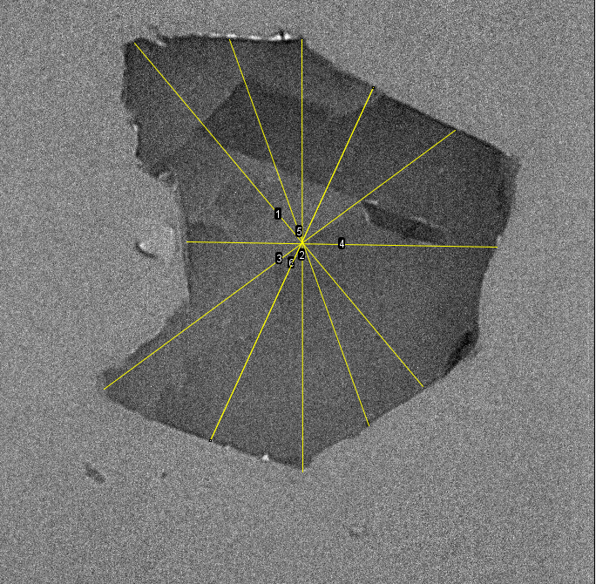
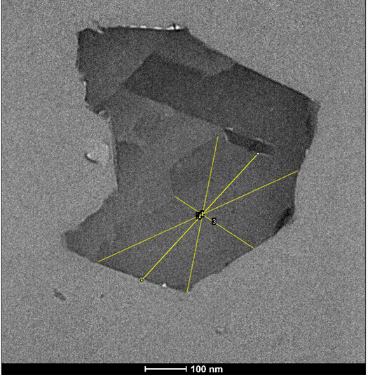
The 4th International Online Conference on Nanomaterials
5–19 May 2023
IMAGE ANALISYS OF THE CLINOPTILOLITE LAMELLAR AGGREGATES
a)
b)
c)
d)
1
2
3
4
200 nm
100 nm
100 nm
Measurement of the average diameter of clinoptilolite lamellar aggregates.
Size measurements of one of the lamellas contained in the aggregate.
The analysis of the average sizes of micro-aggregates (a, b) and single lamellar crystals (c) of clinoptilolite are performed by using the “ImageJ” Software analysis. Owing to these analysis it is possible to determine the average sizes of both micro-aggregates and single lamellar crystals (d), that is varying from 200 to 500 nm.

Slide 7
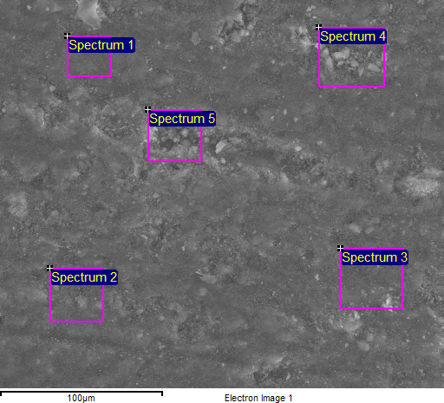
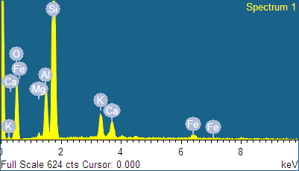
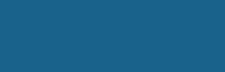
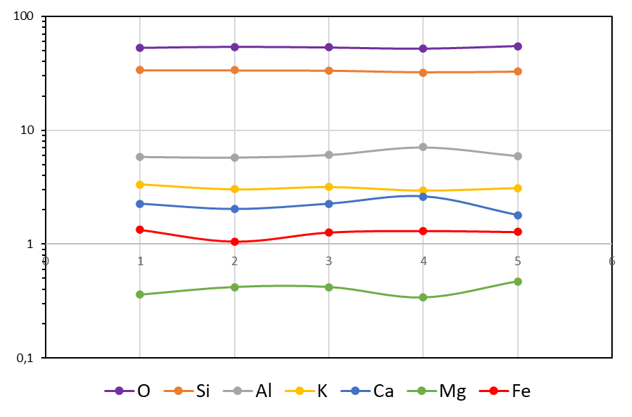
The 4th International Online Conference on Nanomaterials
5–19 May 2023
EDS CHARACTERIZATION OF THE CLINOPTILOLITE AGGREGATES
a)
b)
c) Atomic percentages of the elements present in the sample
Areas | O | Si | Al | K | Ca | Mg | Fe
1 | 53,1 | 33,8 | 5,8 | 3,3 | 2,3 | 0,4 | 1,3
2 | 54,1 | 33,7 | 5,7 | 3,0 | 2,0 | 0,4 | 1,1
3 | 53,4 | 33,4 | 6,1 | 3,2 | 2,3 | 0,4 | 1,3
4 | 52,4 | 32,1 | 7,1 | 3,0 | 2,6 | 0,3 | 1,3
5 | 54,8 | 32,7 | 5,9 | 3,1 | 1,8 | 0,5 | 1,3
keV
d)
Analysed areas (a), EDS-spectrum (b), sample elemental composition in the analysed areas (c) and compositional homogeneity obtained by EDS analyses (d) of the clinoptilolite sample.
According to the EDS analysis, the sample consisted of the clinoptilolite–K,Ca. In addition, little variations in the sample composition have been found only for cations present at low concentration.

Slide 8
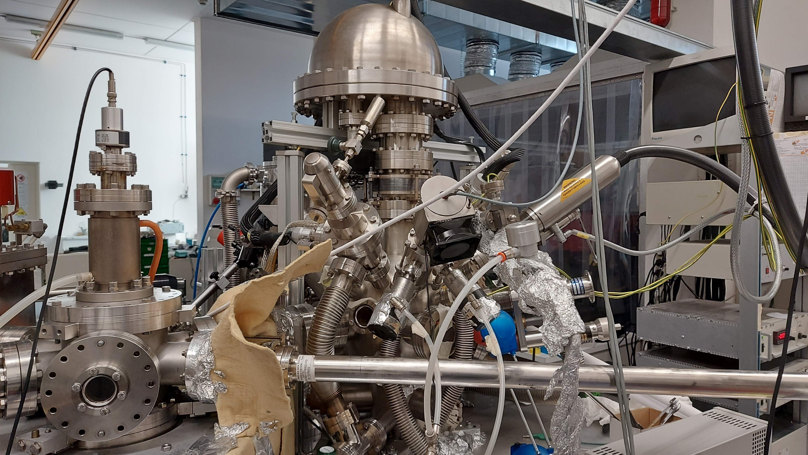
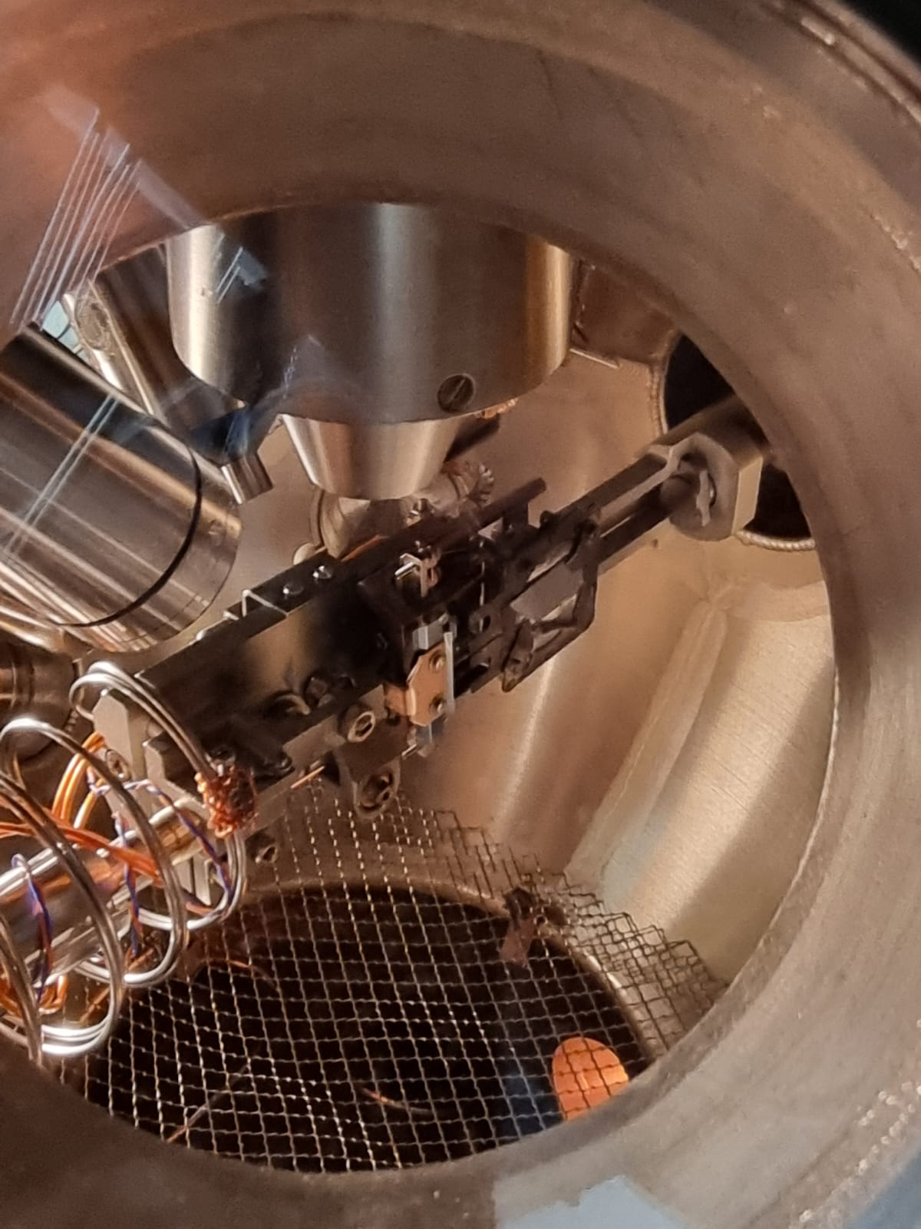
The 4th International Online Conference on Nanomaterials
5–19 May 2023
XPS SURFACE CHARACTERIZATION OF THE AGGREGATES
UHV Chamber equipped with
VSW HA100 analyser
XPS): X-Ray source VG 8600 dual anode @ 1253.6eV (Mgkα)
UPS: UV lamp, HeI (21.22eV) and HeII (40.8 eV)
AES: e-beam LEG62 ThermoVG @ 3-5 KeV spot size down to 5μm
LEED: LaB₆ filament, reverse view, energy range 10-1000 eV
Ion Gun VG EX03: Ar+, 0.3 to 3 KeV
XPS spectra @ PE=20eV of all chemical species on the surface, for quantitative analysis of Clinoptilolite in powder form (supported on carbon tape)

Slide 9
The 4th International Online Conference on Nanomaterials
5–19 May 2023
CONCLUSIONS
Natural clinoptilolite has a nanostructured texture, that is made of 40 nm thick single lamellar crystals stacked together;
The clinoptilolite structure can be exfoliated by applying a friction force to the sample surface;
The number of the lamellas per aggregate and the average size of the both aggregates and single lamellar crystals can be easily obtained by the morphological analysis (TEM);
Zeolite type identification and the homogeneity of the elemental composition has been determined by EDS analysis;
Clinoptilolite nanoplatelets can be conveniently obtain by using the abrasion-drill technology;
The obtained nanoplatelets have a convenient shape to be used in a supported form as required to fabricate molecular traps for VOCs.

