Slide 1

TH-PMM Group. Physics department, Faculty of science
Beni -Suef University
The 4th International Online Conference on Nanomaterials
(2023) , sciforum
“ Detection of CO2 pollutions based on Phononic crystals”
Physics Department, Faculty of Science, Beni-Suef University, Egypt
By
Ahmed M. Mehany

Slide 2
TH-PMM Group. Physics department, Faculty of science
Beni -Suef University
OUTLINE
Detection of CO2 pollutions based on Phononic crystals
2. Phononic Crystal as a CO2 Detector
3. Discussion of some findings

Slide 3
TH-PMM Group. Physics department, Faculty of science
Beni -Suef University
ENPPC#3, Hurghada 2018
Frequency Domain in PnCs
M. Maldovan, Nature 5 0 3 , 210 ( 2 0 1 3).

Slide 4
TH-PMM Group. Physics department, Faculty of science
Beni -Suef University
ENPPC#3, Hurghada 2018
Inspiration
Most conventional radiation detectors are based on:
Electronic Collections Photons Collections
Gas Filled detectors (Geiger),
Semiconductors detectors,…
Scintillation, Cerenkov,…
But on Phonons collections, is that possible ??!!

Slide 5
TH-PMM Group. Physics department, Faculty of science
Beni -Suef University
ENPPC#3, Hurghada 2018
RADIATION-PHONON COUPLING
IN PHONONIC CRYSTALS
● The interaction of ions with matter is divided into two categories:
1- Electronic scattering (electronic stopping power)
2- Nuclear scattering (nuclear stopping power) √√√√√√
● If the ions have energy >1MeV, the nuclear collision loss will be small compared with the electronic energy loss.
● The energy transferred via nuclear scattering imparts some recoil energy to an atom, knocking it out of its lattice site.
produce phonons.
● The values for displacement energies are approximately 15 eV and 25 eV for semiconductors and metals, respectively. For polymers, a value as low as 2–5 eV may be more accurate.

Slide 6
TH-PMM Group. Physics department, Faculty of science
Beni -Suef University
ENPPC#3, Hurghada 2018
**Advantages of Phononic crystals as a radiation detector !!
1- Ion interactions in the materials produce phonons at the Debye frequency (Frequency ≤ 0.5 THz ≈ 0.002 eV), so the resolution of the phonon detectors is greater than semiconductor detectors by about ten times.
2- Easy to be experimentally fabricate.
Detector type | ε (eV) | FWHM _{det} (keV) | FWHM _{Total} (keV)
GM detector (Argon gas) | 25 | 27.52 | ------
Semiconductor silicon detector | 3.62 | 10.47 | 12**
Phononic detector | 0.034* | 1.01 | --------

Slide 7
TH-PMM Group. Physics department, Faculty of science
Beni -Suef University
ENPPC#3, Hurghada 2018
The Debye frequency (ω_{max}) is calculated from the following relation
ω_{max}=v(6π²N/V)^{1/3},
The total phonon numbers (φ) can be determined by dividing the total phonons energies and the phonon energy at Debye frequency:
Φ=η/(ħω_{max}).
The total phonon energies due to incidence of 99,999 ions (η) can be calculated as:
η = Prob. of phonons emitted from ions and recoils*Incident ion energy*99,999.
A. H. Aly, A. Mehaney, and M. F. Eissa, Journal of Applied Physics , 118, 064502 (2015).

Slide 8

TH-PMM Group. Physics department, Faculty of science
Beni -Suef University
ENPPC#3, Hurghada 2018
A Helium-4 ion detection based on PnCs
Incident and transmitted helium-4 ions in PMMA-PE PnC Detector.
A. H. Aly, A. Mehaney, and M. F. Eissa, Journal of Applied Physics , 118, 064502 (2015).

Slide 9
TH-PMM Group. Physics department, Faculty of science
Beni -Suef University
ENPPC#3, Hurghada 2018
2. Challenge of Phononic Crystal as a Neutron Detector
*The Debye frequency is related to each material NOT the incident ionizing particle .
Here we proposed a material used extensively in the field of radiation and neutrons shielding.
concrete
The thickness of the concrete and epoxy layers were $a_{1}$ and $a_{2}$ , and were considered $1×{10}^{−2} m$ and $0.5×{10}^{−2} m$ respectively.

Slide 10
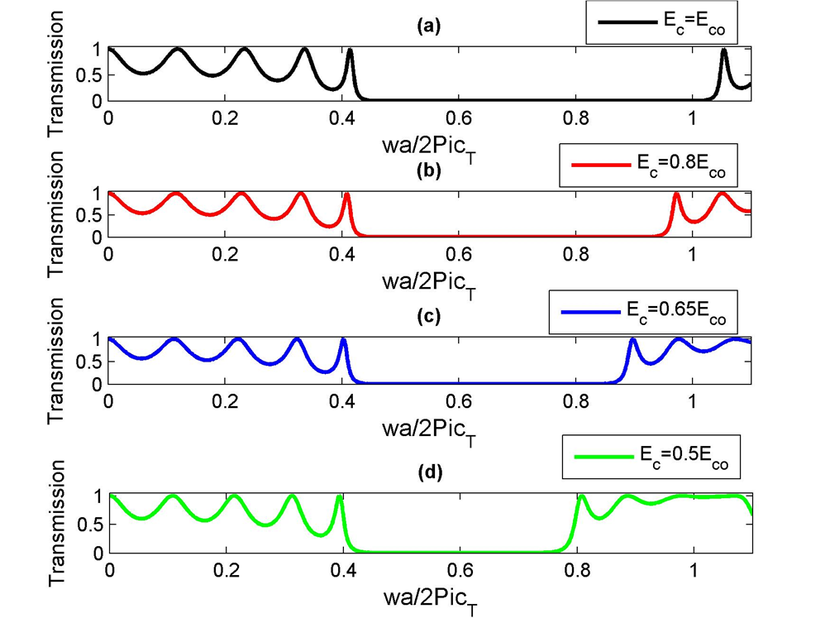
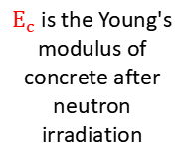
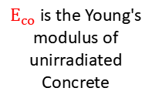
TH-PMM Group. Physics department, Faculty of science
Beni -Suef University
ENPPC#3, Hurghada 2018
$E_{co}$is the Young's modulus of unirradiated Concrete
$E_{c}$is the Young's modulus of concrete after neutron irradiation
Transmission spectrum of a 1D PnC structure (Concrete/Epoxy)⁵ at different neutrons fluences (at room temperature).

Slide 11
ENPPC#3, Hurghada 2018
- As shown in the figure, once the incident neutrons fluence on the concrete reached 1×10¹⁹ n cm⁻² the Young’s modulus of the concrete significantly decreased.
- For epoxy, experiments proved that the Young's modulus of epoxy is almost constant under neutrons irradiation over a wide fluence range.

Slide 12
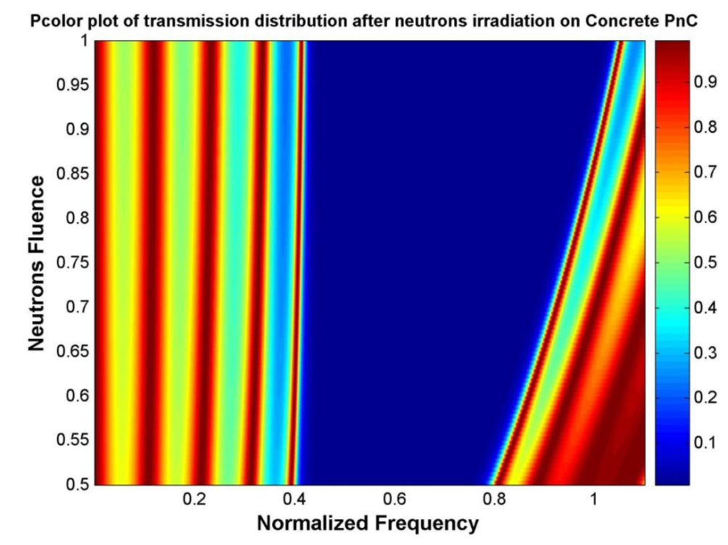

ENPPC#3, Hurghada 2018
$E_{c}$/ $E_{co}$

Slide 13
ENPPC#3, Hurghada 2018
The sensitivity of the concrete PnC to neutrons fluence .

Slide 14
TH-PMM Group. Physics department, Faculty of science
Beni -Suef University
ENPPC#3, Hurghada 2018
1-Therefore, in order to construct neutrons detector based on the concrete material, effects of the induced temperature has to be taken into account.
The transmission spectra of the (Concrete/Epoxy)⁵ PnC were re-calculated at neutrons fluence of 1×10¹⁹ n cm⁻² at temperature influences.

Slide 15
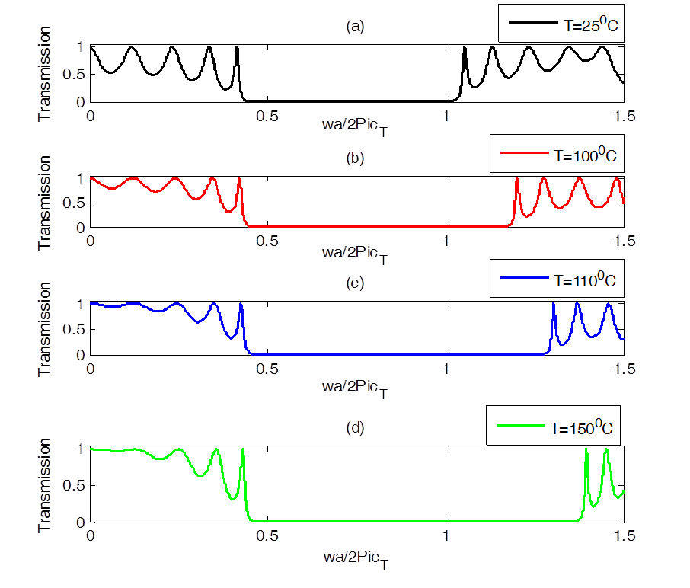
TH-PMM Group. Physics department, Faculty of science
Beni -Suef University
ENPPC#3, Hurghada 2018
2- The temperature effect on the concrete PnC was opposite to the influence of neutron irradiation.
3- Epoxy Young's modulus decreased much larger than of the concrete with temperature effects.

Slide 16
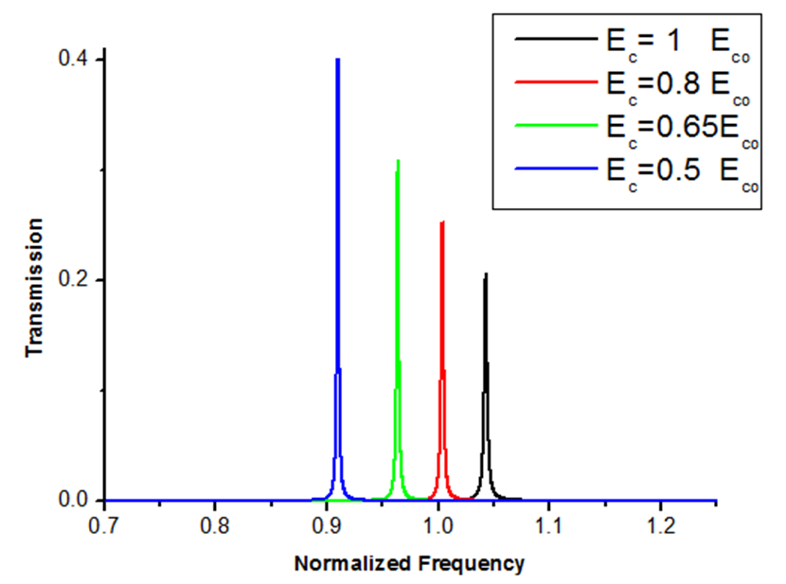
TH-PMM Group. Physics department, Faculty of science
Beni -Suef University
ENPPC#3, Hurghada 2018
Local resonance in a 1D concrete phononic crystal.
(Al/Epoxy)⁴ with concrete in the middle.

Slide 17
TH-PMM Group. Physics department, Faculty of science
Beni -Suef University
ENPPC#3, Hurghada 2018
Conclusions Future Research
Neutron detection is achieved over a wide range of fluence by phononic crystals using a material of great practical importance Concrete.
* Studying a detector capable of detection ions from Z = 1 to 92, based on phononic crystal.

Slide 18



Slide 19
TH-PMM Group. Physics department, Faculty of science
Beni -Suef University

