Slide 1
Formation of nanostructured functional elements in
TiO₂-PVTMS-Ag-La nanocomposites for photocatalytic applications
Sohrab Nasiri and Giedrius Janusas
Department of Mechanical Engineering and Design
Notes:
Hello audience. I hope every thing goes safe for you. I am Marzieh Rabiei PhD student in Mechanical Engineering field. The topic of my dissertation is “DEVELOPMENT AND ANALYSIS OF NANOCOMPOSITE BASED ON HYDROXYAPATITE (HA) FOR APPLICATION IN BIOENGINEERING ” My supervisor is Professor Arvydas Palevicius and my advisor is Professor Giedrius Janusas.

Slide 2
Introduction
Nanotechnology is one of the most important of technologies, whose applications are associated with lower costs, longer life, lower energy consumption, and better properties. The best way to clean contaminated sites is to use a photocatalyst nanocomposites, which is suitable for a large number of pollutants
Among all existing photocatalysts, titanium oxide (TiO₂) was considered for its non-toxicity and availability, high stability, high photochemical properties and corrosion resistance.
Photocatalysts are a group of catalysts that act when exposed to light. Photocatalysts are usually solid semiconductor oxides in which the absorption of photons creates electron-hole pairs that can react with molecules on the surface to produce active radicals
PVTMS is synthesized by polymerization of VTMS [4]. The features of vinyl group (–CH–CH₂) in the structure of PVTMS can be used to perform free radical polymerization. Moreover, PVTMS can improve the thermal stability and physical properties of the framework

Slide 3
Synthesis route for nanocomposites
100 ml of 2-propanol was poured into the dish, then lanthanum nitrate was added and the sample was stirred for 1 hour. After the lanthanum nitrate dissolved completely and the solution became reasonably transparent, silver nitrate was added and stirred. After the above time has elapsed and the silver nitrate has completely dissolved and the solution has become homogeneous, titanium isopropoxide is slowly added to the solution, and after 1 hour, distilled water is added dropwise until a gel is formed. 2) Then the gel was heated at 120 °C for 30 minutes and the gel was converted into powder. 3) Then the powder was washed with distilled water and filtered, then the product was put into the oven for 2 hours at 200 °C under the air environment for calcination process. Two composites with different weight percentages of the TiO₂ and PVTMS components were synthesized, consisting of
(1) [TiO₂ (82 wt.%)-PVTMS (5 wt.%)-Ag (2 wt.%)-La (11 wt.%)] and (2) [TiO₂ (80 wt.%)-PVTMS (7 wt.%)-Ag (2 wt.%)-La (11 wt.%)]

Slide 4
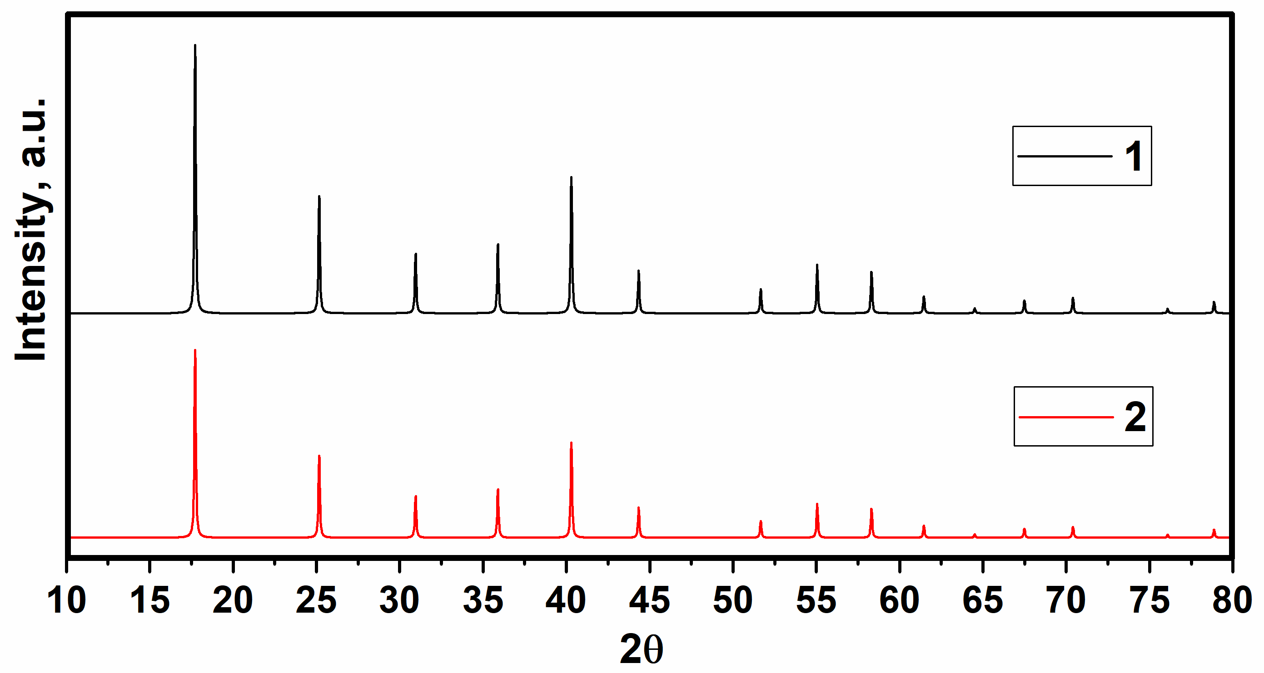
X-ray diffraction analysis
The modified scherrer method was used for calculating nanocrystallite size
values of nanocomposites and the values were gained at the range of 61 and 57 nm respectively for compounds 1 and 2.
As, it is predicted with increasing PVTMS the crystalline size was decreased.
Figure . X-ray diffraction of nancomposites 1 and 2

Slide 5
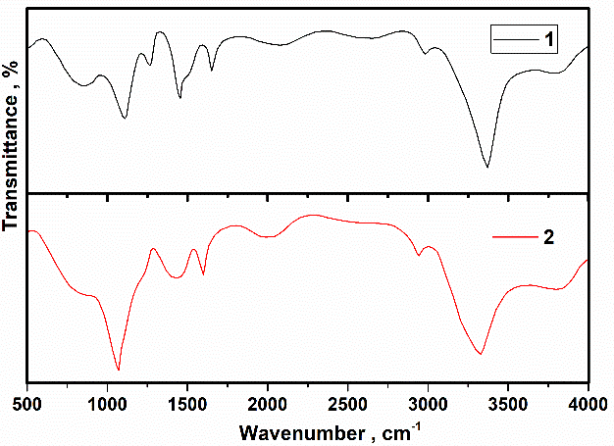
Investigation of FTIR
Bending vibrations of Si­–OH can be associated with the peaks at 1300 and 1650 cm⁻¹, and the peaks at around 800 cm⁻¹ can be correspond to Si–O and Ag–O In addition - OH groups have suggested the existence of PVTMS and the small range of wavenumber value of 956 cm⁻¹ may be from La oxide and PVTMS
Figure. FTIR spectra of compounds

Slide 6
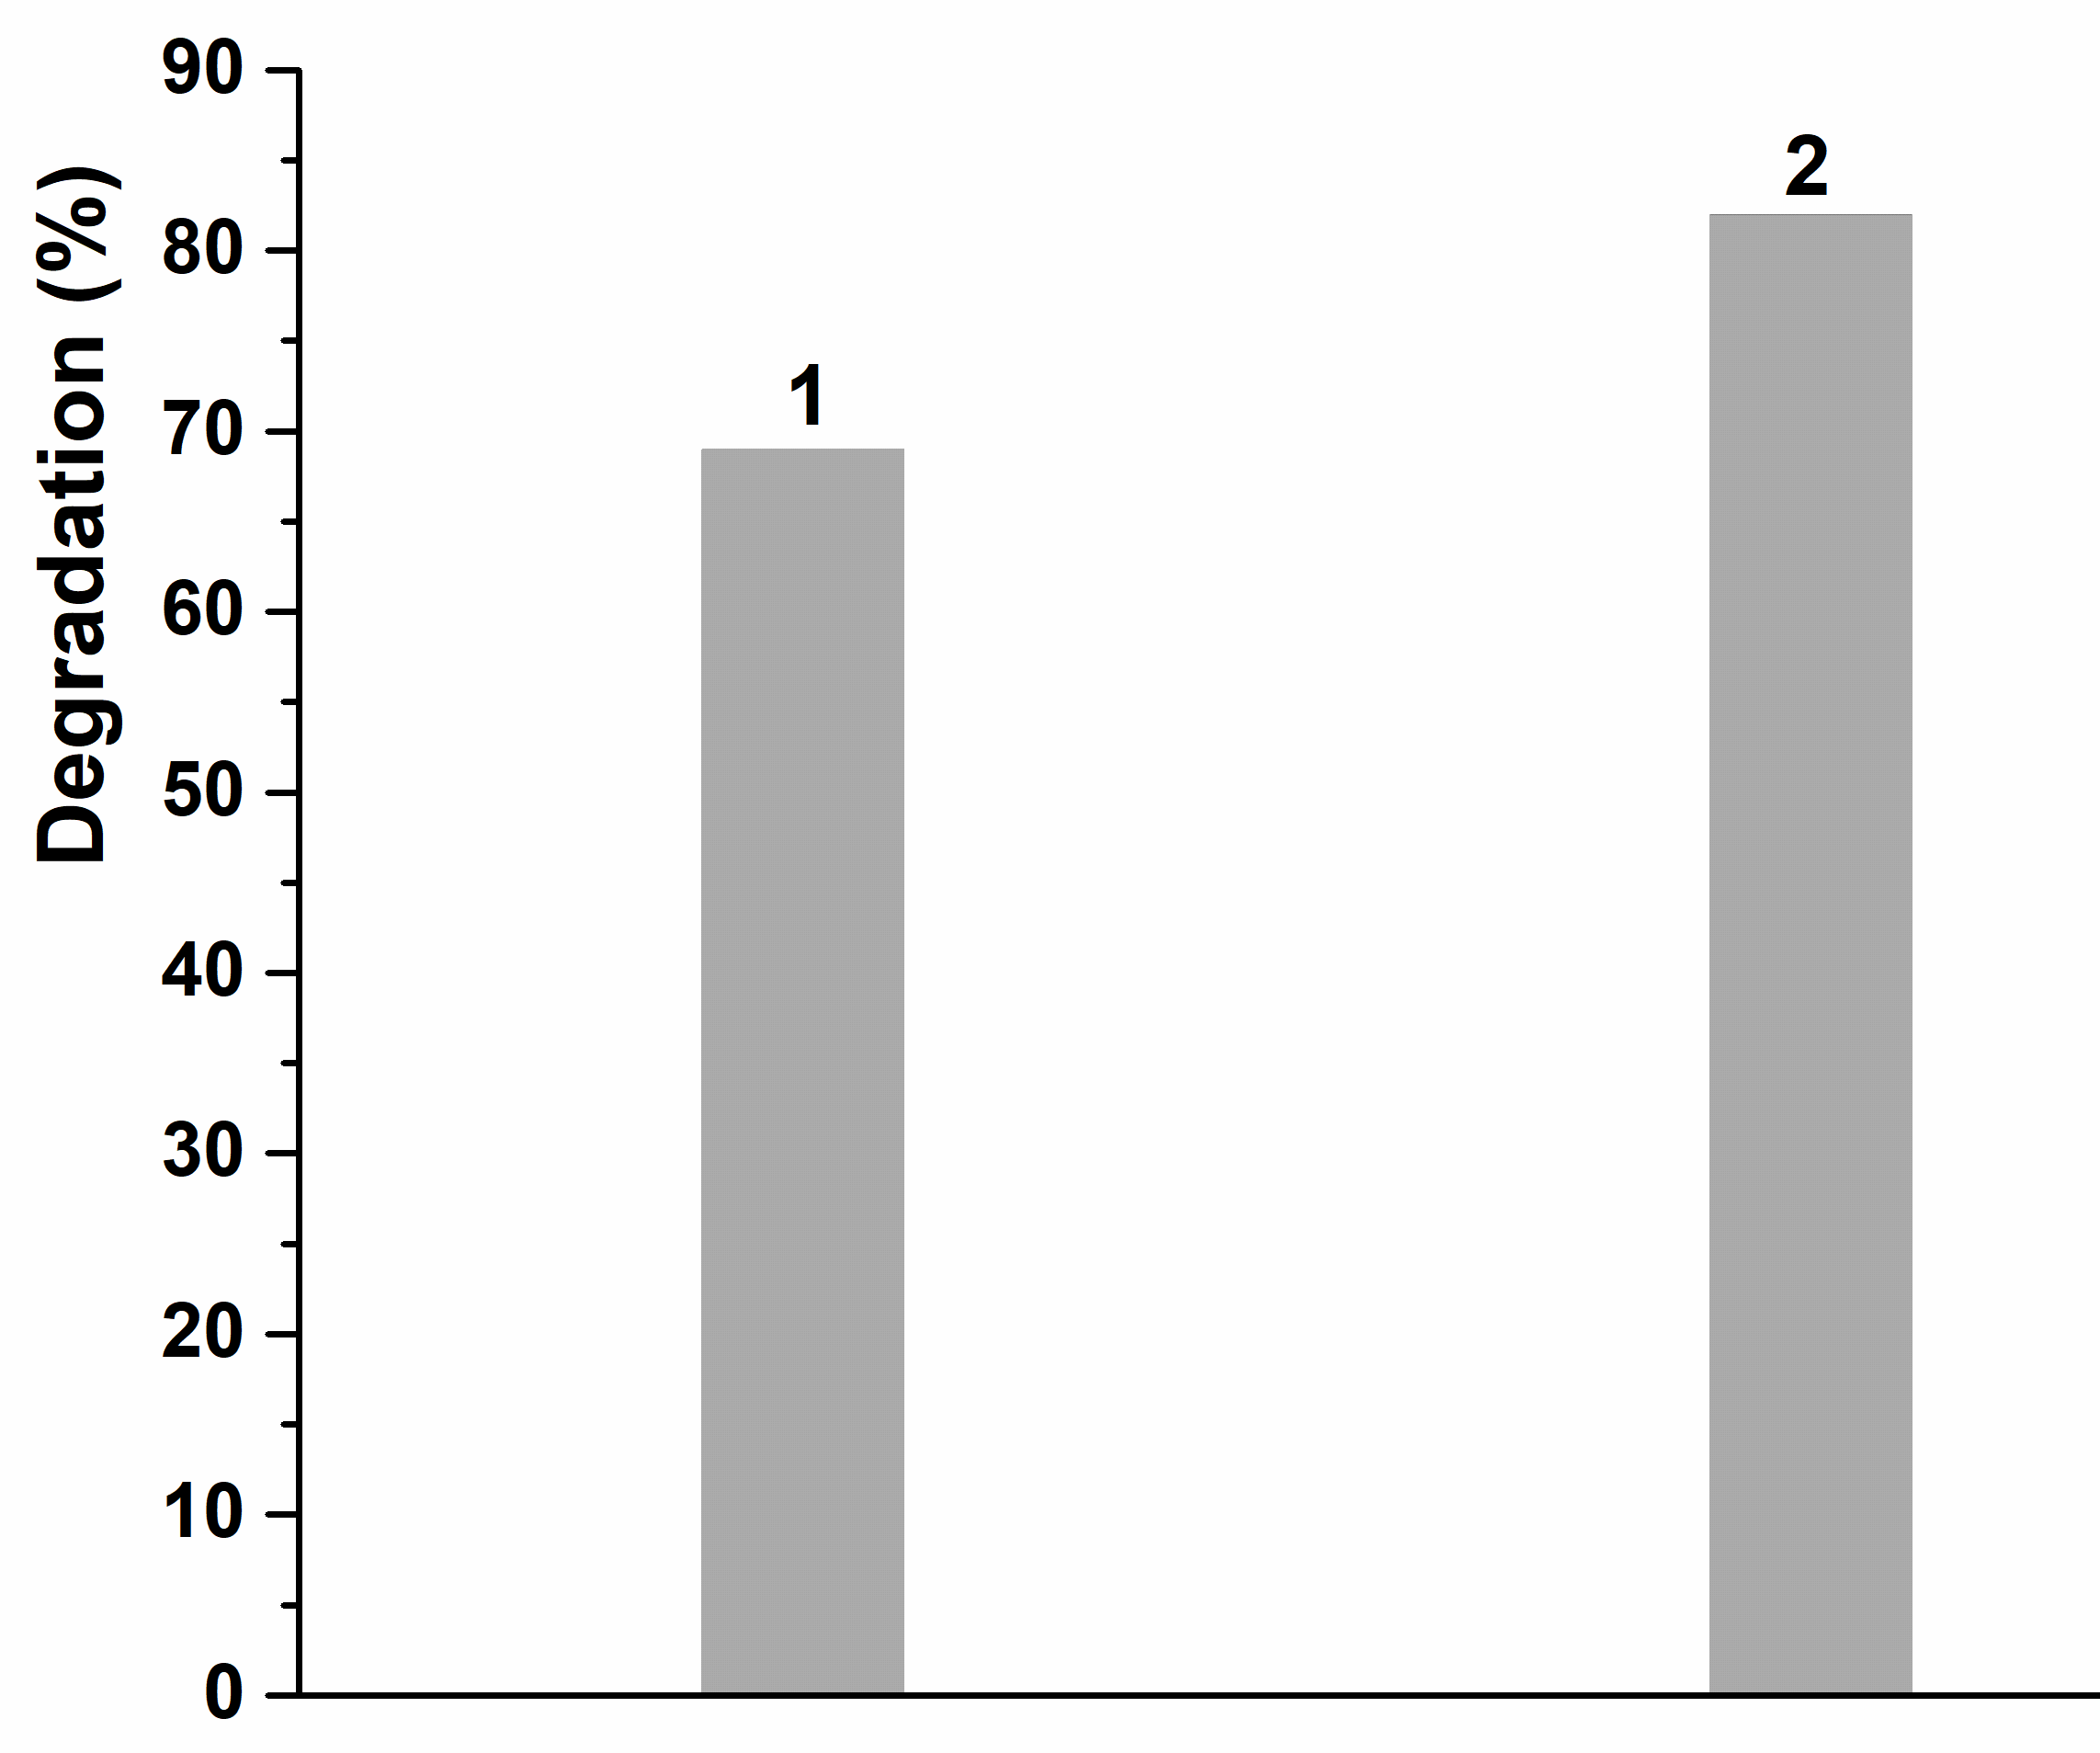
Degradation analysis
The destruction results are shown in Figure. These samples were added to a solution of 20 ppm methylene blue with a pH of 9 and initially stirred for 10 minutes in a dark room with the test of turned off/on UV lamp. From the diagram, it can be seen that the amount of 7% PVTMS in the shows a better result compared to the other sample since larger amounts with agglomerated particles reduce the surface area and thus the degree of destruction is also lower
Figure. Degradation curve of compounds

Slide 7
Degradation curve of compounds
The results showed that the sample 1 with the nanocomposite tested in the absence of light as an absorbent had an absorbance of 68.20% under the same optimal conditions and in a period of 1 hour. It can be concluded that the prepared sample was not efficient in the absorption process and can be expected to have a high activity only as a photocatalyst in the degradation process.
Figure . Comparison of the optimal degradation and absorption performance of photocatalysts in the presence and absence of light

Slide 8
Conclusions
1) In this study, TiO₂ -PVTMS -Ag -La nanocomposite was synthesized by sol-gel method at the appropriate calcination temperature. 2) The size of nanocrystallites was detected by XRD diagram, and the amorphous phases were not observed. 3) FTIR was used and the group bands of the nanocomposites showed that there were no impurities in the compositions. 4) Nanocomposite 2 showed the better behavior in the degradation test. 5) The increasing percentage of PVTMS improved the degradation efficiency as photocatalyst nanocomposite sample.
Acknowledgments: This project has received funding from European Social Fund (project No 09.3.3-LMT-K-712-23-0156) under the grant agreement with the Research Council of Lithuania (LMTLT).

Slide 9
Thanks
for
your attention
44
Notes:
I tried for speaking shortly according to the limitation of time of presentation. Thanks for you attention.

