Slide 1
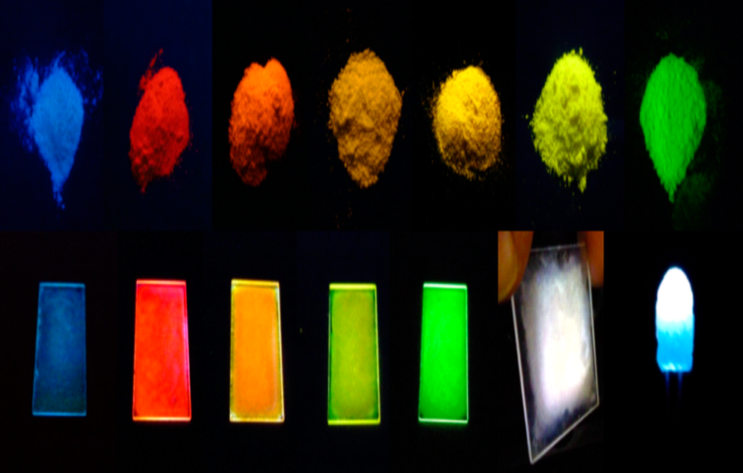
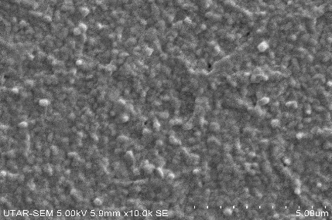
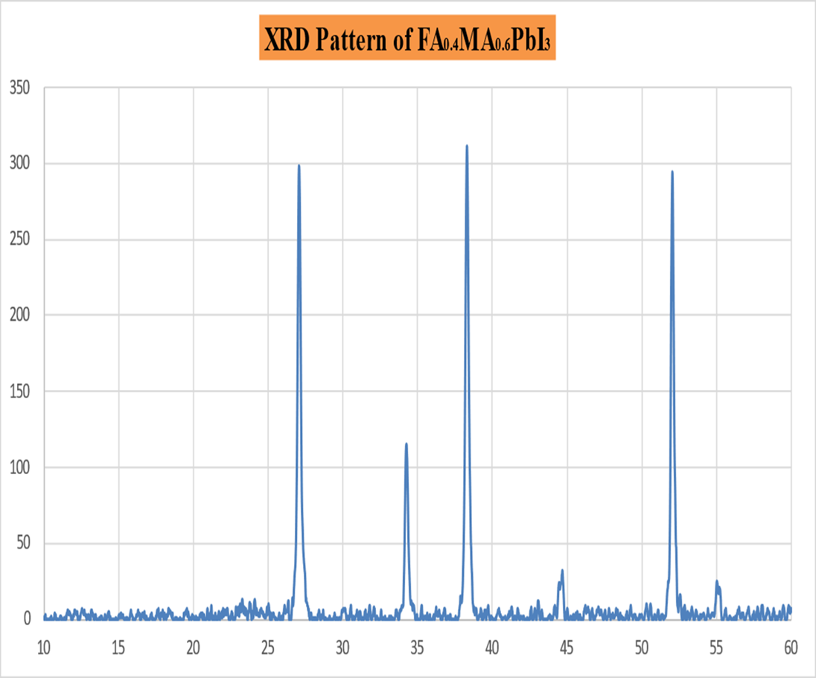
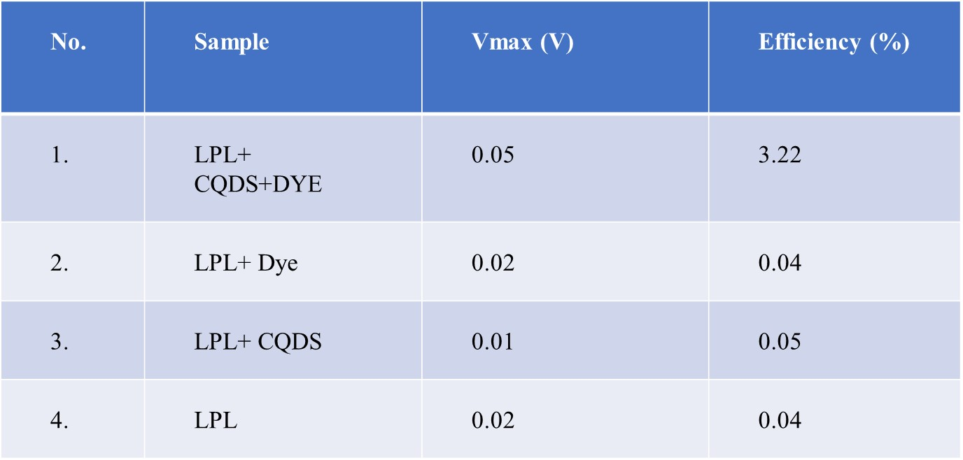
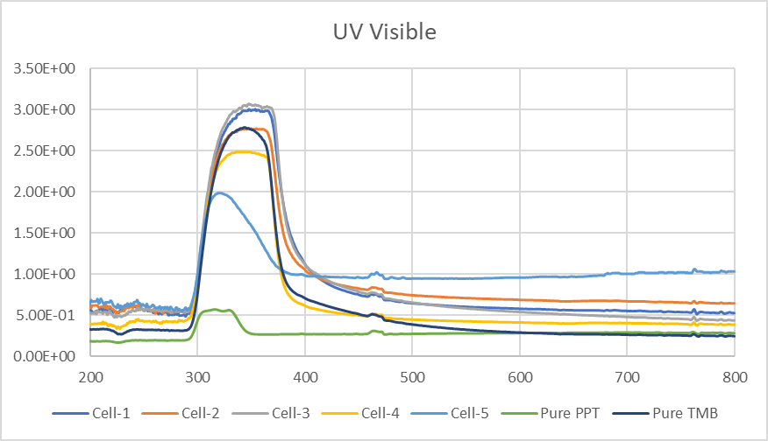
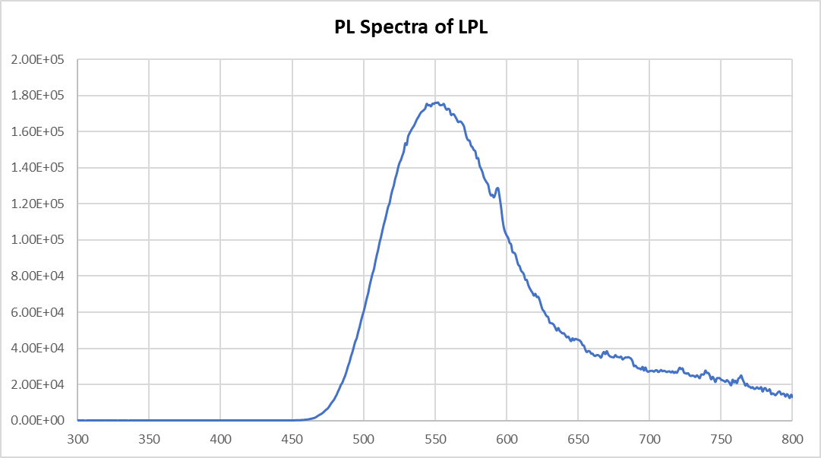
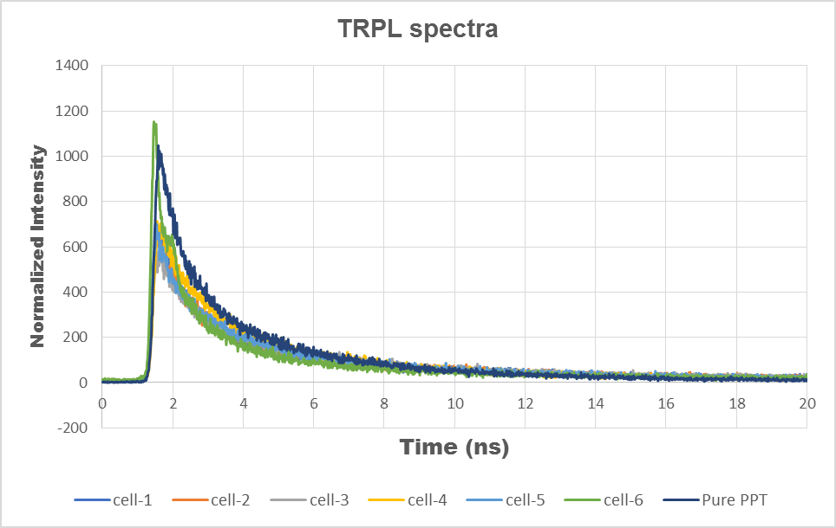
A short study of perovskite solar cells with the incorporation of long persistent luminescence material
Tejas Sharma, Jun Hieng Kiat
Department of Mechanical and Materials Engineering, Lee Kong Chian Faculty of Engineering and Science, Universiti Tunku Abdul Rahman, Sungai Long Campus, Bandar Sg. Long, 43000 Kajang, Malaysia
Abstract
Objectives
Concerning global climate change and the energy crisis, technologies relying on non-fossil renewable energy sources are in high demand. Solar energy appears to be one of the finest alternatives among all non-conventional energy resources due to its economic capability and environmental sustainability. Perovskite materials have great potential for use as active materials in third-generation solar cells, thanks to their wide spectrum absorption, low excitation binding energy, and long excitation diffusion length. In this work, we studied the room-temperature mixed-cation perovskite material FAMAPbI3 for perovskite solar cells (PSC). To enhance the performance of the PSC samples, we integrated a layer of organic long persistent luminescence (LPL) material into the samples. X-ray diffraction (XRD), scanning electron microscopy (SEM), and photoluminescence (PL) spectroscopy were carried out to identify the phase, morphology, and emission spectra, respectively. We discuss the luminescence material and its application in solar cells, as well as the afterglow effect. The optimized ratio of the LPL material will be used in the fabrication of laboratory-scale PSC.
To assess the performance of mixed cation perovskite solar cells with the incorporation of blended organic LPL materials (i.e., TMB and PPT).
Highlights of LPL
Emission of light from a material at a specific wavelength
This material has the ability to glow in the dark after being excited by the light
Methodology
Preparation of LPL
Synthesis of FAMAPbI3 Perovskite
Add 2% of DMSO
Spin-coating (layer by layer)
Fabrication of Device
Data Analysis
I-V Analysis
XRD, SEM
Results and discussion
I-V measurement of LPL with solar cell
Figure 1. SEM of Perovskite
Figure 2. XRD of Perovskite
Conclusion
The FAMAPbI3 based perovskite material has been successfully synthesized under in-room ambient conditions. The synthesized material is characterized under various techniques such as:, SEM, XRD, PL spectroscopy.
Long persistent luminescent (LPL) materials as an afterglow effect (ETL) has been studies and characterized. Due to afterglow mechanisms of LPLs, they are being in the design of the PSC in future.
In this work, we present perovskite solar cells that can generate electricity like DSSC in the daytime and in the dark by incorporating long persistence luminescence material.
Figure 3. UV-VIS of TMB:PPT (with varying ratio)
Figure 4. PL of LPL (Cell-3)
FAMAPbI3 film has the largest grains because of the FA+, perovskite film has a better compact surface with larger grain size.
The main peaks are located at around 25.02 , 34.2 ° , 38.2 , 52.02 and for the mixed-cation FA_{0.4}MA_{0.6}PbI₃ perovskite film which clearly match with reported perovskite literature.
Cell-3 has the highest absorbance rate among the all cells.
Acknowledgment:
This work was supported by the AOARD grant (award no: FA2386-21-1-4106).
Figure 5. TRPL of Cells with varying ratio

