Slide 1


The Influence of Dairy Rumen Anaerobic Bacteria Inoculum on Biogas Process
Presented at the The 2nd International Electronic Conference on Processes
Bronius Žalys¹*, Kęstutis Venslauskas², Kęstutis Navickas², Egidijus Buivydas¹, Mantas Rubežius²
1. Lithuanian Energy Institute; Breslaujos g. 3, LT−44403, Kaunas.
2. Vytautas Magnus University, Faculty of Engineering; K. Donelaičio g. 58, LT−44248, Kaunas

Slide 2
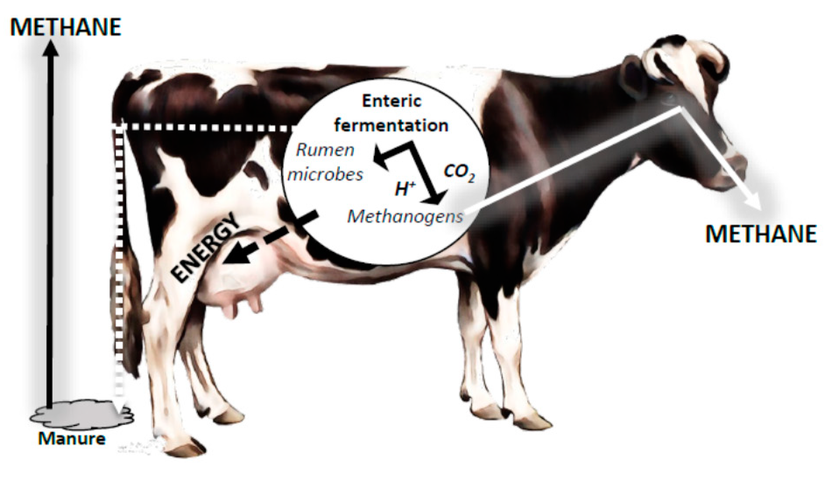
Introduction (1)
Recent research related to the degradation of lignocellulose in biogas processes has had a strong focus on the microorganisms involved, with the aim of further under-standing and improving degradation.
Improving the performance of the microbial strains for an efficient conversion of sugars from complex substrates (hydrolysates produced from lignocellulosic biomass) is an important question to be solved to support the large-scale implementation of these bioprocesses.
Employing a combination of two or more microbial species for bioprocessing biomass into biogas remains an underrated strategy to increase processing efficiency. Revolutionizing biotechnological biomass usage, a cutting-edge approach involves synergizing multiple microbial species for bioprocessing may enhance overall process efficiency.

Slide 3
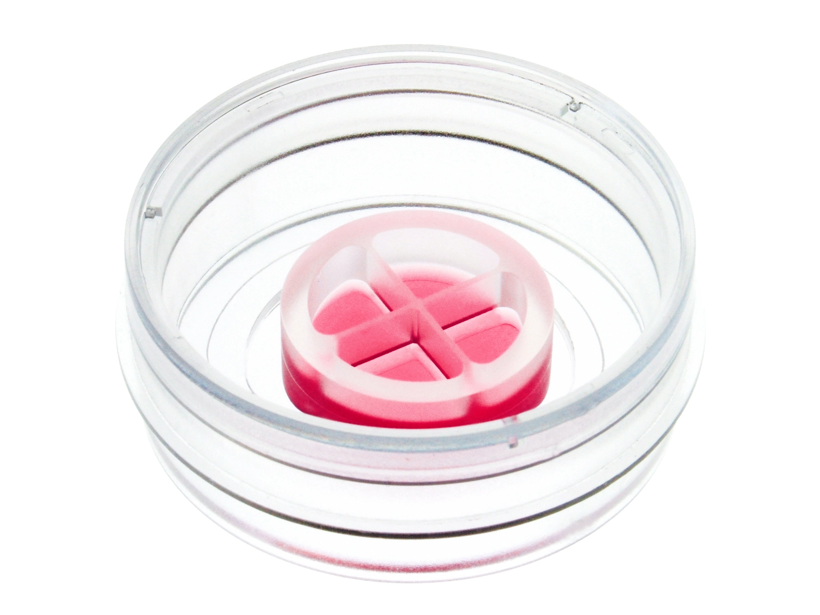
Introduction (2)
This microbiological co-cultivation approach can potentially alleviate some of the problems associated to the lignocellulose biomass use in biogas process.
The general idea of this concept is to take advantage of the specialized ability of two or more organisms and create a synergistic effect. Since multiple strains are used in a single process, a broader variation in beneficial characteristics can be selected. Optimization of a co-cultivation process could then be performed by selecting the right strains to be combined, instead of engineering one do-it-all strain.

Slide 4
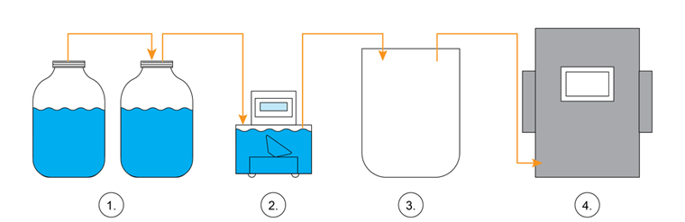
Hypothesis and the aim of the research
The addition of rumen fluid to the anaerobic digestion process can significantly enhance biogas production by providing a diverse range of microorganisms that possess the necessary enzymatic activity to break down complex lignocellulosic materials.
The aim of the work was to investigate the influence of rumen anaerobic bacteria inoculum on biogas yield and quality from alfalfa biomass using single-load biogas yield experiment with a biochemical methane potential test bench (BMP).
Fig 1: Technological research scheme. 1 – a set of BMP bioreactors, 2 – Ritter Miligascounter, 3 – Tedlar biogas bag, 4 – Awite Bioenergie GmbH AwiFlex biogas analyzer.

Slide 5
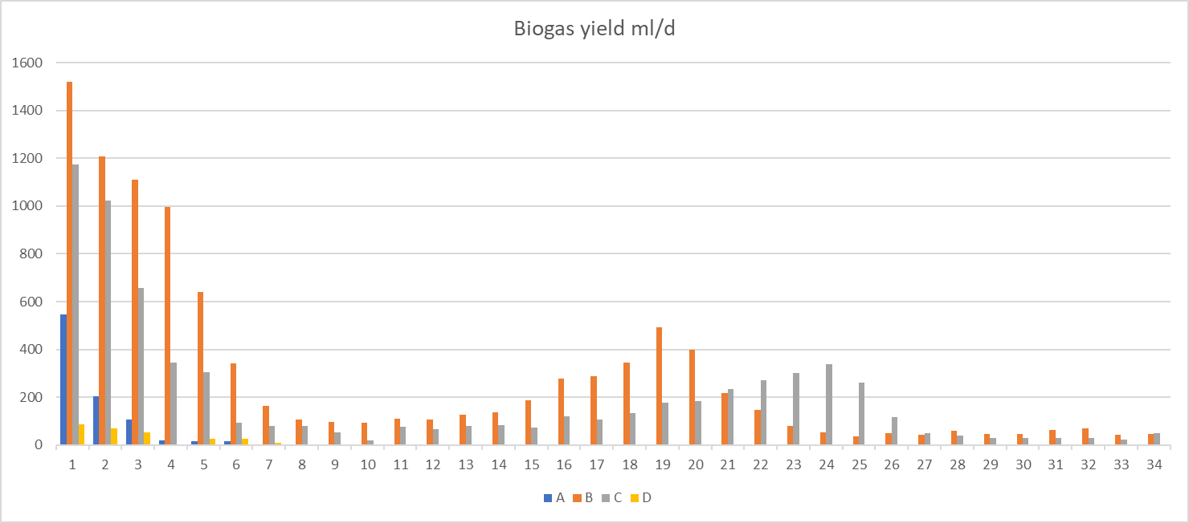
Results and Discussion (1)
The results of the BMP experiment indicated that the highest volumetric biogas yield of 12,17 ± 0,62 L/L was achieved in test B, where a combination of rumen fluid and digestate was used as an inoculum for alfalfa leaves. The second highest volumetric biogas yield of 8,41 ± 0,45 L/L was obtained in test C, where bioreactor digestate were used as inoculum for alfalfa leaves. These findings suggest that the increase in biogas yield was due to the presence of highly active cellulolytic and hemicellulolytic enzymes, which are combined in extracellular multienzyme complexes known as cellulosomes.
Fig 2: Daily biogas yield.
“A” 800 grams of rumen fluid (proportion 100%/0%),
“B” 400 grams rumen fluid and 400 grams digestate from laboratory bioreactor using wheat straw as a feedstock (proportion 50%/50%),
“C” 800 grams wheat straw digestate (proportion 0%/100 %).
“D” was started without any alfalfa addition and it served as a negative control sample

Slide 6
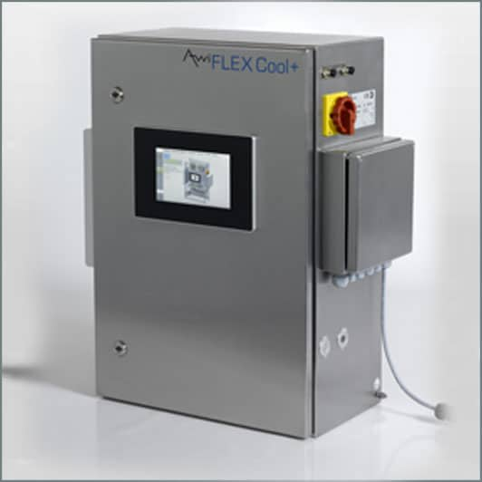
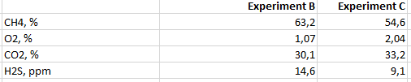
Results and Discussion (2)
The concentration of methane in the biogas was also dependent on the inoculum used for the research. It’s necessary to mention that only B and C experiments gained enough biogas to analyse it with Awite biogas analyser. The highest concentration of methane was gained from experiment B (63,2 ± 1,5 %). Biogas gained from digestate (experiment C) had a lower concentration of methane, at 54,6 ± 1,1%). This finding fulfils the conclusions from the experiment conducted by Zheng et al. 2019, which demonstrated that a ratio of 1:5 of rumen microorganisms to biogas slurry yielded high methane production and content, thereby establishing it as the optimal ratio.

Slide 7
Results and Discussion (3)
The biomethane yield from alfalfa volatile solids using obtained in experiment B and experiment C was respectively 598 ± 8,3 and 357 ± 12,4 L/kg. The employment of digestate and ruminant inoculum resulted in a 32% increase in biomethane yield, in contrast to the C sample, where pure digestate was used as an inoculum. The experiment B yielded a biomethane yield of 668 ± 12,2 L/kg from the total solids of alfalfa, whereas the experiment C produced a biomethane yield of 462 ± 18,3 L/kg.
Hakl et al., 2012 performed experimental research on alfalfa biomethane yield. In their experiment approximately from 250 to 390 L CH4/kg VS of lucerne forage was obtained [11]. Comparison of research results suggest that optimizing the conditions of alfalfa digestion, such as feedstock characteristics, inoculum type, and operating conditions, will lead to improved biomethane yields.
Experimental results of the research complements the (Nagler et al. , 2019) research that the inclusion of rumen liquid enhances the degradation of complex lignocellulosic compounds by providing a diverse range of cellulolytic and hemicellulolytic microorganisms [12]. This leads to an increase in biogas production and improved process stability. The authors suggest that the addition of rumen liquid could be a simple and effective strategy to enhance the performance of lignocellulose-degrading biogas plants.

Slide 8
Conclusions
Through a series of laboratory BMP experiments, the effect of using rumen fluid dairy cows as an inoculum on biogas production rate was studied.
Experiment B, which inoculated rumen fluid and digestate, yielded the maximum volumetric biogas yield of 12,17 ± 0,62 L/L. The second largest volumetric yield of biogas was observed in experiment C, which used only digestate as inoculum, with a yield of 8,41 ± 0,45 L/L. The combination of rumen fluid and digestate in the inoculum for experiment B resulted in a 30,9% increase in biogas production from the same quantity of alfalfa biomass.
Dairy rumen fluid inoculated BMP experiment resulted a methane concentration of 63,2 ± 1,5%, while digestate inoculated experiment yielded a slightly lower concentration of methane at 54,6 ± 1,1%. Therefore, the use of rumen fluid in combination with digestate increased the methane concentration by approximately 8,6% (63,2 - 54,6) in methane content in biogas.
The biomethane yield from alfalfa volatile solids obtained in experiment B and experiment C was respectively 598 ± 8,3 and 357 ± 12,4 L/kg.
The employment of digestate and ruminant inoculum resulted in a 32% increase in biomethane yield, compared to the C sample, where pure digestate was used as an inoculum.
These findings suggest that utilizing a mixture of rumen fluid and digestate as the inoculum can significantly enhance the biogas pro-duction from alfalfa biomass.

Slide 9
Thank you for attention
Bronius Zalys
Bronius.zalys@lei.lt

