Slide 1
Focusing on eco-friendly adsorption method: Removal of endocrine-disrupting Cu²⁺ ions by iron shavings
Hakan Çelebi ^{1*}, Tolga Bahadır ², İsmail Şimşek ³ and Şevket Tulun ⁴
Aksaray University, Department of Environmental Engineering
¹Aksaray University, Department of Environmental Engineering
²Aksaray University, Department of Environmental Engineering
³Aksaray University, Department of Environmental Engineering
⁴Aksaray University, Department of Environmental Engineering
* Corresponding author: hakancelebi@aksaray.edu.tr

Slide 2
Abstract: Today, the common problem of all countries of the world is the presence of different environmental pollutants in water, air and soil environments. In particular, endocrine disruptors represent a broad group of pollutants. Copper, which is both in this group and among the heavy metals, reaches aquatic environments directly and indirectly from anthropogenic activities. The adsorption process is the most environmentally friendly, economical and practical method to prevent pollution caused by these Cu²⁺ ions, and intensive studies have been carried out on this method in recent years. The main target in these studies is to prefer adsorbents that do not cause pollution after removal. In this study, iron shavings (FeS) was considered to be used as an adsorbent. Laboratory scale batch analyzes were performed in synthetic solution un-der constant stirring speed (150 rpm) and temperature (20±2 ⁰C) with different pH (2.0 - 6.0), FeS dose (0.1-5 g) and contact times (1-60 minutes). The maximum removal efficiency of Cu²⁺ was determined as 78% under optimum operating conditions. The aim of this research article is to understand the application possibility of FeS adsorbent for efficient removal of Cu²⁺. Interestingly, laboratory studies have shown that the use of FeS adsorbent can efficiently remove the endocrine disrupting Cu²⁺
Keywords: adsorption; adsorbent; eco-friendly; copper ions; iron shavings

Slide 3
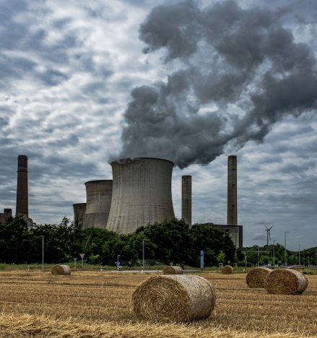
Introduction
One of the high potential pollutant groups that endanger the health of humans and other living things is endocrine disrupting chemicals. Living habits, technological developments, production-oriented industrial activities increase their presence in the environment on an international scale. This group of pollutants is wide and they show disruptive effects on the hormonal system of living things. Heavy metals, dyes, and pharmaceuticals are at the forefront of endocrine disruptors. They are not biodegradable by natural mechanisms and accumulate in living things through the food chain. According to the USEPA, seven heavy metals (Pb, Cr, Zn, Cu, Cd, Hg, Ni) are listed as the most common heavy metals in the environment. Heavy metal pollution has been a research topic for many years.

Slide 4
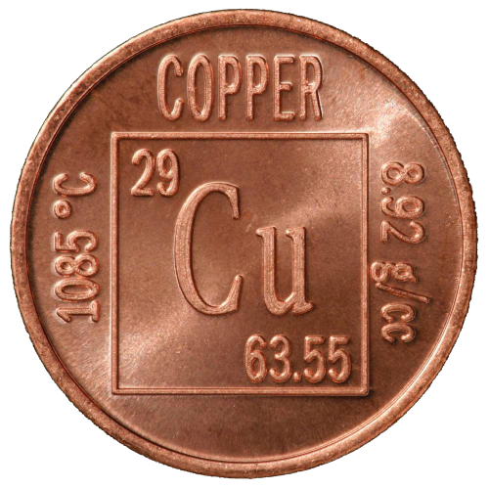
Introduction
Copper is a widely used material in a wide variety of fields such as electronic appliances, construction, food preparation industry, energy industry, automobile industry, livestock, tanneries, cosmetics and jewelry. All these applications increase the use of copper and are reflected in the receiving waters as copper input. [8,9]. High copper exposure can lead to anemia, gastrointestinal problems, hair loss and kidney failure. [7,10]. As a result, wastewater containing copper ions (Cu2+) must be treated before being discharged into the natural water flow.

Slide 5
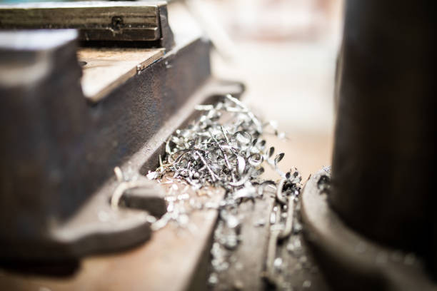
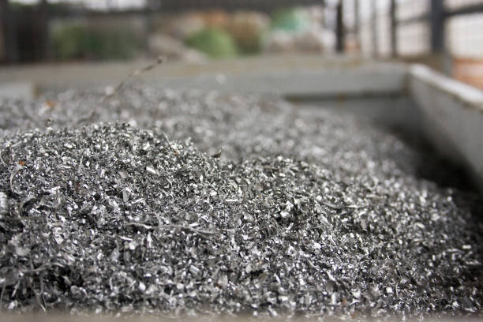
Apart from adsorption, these methods have disadvantages such as expensive chemical requirements, low removal efficiencies and generation of secondary wastes. Among these methods, the adsorption process is more advantageous than other methods in terms of simple design, cheap, fast, and environmental friendliness. [4,11]. In addition to adsorption, the adsorbent used should also be economical. Therefore, different alternatives have been evaluated. [12,13]. Evaluation of some wastes originating from industrial sectors in this process is important in terms of both recovery and heavy metal removal. In particular, iron shavings (FeS) is produced in the iron and steel industry with high iron content and in areas where iron is used intensively. [14]. The structural state of FeS facilitates its use as an adsorbent. FeS is evaluated in terms of different properties such as high selectivity, high adsorption capacity, active surface, pore distribution quality and surface functional groups. As a result, the treatment of Cu2+ ions of FeS as an adsorbent source under optimum adsorption conditions was evaluated. The primary aim of this study is to support a circular economy and to minimize the dangerous impact of waste. Therefore, the experimental results of this study can serve as a guide for the iron production industry in terms of waste management for the efficient and environmentally friendly treatment of wastewater containing metal ions. For this reason, the effects of optimum solution pH, contact time and amount of adsorbent on the adsorbent capacity were investigated and the results obtained were evaluated.

Slide 6
Material and Methods
All chemicals used in the experiments performed in batch mode were obtained from Merck company with 99% purity. To prepare a 1000 mg/L copper stock solution, 3.928 g CuSO4.5H2O was weighed and prepared with distilled water (Millipore Elix Advantage) with a chemical resistance of 18 MΩ cm. In batch adsorption studies, solutions with a concentration of 100 mg/L prepared by diluting from the stock solution were used. Before adsorption, the initial pH values of the solutions were adjusted with a digital pH meter (HANNA pH 211). The industrial waste raw material used in the research was collected from the relevant sector in the organized industrial site of Aksaray Province. FeS was washed with distilled water before being used as an adsorbent. It was then dried at room temperature. The surface morphology and element distribution of FeS were investigated by scanning electron microscopy (SEM/EDX) (Hitachi-SU 1510). The functional groups of the material were carried out with Perkin Elmer brand Fourier Transform Infrared Spectroscopy (FTIR) device in the range of 4000-500 cm-1. Adsorption studies were carried out in a discontinuous order in 250 mL flasks with a closed mouth. In order to determine the amount of Cu2+ adsorbed, the filtered samples were analyzed in an inductively coupled plasma optical emission spectrometer (ICP-OES) (ICP-OES, 2100DV, Perkin Elmer, USA).

Slide 7
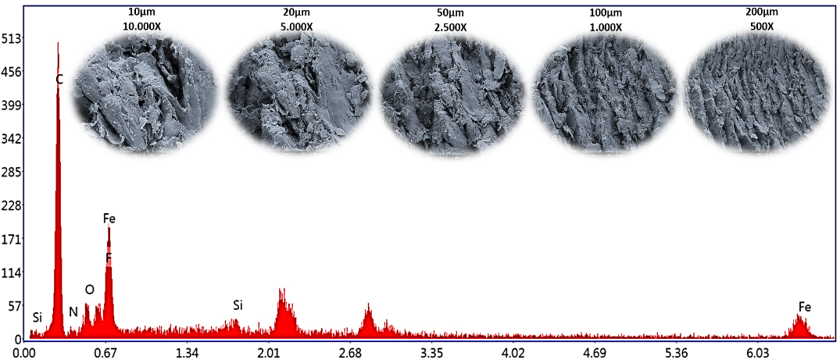
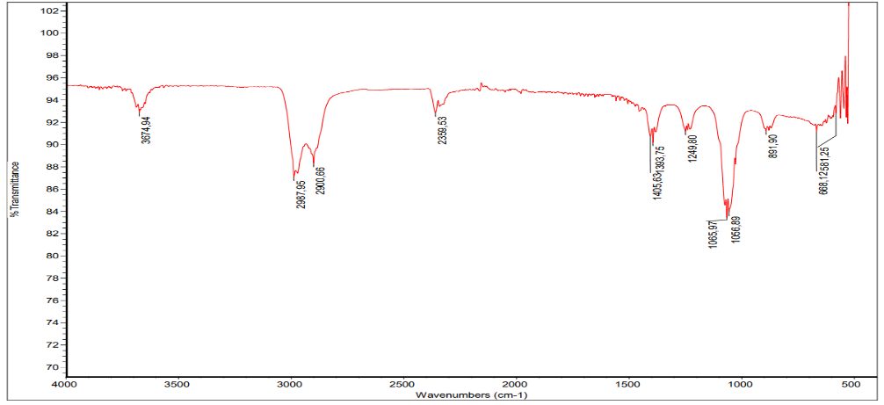
Results and Discussions
FeS Morphological Element Analysis
The SEM and EDX distribution of FeS are shown in Figure 1. SEM images of the FeS surface before Cu2+ adsorption were examined at different magnifications and the results showed a heterogeneous, microporous surface (Fig. 6a). The porous structure of FeS allows faster interaction with Cu2+. EDX analysis was used to determine the FeS surface composition (Figure 1). According to the elemental change analysis in FeS, by weight; It consists of the elements C (56.62%), O (7.51%), N (4.45%), F (4.37%), Fe (25.04%) and Si (2.02%). EDX spectra showed that FeS consisted mostly of C and Fe. This result can be referred to the fact that the adsorption mechanism of Cu2+ ions may be due to ion exchange. The surface chemistry of FeS was performed by FTIR analysis (Figure 2.). Eight different peaks (1405.63, 1393.75, 1249.80, 1065.97, 1056.89, 891.90, 668.12 and 581.25 cm-1) were detected in the fingerprint region. In this region, special vibrations such as O-H, C=C and C-H bending and C-O, C-N, C-I and S=O stretching take place. In the 4000-1500 cm-1 region, 3674.94, 2987.95, 2900.66 and 2359.53 cm-1 peaks are observed. These peaks form double (C=O, O=C=O) and single (O-H, N-H) bonds.
Figure 1. SEM images and EDX distribution of FeS.
Figure 2. FTIR analysis image of FeS adsorbent.

Slide 8
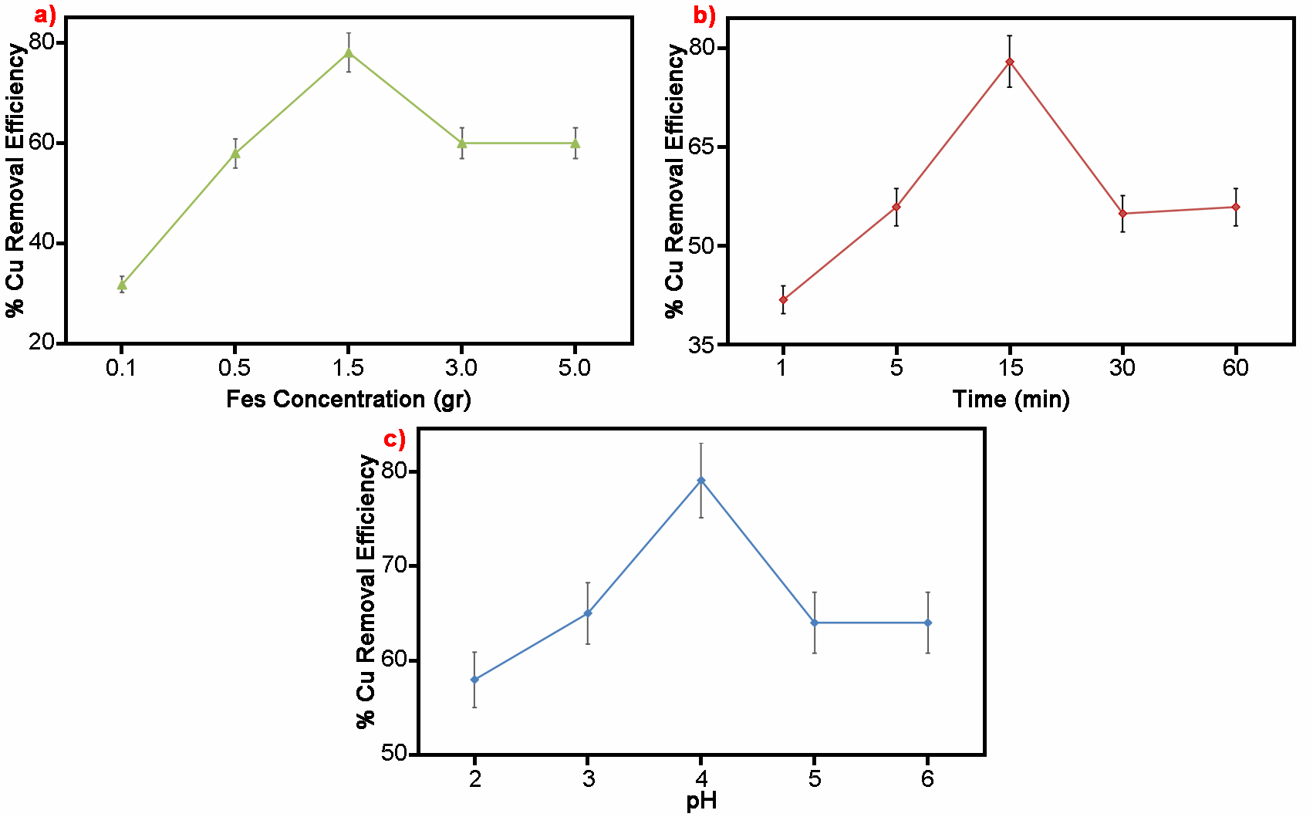
Effect of Adsorption Factors on Cu2+ Adsorption
Figure 3c shows the pH change of the study. As a result of the batch experiments carried out with 5 different pH values, the maximum Cu2+ removal efficiency of 79% was found at pH 4.53. At the acid level, chemical interaction is observed between the cations in solution and the main functional groups of FeS. The effect of FeS amount on Cu2+ removal was evaluated in the range of 0.1-5.0 g at 100 mg/L Cu2+ concentration at 20±2 °C at 150 rpm. Cu2+ removal rate increased rapidly up to 1.5 g FeS dose and decreased at 3 and 5 g doses (Figure 3a). It can be said that this is due to the effective FeS surface area distribution. The maximum Cu2+ removal efficiency was found to be 78% at a dose of 1.5 g FeS. As can be seen in Figure 3b, the contact time relationship between FeS and Cu2+ ions occurs in accordance with the adsorption process. Efficiency increased rapidly at the beginning, reaching a maximum of 78% within 15 minutes of contact time. The rapid adsorption process may be due to the denser free surface area of FeS for Cu2+ removal.
Figure 3. Changes of Cu2+ removal according to adsorption parameters a) FeS Concentration, b) Time, c) pH.

Slide 9
Isotherm and Kinetic Models Applied in Batch Experiments
The coefficients, correlation factors (R2) and equations of the obtained isotherm parameters are listed in Table 1 [13]. As can be seen in Table 1, the Langmuir model gave the best result to the experimental data of Cu2+ adsorption on FeS due to the highest correlation coefficient (0.999). The dimensionless fixed separation factor, RL, was 0.3251 for an initial Cu2+ concentration of 282.1 mg/L, showing favorable adsorption for Langmuir in the range 0 <RL <1. For Freundlich, the R2 (0.6841) value remained low. In this study, pseudo-first-order (PFO) and pseudo-second-order kinetic (PSO) mod-els, which are widely used in the adsorption process, were tested (Figure 5). When the kinetic parameters were compared according to Table1, the best correlation coefficient (R2=0.9903) was found in the PSO model. Studies of Cu+2 ions with different adsorbents are also suitable for second-order kinetic modeling.
Models | Equations | Coefficients
Langmuir | $$q_{e}=\frac{q_{m}K_{L}C_{e}}{1+K_{L}C_{e}}$$ $$R_{L}=\frac{1}{1+K_{L}{xC}_{e}}$$ | q_{m} (mg/g) | 15.64
 |  | K_{L} (L/mg) | 0.2978
 |  | R_{L} | 0.3251
 |  | R² | 0.9987
Freundlich | $$q_{e}=K_{F}\sqrt[n]{C_{e}}$$ | K_{F} (L/mg) | 30.323
 |  | n | 1.8103
 |  | R² | 0.6841
PFO | $$In\left(q_{e}−q_{t}\right)=Inq_{e}−k_{1}×t$$ | k₁(1/min) | 0.0122
 |  | q_{e} (mg/g) | 9.36
 |  | R² | 0.5950
PSO | $$\frac{t}{q_{t}}=\frac{1}{k_{2}×q_{e}^{2}}+\frac{1}{q_{w}}t$$ | k₂ (g/mg/min) | 0.1020
 |  | q_{e} (mg/g) | 15.45
 |  | R² | 0.9903
Figure 4. a) Langmuir b) Freundlich.
Table 1. Isotherm and kinetic coefficients.
Figure 5. Kinetic curves a) PFO, b) PSO.

Slide 10
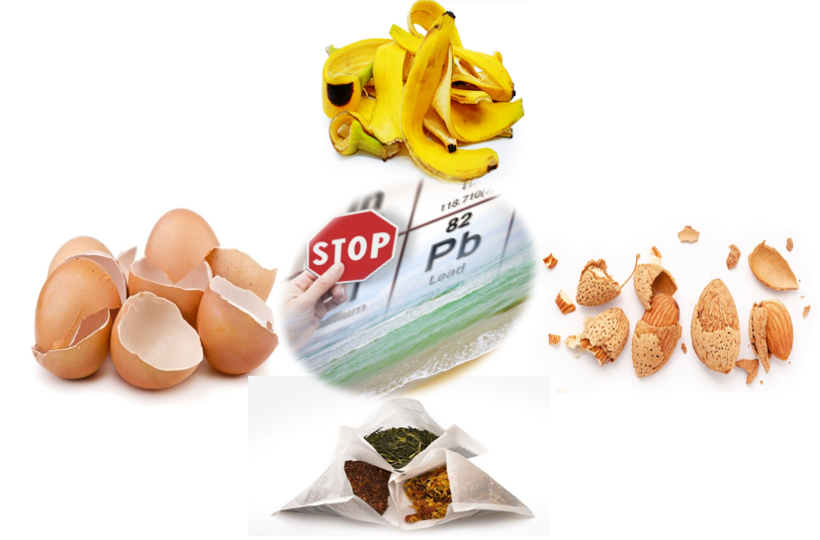
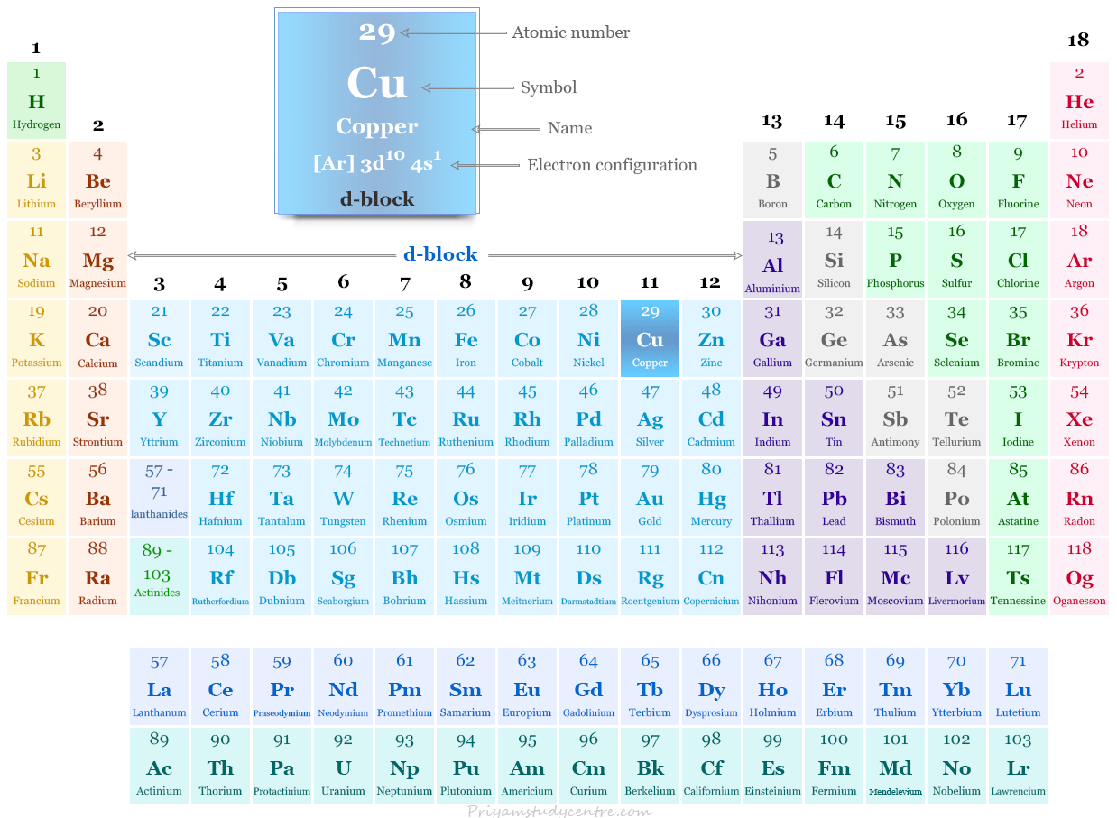
CONCLUSIONS
Infographics
Infographics
Infographics
Infographics
The study data showed that the adsorption of Cu+2 on FeS surface was dependent on pH, contact time and FeS dose. The maximum Cu+2 removal rate of FeS was obtained as approximately 78% under optimum conditions (pH: 4.53, time: 15 min, FeS dose: 1.5 g).The system was found to be more suitable for Langmuir isotherm and pseudo-second order kinetics.

Slide 11
Thank You

Slide 12
Focusing on eco-friendly adsorption method: Removal of endocrine-disrupting Cu²⁺ ions by iron shavings
Hakan Çelebi ^{1*}, Tolga Bahadır ², İsmail Şimşek ³ and Şevket Tulun ⁴
Aksaray University, Department of Environmental Engineering
¹Aksaray University, Department of Environmental Engineering
²Aksaray University, Department of Environmental Engineering
³Aksaray University, Department of Environmental Engineering
⁴Aksaray University, Department of Environmental Engineering
* Corresponding author: hakancelebi@aksaray.edu.tr

