Slide 1
Photocatalytic Degradation and Defluorination of Per- and poly-fluoroalkyl substance (PFAS) using Biosynthesized TiO₂ Nanoparticles under UV-visible Light
Saheed Mustapha, PhD (saheedmustapha09@gmail.com)
Federal University of Technology, Minna, Nigeria
May, 2023

Slide 2
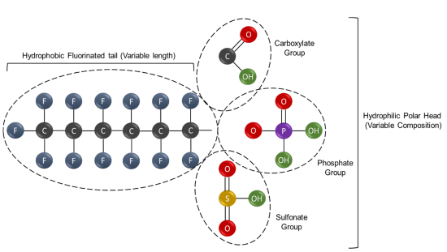
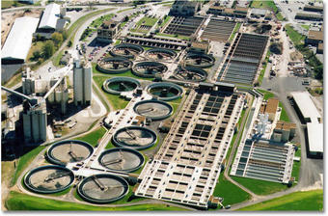
INTRODUCTION
Figure 1. Overview of the general structure of perfluorinated substances (PFAS)
Figure 2. Sources of PFAS environmental distribution

Slide 3
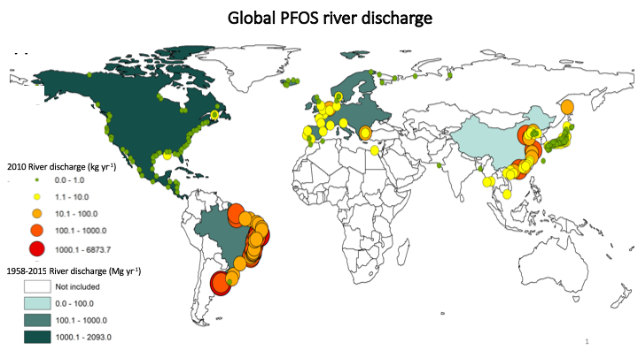
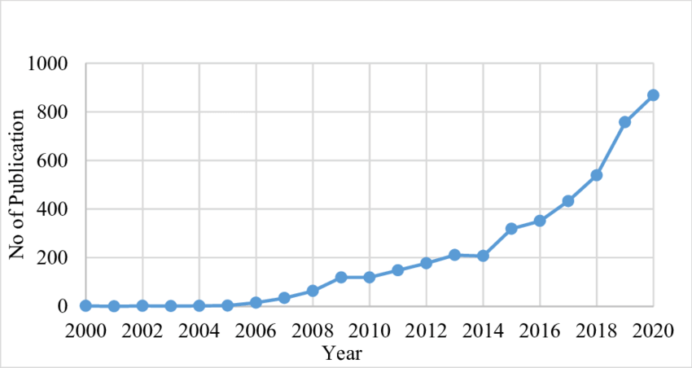
Figure 3: Total number of documents published on PFAS from 2000 to 2020 (data extracted from Scopus; October 2020).

Slide 4
Some previous studies on PFAS removal
Verma et al. (2021) conducted research to explore the effectiveness of UV-vis/Zn_{x}Cu_{1-x}Fe₂O₄/oxalic acid in the breakdown of perfluorooctanoic acid (PFOA) in water. The reactive species generated from Zn_{x}Cu_{1-x}Fe₂O₄ photodegraded PFOA as a result of oxidation dissociation and defluorination.
The adsorption and solid-phase photodegradation of perfluorooctane sulphonate (PFOS) was investigated by Zhu et al. (2021) using gallium-doped carbon-modified titanate nanotubes (Ga/TNTs@AC).
As a consequence of this, the TiO₂ demonstrated significantly higher photocatalytic degradation efficiencies, and the photocatalysts may also enable photodegradation.

Slide 5
RESULLTS AND DISCUSSION
Characterization of TiO₂ nanoparticles
Fig. 4 shows XRD patterns of TiO₂ nanoparticles at different pH. It can be seen that the synthesized samples at pH 8 to 12 showed the pure anatase phase of TiO_{2.} The crystallite size of synthesized TiO₂ at pH 8 (14.91 nm), 12.01 nm at pH 10, and 9.15 nm at pH 12 were calculated using Debye Scherrer Equ. (1);
$D=\frac{kλ}{βCosθ}$ (1)
where $k$ is the Scherrer constant (0.94), $λ$ is the radiation wavelength (0.152 nm) of CuKα, $β$ is the full width at half maximum, and $θ$ is the Bragg angle of the orientation plane.

Slide 6
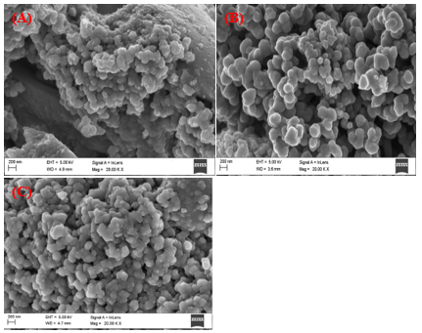
Figure 4. XRD patterns of biosynthesized TiO₂ nanoparticles at different pH values
Figure 5. HRSEM image of biosynthesized TiO₂ nanoparticles at (a) pH 8 (b) pH 10 (c) 12

Slide 7
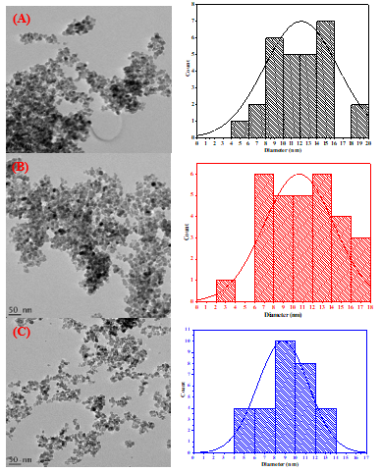
Figure 6. HRTEM image and size distribution of biosynthesized TiO₂ nanoparticles at (a) pH 8 (b) pH 10 (c) pH 12

Slide 8
Photodegradation and defluorination of PFOS
It was observed that as the pH increases the degradation and defluorination rates are reduced (Fig. 7). The variation in pH plays a key role in the distribution of radicals in the photocatalytic processes. The increase in the trend in PFOS with a decrease in pH solution could be attributed to the increase in the number of positive active sites on the nanoparticles at decreased pH values, leading to the photoinduced desulphonation.
Figure 7. The effect of pH on the degradation and defluorination of PFOS

Slide 9
Conclusion
In summary, biosynthesized TiO₂ nanoparticles were used to demonstrate the photodegradation and defluorination of PFOS. The influence of basic pH media on the biosynthesis of the anatase phase of TiO₂ was studied. The HRSEM and HRTEM results confirmed the spherical shapes of the synthesized nanoparticles. The biosynthesized TiO₂ exhibited the highest degradation and defluorination at low pH of PFOS under UV irradiation. Thus, the findings unveil the potential of biosynthesized TiO₂ nanoparticles as a photocatalytic material for the defluorination and degradation of PFOS in water.

Slide 10
REFERENCES
S. Verma, B. Mezgebe, E. Sahle-Demessie, and M. N. Nadagouda, “Photooxidative decomposition and defluorination of perfluorooctanoic acid (PFOA) using an innovative technology of UV–vis/Zn_{x}Cu_{1-x}Fe₂O₄/oxalic acid,” Chemosphere 2021, 280, 1–11, doi: 10.1016/j.chemosphere.2021.130660.
Y. Zhu et al., “Adsorption and solid-phase photocatalytic degradation of perfluorooctane sulfonate in water using gallium-doped carbon-modified titanate nanotubes,” Chem Eng J 2021, 421(1), 129676, doi: 10.1016/j.cej.2021.129676.

Slide 11
THANK YOU
FOR
LISTENING

