Slide 1
Synthesis and Application of Magnesium-based Nanoparticles for Photocatalytic Degradation of Methylene Blue in Aqueous Solution: Optimization and Kinetic Modelling
A Presentation by
Eng. Khumbolake Faith Ngulube
Environmental Engineering Department, Egypt-Japan University of Science and Technology (E-JUST), Alexandria, 21934, Egypt
khumbolake.ngulube@ejust.edu.eg

Slide 2
Introduction
Methylene blue dye (MB) is one of the most commonly utilised colorants in the textile industry. Unfortunately, exposure to high concentrations of MB has displayed negative impacts not only on the aesthetic appearance of water bodies they are discharged into, but also on both human and aquatic life.
In humans it could cause complications such as respiratory issues, abdominal disorders, blindness and mental disorders, amongst others [1].
On aquatic life, the presence of MB in the marine environment limits light penetration into the marine environment, slowing down photosynthetic processes of aquatic plants, leading to low dissolved oxygen levels [2].
This is lethal for marine life and leads to disturbances in the marine ecosystems

Slide 3
Introduction
It is therefore, important that MB is effectively treated from textile wastewaters and prevented from entering the environment.
In this regard, several conventional treatment techniques such as adsorption, coagulation/flocculation, phytoremediation and more have been applied.
However, these techniques are not very effective for treatment of dyes such as MB and have displayed other shortfalls such as production of large amounts of sludge, they require large land areas and they also require long retention times.
Therefore, more advanced treatment methods such as advanced oxidation processes (AOPs) have become a popular topic because they have displayed the ability to limit the shortfalls presented by conventional techniques and work more effectively.

Slide 4
Introduction
Figure 1: Advanced Oxidation Processes

Slide 5
Introduction
Heterogeneous photocatalysis is one such AOP which involved the use of a catalyst material (usually a semi conductor material) that is in a different phase than the substance to be treated.
It is a very efficient treatment technique which can degrade MB by generation of reactive oxygen species (ROS) such as hydroxyl radicals (•OH) which interact with the MB in a repeated cascade of reactions, breaking it down into less harmful intermediated and finally into simple compounds such as CO₂ and H₂O.
Many different semiconductor materials such as ZnO, TiO and MgO have been explored for use in heterogeneous photocatalytic processes and have displayed reasonable efficiencies. However, there is still need to explore more materials for more efficient photocatalytic activity.

Slide 6
Introduction
In this study, we synthesized a ZnO@MgO core-shell nanocomposite material and applied it for photocatalytic degradation of a MB.

Slide 7
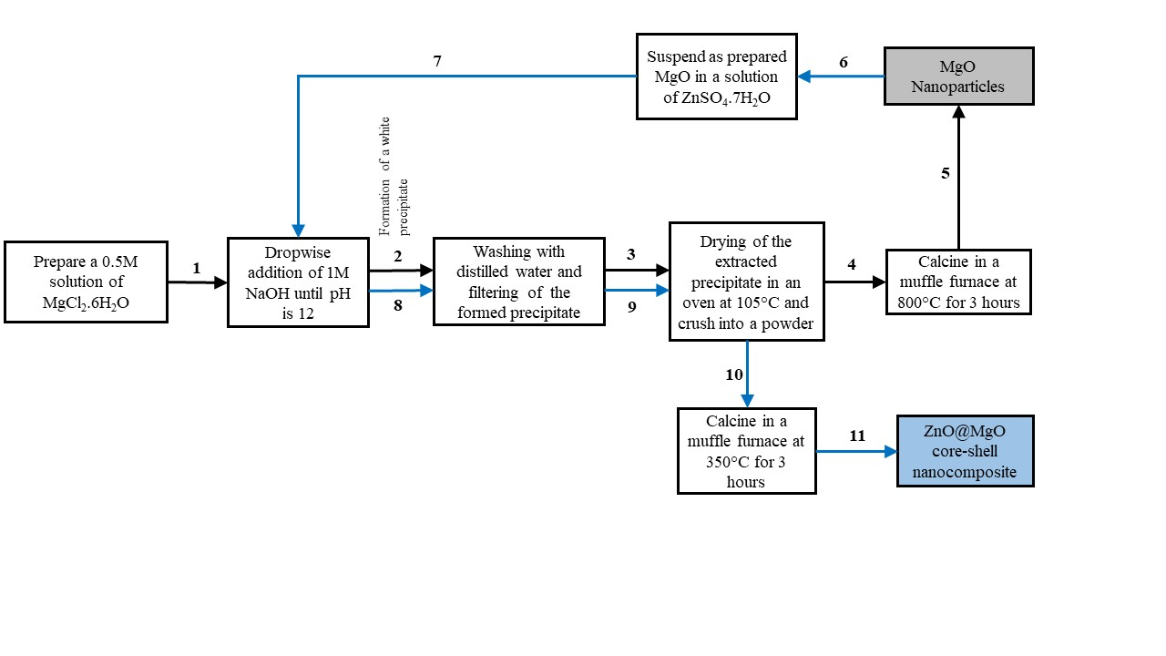
Experimental Methods
PHOTOCATALYST SYNTHESIS
Figure 2: Catalyst synthesis procedure

Slide 8
Experimental Methods
STATISTICAL ANALYSIS
The experimental design and optimization of parameters was done in design expert 13 software using a box-behnken design (BBD).
The BBD was used to study the effects of four independent variables i.e.; A (dye concentration), B (catalyst dose), C (pH) & D (time) on MB dye removal.
Variable name | Symbol | Units | Low | Mid | High
 |  |  | Coded
 |  |  | -1 | 0 | 1
 |  |  | Actual
Dye Concentration | A | mg/L | 10 | 55 | 100
Catalyst Dose | B | mg/L | 100 | 550 | 1000
pH | C | - | 3 | 6.5 | 10
Time | D | minutes | 60 | 120 | 180

Slide 9
Experimental Methods
To verify the adequacy of the generated model and each of the independent variables, analysis of variables (ANOVA) was done, and the significance of each parameter was denoted by a p-value less than 0.05. The model significance was also verified using the coefficient of determination (R2) values. Once the model was verified, optimization of parameters was done using numerical optimization and the degradation kinetics were studied.
DEGRADATION EXPERIMENTS
The photocatalytic degradation experiments involved the dilution of an MB stock solution to the desired concentration and adjusting the pH by adding NaOH or H2SO4 until the desired pH was achieved.

Slide 10
Experimental Methods
The catalyst was then added into the MB solution and placed in the reactor under constant stirring in the dark for 1 hour to allow for adsorption-desorption equilibrium.
After adsorption-desorption equilibrium was achieved, a 2 ml sample was extracted and centrifuged to separate the catalyst from the solution and the concentration, C_{o} was measured.
The light in the reactor was switched on and photocatalytic degradation was allowed to proceed for the desired amount of time, t, after which, another 2 ml sample was extracted and the final MB concentration, C_{t} was measured.
MB removal, R%, was calculated using the formula given by;
R% = [(C_{o} – C_{t})/C_{o}] x 100

Slide 11
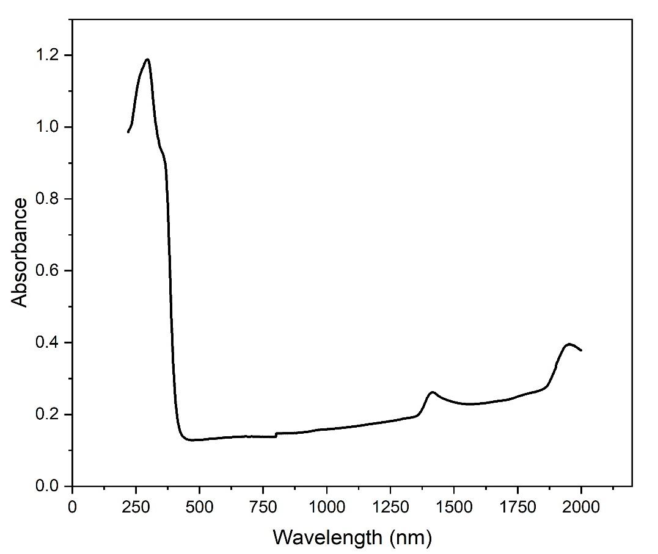
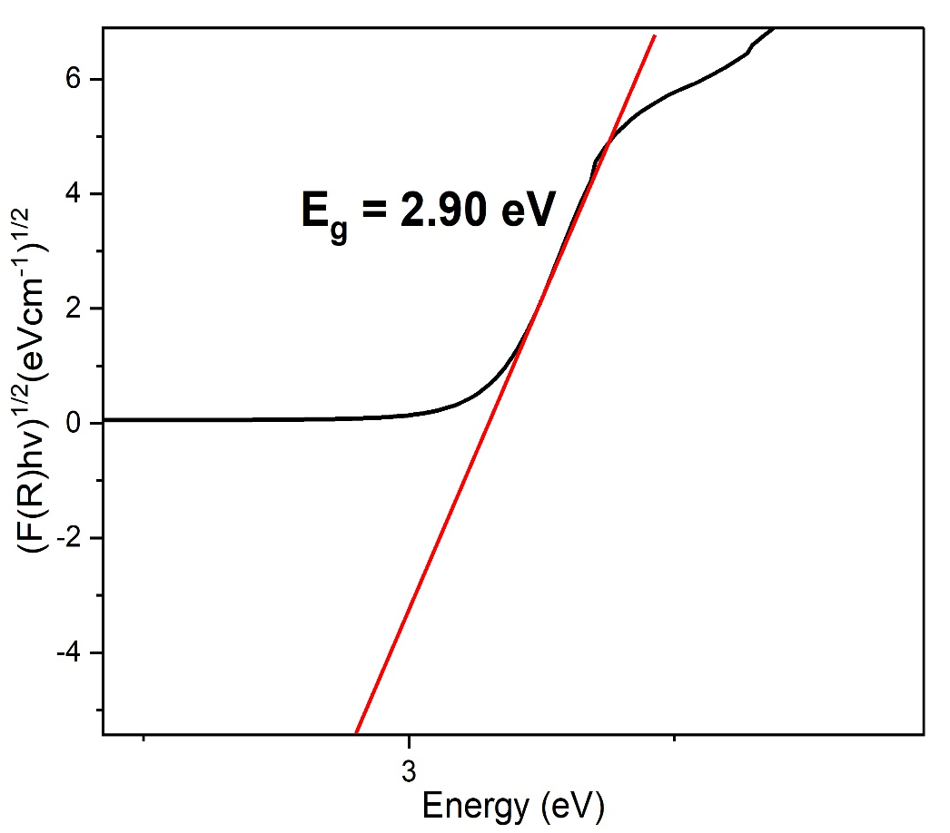
Results and Discussion
UV-vis DRS
Figure 3: Absorbance spectrum and Indirect tauc plot of ZnO@MgO

Slide 12
Results and Discussion
The theoretical band gap energy of pure ZnO has been identified in literature to be around 3.33 eV [3] whereas that of pure MgO has been identified as 4.8 eV [4].
The reduction in the energy band gap of the nanocomposite shows successful band gap narrowing by the core-shell combination of the two materials which can facilitate better electron excitation within the visible light irradiation range (400 – 800 nm) compared with the pure ZnO and MgO separately
OPTIMIZATION VALIDATION AND KINETICS
R% = 9.56 – 29.84A +2.84B + 13.18C + 2.71D -1.99AB – 14.05AC -2AD + 6.05BC +1.37BD + 8.72CD + 19.56A2 + 1.43B2 – 1.40C2 + 1.01D2

Slide 13
Results and Discussion
Source | Sum of Squares | df | Mean Square | F-value | p-value
Model | 16927.30 | 14 | 1209.09 | 324.54 | < 0.0001 | significant
A-Dye Conc. | 10687.08 | 1 | 10687.08 | 2868.62 | < 0.0001
B-Catalyst Dose | 96.65 | 1 | 96.65 | 25.94 | 0.0002
C-pH | 2084.83 | 1 | 2084.83 | 559.61 | < 0.0001
D-Time | 88.13 | 1 | 88.13 | 23.65 | 0.0003
AB | 15.77 | 1 | 15.77 | 4.23 | 0.0587
AC | 789.96 | 1 | 789.96 | 212.04 | < 0.0001
AD | 15.99 | 1 | 15.99 | 4.29 | 0.0572
BC | 146.57 | 1 | 146.57 | 39.34 | < 0.0001
BD | 7.49 | 1 | 7.49 | 2.01 | 0.1780
CD | 304.33 | 1 | 304.33 | 81.69 | < 0.0001
A² | 2480.93 | 1 | 2480.93 | 665.93 | < 0.0001
B² | 13.31 | 1 | 13.31 | 3.57 | 0.0796
C² | 12.77 | 1 | 12.77 | 3.43 | 0.0853
D² | 6.66 | 1 | 6.66 | 1.79 | 0.2025
R² | 0.9969
Adjusted R² | 0.9939
Predicted R² | 0.9826
Table 2: ANOVA Table

Slide 14
Results and Discussion
Optimization of parameters gave an MB removal of 95.948% in 115.7 minutes, for dye concentration 10mg/L, catalyst dose of 1000mg/L and pH 10.
A validation run was carried out at optimum conditions and resulted in an MB removal of 90.858%.
Kinetic modelling was then carried out to determine the reaction rate constant.
The reaction was tested with zero order, half order, first order and second order degradation kinetics.
It was found that the model kinetics were best suited to pseudo first-order degradation kinetics with a reaction rate constant of 0.07593 min-1.

Slide 15
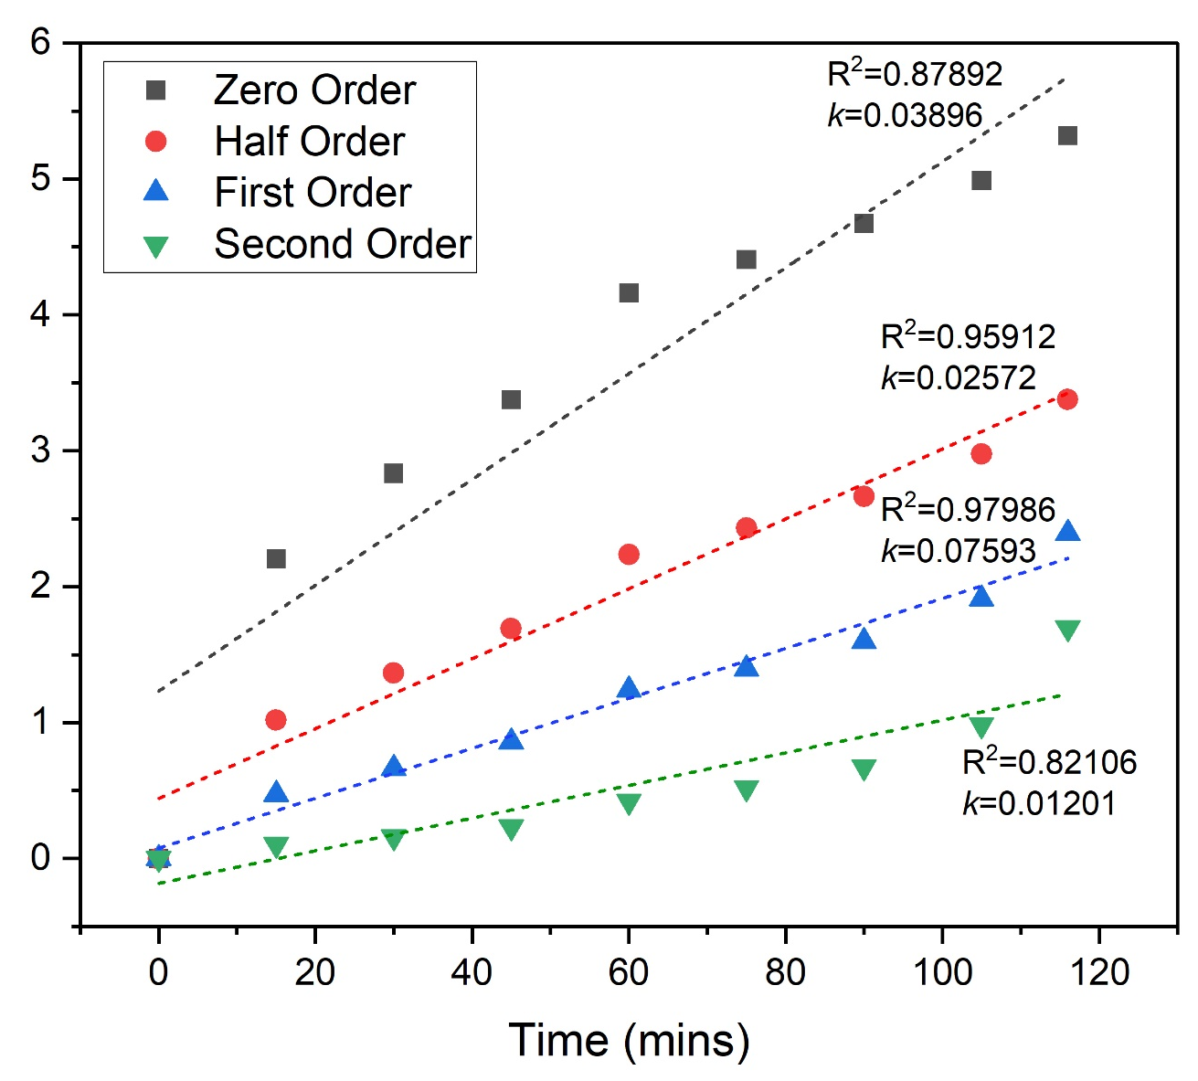
Results and Discussion
Figure 4: degradation curve and degradation kinetics

Slide 16
Results and Discussion
EFFECT OF OPERATIONAL PARAMETERS

Slide 17
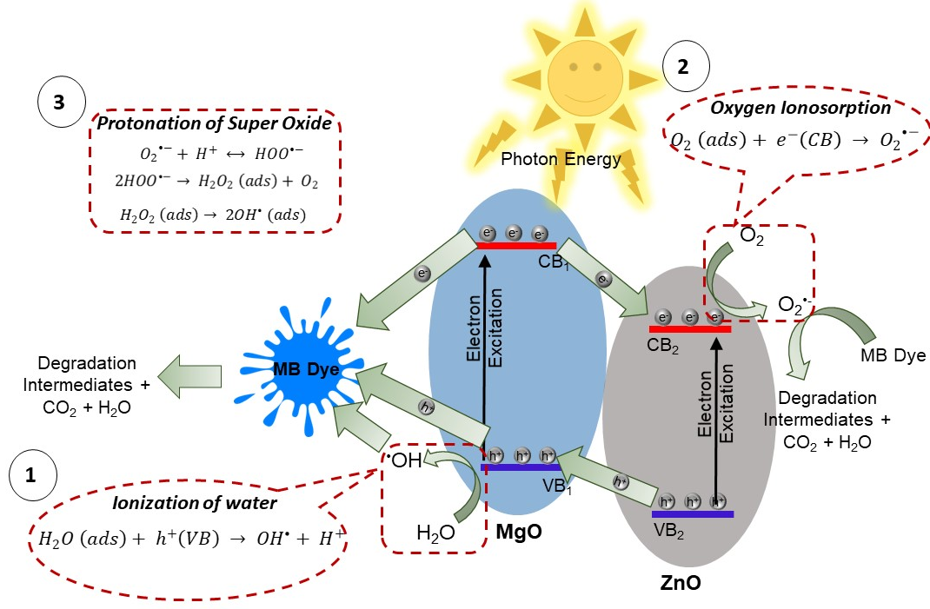
Results and Discussion
PROPOSED MECHANISM

Slide 18
Results and Discussion
COMPARISON WITH LITERATURE
Photocatalyst | Optimum Reaction Conditions |  |  |  | Removal efficiency % | Reference
 | MB Concentration (mg/L) | Catalyst Dose (mg/L) | pH | Reaction time (mins)
ZnO@MgO core-shell nanocomposite | 10 | 1000 | 10 | 115.7 | 90.858 |  | Present study
ZnO/MgO/AC nanoparticle | 3.2 | 1000 | 7 | 20 | 100 |  | [5]
Novel tri-phase CuO–MgO–ZnO nanocomposite | 5 | 400 | 7 | 100 | 88.5 |  | [6]
Hollow MgO-ZnO microspheres | 5 | 300 | 7 | 150 | 100 |  | [7]
CdO–ZnO–MgO nanocomposite | 1 | 25 | 7 | 120 | 91 |  | [8]

Slide 19
Results and Discussion
COMPARISON WITH LITERATURE
The performance of the core-shell nanocomposite was compared with other photocatalyst materials containing ZnO and MgO for the degradation of MB dye.
Other photocatalysts have displayed high degradation efficiencies for lower MB concentrations and/or longer degradation times.
It was also observed that most studies combined ZnO, MgO and a third material in their catalyst materials for enhanced performance. In our study, the photocatalyst material contained ZnO and MgO only and the parameters were optimized to use shorter degradation periods in order to yield higher degradation efficiencies.
The results obtained show that the ZnO@MgO core-shell nanocomposite could be utilized as an alternative for MB degradation.

Slide 20
Results and Discussion
ECONOMIC FEASIBILITY
 | Unit | Cost
TOTAL CAPITAL COSTS | $ | 2,941,149.22
TOTAL OPERATING COSTS | $/year | 182,443.56
TOTAL REVENUES | $/year | 1,097,416.73
To estimate the feasibility of the up-scale synthesis and application of the ZnO@MgO core-shell nanocomposite for dye removal, an economic analysis was carried out where the capital costs, operating costs and possible revenues were estimated based on the optimized parameters of the lab experiments.
The analysis assumes a daily wastewater inflow of 80m3 which is suitable for a roughly medium size treatment plant.

Slide 21
Results and Discussion
ECONOMIC FEASIBILITY
The capital costs included the costs of the photocatalytic reactor and all its components, catalyst synthesis apparatus, plant infrastructure construction costs, contractor charges and contingencies. The total capital costs were then estimated to about $2,941,149.22.
The operational costs were also estimated and comprised expenses such as electricity, cost of chemicals, water bills, statutory obligations such as taxes, workers’ salaries as well as equipment repair and maintenance costs.
The total annual operational costs estimate amounted to $182,443.56 which gave a running cost of $7.6/m3 of influent water.
The possible revenues identified were the removal of the dye from the water, the sale of the synthesized catalyst material as well as the reuse of the treated effluent for on-site applications.

Slide 22
Results and Discussion
ECONOMIC FEASIBILITY
The estimate of the total revenues was $1,097,416.73.
Finally, the capital costs, operational costs and the revenues were used to derive the payback period and it was estimated at 3.2 years using the formula given as;
Payback period $=\frac{\text{total} \text{capital} \text{costs} (\$)}{\text{total} \text{revenues}\text{ (}\$\text{/}\text{year}\text{) – }\text{total} \text{operating} \text{costs}\text{(}\$\text{/}\text{year}\text{)}}$

Slide 23
References
[1] L. F. Cusioli, H. B. Quesada, A. T. A. Baptista, R. G. Gomes, and R. Bergamasco, “Soybean hulls as a low-cost biosorbent for removal of methylene blue c ontaminant,” Environ. Prog. Sustain. Energy, vol. 39, no. 2, p. e13328, 2020, doi: https://doi.org/10.1002/ep.13328.
[2] O. Ebi Ebi, A. Falilat Taiwo, and A. Tunde Folorunsho, “Kinetic Modelling of the Biosorption of Methylene Blue onto Wild Melon (Lagenariasphaerica),” Am. J. Chem. Eng., vol. 6, no. 6, pp. 126–134, 2018, doi: 10.11648/j.ajche.20180606.12.
[3] N. Kamarulzaman, M. F. Kasim, and R. Rusdi, “Band Gap Narrowing and Widening of ZnO Nanostructures and Doped Materials,” Nanoscale Res. Lett., vol. 10, no. 1, p. 346, Aug. 2015, doi: 10.1186/s11671-015-1034-9.
[4] A. Almontasser, A. Parveen, and A. Azam, “Synthesis, Characterization and antibacterial activity of Magnesium Oxide (MgO) nanoparticles.,” IOP Conf. Ser. Mater. Sci. Eng., vol. 577, p. 012051, Dec. 2019, doi: 10.1088/1757- 899X/577/1/012051.

Slide 24
References
[5] M. A. Karimi, A. Hatefi-Mehrjardi, A. Askarpour kabir, and M. Zaydabadi, “Synthesis, characterization, and application of MgO/ZnO nanocomposite supported on activated carbon for photocatalytic degradation of methylene blue,” Res. Chem. Intermed., vol. 41, Jun. 2014, doi: 10.1007/s11164-014-1729-z.
[6] T. Munawar et al., “Sunlight-induced photocatalytic degradation of various dyes and bacterial inactivation using CuO–MgO–ZnO nanocomposite,” Environ. Sci. Pollut. Res., vol. 28, no. 31, pp. 42243–42260, 2021, doi: 10.1007/s11356-021- 13572-8.
[7] S. Vishwanathan and S. Das, “Glucose-mediated one-pot hydrothermal synthesis of hollow magnesium oxide-zinc oxide (MgO-ZnO) microspheres with enhanced natural sunlight photocatalytic activity,” Environ. Sci. Pollut. Res., vol. 30, no. 4, pp. 8512–8525, Jan. 2023, doi: 10.1007/s11356-022-20283-1.
[8] V. Revathi and K. Karthik, “Microwave assisted CdO–ZnO–MgO nanocomposite and its photocatalytic and antibacterial studies,” J. Mater. Sci. Mater. Electron., vol. 29, no. 21, pp. 18519–18530, Nov. 2018, doi: 10.1007/s10854-018-9968-1.

