Slide 1
Fabrication of aluminum-based hybrid nanocomposite for photocatalytic degradation of methylene blue dye: A techno-economic approach
Samuel Demarema ¹, Amal Abdelhaleem ¹, Shinichi Ookawara ², and Mahmoud Nasr ^{1,3}
¹Environmental Engineering Department, Egypt-Japan University of Science and Technology (E-JUST), Alexandria, 21934, Egypt Egypt;*amal.elsonbaty@ejust.edu.eg
²Department of Chemical Science and Engineering, Tokyo Institute of Technology, Meguro-ku, Tokyo, 152-8552, Japan; ookawara.s.aa@m.titech.ac.jp
³Sanitary Engineering Department, Faculty of Engineering, Alexandria University, Alexandria, 21544, Egypt; Mahmoud.Nasr@just.edu.eg
Correspondence: samuel.demarema@ejust.edu.eg

Slide 2
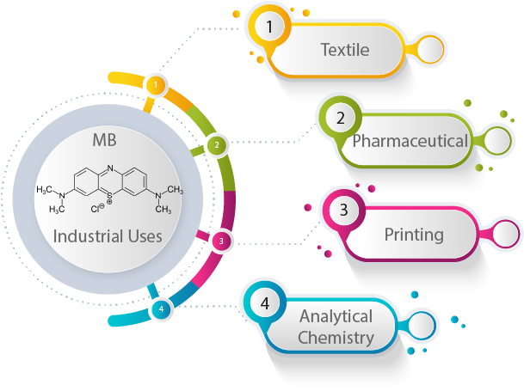
Methylene Blue (MB) dye
MB is a synthetic cationic thiazine dye
Soluble in water (43,600 mg/L at 25 °C)
Figure 1. Industrial uses of MB dye

Slide 3
Toxicity of MB dye
MB dye laden wastewater discharge in marine ecosystems:
Low sunlight transmittance for photosynthesis by aquatic plants
MB dye forms complex products leading to low dissolved oxygen and death of aquatic organisms
MB is highly stable and cannot be removed by conventional wastewater treatment methods
Figure 2. Effects of MB dye exposure on humans

Slide 4
Advanced Oxidation Processes
Advanced Oxidation Processes(AOPs) are treatment techniques aimed at mineralizing refractory organic pollutants in wastewater mainly using OH•.
AOPs are efficient technologies in the elimination of pollutants such as MB from wastewater
AOPs include;
Photocatalysis
Ozonation
Photo-Fenton

Slide 5
Photocatalysis
It is an AOP that utilizes catalysts and light irradiation for degradation of pollutants
Heterogenous photocatalysis utilizes solid semiconductor catalysts such as TiO₂, ZnO for degradation of pollutants in aqueous phase
Al₂O₃ has orderly nanopore structures and significant photocatalytic activity.
Al₂O₃ can be synthesized from waste material such as aluminum cans, hence reducing costs in photocatalysis.
Al₂O₃ nanocomposites can have higher photocatalytic activity due to formation of heterojunctions with other semiconductor materials.

Slide 6
Study Objectives
Synthesis of Al₂O₃-MgO nanocomposite
Investigate the effect of operating parameters in MB photodegradation
Estimate the economic feasibility of photocatalytic degradation of MB dye using Al₂O₃-MgO

Slide 7
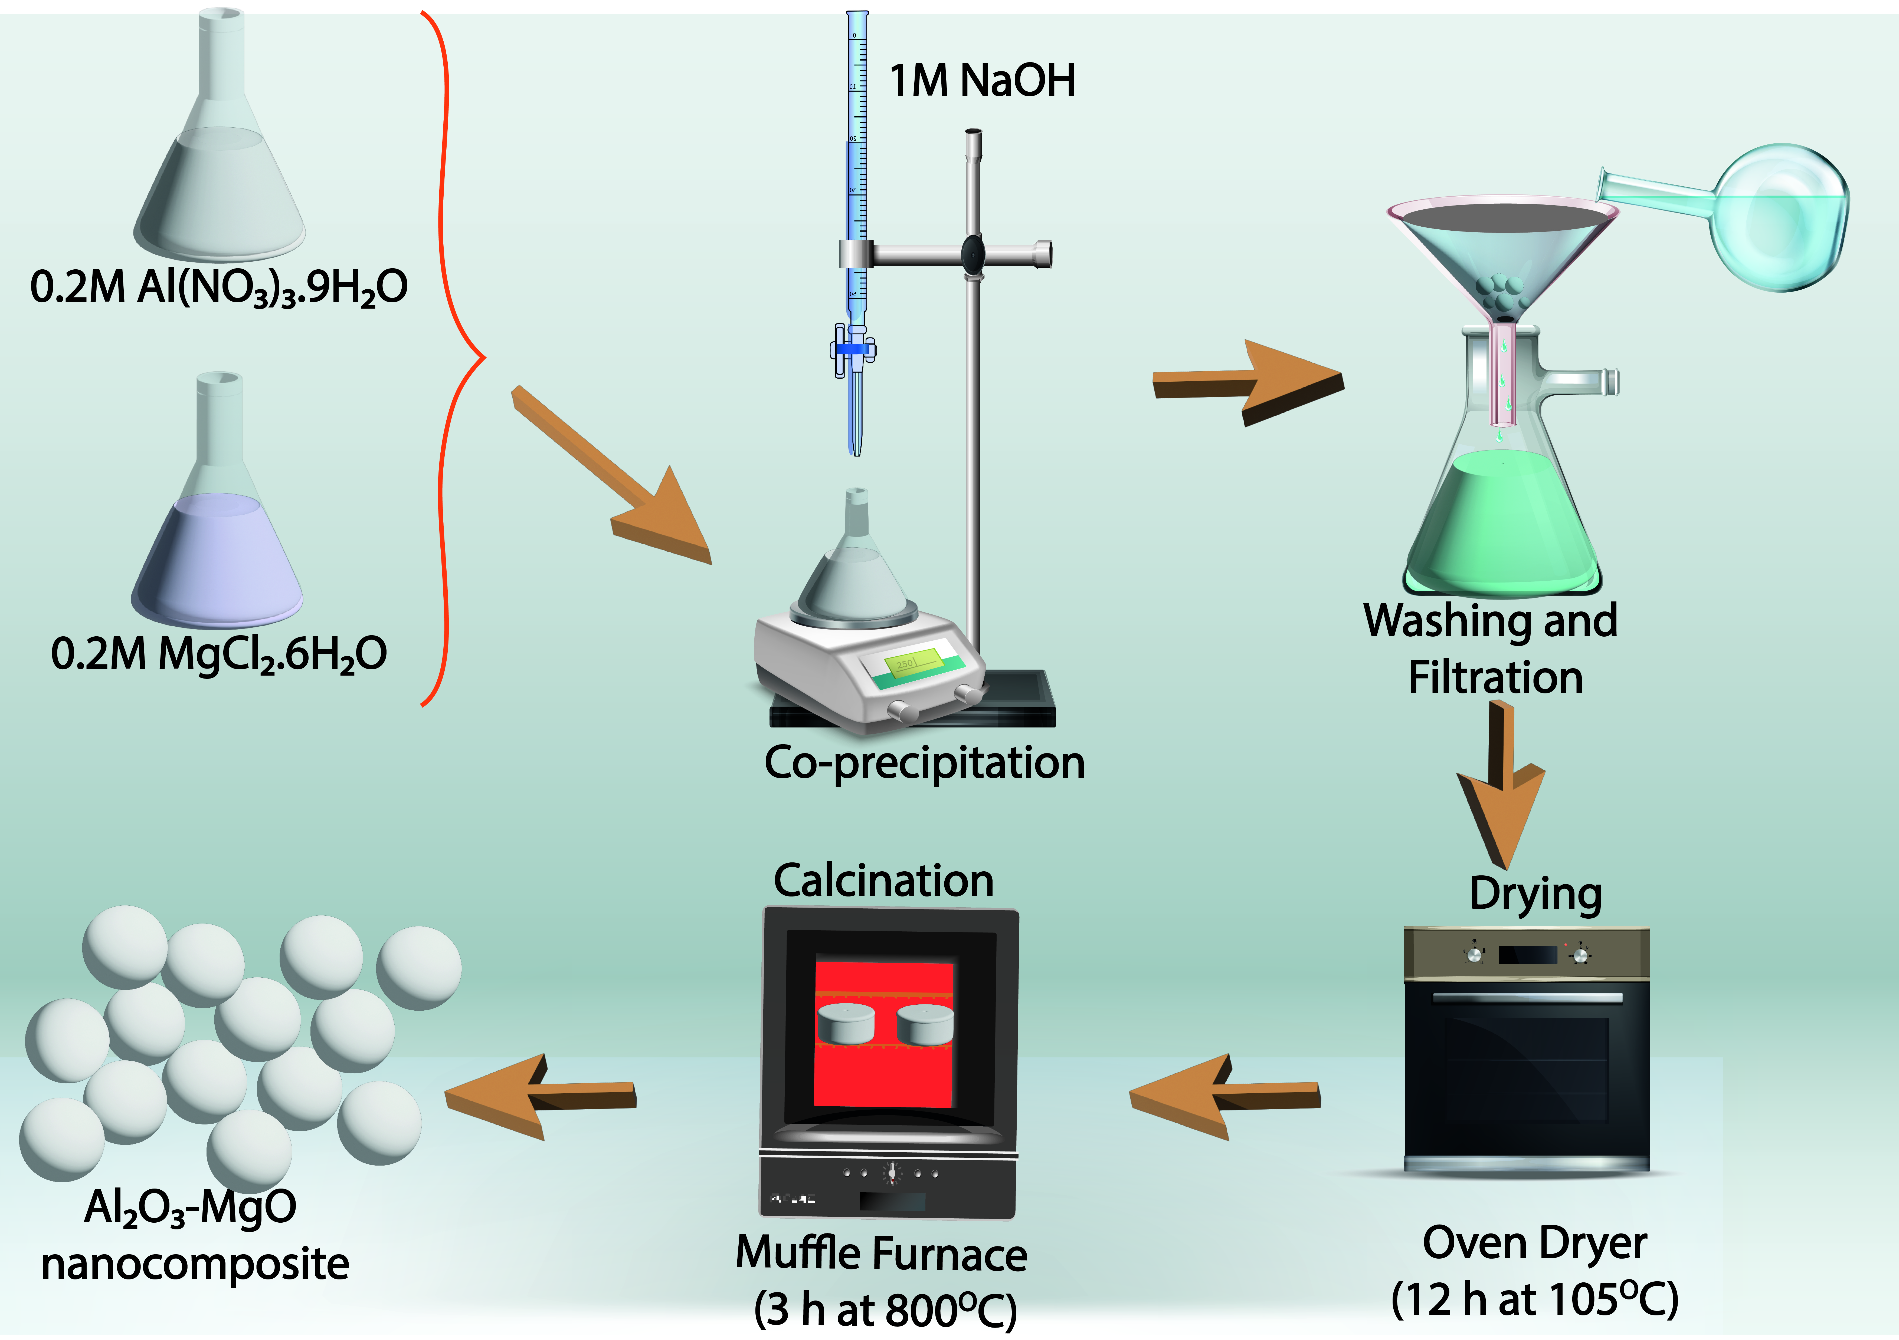
Methodology: Al₂O₃-MgO photocatalyst synthesis
Co-precipitation method was used for synthesis of Al₂O₃-MgO.
Figure 1. Synthesis method

Slide 8
Experimental setup
Photoreactor with a 400 W metal halide lamp
60 min stirring in the dark to achieve adsorption/desorption. Light is turned on for MB dye photocatalytic degradation reaction.
Initial(C_{o}) and final(C_{f}) concentrations of MB dye measured at 664 nm using UV-spectrophotometer.
Table 1. Experimental factors and limits for Box Behnken Design(BBD) in Response Surface Methodology(RSM)
Factor | Parameter | Unit | Levels
 |  |  | Low | Median | High
A | pH | - | 3 | 7 | 11
B | Time | min | 60 | 120 | 180
C | Photocatalyst dosage | mg/L | 200 | 600 | 1000
D | Initial MB dye concentration | ppm | 10 | 55 | 100

Slide 9
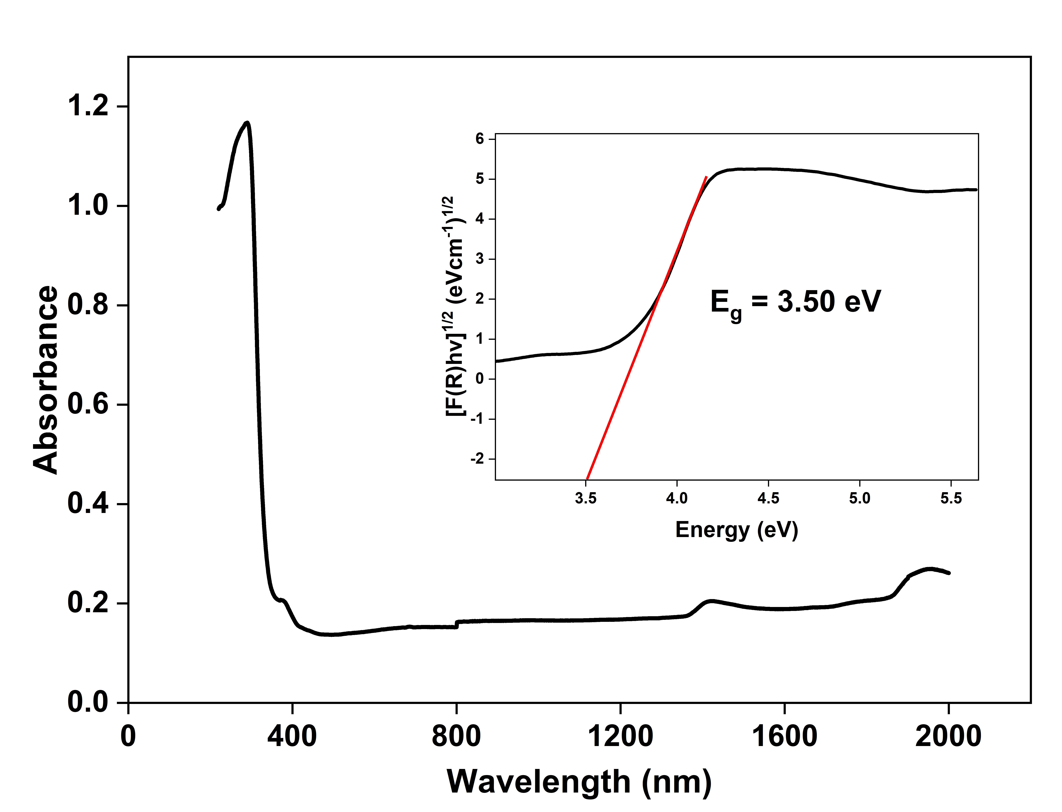
UV-DRS Analysis
Band gap energy of Al₂O₃-MgO is 3.50 eV.
This is higher than that of Al₂O₃ (5.97 eV).
Figure 2. Absorbance plots for Al₂O₃-MgO

Slide 10
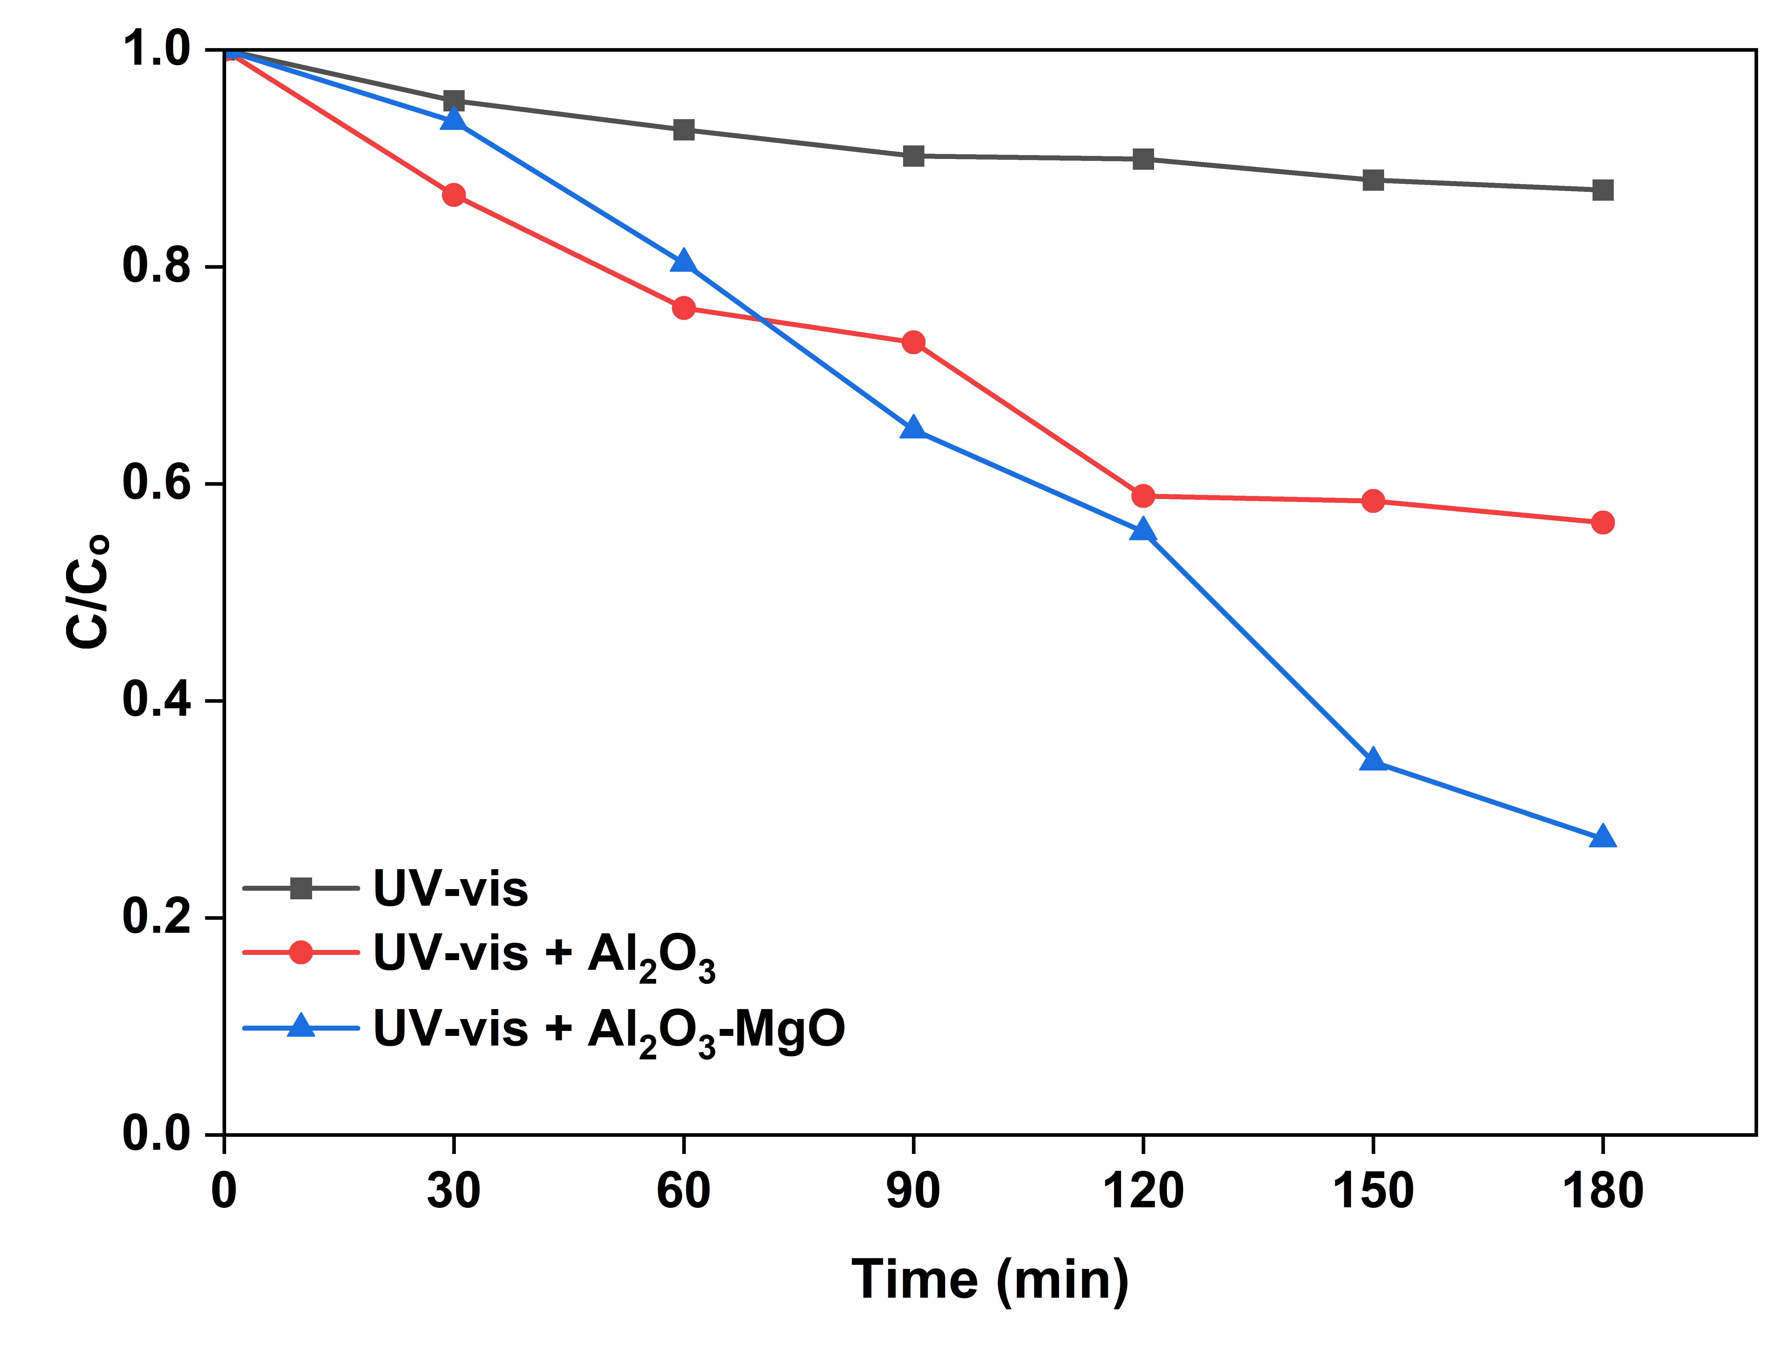
Initial catalyst tests
Pure Al₂O₃ had photodegradation efficiency of 43,57% whereas Al₂O₃-MgO had 72.72%.
Al₂O₃-MgO has lower band gap energy than Al₂O₃ hence higher photocatalytic activity.
Figure 3. Initial photocatalyst test

Slide 11
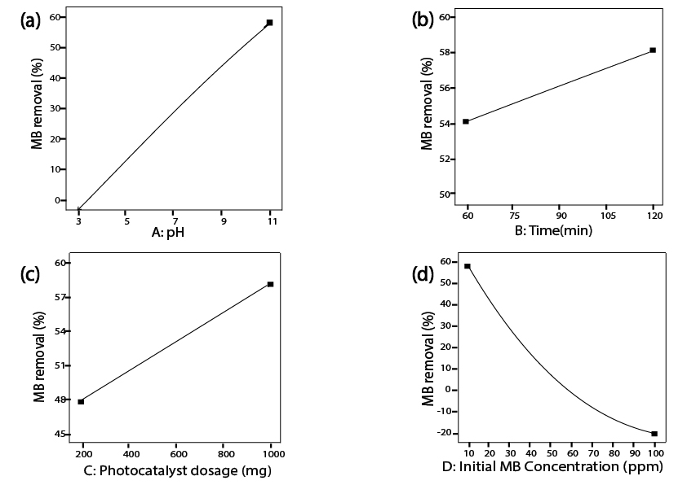
Effect of operational parameters
Figure 4. Effect of operational parameters

Slide 12
Effect of operational parameters
Figure 4a shows effect of pH. In acidic pH, MB exists as a neutral molecule(pH< pKa (3.8)) below and surface of Al₂O₃-MgO is positively charged (pH_{zc} = 10.04) hence low adsorption on catalyst surface and low photodegradation efficiency.
As the pH approaches the pH_{zc}, the repulsive force against MB cations is reduced . Above the pH_{zc}, Al₂O₃-MgO surface is negatively charged and attracts the MB cations hence higher photodegradation efficiency.
In Figure 4b, at constant photocatalyst dosage, more electrons and holes are generated by Al₂O₃-MgO as irradiation time increases. This leads to production of more reactive radical species, leading to an increment in the photocatalytic degradation efficiency

Slide 13
Effect of operational parameters
Figure 4c shows effect of photocatalyst dosage. Increasing Al₂O₃-MgO dosage leads to the generation of more active sites and subsequently leads to higher MB photodegradation efficiency.
In Figure 4d shows effect of initial MB dye concentration. As MB dye concentration increase, there is limitation of photon influx on the Al₂O₃-MgO surface, resulting in low generation of electrons and holes.

Slide 14
Optimization of operational parameters
Table 2. ANOVA analysis
Source | Sum of Squares | df | Mean Square | F-value | p-value
Model | 1029.44 | 14 | 73.53 | 81.99 | < 0.0001 | significant
A-pH | 29.26 | 1 | 29.26 | 32.63 | < 0.0001
B-Time | 11.41 | 1 | 11.41 | 12.73 | 0.0031
C-Photocatalyst dosage | 2.46 | 1 | 2.46 | 2.74 | 0.1198
D-Initial MB dye concentration | 348.8 | 1 | 348.8 | 388.92 | < 0.0001
AB | 15.5 | 1 | 15.5 | 17.29 | 0.001
AC | 0.5407 | 1 | 0.5407 | 0.6029 | 0.4504
AD | 412.34 | 1 | 412.34 | 459.77 | < 0.0001
BC | 4.39 | 1 | 4.39 | 4.9 | 0.0441
BD | 8.2 | 1 | 8.2 | 9.14 | 0.0091
CD | 4.11 | 1 | 4.11 | 4.59 | 0.0503
A² | 12.29 | 1 | 12.29 | 13.7 | 0.0024
B² | 0.0067 | 1 | 0.0067 | 0.0074 | 0.9325
C² | 0.0006 | 1 | 0.0006 | 0.0006 | 0.9804
D² | 152.97 | 1 | 152.97 | 170.57 | < 0.0001
Residual | 12.56 | 14 | 0.8968
Lack of Fit | 10.6 | 10 | 1.06 | 2.17 | 0.2372 | not significant
Pure Error | 1.96 | 4 | 0.489
Cor Total | 1042 | 28
Significant terms to the model have p < 0.05
Model R² value of 0.9880 indicating good fit

Slide 15
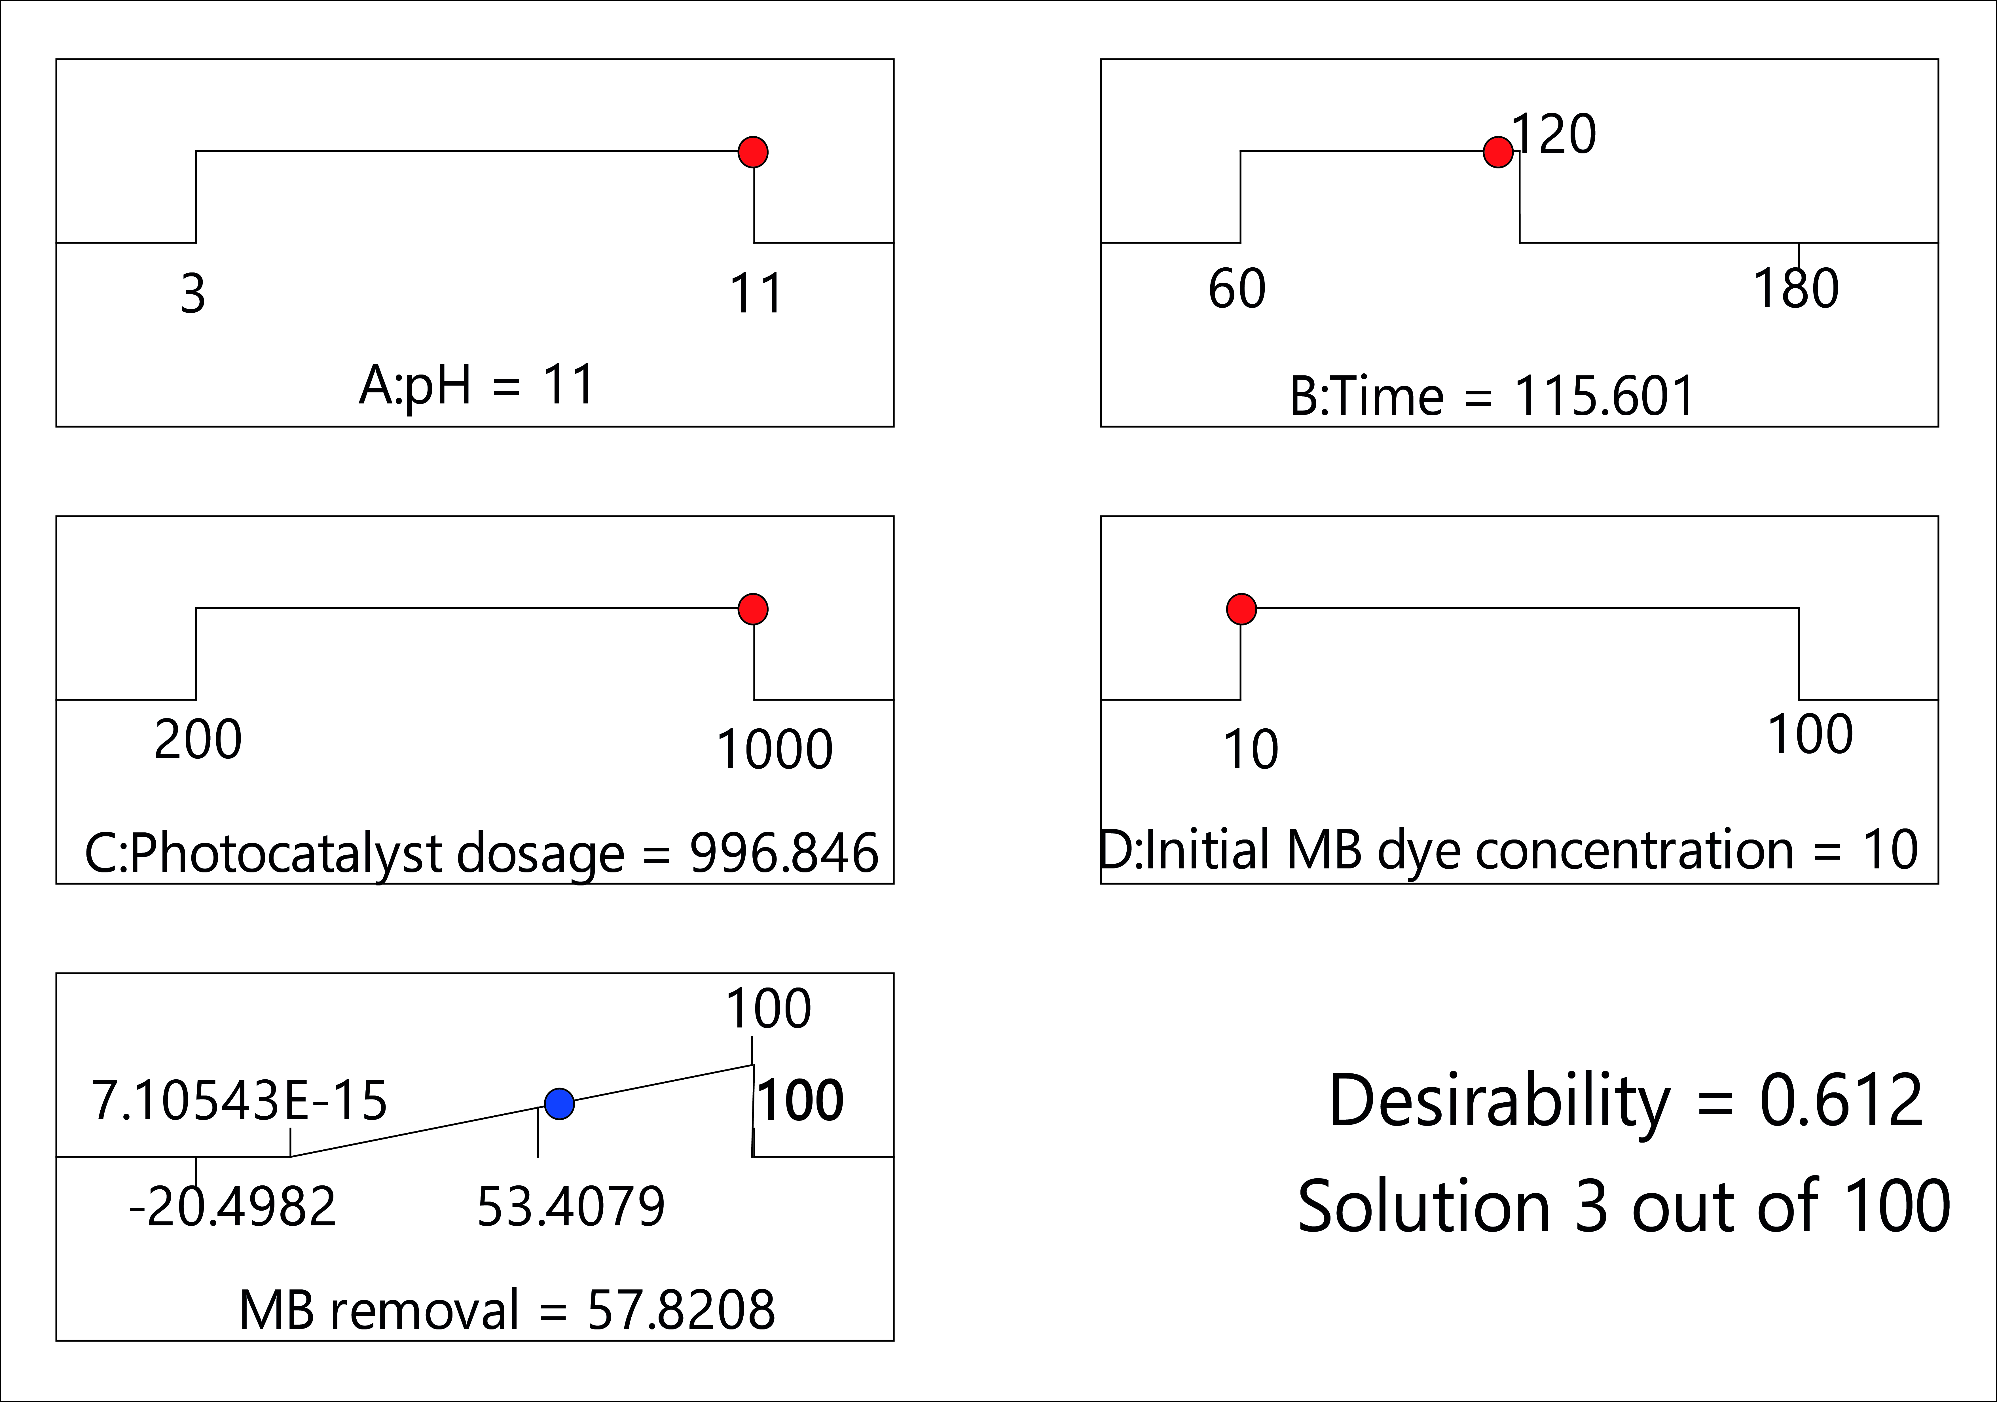
Optimization of operational parameters
Figure 5. Optimized conditions
Coded Equation for MB removal:
(MB removal +22.5)^{0.81} = 12.63 + 1.56A -0.9753B + 0.4529C -5.39D + 1.97AB + 0.3677AC -10.15AD-14.3BD -1.01CD -1.38A² - 0.0321B² - 0.0093C² + 4.86D²

Slide 16
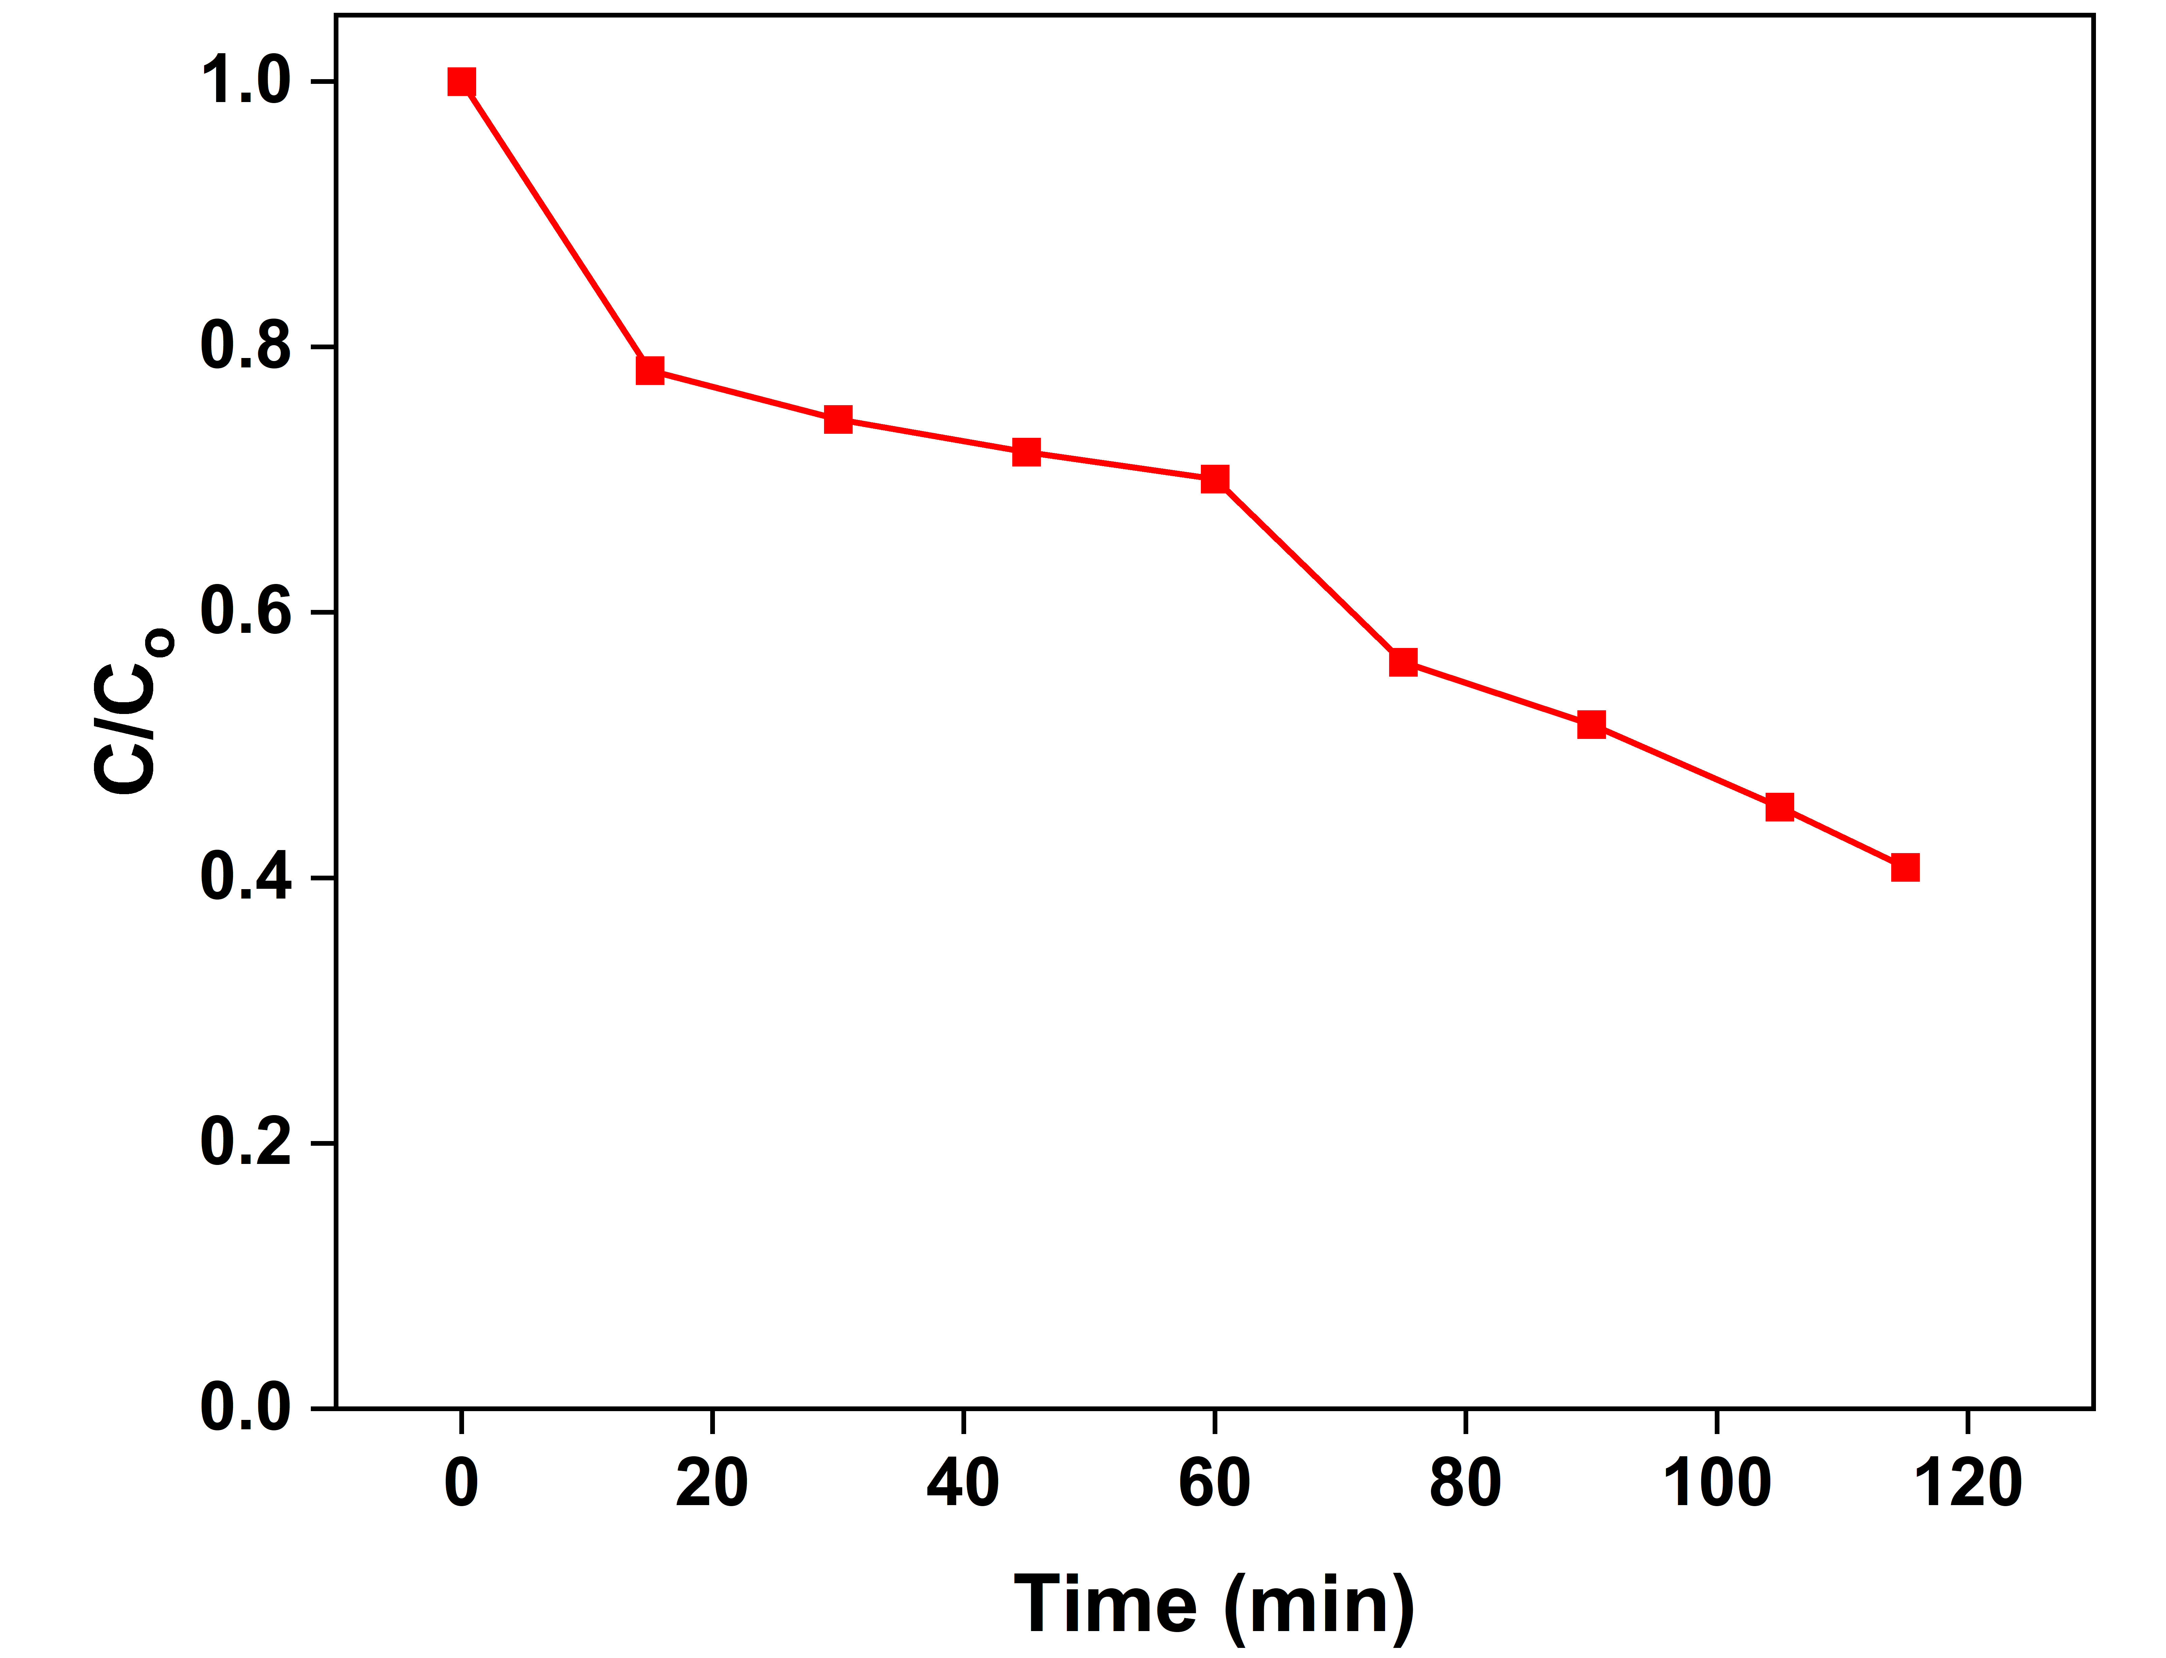
Model validation
Verification experiment : 59.20 % MB removal
Model prediction : 57.82 % MB removal
Error : 1.68 %.
Figure 6. Optimized conditions

Slide 17
Model kinetics
Model best fits first order kinetics
InC_{t} = InC_{o} -k₁t
C_{t} (ppm) Concentration of MB at time t(min)
C_{o}(ppm) Initial concentration of MB dye
k₁(min⁻¹) First order rate constant
Figure 7. Kinetic models

Slide 18
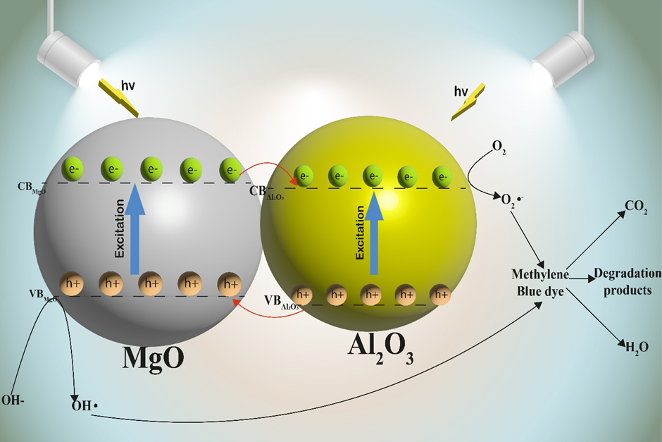
Suggested removal mechanism
Generation of electron-hole combinations from light photons
OH• and O₂⁻• responsible for MB degradation
Mechanism summarized in Equations 1-5.
Figure 8. Suggested Removal mechanism
Al₂O₃-MgO + hv (vis region) → Al₂O₃-MgO (e_{cb}⁻ + h_{vb}⁺) (1)
h_{vb}⁺ + H₂O(OH-) → OH• + H⁺ (2)
e_{cb}⁻ + O₂ → O₂⁻• (3)
O₂⁻• + MB → degradation products + CO₂ + H₂O (4)
OH• + MB → degradation products + CO₂ + H₂O (5)

Slide 19
Economic Evaluation
Cost estimates based on textile wastewater treatment using the optimized conditions
Table 3. Economic feasibility
Item | Value
Volume of wastewater treated | 80 m³ per day
Number of operating days in year | 300 days
Capital costs | US$ 3,896,428.57
Amortization Cost (25 years at 6% per annum interest rate) | US$ 365,765.78
Operational expenses | US$ 30,250
Wastewater Treatment Cost | US$ 16.50/ m³
Profits (Wastewater re-use, color removal and Al₂O₃-MgO sales) | 5.20/ m³ of wastewater treated
Payback Period | 3.17 years

Slide 20
Conclusion
Al₂O₃-MgO nanocomposite was prepared using co-precipitation technique
UV-DRS analysis showed that the band gap energy was of Al₂O₃-MgO is 3.50 eV.
RSM model had R² of 0.9880 for photocatalytic degradation of MB dye.
MB photocatalytic degradation using Al₂O₃-MgO followed first order kinetics.
Economic estimation revealed that the wastewater treatment cost was US$ 16.50/ m³ with a payback period of 3.17 years.

Slide 21
THANK YOU

