Slide 1


Combining COMSOL modelling with different Piezoelectric Materials to design MEMS cantilevers for marine sensing robotic
F
Dr. Basit Abdul
Sabanci University, Nanotechnology Research, and Application Center Istanbul Turkey
Mr. Abul Hasan Shibly
Department of Textile Engineering National Institute of Textile Engineering and Research Dhaka-1350, Bangladesh
Dr. Abdul Rab Asary
University of Naples Parthenope, 80133 Napoli, Italy

Slide 2

Outline
Introduction and objective of work, Approach/Bionic Principle/Application
Designing of Piezoelectric Cantilevers on COMSOL
Simulation and modeling of Cantilevers
Result

Slide 3
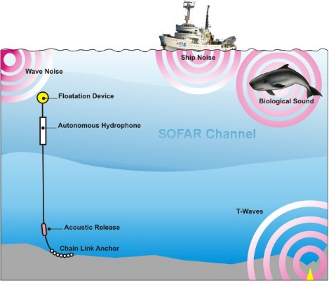
Aim of the Work
Novelty
To design an innovative transducer by piezoelectric materials which will sense the intensity and directionality of underwater acoustic pulses.
The device will have a wider frequency range. This wider frequency range is necessary for the dynamic range of signals for marine sensing acoustics.
It will show a good directionality pattern, which helps to detect the acoustics source direction in the water.
Approach/Bionic Principle/Application
A biomimetic approach inspired by Fish lateral line system

Slide 4
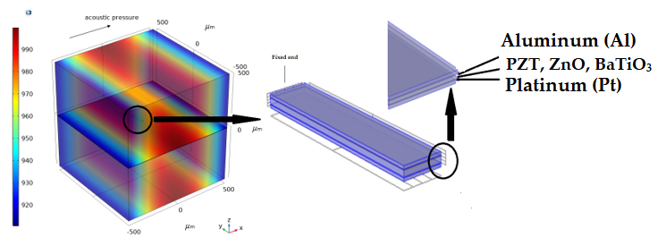
Combining COMSOL modelling with different Piezoelectric Materials to design MEMS cantilevers for marine sensing robotic
Materials Properties
Dimension
Materials | Thickness
Platinum (Pt) | 200 nm
Aluminum (Al) | 200 nm
PZT, ZnO, BaTiO3 | 1 µm
Length (µm) | Width (µm)
100,200,300,40,500,600,700,800900,1000 | 50

Slide 5
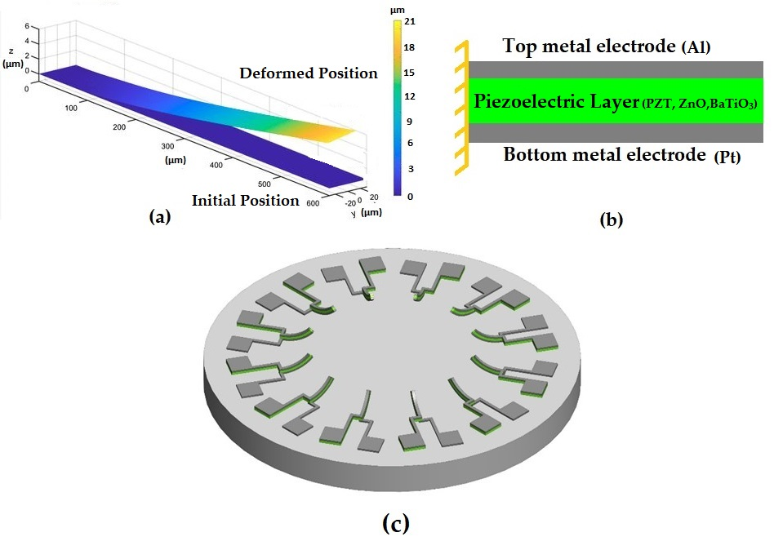
Combining COMSOL modelling with different Piezoelectric Materials to design MEMS cantilevers for marine sensing robotic
Figure 2. (a) Simulated microcantilever with deformed position. (b) Side view of micro cantilevers (C) Face to face configuration of microcantilever.

Slide 6
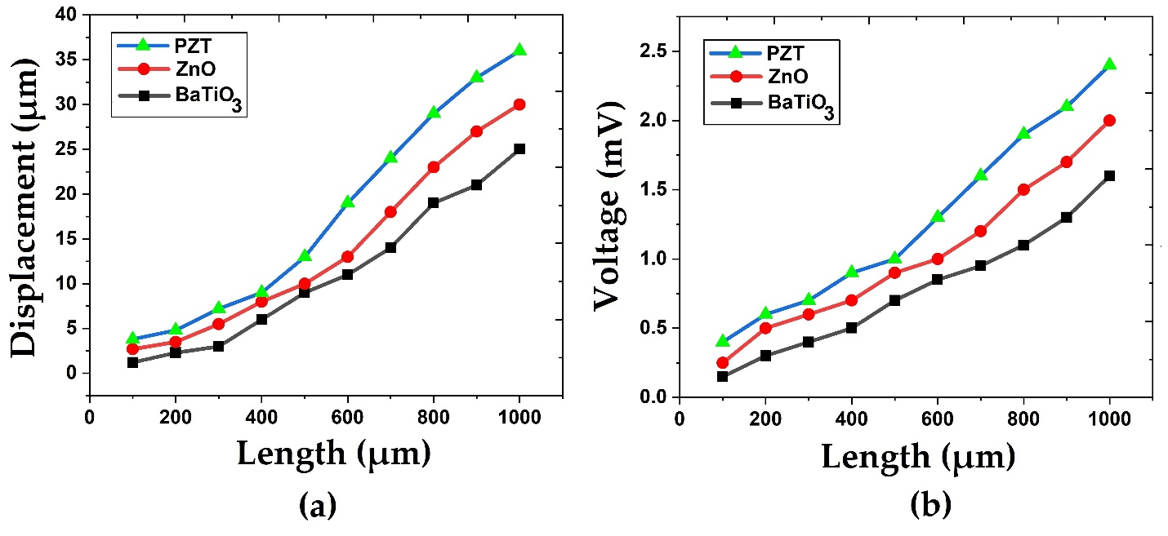
Combining COMSOL modelling with different Piezoelectric Materials to design MEMS cantilevers for marine sensing robotic
Figure 2. (a) Microcantilevers displacement vs Length with different piezoelectric materials (b) Microcantilever Voltage response vs Length with different piezoelectric materials

