Slide 1





Developing Biopolymer Based Edible Films with Improved Anti-Microbial Properties.
Authors: Katyayani Kashyap, Yamini Sudha Sistla, Shumyla Mehraj
Chemical Engineering Department
Shiv Nadar Institude of Eminence

Slide 2
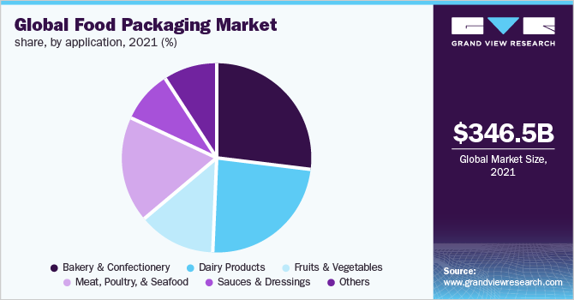
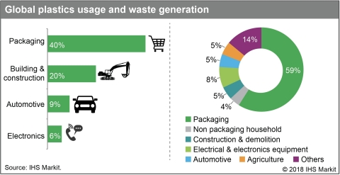
INTRODUCTION
Global market of edible packaging -US$1004 million with an annual growth rate of 6.3% Packaging contributes one-third to waste generated by industrial sectors Edible coating-An effective measure to tackle the global issue Improves shelf life of consumable items Improves barrier for moisture, gas and microorganism Source : https://www.grandviewresearch.com/industry-analysis/food-packaging-market(1) https://news.ihsmarkit.com/prviewer/release_only/slug/chemicals-plastic-storm-ocean-plastic-waste-brewing-tidal-wave-consumer-activism-and-i(2)
1

Slide 3
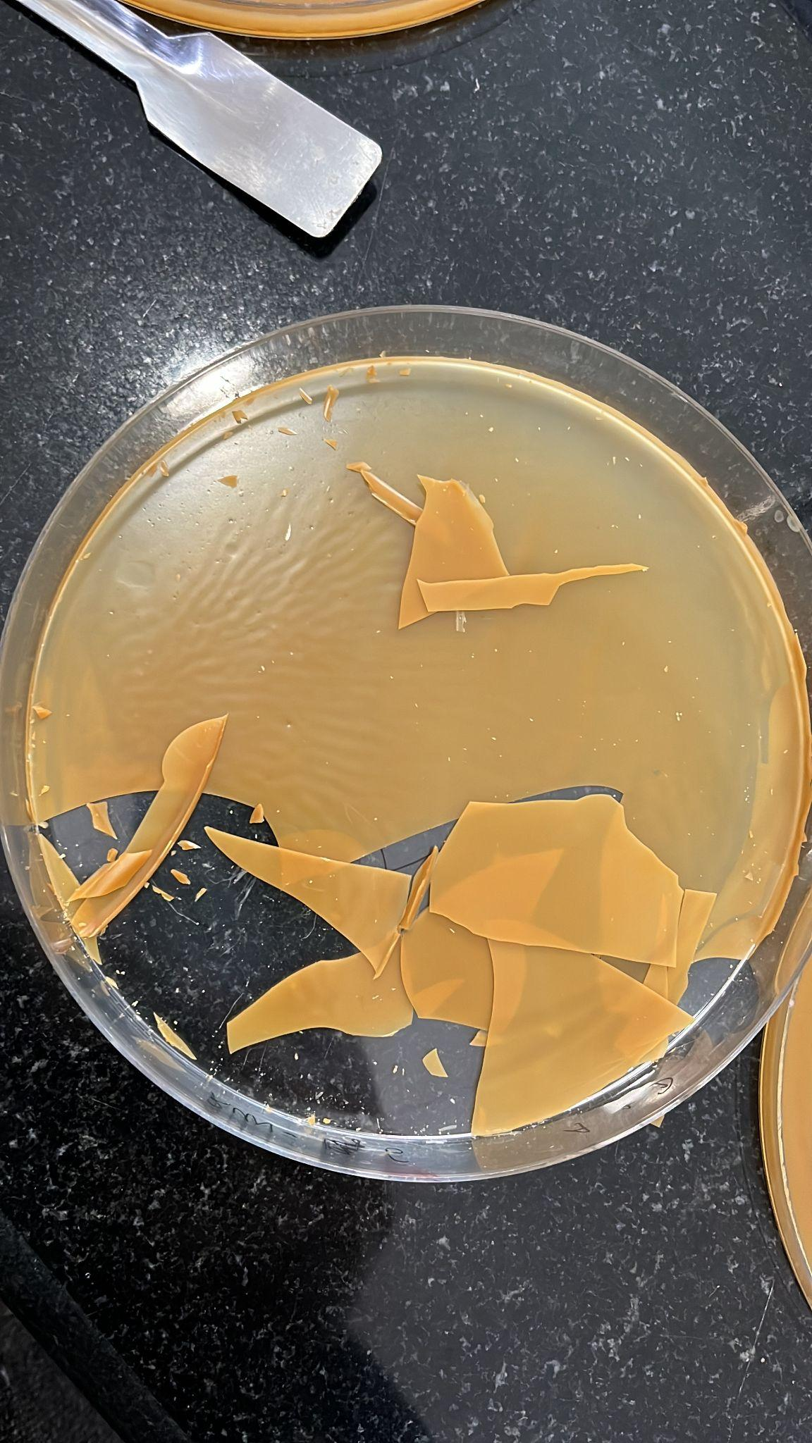
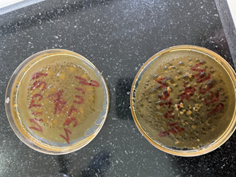
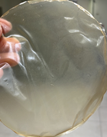
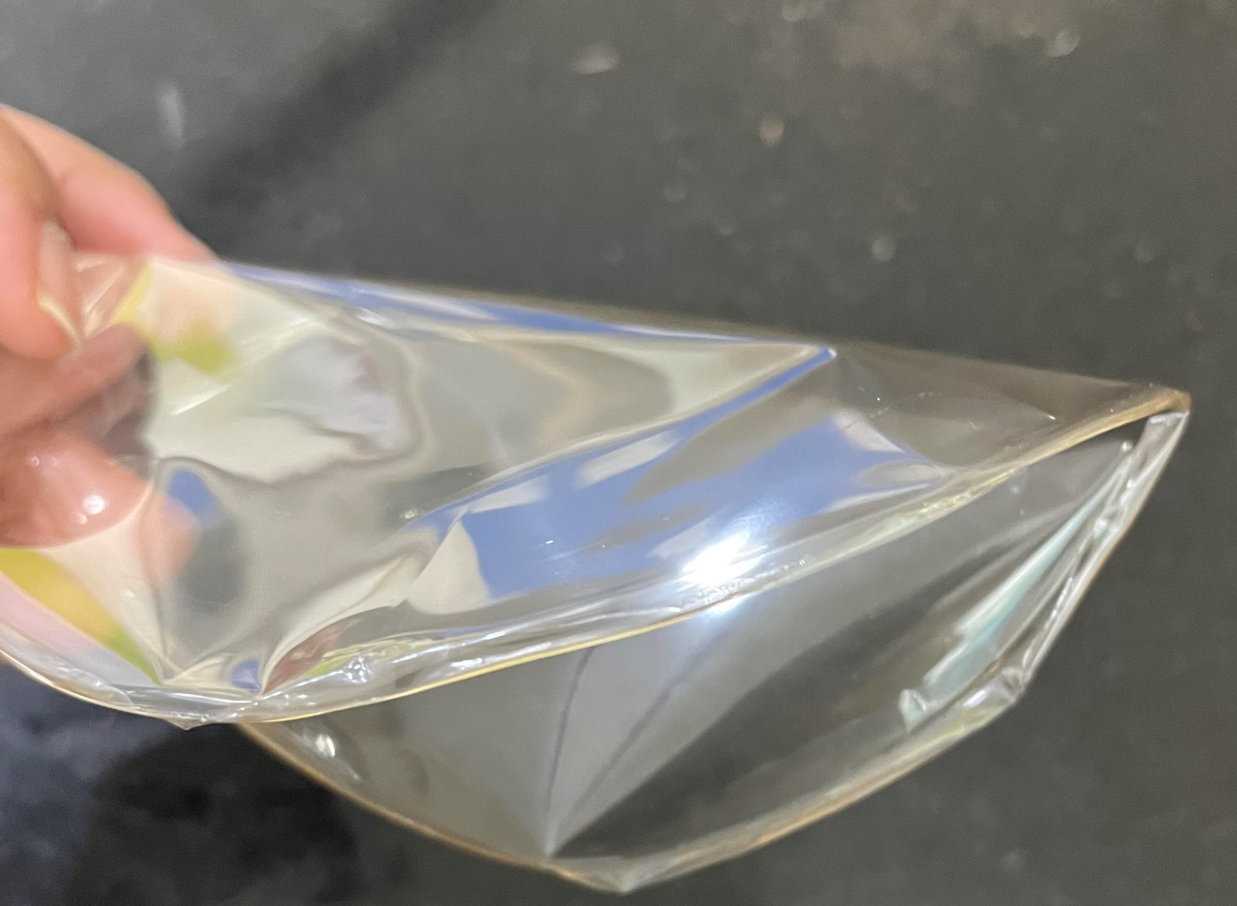
METHODOLOGY
Multiple trials conducted using varied composition of components. Components weighed and dissolved in distilled water. Solution was homogenized(stirrer) at 40C and pH of 4.2 maintained. Homogenization using ultrasonic sonicator. Poured in petri dish and dried in a humidity chamber (Temp: 40C, Humidity-60%). Peeled off, sealed in pouches and stored in a vacuum desiccator. Trial without humidifier Excess humidity Transparent, flexible thin protein-polysaccharide film
2

Slide 4
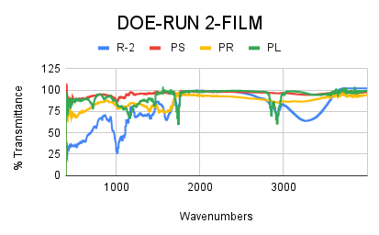
RESULTS AND DISCUSSIONS contd.,
Design of Experiment FTIR Results DOE based FILM
RUN NO. | GLUTEN(g) | CASTOR OIL(g)
1 | 0.75(+1) | 0.125
2 | 0.25(-1) | 0.125(-1)
3 | 0.75 | 0.375(+1)
4 | 0.25 | 0.375
3

Slide 5
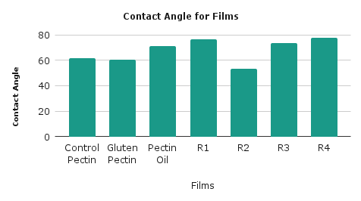
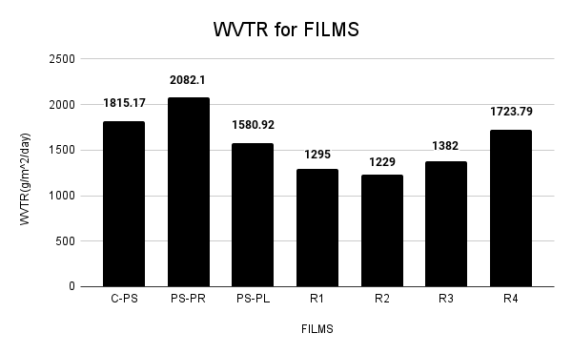
RESULTS AND DISCUSSION contd.,
Contact Angle WVTR Test Standard specimen size sent to Northern India Textile Research Association and Sree Chitra Tirunal Institute For Medical Sciences & Technology Analysis done for the test using water method
The results show that in general the hydrophobicity was improved for films based on design of experiment in comparison to control films.
4

Slide 6
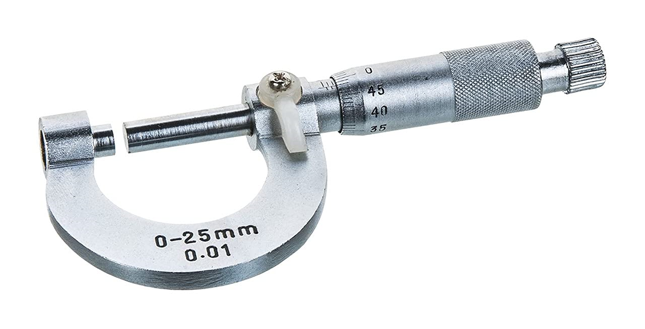
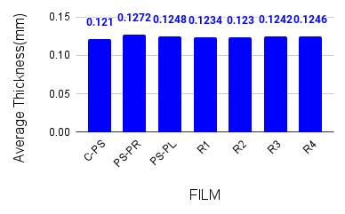
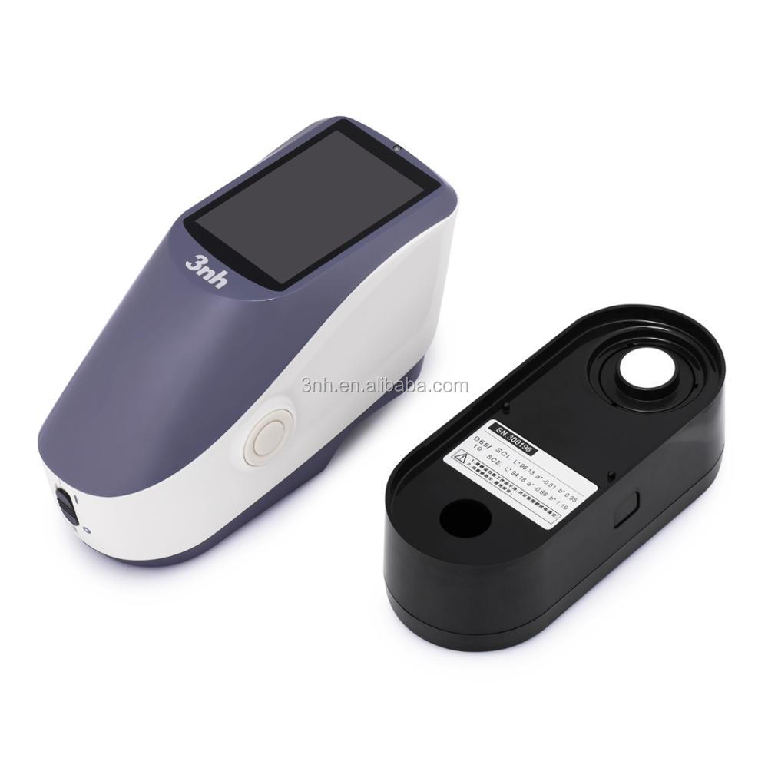
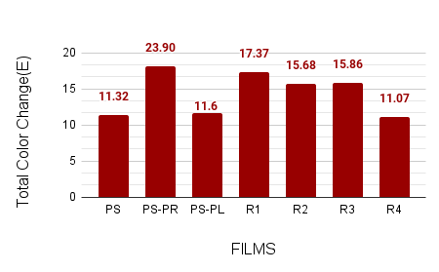
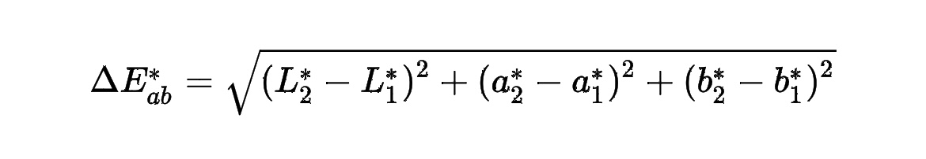
RESULTS AND DISCUSSION contd.,
Thickness Test All films were thin and falls in the range of 0.125±0.004 which is in accordance with the std. range(≤0.25 mm). Transparency Test All films were transparent with E ranging between 11-25. L-light/dark a-red/green b-yellow/blue where L₂*,a₂*,b₂* are values of reference transparent film and L₁*,a₁*,b₁* are values of prepared films
5

Slide 7
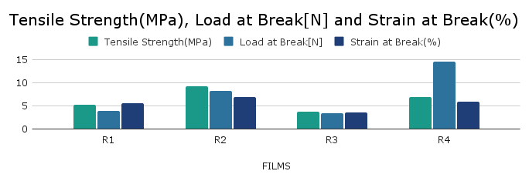
RESULTS AND DISCUSSION
Mechanical Properties Film R2 had the highest tensile strength. Film R4 had the maximum load at break. Lower gluten content with higher plasticizer content may improve mechanical properties. Film R3 had the lowest tensile strength and load at break. Higher plasticizer content may not always improve mechanical properties. Optimizing the gluten and plasticizer content can lead to films with improved mechanical properties.
6

Slide 8
RESULTS AND DISCUSSIONS contd.,
BIODEGRADABILITY
Film sown in soil
In 15hrs,film was biodegraded
Leaves grown(DAY-7)
Germination(Day-5)
7

Slide 9
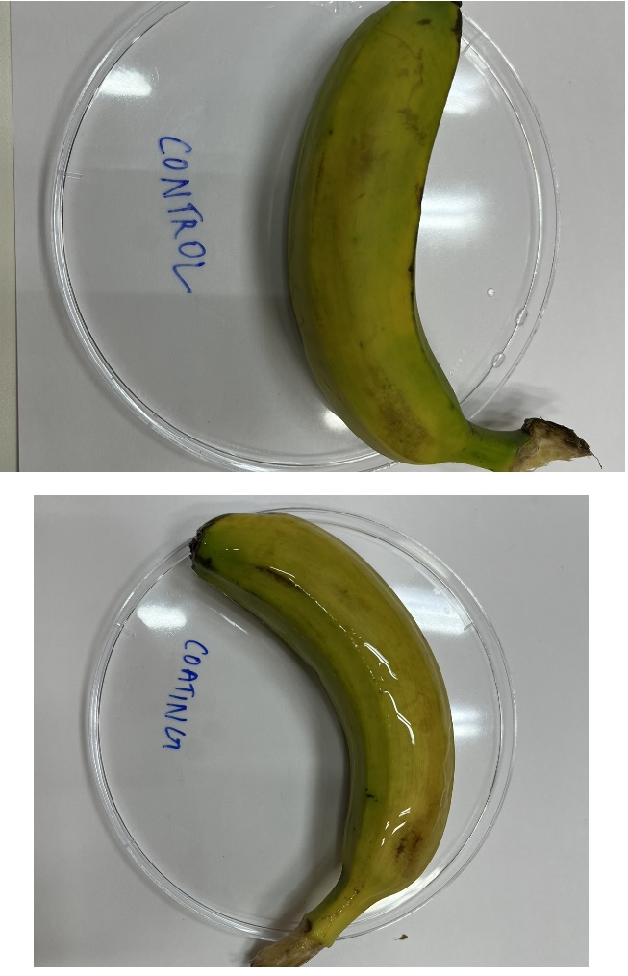
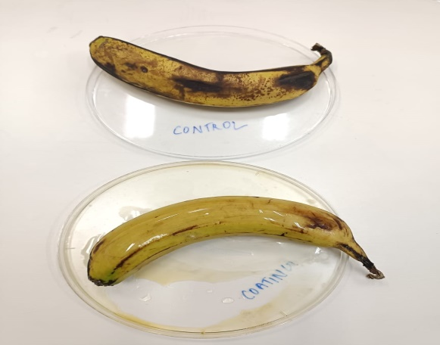
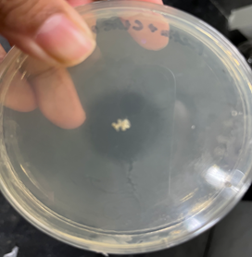
RESULTS AND DISCUSSIONS contd.,
Coating on fruits and vegetable Day-1 Day-6 Antimicrobial Test
Bacteria Used: E. coli
Purpose: To prove improved anti-microbial property using growth of inhibition
Result: Zone of inhibition was formed of 3.2 cm against well created of 1 mm in which film solution was added
8

Slide 10
CONCLUSIONS
The polysaccharide-polymer films were successful developed with plasticizer range between 5% to 15% and protein range between 10% to 30%. All films made including control films were thin, flexible and transparent Films based on DOE compared to control films showed: Improved barrier properties Improved shelf life Improved hydrophobic properties Biodegradability and anti-microbial properties All films were completely soluble in water Moisture content for all films ranged between 0.05-1% FTIR spectra provides information regarding material state and new bond formation for the samples Polysaccharide based edible films- An environmental friendly alternative to petroleum-based polymers
9

Slide 11
REFERENCES
Abral, H., Basri, A., Muhammad, F., Fernando, Y.,Hafizulhaq, F.,Mahardika, M.,Sugiatri, 12 E., Sapuan, S. M., Ilyas, R. A., & Stephane, I. (2019). A simple method for improving the 13 properties of the sago starch films prepared by using ultrasonication treatment. Food 14 Hydrocolloids,93, 276–283. J. Bai & A. Plotto, Coating for fresh fruits and vegetables,In edible coating and films to improve food quality, Edited by Jinhe Bai CRC Press, pp. 186-248 (2012) E.A. Baldwin, M.O. Nesperos-Carriedo & R.A. Baker, Use of edible coating to preserve quality of lightly and slightly processed product, Criti. Rev. Food Sc. Nutri. 35, pp. 509-552 (1995) W. Borchard, A. Kenning, A. Kapp & C. Mayer, Phase diagram of the system sodium alginate/water: A model for biofilms, Int. J. Boil. Macromol.; (2005) F. Debeaufort, G.J.A. Quezada & A. Voilley, Edible films and coating: Tomorrow’s packaging: A review, Criti. Rev. Food Sc. and Nutri. 38, pp. 299-313 (1998). L.J. Harris, J.N. Farber, L.R. Beuchat, M.E. Paris, T.V. Suslow, E.H. Garrett & F.F. Buster, Outbreak association with fresh produce, Compre. Rev. Food Sc. 78-141 (2003) J.J. Kester & O.R. Fennema, Edible films and coatings: A review, Food tech., 40, pp. 47-49 (1986)
10

Slide 12
THANK YOU

