Slide 1
The Effect of Twisted Baffle on the Microbubble Generator Swirl Ventury Type
Fatma Roshanti, Sigit Deddy Purnomo Sidhi, Samsul Kamal, Deendarlianto and Indarto
Correspondence: deendarlianto@ugm.ac.id

Slide 2
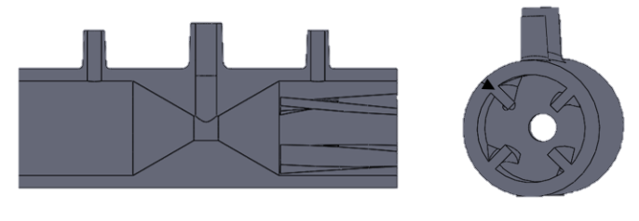
Introduction
Microbubble has been widely applied in several field due to its high gas-liquid mass transfer rate [1].
Modifications such as the addition of spiral fins [5], porous media [6], combined with orifices [7], have been made to increase the efficiency on the ventury microbubble generator to generate a microbubble. The addition twisted baffle on the inlet ventury not has been widely reported.
The performance of the ventury will evaluated by bubble diameter, hydraulic power, bubble generating efficiency.

Slide 3
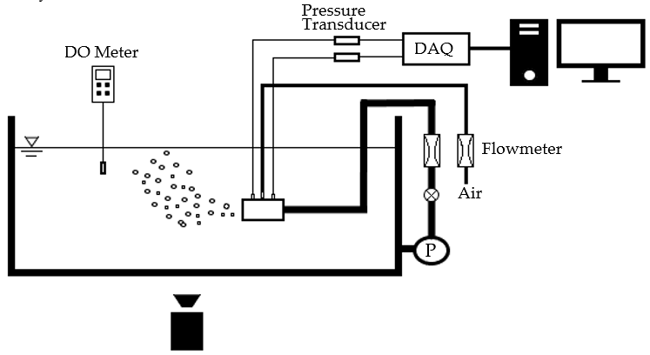
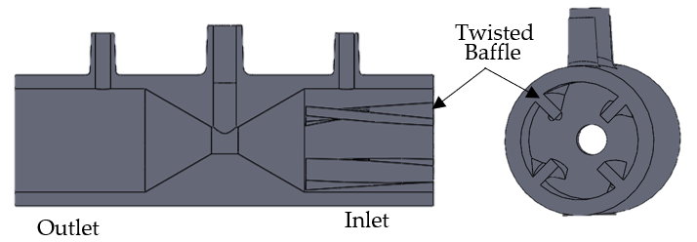
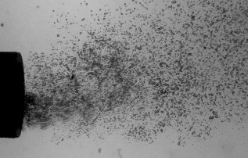
Sistem Experimental Apparatus
Data Processing:
MATLAB to extract bubble diameter from video data

Slide 4
Results and Discussion
Bubble Size Distribution
Pressure Drop
Hydraulic Power
Bubble Generating Efficiency

Slide 5
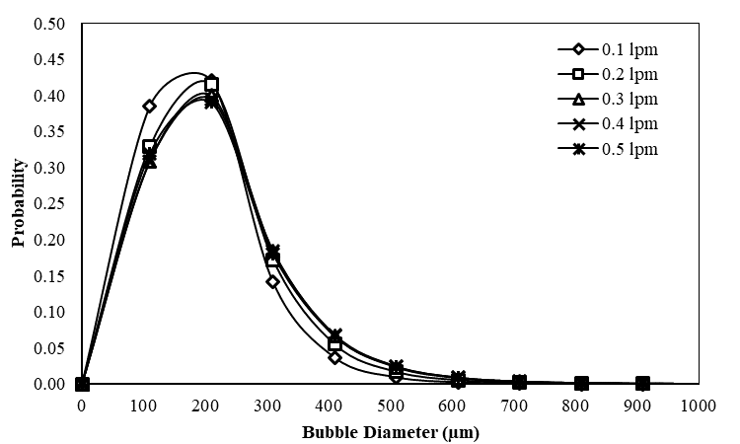
Bubble Size Distribution
Swirl Ventury Microbubble Generator successful generated 100 – 300 µm bubble diameter. An increase in water flow rate increases inertia forces and inhibit initial bubble formation so that the average bubble diameter will decrease.
In the meantime, enlargement of the gas flow rate should diminish bubble stability while increasing the effect of bubble coalescence. Coalescence is defined as forming large bubbles from small ones. Colaessence decreases probability curve distribution.

Slide 6
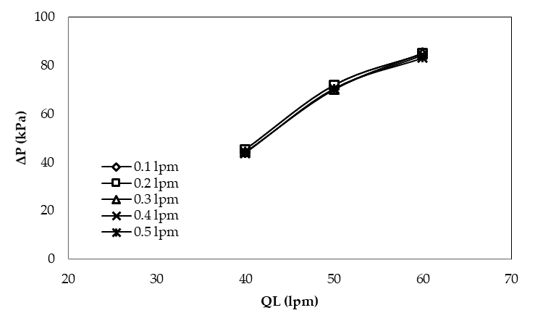
Pressure Drop
A combination of QL and QG has a distinct response. The pressure drops are linearly increased with increasing water flow rates. Conversly, the enhancement of gas flow rate created an identical graphic and it is not significantly affected pressure drop.

Slide 7
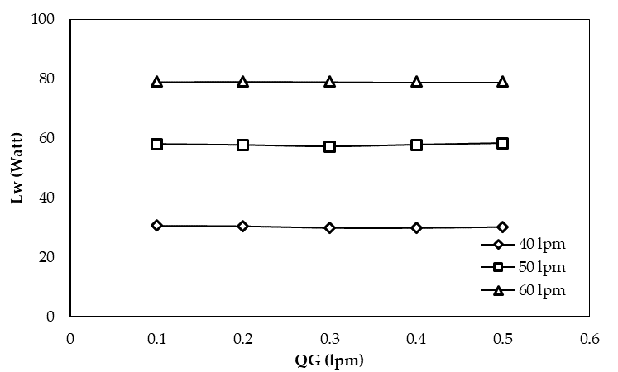
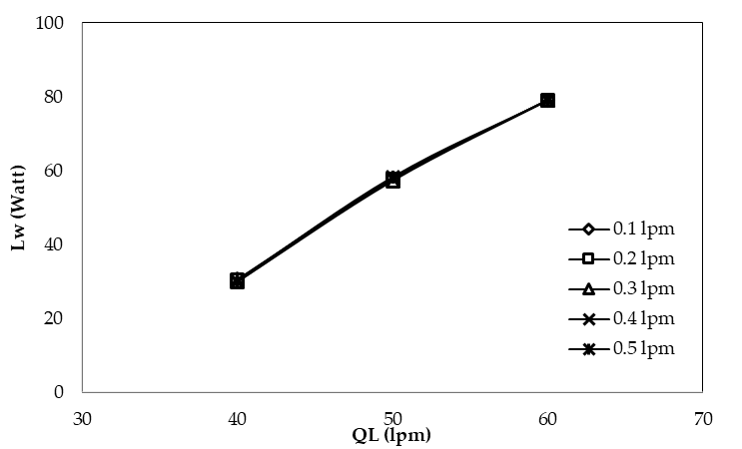
Hydraulic Power
Hydraulic power represents stored energy from water flow in a microbubble generator. Hydraulic power increased linearly with pressure drop and QL. An increased QL will increase the hydraulic power by 22 - 27 W, while an increase QG will only increase 1 W and conduce almost the same graphic. So, we can conclude that the water flow rates more significantly affected Lw than gas flow rates.

Slide 8
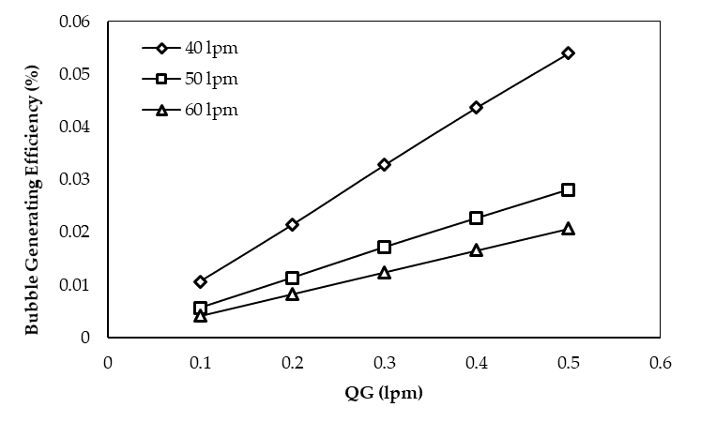
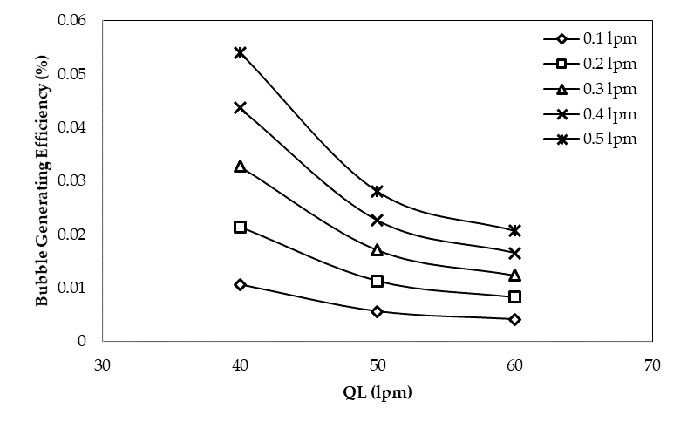
Bubble Generating Efficiency
Bubble-generating efficiency means the energy received by air from water flow rates. Bubble-generating efficiency decreases with an increase in hydraulic power. The lower values of bubble-generating efficiency indicates that energy inside the water is used to break air into a tiny bubble in the microbubble generator rather than suck air into it

Slide 9
Conclusion
[1] H. Tsuge, Micro and Nanobubbles Fundamentals and Applications, 1 ed. 6000 Broken Sound Parkway NW, Suite 300: Taylor & Francis, 2015.
[2] J. Huang dkk., “A review on bubble generation and transportation in Venturi-type bubble generators,” Exp. Comput. Multiph. Flow, vol. 2, no. 3, hal. 123–134, 2020, doi: 10.1007/s42757-019-0049-3.
[3] Deendarlianto, Wiratni, A. E. Tontowi, Indarto, dan A. G. W. Iriawan, “The implementation of a developed microbubble generator on the aerobic wastewater treatment,” Int. J. Technol., vol. 6, no. 6, hal. 924–930, 2015, doi: 10.14716/ijtech.v6i6.1696.
[4] A. Gordiychuk, M. Svanera, S. Benini, dan P. Poesio, “Size distribution and Sauter mean diameter of micro bubbles for a Venturi type bubble generator,” Exp. Therm. Fluid Sci., vol. 70, hal. 51–60, 2016, doi: 10.1016/j.expthermflusci.2015.08.014.
[5] D. H. Shin, Y. Gim, D. K. Sohn, dan H. S. Ko, “Development of venturi-tube with spiral-shaped fin for water treatment,” J. Fluids Eng. Trans. ASME, vol. 141, no. 5, hal. 1–9, 2019, doi: 10.1115/1.4042750.
[6] A. I. Majid, F. M. Nugroho, W. E. Juwana, W. Budhijanto, Deendarlianto, dan Indarto, “On the performance of venturi-porous pipe microbubble generator with inlet angle of 20°and outlet angle of 12°,” AIP Conf. Proc., vol. 2001, no. 050009, 2018, doi: 10.1063/1.5050000.
[7] W. E. Juwana, A. Widyatama, O. Dinaryanto, W. Budhijanto, Indarto, dan Deendarlianto, “Hydrodynamic characteristics of the microbubble dissolution in liquid using orifice type microbubble generator,” Chem. Eng. Res. Des., vol. 141, hal. 436–448, 2019, doi: 10.1016/j.cherd.2018.11.017.
[8] M. Sadatomi, A. Kawahara, K. Kano, dan A. Ohtomo, “Performance of a new micro-bubble generator with a spherical body in a flowing water tube,” Exp. Therm. Fluid Sci., vol. 29, no. 5, hal. 615–623, 2005, doi: 10.1016/j.expthermflusci.2004.08.006.
[9] I. Levitsky, D. Tavor, dan V. Gitis, “Micro and nanobubbles in water and wastewater treatment: A state-of-the-art review,” J. Water Process Eng., vol. 47, no. 102688, 2022, doi: 10.1016/j.jwpe.2022.102688.
Swirl ventury microbubble generator success generated 100 – 300 µm diameters. The bubble size linearly to gas flow rate and decrease as increases of water flow rate. Hydraulic power increase linearly with pressure drop and QL. The higher Lw decrease in ηB means the better performance of the microbubble generator

Slide 10
Thank You

