Slide 1
A comparative study of the effects of Jatropha multifida and Euphorbia hirta, and their mixture on pathogenic growth rate
Ekangu Gerald, Opio Alfonse
Gulu University, Faculty of Science, Department of Biology,
P. O. Box 166, Gulu-Uganda.

Slide 2
Introduction
Plants are a source of vast array of natural products that have been exploited as medicaments for a variety of disease conditions.
Bioactive compounds.
Much recent attention has been made to extracting the biologically active compounds which are isolated from plants.
Effective life span of any antibiotic has become limited.
This is a growing threat to public health due to uncontrolled use and abuse of antibiotics.
Medicinal plants possess both potential antimicrobial crude drugs as well as a source of natural compounds that act as new anti-infective agents in the future.

Slide 3
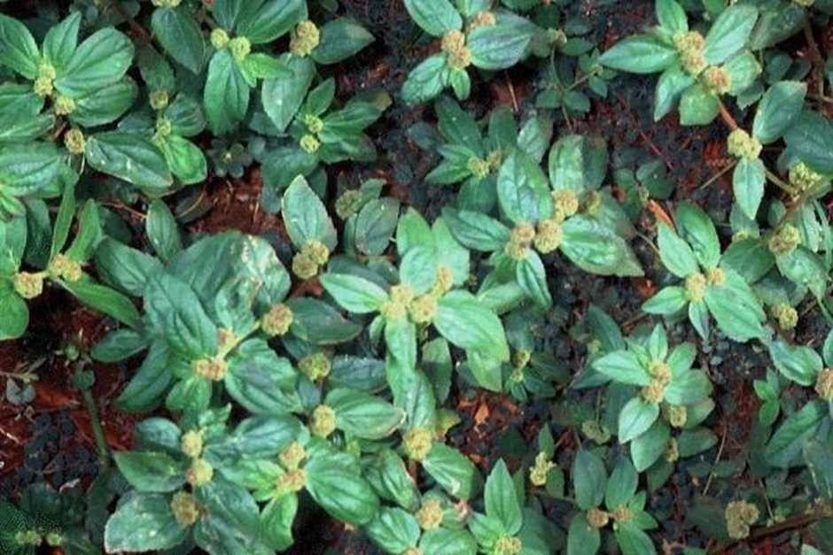
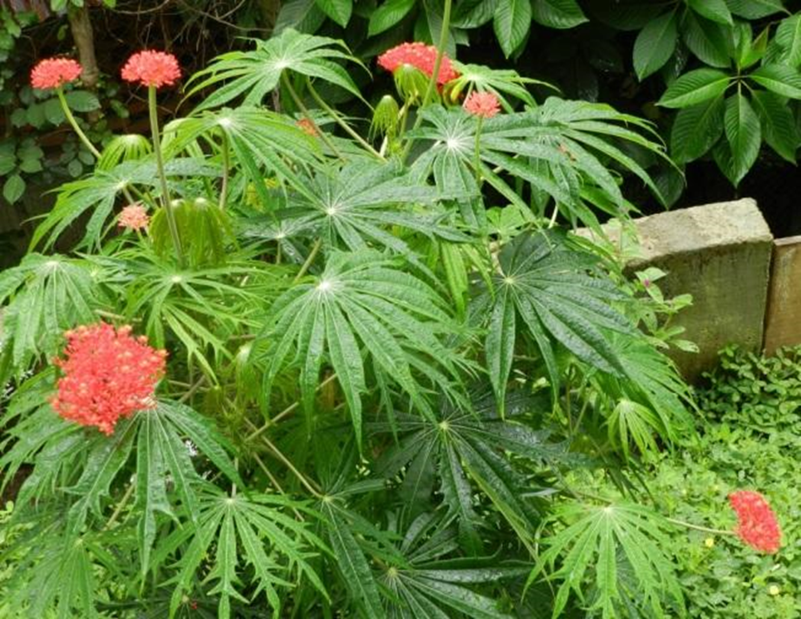
Escherichia coli (E. coli) is a bacterium found in the gut of humans and warm-blooded animals.
E. coli is also an indicator of the presence of pathogenic bacteria.
This study assessed the effectiveness of the different plant herbs (Euphorbia hirta and Jatropha multifida) and their mixture on the growth inhibition of pathogenic bacteria.
Euphorbia hirta Jatropha multifida

Slide 4
The herbal potency in treating pathogenic bacterial infections, if used appropriately would;
Solve the global multi-drug resistance created by the overuse of antibiotics.
Benefit low income communities due to the high costs of antibiotics, since the herbs are readily available.

Slide 5
Materials and Methods
Study area
The research was conducted at Gulu University in the Multifunctional Laboratory.
Because a study in Gulu Regional Referral hospital reveals relatively high frequencies of resistance to most antibiotics. (Odongo et al, 2013).
Collection of plants and E. coli samples
The fresh parts of Jatropha multifida and Euphorbia hirta were collected from around the surroundings of Gulu University.
Pure isolates of E. coli bacteria were obtained from patients diagnosed with gastro-intestinal infections from hospital.

Slide 6
Preparation of crude extracts of Euphorbia hirta and Jatropha multifida
Plants parts were washed, shadow dried and pounded in a motor to form powder.
50 g of each plant powder was soaked in 100 ml of ethanol for 24 hours.
This was later filtered, and evaporated to dryness and concentrated using vacuum evaporator and stored in moisture free container.
To form the concoction of Equal mass (50 g) of Euphorbia hirta and 50 g of Jatropha multifida were mixed and soaked in 100 ml of ethanol for 24 hours.
This was also filtered, concentrated with vacuum evaporator, and stored.

Slide 7
Preparation the nutrient agar and physiological saline
Seven (7) g of nutrient agar powder put in 250 ml of distilled water was heated to dissolve, autoclaved and cooled.
Physiological saline prepared by dissolving 8.5 g sodium chloride (NaCl) in water was also autoclaved for 20 minutes at 121°C, and cooled to room temperature.
Colonies of E Coli was transferred from the storage media into physiological saline and mixed to maintain the cell osmotic pressure.

Slide 8
Bacterial culture
The wire loop heated, cooled and the sterile wire loop dibbed into the plate containing physiological saline and the E. coli was scrapped, and spread evenly over area of agar surface and incubated at 37°C for 24 hours.

Slide 9
Determination of plant extracts efficacy
The antimicrobial activity of the plant extracts was tested using diffusion of plant extract.
The petri dishes with bacterial cultures were loaded with plant extracts.
The concentrated plant extracts placed on the center of the petri dish and incubated at 37°C for 24hours.
The antibacterial activity was recorded by measuring the diameter of inhibition zone around each plant extract (in mm) after two (2) days.

Slide 10
RESULTS
Mean ± standard deviations of zones of inhibition of aqueous extracts of Euphorbia hirta, Jatropha multifida and their mixture against the growth of E coli measured after two days.
The mixture of the plant extracts showed highest zone of inhibition of E. coli growth.
 | Treatment
 | Euphorbia hirta (mm) | Jatropha multifida (mm) | Mixture (Euphorbia hirta + Jatropha multifida) (mm)
Mean | 19.7 ± 1.8 | 10.8 ± 1.9 | 27.8 ± 1.7

Slide 11
DISCUSSIONS
Extracts of Euphorbia hirta contain bioactive components with antibacterial activities which include Tannins, Flavonoids, Alkaloids and Cardiac glycosides (Jenifer, 2014).
These components have effects on the cell membrane of bacteria or form complexion of metal ions (Anani et al, 2016).
The flavonoid results in lysis of the membrane and cell death.
Extracts of J. multifida contains alkaloids, phenols, steroids and tannins and lack coumarins, flavonoids and saponins (Rampadarath et al, 2014).
E. coli is a Gram negative bacteria with the cell wall made up of peptidoglycan containing lipopolysaccharides and lipoproteins which act as a permeability barrier to large molecules and hydrophobic molecules (Anne, 2016).

Slide 12
The mixture of the plants’ extracts contain higher concentration of the bioactive components and activity on the membrane complexion.
Thus the increased cell lysis and death.
Conclusion
The mixture of the two plants (Jatropha multifida and Euphorbia hirta) extract is a better option for pathogenic growth inhibition.
Recommendation
We suggest further exploration of the microbial activity of the mixture of Jatropha multifida and Euphorbia hirta using different solvents to determine the adequate concentration of the mixture of the two plant extracts.

Slide 13
THANK YOU FOR LISTENING

