Slide 2
Isolation and Characterization of Plant Growth Promoting Bacteria from the Rhizosphere of Chamaecytisus ruthenicus (Russian broom) Growing on Chalky Soil
Zekarias A. Asfha¹ , Nataliya Suzina², Yulia Kocharovskaya², Yanina Delegan², Inna P. Solyanikova ^{1,2}
1. Institute of Pharmacy, Chemistry and Biology, Belgorod State
University, Belgorod Region, Russia.
E- mail:andzekarias@gmail.com
2 Federal Research Center “Pushchino Scientific Center for
Biological Research of the Russian Academy of Sciences”, Pushchino, Moscow region, 142290, Russian Federation

Slide 3
1. Introduction
Intensive use of agro-chemicals has negative effect on the environment and animal health (Singh et al., 2027).
Plant growth promoting rhizobacteria (PGPR) have often been used as potential substituent of Agro-chemicals (Palaniyandi et al., 2022)
PGPR promotes plant growth either through direct or indirect mechanisms (Khan et al., 2022)

Slide 4
Cont…
Some PGPR directly promoting plant growth (eg. increase in length of shoot and root). While others indirectly promoting plant growth by inhibiting phytopathogens
(Saharan et al., 2011 ).
However, the mechanism of PGPR activity differ depending on host plant species, soil type, and soil nutritional status (Kalam et al., 2021 ).

Slide 5
Cont…

Slide 6
2. Statement of the problem
Researchers are still looking for potential PGPR from the rhizosphere of different plant species.
However, no research has been done on chalky soil bacteria found in the rhizosphere of Chamaecytisus ruthenicus (the wild legume plant).

Slide 7
3. Objectives
Therefore, the aim of the present study was:
To evaluate the abundance of culturable
bacteria
To assess the morphology of bacterial
isolates
To profile chalky soil bacterial community
To characterize their ability to stimulate
plant growth.

Slide 8
4. Materials and Methods
4.1. Soil sample collection

Slide 9
4.2. Bacterial abundance and isolation
LB Composition:
yeast extract=1g/L
Pepton = 2g/L
Nacl = 5g/L
Agar = 20g/L
Plates were incubated
at 29^{O}C for 48 hours

Slide 10
Cont…
4.3. Microscopy examination of bacterial isolates
Bacterial cells morphology were obeserved using light microscop, after the cells have been fixed with glutaraldehyde solution.

Slide 11
Cont…
4.4. Soils profile by 16S rRNA gene
sequencing
Sequence analysis was performed using
QIIME2 v.2022.2 software
(Bollyen et al., 2019 )
and
MicrobiomeAnalyst 2.0 web service
(Dhariwal et al., 2017)

Slide 12
Cont…
4.5. Bacterial inhibition against phytopathogenic
microbes
All the tested bacterial isolates (Z10, Z11, Z12, Z15, Z26, and Z44) and phytopathogenic microbes (three bacteria and five fungi) were cultured for five and three days, respectively.
5 μL of bacterial solution was added onto plates
containing phytopathogenic microbes
Plates were incubated at 29 ºC for 48 hours.
Presence of inhibition zone indicated inhibition
effect.

Slide 13
Cont….
4.6. Bacterial stimulation effect on Plant growth

Slide 14
5. Results
5.1. Abundance and isolation of rhizospheric
bacteria
The number of CFU/g:
1. Top soil sample = 4.25 x 10⁸ cfu/g
2. 15 cm beneath the surface = 3.58 x 10⁸ cfu/g
3. Rhizosphere = 10.1 x 10⁷ cfu/g
A total of 23 morphologically diversified chalky
soil bacteria were isolated

Slide 15
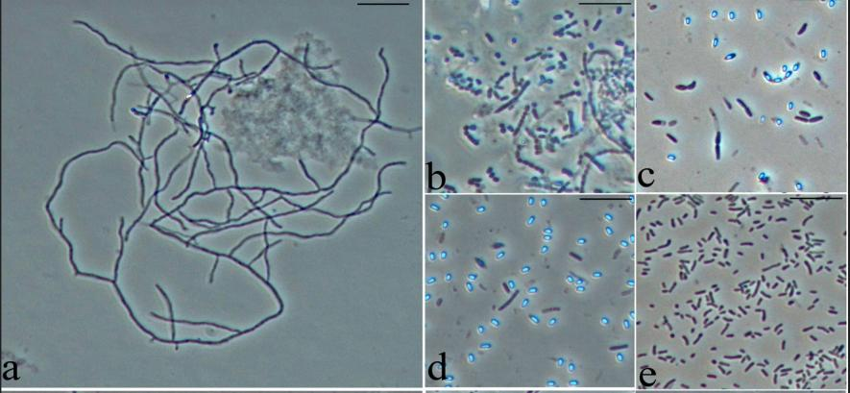
Cont…
5.2. Morphology of the isolated strains
Chalky soil bacteria with a wide range of morphology

Slide 16
Cont…
5.3. Profile of soil bacteria community
Proteobacteria were the most dominant and cosmopolitan
group among all the bacterial communities.

Slide 17
5.4. Bacterial inhibition against phytopathogenic microbes

Slide 18
Cont…
Formation of inhibition zone by bacterial strains Z11 and Z15 against
two phytopathogenic fungi

Slide 19
5.5. Bacterial stimulation effect on germinated seeds (wheat, maize, oats, and lentils)

Slide 20
6. Conclusion
Chalky soil is comprised of morphological
diversified bacterial community.
All the selected bacterial isolates showed both
growth stimulation and phytopathogenic
microbial inhibition activity.
This is the first report on chalky soil bacteria found in the rhizosphere of wild legume plant.
In the future, further investigation will be carried out on these potent chalky soil bacteria.

Slide 21
Thank you !!!!!

