Slide 1
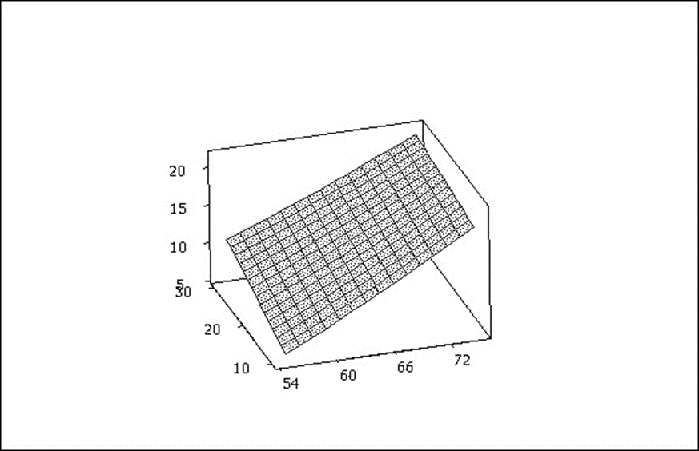
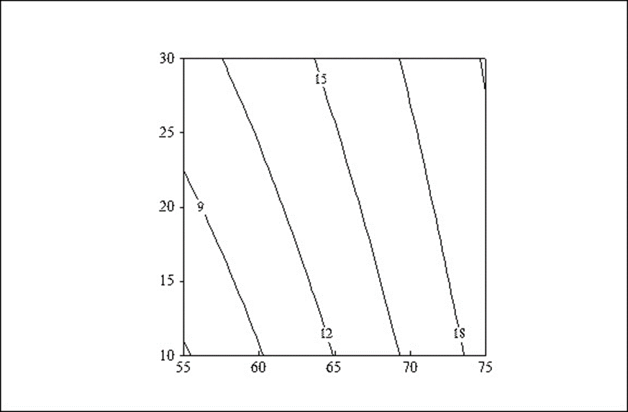
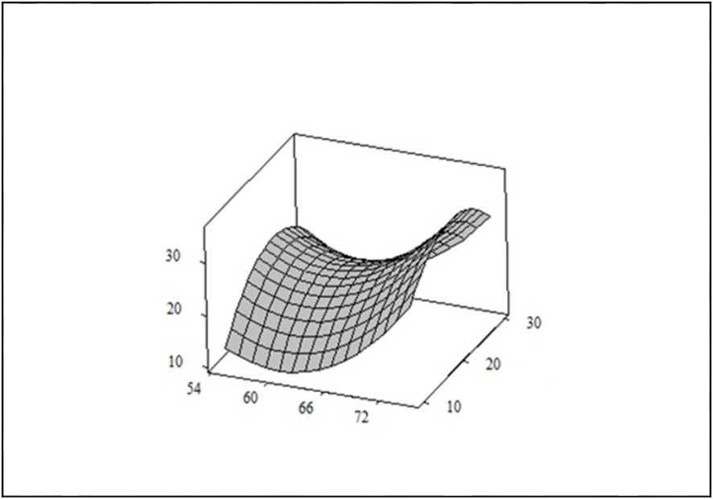
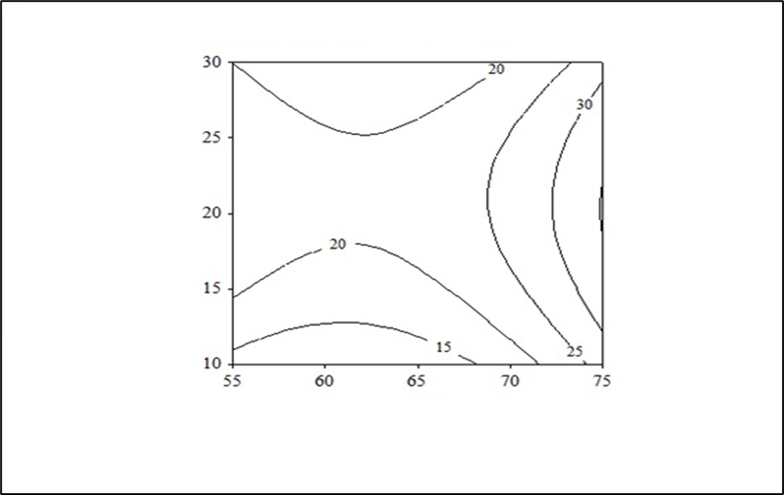
Optimizing the thermal processing of honey by studying the physicochemical properties and its hydroxymethylfurfural content
S. Seyyedi-Mansour ¹, P. Donn¹, P. Garcia-Oliveira^{1,2}, J. Echave ¹, F. Chamorro ¹, A.G. Pereira ^{1,2}, A. Silva ^{3,1},
A. Perez-Vazquez¹, J. Simal-Gandara ¹, M.A. Prieto ^{1,2,*} and L. Roufegari-nejad^{4,*}
¹ Nutrition and Bromatology Group, Department of Analytical and Food Chemistry, Faculty of Food Science and Technology, University of Vigo, Ourense Campus, E32004 Ourense, Spain.
² Centro de Investigação de Montanha (CIMO), Instituto Politécnico de Bragança, Campus de Santa Apolonia, 5300-253 Bragança, Portugal.
³ LAQV-REQUIMTE Department of Chemistry and Biochemistry. Faculty of Sciences. University of Porto. Rua do Campo Alegre s/n 4169-007 Porto, Portugal.
⁴ Department of Food Science and Technology, Azad University, Tabriz branch, Iran Basmenj road, 5157944533, Tabriz, Iran.
* Correspondence: mprieto@uvigo.es, L.roufegari@iaut.ac.ir.
INTRODUCTION
RESULTS
Honey due to its valuable nutritious components, antimicrobial and antioxidative effect has a nutritional importance [1]. Honey producers have been heating honeys in order to prevent post-bottling crystallization and delay microbial spoilage. In spite of its desirable effects, heating causes some deterioration in physicochemical properties and lead to unhealthy component formation such as hydroxyl methyl furfural (HMF) [2]. The formation of this compound during heat treatment, has been one of the major challenges of consumers safety and because of its carcinogenic and mutagenic effects, there is a strong research potential to achieve the legal levels of food safety. The maximum level of HMF in honey has been set at 40 ppm under codex standards [3]. So, modeling and finding a relation between different heat treatment and storage parameters could be a reasonable approach to optimize process and increase quality and safety of end product.
The results showed that the heating, processing time and storage time had no effect on pH and moisture and color (data not shown) while storage temperature had a significant effect on L* and a* parameters. All the studied factors showed a significant effect on HMF formation (p<0.05), indicating that this content was significantly increased with increasing heating time, temperature and storage conditions (Figure 1,2). From the optimization study, it can be concluded that the minimum content of HMF resulted by heating honey at 55 °C for 10 min and keep it at 25 °C for 45 days. These processing and storage conditions could help to find the best operation conditions to preserve both the quality and safety of honey.
HMF (mg/kg )
METHODS
Heating temperature (°C)
This research applied Response Surface Methodology (RSM) and Central Composite Design (CCD) to 1) survey independent variable effects such as heating pasteurization temperature (55, 65 and 75(°C), time of heating (10, 20 and 30 min) and storage temperature (25 and 40(°C) on physicochemical properties (moisture content, pH, color parameters) and HMF formation at the two different storage time (45 and 90 days); 2) find the optimal conditions to minimize the HMF formation (Table 1).
Time of heating (min)
HMF (mg/kg )
Time of heating (min)
Table 1. Central composite design (by Minitab 16 software)
Heating temperature (°C)
Run Order | Block | Heating pasteurization temperature (°C) | Time of heating (min) | Storage temperature (°C)
1 | 1 | 65 | 20 | 25
2 | 1 | 55 | 30 | 25
3 | 1 | 55 | 10 | 25
4 | 1 | 75 | 10 | 25
5 | 1 | 65 | 20 | 25
6 | 1 | 65 | 20 | 25
7 | 1 | 75 | 30 | 25
8 | 2 | 65 | 20 | 40
9 | 2 | 65 | 30 | 40
10 | 2 | 65 | 20 | 40
11 | 2 | 65 | 10 | 40
12 | 2 | 55 | 20 | 40
13 | 2 | 75 | 20 | 40
14 | 2 | 65 | 20 | 40
Figure 1. The effect of thermal process temperature on the amount of hydroxymethylfurfural during 45 days storage
HMF (mg/kg )
Heating temperature (°C)
Time of heating (min)
HMF (mg/kg )
Time of heating (min)
Heating temperature (°C)
Figure 2. The effect of thermal process temperature on the amount of hydroxymethylfurfural during 90 days storage
References
[1] Abraham, K., Gurtler, R., Berg, K., Heinemeyer, G., Lampen, A, and Appel., K.E. 2011. Toxicology and risk assessment of 5-Hydroxymethylfurfural in food. Molecular Nutrition & Food Research. 55: 667–678.
[2] Ajlouni, S., and Sujirapinyokul, P. 2010. Hydroxymethylfurfuraldehyde and amylase contents in Australian honey. Food Chemistry. 119: 1000–1005.
[3] Fallico, B., Zappala, M., Arena, E. and Verzera.A. 2004. Effects of conditioning on HMF content inunifloral honeys. Food Chemistry. 85: 305–313.
Acknowledgments:
The research leading to these results was supported by MICINN supporting the Ramón y Cajal grant for M.A. Prieto (RYC-2017-22891); by Xunta de Galicia for supporting the program EXCELENCIA-ED431F 2020/12, the pre-doctoral grants of P. Garcia-Oliveira (ED481A-2019/295) and A.G. Pereira (ED481A-2019/0228). The authors thank the program BENEFICIOS DO CONSUMO DAS ESPECIES TINTORERA-(CO-0019-2021) that supports the work of F. Chamorro

