Slide 1
The Potential of Algae Biofuel as a Renewable and Sustainable Bioresource Id- sciforum-070863 Presented by: Krishna Neeti (Research Scholar)
ECP 2023: The 2nd International Electronic Conference on Processes: Process Engineering—Current State and Future Trends

Slide 2
Introduction
Recent years have witnessed global energy consumption steadily increase as a result of rapid urbanization and industrial development
Conventional fossil fuels such as oil, coal, and natural gas still represent the primary energy supply. Renewable and sustainable sources such as wind, solar, tidal hydropower and biomass must be applied to meet the increasing energy demands
Algae species boast over 30000 varieties that reproduce rapidly making them one of the most diverse groups among plants
Microalgae are capable of rapidly growing through photosynthesis, carbon dioxide, and nutrients and also producing significant oil production that can be extracted by disrupting their cell structure and producing biofuels (Biodiesel, Bioethanol, Biohydrogen, Bio-oil and Biohydrogen)
With various conversion processes such as Transesterification Fermentation Pyrolysis, and Anaerobic Digestion, algal feedstock could easily be transformed into algae-based biofuels
The algae can withstand almost all environments and temperatures, including extreme cold and scorching heat
They can eliminate CO₂ from industrial chimney gases by bio-fixation, and after oil extraction, produce electricity or heat energy, as well as biofertilizer, animal feed, healthcare products, and food products

Slide 3
Overview of Algae
A wide variety of algae exist in different sizes and forms, including single-celled microalgae and the largest multicellular seaweeds
Algae produce organic compounds through photosynthesis
Algae are highly efficient biofuel sources due to their ability to convert solar energy directly into biomass

Slide 4
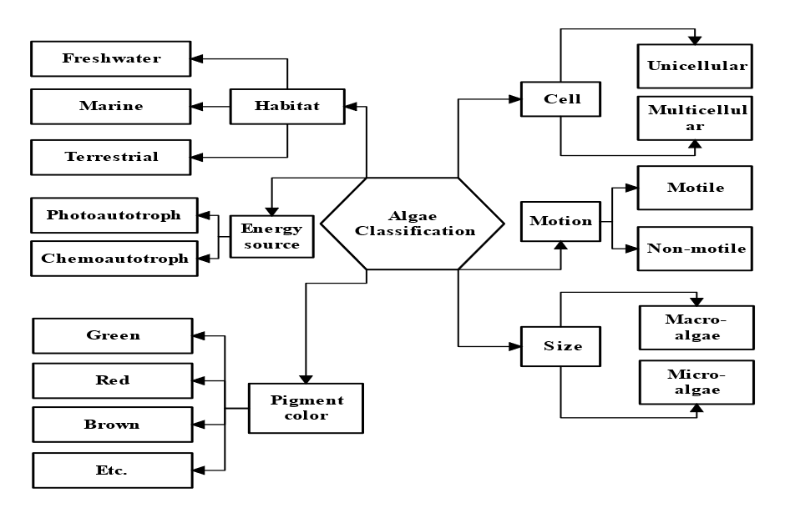
Classification of algae
Algae can be classified according to various characteristics such as size, cell type, habitat, energy source, pigment color, and motion. Classification of algae is illustrated in Figure 1
Figure: -1 Classification of algae

Slide 5
Sustainable Development of Algae
Sustainably developing algae means using this natural resource in a way that minimizes greenhouse gas emissions while decreasing our dependence on non-renewable resources
Furthermore, sustainable development means minimizing negative environmental impacts while optimizing economic and social benefits. Table 1 details these applications and benefits of algae in sustainable development in various fields
Table- 1 Algae's contributions to sustainable development in a variety of contexts
Areas | Application | Benefits
Energy Production | Power generation | Algae-powered microbial fuel cells produce electricity Algae biogas used to generate electricity
Environmental Remediation | Carbon sequestration | Algae improve water quality, ecological health, and biodiversity Algae are used as carbon reservoirs by stores.
Food and Agriculture | Nutrient Supplement | Nutritional vitamins, minerals, and omega-3 fatty acids are found in algae
Sustainable Materials | Bioplastics | Algae-based bioplastic Algae-based polymers help reduce plastic use and waste
Waste Management | Wastewater treatment | algae extract nutrients and toxins from wastewater

Slide 6
Types of Algae Biofuels
Different biomass from different sources like forests, farms, and aquatic environments has been considered feedstock for the production of various biofuels such as biodiesel, bioethanol, biogas, bio-oil, and biohydrogen
Algae are an economical and eco-friendly choice when it comes to producing biodiesel; numerous techniques exist that transform it into algae-based fuels. Table 2 details their production process
Table- 2 Production process of algae biofuel
Types of algae biofuels | Production process
Biodiesel | Transesterification
Bioethanol | Fermentation
Biohydrogen | Fermentation
Bio-oil | Pyrolysis
Biogas | Anaerobic digestion

Slide 7
Advantages of Algae Biofuels
Algae biofuel offers several advantages over traditional fossil fuels and other biofuels. Table 3 lists these advantages of algae biofuel, with descriptions
Table- 3 Advantages of Algae Biofuels
Advantage | Description
Carbon neutral | Conversely, algae absorb CO₂ during growth which balances out any CO₂ released during combustion.
High productivity | Algae is an attractive biofuel crop due to its fast growth rate and high biomass output per unit area.
No competition with food crops | Algae are not a competition to food crops.
Potential for sustainable production | Algae can be grown safely and sustainably within an enclosed system (photobioreactor), eliminating contamination risk while simultaneously supporting sustainable production.
Versatility | Algae can produce biodiesel, bioethanol, biohydrogen, and bio-oil as by-products from its fermentation. Biogas production also depends on algae for power.
Waste reduction | Algae can be grown using wastewater or carbon dioxide emissions from industrial processes, reducing pollution and waste while decreasing pollution levels.

Slide 8
Indian Scenario of Algal Biofuel
India currently ranks fifth globally, using 4.1% of global energy production. By 2025, however, it is expected to surpass both China and the US to become the third-biggest energy user worldwide
India boasts the world's highest urban electrification rate (93.1%), as well as the world's largest rural population rural electrification schemes, are implemented at various times across rural regions; however, due to limited electricity generating capacity in India, it makes these plans hard to implement
India has shown increasing interest in algae production for various purposes and is taking steps to advance it through research, development, and commercialization. Table 4 depicts India's recent progress and program related to algal biofuel

Slide 9
Indian Scenario of Algal Biofuel (Cont…)
Table- 4 The Indian scenario of algal biofuel in recent years
Year | Research/ Program
2010 | The Department of Biotechnology (DBT) initiated its "National Program on Microalgal Technologies" to advance the development and utilization of microalgae in India.
2012 | The Indian government announced plans to produce biofuel from algae, to produce 20,000 tons of algal biofuel per year by 2017.
2013 | The Indian Institute of Technology Madras IITM established a pilot-scale facility for cultivating microalgae for biofuel production.
2016 | The Department of Biotechnology (DBT) established the University of Madras' "Centre of Excellence for Algae Research", to further promote algae research and technology development.
2017 | The Council of Scientific and Industrial Research CSIR launches a project to develop cost-effective technology for producing biofuel from algae.
2020 | The DBT and International Energy Agency's (IEA) "Bioenergy Task 39" recently issued a joint report on India's potential algal biofuel market, calling for further research and development to overcome technical and economic obstacles to algal biofuel development.

Slide 10
Challenges of Algae Biofuels
Algae biofuels have long been seen as a potential replacement for traditional fossil fuels in our energy needs, producing biofuels from algal biomass with several advantages over first and second-generation feedstocks
Unfortunately, algae biofuel production remains underdeveloped on a large scale; therefore, revisits will need to take place to address any technology-related issues. Table 5 offers details of all of these issues with algae biofuel production
Table- 5 Algae Biofuel Challenges
Challenges | Description
Contamination | Growing algae can be challenging in terms of avoiding contamination.
High production cost | Algal biofuels have become more expensive to produce in comparison with fossil fuels.
Land use | Massive cultivation of algae would require considerable space, which may conflict with other activities like farming or protecting wildlife habitats.
Scalability | One of the greatest challenges associated with algae farming is scaling.
Temperature and light | Air, water, and light conditions may alter algae growth and yield due to changes in environmental conditions.
Water quality | Maintaining water quality in an industrial-scale algae farm poses a significant technological challenge.

Slide 11
Conclusion
Microalgae have one of the fastest growth rates among photosynthetic organisms and can be grown on non-arable soil using wastewater as their nutrient source, offering exciting prospects for biofuel production from them
Algae-based fuels are considered one of the most cost-effective, renewable, sustainable, renewable, environmentally friendly solutions to climate change and food security; potentially meeting long-term global fuel demands by meeting energy demand from microalgae cultivation approaches as well as efficient low-cost harvesting methodologies
Nevertheless, more research needs to take place if microalgae will produce biofuel production from them than currently possible due to cultivation approaches as well as the lack of effective low-cost harvesting mechanisms from this organism

Slide 12
References
1. Ahmad, T.; Zhang, D. A Critical Review of Comparative Global Historical Energy Consumption and Future Demand: The Story Told so Far. Energy Reports 2020, 6, 1973–1991, doi:10.1016/J.EGYR.2020.07.020.
2. Megia, P.J.; Vizcaino, A.J.; Calles, J.A.; Carrero, A. Hydrogen Production Technologies: From Fossil Fuels toward Renewable Sources. A Mini Review. Energy and Fuels 2021, 35, 16403–16415, doi:10.1021/ACS.ENERGYFUELS.1C02501/ASSET/IMAGES/LARGE/EF1C02501_0004.JPEG.
3. Yang, Y.; Du, L.; Hosokawa, M.; Miyashita, K. Total Lipids Content, Lipid Class and Fatty Acid Composition of Ten Species of Microalgae. J. Oleo Sci. 2020, 69, 1181–1189, doi:10.5650/JOS.ESS20140.
4. Laurens, L.M.L.; Chen-Glasser, M.; McMillan, J.D. A Perspective on Renewable Bioenergy from Photosynthetic Algae as Feedstock for Biofuels and Bioproducts. Algal Res. 2017, 24, 261–264, doi:10.1016/J.ALGAL.2017.04.002.
5. Aro, E.M. From First Generation Biofuels to Advanced Solar Biofuels. Ambio 2016, 45, 24–31, doi:10.1007/S13280-015-0730-0/FIGURES/1.
6. Barta, D.G.; Coman, V.; Vodnar, D.C. Microalgae as Sources of Omega-3 Polyunsaturated Fatty Acids: Biotechnological Aspects. Algal Res. 2021, 58, 102410, doi:10.1016/J.ALGAL.2021.102410.
7. García-Márquez, J.; Rico, R.M.; Sánchez-Saavedra, M. del P.; Gómez-Pinchetti, J.L.; Acién, F.G.; Figueroa, F.L.; Alarcón, F.J.; Moriñigo, M.Á.; Abdala-Díaz, R.T. A Short Pulse of Dietary Algae Boosts Immune Response and Modulates Fatty Acid Composition in Juvenile Oreochromis Niloticus. Aquac. Res. 2020, 51, 4397–4409, doi:10.1111/ARE.14781.
8. Kumar, M.; Dutta, S.; You, S.; Luo, G.; Zhang, S.; Show, P.L.; Sawarkar, A.D.; Singh, L.; Tsang, D.C.W. A Critical Review on Biochar for Enhancing Biogas Production from Anaerobic Digestion of Food Waste and Sludge. J. Clean. Prod. 2021, 305, 127143, doi:10.1016/J.JCLEPRO.2021.127143.
9. Khandelwal, A.; Vijay, A.; Dixit, A.; Chhabra, M. Microbial Fuel Cell Powered by Lipid Extracted Algae: A Promising System for Algal Lipids and Power Generation. Bioresour. Technol. 2018, 247, 520–527, doi:10.1016/J.BIORTECH.2017.09.119.
10. Siddiki, S.Y.A.; Mofijur, M.; Kumar, P.S.; Ahmed, S.F.; Inayat, A.; Kusumo, F.; Badruddin, I.A.; Khan, T.M.Y.; Nghiem, L.D.; Ong, H.C.; et al. Microalgae Biomass as a Sustainable Source for Biofuel, Biochemical and Biobased Value-Added Products: An Integrated Biorefinery Concept. Fuel 2022, 307, 121782, doi:10.1016/J.FUEL.2021.121782.

Slide 13
THANK YOU

