Slide 1
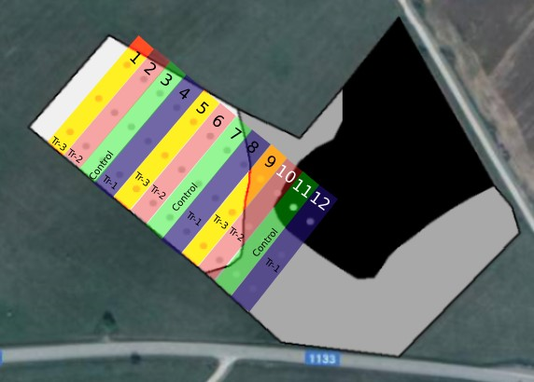
The 2nd International Electronic Conference on Processes
THE EFFECTS OF THE INTERACTION BETWEEN BACTERIAL INOCULANTS AND MINERAL FERTILISERS ON SPRING BARLEY YIELD AND SOIL PROPERTIES
Anušauskas J., Steponavičius D., Lekavičienė K., Zaleckas E., Vytautas Magnus University, Agriculture Academy (Lithuania)
INTRODUCTION
From an environmental and human health point of view, biofertilizers are used as a better alternative to chemical fertilizers. Microorganisms, including bacteria and cyanobacteria, present in biofertilizers sprinkled on plant surfaces, seeds, or soil cover the rhizospheres, or internal spaces, of plants (Rokhzadi et al., 2008; Makusa et al., 2014; Yadav et al., 2019). Biswas (2022) provides a recommendation for the use of biological inoculants with mineral fertilizers. Microbial biofertilizers are cost-effective and cheaper than conventional techniques. They provide 25–30% of the chemical fertilizer equivalent of nitrogen. They increase phosphorus and potassium content in soil, increase water absorption and keep soil biologically active. In soils cropped with legumes, the application of arbuscular mycorrhizal fungi inoculants tremendously improves growth and yields (Mohammadi et al., 2011; Alori et al., 2017). There is currently a lack of knowledge about the effects of biologically enriched, complex mineral fertilizers on soil and spring barley yield. Therefore, the aim of the study was to determine the influence of bacteria-inoculated complex mineral fertilizer on the soil properties and yield of spring barley.
Fig. 2. The effects of different treatments on grain yield
RESULTS
MATERIALS AND METHODS
After three years of experimental studies of soil properties in spring and autumn, in the third year in spring, a decrease in soluble potassium (K₂O) of 1.5 mg kg⁻¹ in the control, and an increase in other treatments were observed (Figure 1). In both spring and autumn, the highest increase in potassium (K₂O) was observed in Tr-3 (17.8 mg kg⁻¹ and 14.5 mg kg ⁻¹, respectively). Comparing the change of soluble phosphorus (P₂O₅) in the soil, the highest increase of Tr-3 (8.5 mg kg⁻¹) was found in spring, and the highest increase of Tr-2 (15.3 mg kg⁻¹) was found in autumn.
In the first year of the study, the spring barley grain yield varied from 5.21 t ha⁻¹ to 6.40 t ha⁻¹; in the second year it varied from 2.29 t ha⁻¹ to 3.82 t ha⁻¹; and in the third year – from 2.31 t ha⁻¹ to 5.43 t ha⁻¹ (Figure 2). In all research years, the lowest grain yield was in the control and the highest in Tr-3. The increase in potassium and phosphorus content in the soil may have influenced the yield increase in Tr-3. In the third year of the study, significant effects of the use of the biological preparation were observed, as the grain yield of Tr-3 (300 kg ha⁻¹ fertilizer rate, biologically enriched) significantly increased compared to Tr-1 (300 kg ha⁻¹ fertilizer rate, not biologically enriched).
Experimental field research was carried out in 2020–2022 in the region of Lithuania characterized by Endoeutric Albeluvisol (Orthieutric Albeluvisol). Experimental studies were carried out on sandy loam soil in four different treatments: no N₅P_{20.5}K₃₆ (control), 300 kg ha ⁻¹ N₅P_{20.5}K₃₆ (Tr-1), 150 kg ha⁻¹ N₅P_{20.5}K₃₆ coated with a bacterial inoculant (Tr-2), and 300 kg ha⁻¹ N₅P_{20.5}K₃₆ coated with a bacterial inoculant (Tr-3). The arrangement of the experimental treatment plots is presented in Figure 3. The complex mineral fertilizers were coated with a bacterial inoculant (500 g ha⁻¹). The bacterial inoculant (Paenibacillus azotofixans, Bacillus megaterium, Bacillus mucilaginosus, and Bacillus mycoides) provided by JSC Nando, Lithuania, was used in equal concentrations (1 × 10⁹ cfu g⁻¹). Nitrogen fertilizer was applied to the crops at the end of tillering (BBCH 25–30). A rate of 68.8 kg N ha⁻¹ of ammonium nitrate (NH₄NO₃; N_{34.4}) was applied. During the experimental studies, the spring barley Hordeum vulgare L. (cv. Iron) seed rate was 4.0–4.5 million units ha⁻¹.
Soil samples collected from each experimental plot (at least 15 locations) (Figure 3) were mixed and analyzed at the Agrochemical Research Laboratory. The amount of available phosphorus and potassium (mg kg⁻¹) was determined by the Egner-Riehm-Domingo (A-L) method (LVP D-07:2016).
Ten random plant samples were taken from each plot (Figure 3), for a total of 30 samples per treatment. The samples were threshed with a stationary Wintersteiger LD 350 laboratory threshing bench (Wintersteiger GmbH, Austria). The weight of the threshed grains (g) was then determined. A probability level of 0.05 was used as the criterion for tests of significance throughout the data analysis.
Fig. 1. The effects of different treatments on changes in soil properties
References
Fig. 3. Arrangement of experimental plots
CONCLUSIONS
Rokhzadi, A., Asgharzadeh, A., Darvish, F., Nour-Mohammadi, G., Majidi, E. 2008. Influence of plant growth-promoting rhizobacteria on dry matter accumulation and yield of chickpea (Cicer arietinum L.) under field conditions. American-Eurasian Journal of Agricultural and Environmental Science, 3(2), 253-257.
Malusa, E., Vassilev, N. 2014. A contribution to set a legal framework for biofertilisers. Applied microbiology and biotechnology, 98, 6599-6607.
Yadav, K. K., Sarkar, S. 2019. Biofertilizers, impact on soil fertility and crop productivity under sustainable agriculture. Environment and Ecology, 37(1), 89-93.
Biswas, S. S., Biswas, D. R., Ghosh, A., Sarkar, A., Das, A., Roy, T. 2022. Phosphate solubilizing bacteria inoculated low-grade rock phosphate can supplement P fertilizer to grow wheat in sub-tropical inceptisol. Rhizosphere, 23, 100556.
Mohammadi, K., Khalesro, S., Sohrabi, Y., Heidari, G. 2011. A review: beneficial effects of the mycorrhizal fungi for plant growth. J. Appl. Environ. Biol. Sci, 1(9), 310-319
The results showed that in all the years of the research, Tr-3 spring barley yields increased by 8%, 7%, and 17%, respectively, compared to Tr-1. This indicates that biological enrichment with fertilizers increases the yield without increasing the fertilizer rate. This was due to the increase of potassium and phosphorus in the soil and the ability of bacterial inoculants to convert insoluble phosphorus and potassium compounds into soluble ones.

