Slide 1
ASPEN PLUS MODELLING AND SIMULATION OF SUPERCRITICAL STEAM AND POULTRY LITTER GASIFICATION FOR THE PRODUCTION OF HYDROGEN FUEL AND ELECTRICITY
By
Ahmed Mohammed INUWA
Isaac JATO
Saidat Olanipekun GIWA
Department of Chemical Engineering
Faculty of Engineering and Engineering Technology
Abubakar Tafawa Balewa University Bauchi
April, 2023

Slide 2
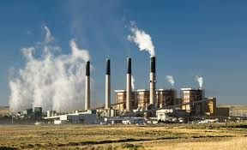
1.0 INTRODUCTION
Figure 1: Fossil Fuel Exploration and Refining (Source: Martínez et al. 2020).
Fossil fuel: hydrocarbon -containing materials such as coal, oil and natural gas formed naturally in the earth.
Climate change: this long time shifts in temperature and weather pattern, which causes by burning fossil fuel and other impurities to the atmosphere.

Slide 3
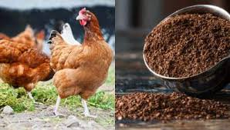
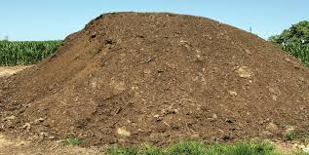
INTRODUCTION CONT…
Figure 2: Poultry Litter (Source: Singh et al. 2022).
Renewable and sustainable energy: Energy sources that has less environmental effect, cheap and abundantly.
Local content: waste poultry biomass, utilized to reduced environmental problems via producing hydrogen fuel and electricity.

Slide 4
2.0 MATERIALS AND METHODS
2.1 Materials
Table 1: Materials and Their Uses in This Research Work
Materials | Uses
Aspen plus version 11.0 Data sheet of poultry litter | Aspen plus is a chemical engineering simulator used for the modelling and simulation of the design process This consist of the feed specifications,3 ultimate, proximate and composition analysis of poultry litter from online literature review
2.2 Methods
Modelling and simulation is an integrated tool used by process engineers to design and gain insight into an existing or expected system. Aspen plus version 11.0 was used to model and simulate the abundant poultry litter biomass via drying, decomposition and steam gasification to produce hydrogen fuel and electricity.

Slide 5
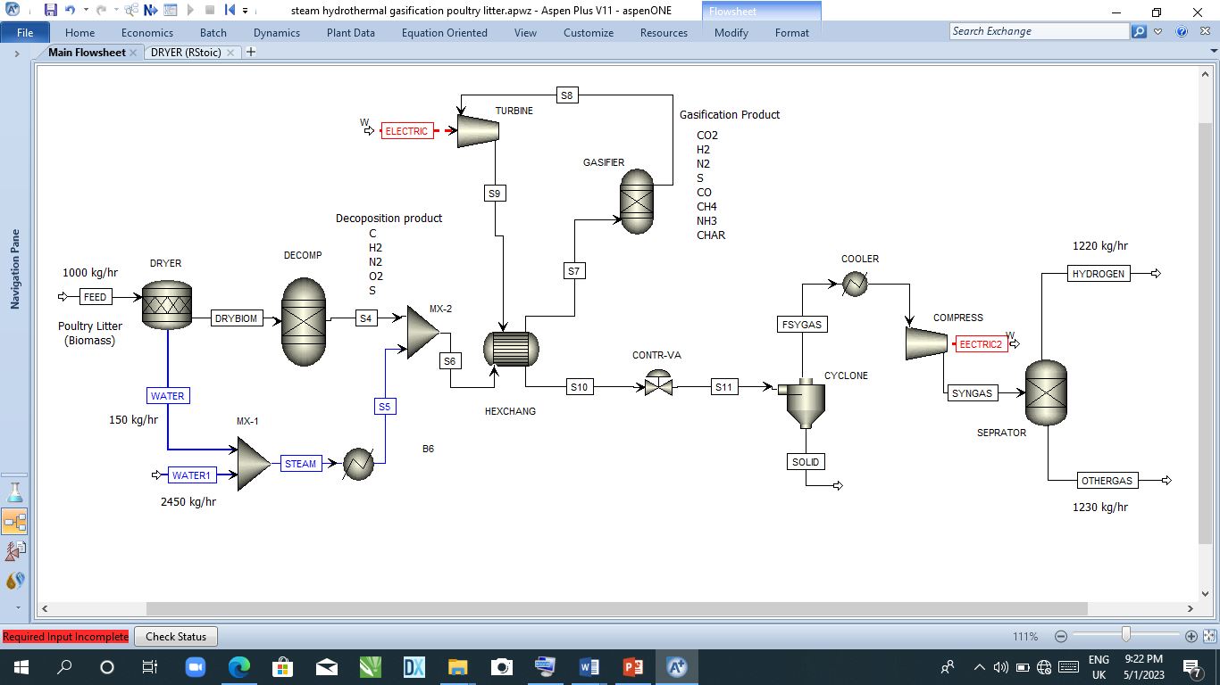
2.2.1 Process description
The process consists of four sections, the dryer, decomposition, steam thermal gasification/electric generation, and hydrogen production as illustrated in figure 3.
Figure 3: Aspen Plus Design Process Flow Diagram for The Production of Hydrogen and Electricity Using Poultry Litter Biomass

Slide 6
2.2.2 Modelling and Simulation
Figure 4: Basic Modelling and Simulation Steps (Source: Inuwa et al. 2023).

Slide 7
Table 2: Ultimate and Proximate Analysis Results of Waste Poultry Litter (Singh et al., 2022)
Ultimate analysis (wt. %) | Poultry litter
Carbon Hydrogen Nitrogen Oxygen Sulphur | 43.98 5.16 4.63 31.98 0.75
Proximate analysis (wt. %)
Volatile matter Fixed carbon Moisture content Ash | 63.6 15.3 7.6 13.5
Table 3: Feed Entering Specifications
Feed | Amount
Biomass (Poultry litter) Temperature Pressure | 1000 kg/h 25 ⁰C 1 atm
Steam | 2000 kg/h

Slide 8
Table 4: Chemical Reaction Involved in The Poultry Litter Biomass Steam Gasification (Hussain et al., 2018).
Reaction no | Reaction name | Reaction equation | Heat of reaction ΔH(KJ/mol)
1 2 3 4 5 6 7 8 9 | Combustion reaction Combustion reaction Bourdouard reaction Methanation reaction Methanation reaction Water gas shift reaction Water gas shift reaction H₂S formation reaction Steam reforming | $$C+O→CO$$ $$C+O_{2}→CO_{2}$$ $$C+CO_{2}→2CO$$ $$C+2H_{2}→CH_{4}$$ $$2C+2H_{2}O→CH_{4}+CO_{2}$$ $$C+H_{2}O→CO+H_{2}$$ $$CO+H_{2}O→CO_{2}+H_{2}$$ $$H_{2}+S→H_{2}S$$ $${CH}_{4}+H_{2}O→{CO}_{2}+{3H}_{2}$$ | -111 -283 +172 -75 +103 +131 -41 -170.5 +206

Slide 9
3.0 RESULT AND DISCUSSSION
The results obtained from the modelling and simulation of the production of hydrogen and electricity using poultry litter as feed stock production process revealed that the developed model was successful and was able to converge when simulated with Non- Random Two Liquid as fluid package. However, the results of a different study by Singh et al. (2022) are consistent with the findings of the current study on gasification temperatures of 850 ºc. According to Mohammadidoust et al. (2022), they found that as the temperature climbed, CO and H2 concentrations rose while CO and CH4 concentrations fell. Additionally, the target products' results revealed in Table 5 that at a gasification temperature of 850 ^{O}C, 1000 kg/h of poultry litter (biomass) and 2500 kg/h of steam respectively, were able to produce 1220 kg/h (99.43%) of hydrogen in contrast to the highest optimum hydrogen yield obtained by Singh et al. (2022), which is 93.2%, and 2,500 kwh of electricity. This identified chicken litter as a promising candidate to lessen reliance on fossil fuels.
Table 5: Target products of the poultry litter steam gasification
Product | Amount
Hydrogen gas | 1220 kg/h
Electricity Generated | 2500 kWh

Slide 10
4.0 CONCLUSION
The results obtained from the modelling and simulation of the production of hydrogen and electricity using poultry litter as feed stock production process revealed that the developed model was successful and was able to converge when simulated with Non- Random Two Liquid as fluid package and gasification temperature 850 ºc, gives the best yield of Hydrogen 1220 kg/h and 2500 kWh of electricity generated.
5.0 CONTRIBUTIONS TO KNWOLEDGE
The following are the knowledge gained from this research work
The results obtained from this work showed that a commercial-scale plant design that will convert poultry litter to hydrogen and electricity is a possibility
The work established that the hydrogen and energy yields of 1220 kg/h and 2500 kWh respectively can be obtained with biomass to steam ratio of 1:2 (1000 kg/h:2000 kg/h)

Slide 11
REFERENCES
Al-Qahtani, A., Parkinson, B., Hellgardt, K., Shah, N., Guillen-Gosalbez, G. 2021. Uncovering the true cost of hydrogen production routes using life cycle monetisation. Applied Energy, 281, 115958.
Hussain, M., & Multan, T. (2018).A kinetic-based simulation model of palm kernel shell steam gasification in a circulating fluidized bed using Aspen Plus ® : A case study https://doi.org/10.1080/17597269.2018.1461510
Khan, M.A., Al-Shankiti, I., Ziani, A., Idriss, H. 2021. Demonstration of green hydrogen production using solar energy at 28% efficiency and evaluation of its economic viability. sustainable energy and fuels, 5(4), 1085-1094.
Mansoori, G.A., Agyarko, L.B., Estévez, L., Fallahi, B., Gladyshev, G., Gonçalves, R., Niaki, S., Perišić, O., Sillanpää, M., Tumba, K., Yen, J. 2021. Fuels of the Future for Renewable Energy Sources (Ammonia, Biofuels, Hydrogen).
Martínez-Rodríguez, A., Abánades, A. 2020. Comparative Analysis of Energy and Exergy Performance of Hydrogen Production Methods. Entropy, 22(11), 1286.
Mohammadidoust, A., Branch, K., & Omidvar, M. R. (2022). Simulation and modeling of hydrogen production and power from wheat straw biomass at supercritical condition through Aspen Plus and ANN approach https://doi.org/10.1007/s13399-020-00933-5
Oruc, O., Dincer, I. 2021. Assessing the potential of thermo-chemical water splitting cycles: A bridge towards clean and sustainable hydrogen generation. Fuel, 286, 119325.
Singh, D. K., & Tirkey, J. V. (2022). Process modelling and thermodynamic performance optimization of biomass air gasification fuelled with waste poultry litter pellet by integrating Aspen plus with RSM. Biomass and Bioenergy, 158 (February)106370.https://doi.org/10.1016/j.biombioe.2022.106370
Inuwa, A. M., Giwa, S. O., & Joel, A. S. (2023). Optimization of Linear Alkyl Benzene Yield through Modelling and Simulation ABUAD Journal of Engineering Research and develop. 2(5),62-73

