Slide 1
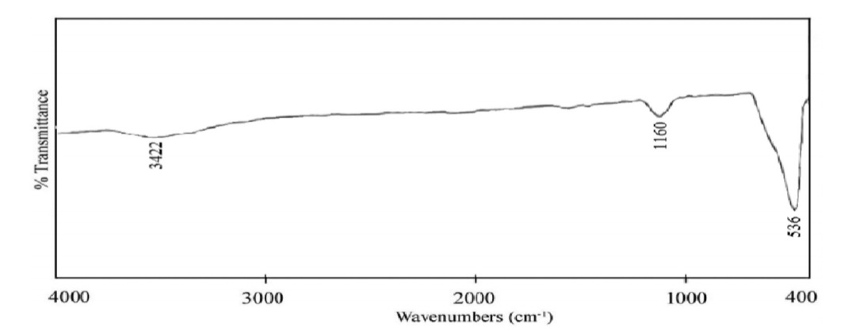
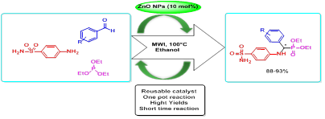
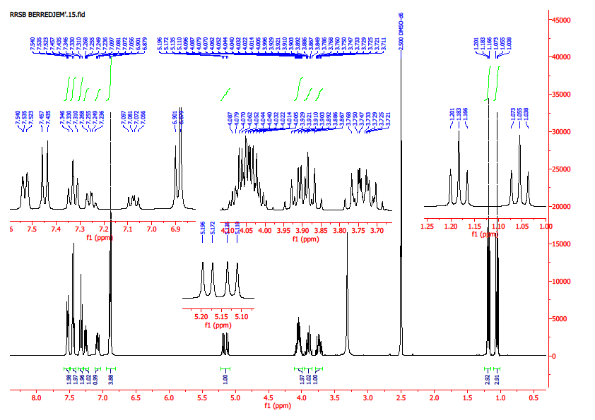
Green and cost-effective synthesis of sulfamidophosphonates using ZnO nanoparticles as catalyst
Rayenne Redjemia¹, Malika Berredjem*¹, Rania Bahadi¹
¹ Laboratory of Applied Organic Chemistry, Synthesis of Biomolecules and Molecular Modelling Group, Sciences Faculty, Chemistry Department, Badji-Mokhtar Annaba University, Box 12, 23000 Annaba, Algeria;
INTRODUCTION
Table 1. Optimization for the synthesis of α-sulfamidophosphonates with /without ZnO NPs
Multi-component reactions (MCRs) are a significant and powerful strategy for the synthesis of organic compounds compared to multistep reactions. MCRs have many advantages such as formation of several new bonds in a one-pot reaction, easy purification, decreasing number of reaction steps, atom economy, simplicity and reduced chemical waste [1-3]
In addition, the use of MWI radiation like source of heat in organic synthesis offers new options in terms of sample preparation regarding shorter reaction time for synthesis and reduced solvent utilization.
Recently, The development of new catalysts by nano-scale design has emerged as a fertile field for research and innovation [4, 5]. Zinc oxide as efficient heterogeneous catalysts has been used in both industrial and nano type as a professional catalyst in various organic transformations [6, 7].
Zinc oxide nanoparticles were obtained from anhydrous ZnCl₂ and NaOH with particle size between 10-30 nm under ultrasound power for 30 min, the precipitate was filtered and washed with distilled and ethanol The ZnO-NPs generated were dried in the air at room temperature for 24 h.
In FT-IR spectrum, the structure of NP ZnO is confirmed by a band between 500 to 600 cm⁻¹ that corresponds to the stretching vibrations of the bond (Zn-O). The broad band with low intensity at 3422 cm⁻¹ is related to vibration mode of (OH) group, indicating the presence of little amount of water adsorbed on the zinc oxide nanoparticles surfaces
 |  | Microwave |  |  | Microwave with ZnO NPs
Entry | Solvent | Time/min | Temp/°C | Yields % | Time/min | Temp/°C | Yields % | Catalyst mol %
1 | No solvent | 30 | 100 | - | 30 | 100 | 20 | 10
2 | CH₂Cl₂ | 20 | 100 | 40 | 20 | 100 | 55 | 10
3 | MeOH | 20 | 100 | 50 | 20 | 100 | 60 | 10
4 | Acetone | 20 | 100 | 40 | 20 | 100 | 53 | 10
5 | EtOH | 15 | 100 | 60 | 15 | 100 | 93 | 10
At 100°C, some solvents were examined under microwave irradiation, and it is observed that the reaction formed only a low yield in CH₂Cl₂, MeOH, acetone and in the absence of solvent. A higher yield of 60 % was obtained using EtOH as solvent (Table 1).
In the other hand, under the same conditions the reaction was carried out in the presence of 10 mol% of ZnO-NPs as green catalyst and the product was obtained in 93% yield after 15 min.
The results show that in the EtOH, the yields are higher than the other solvents.
RESULTS & DISCUSSION
Figure 3. IR spectrum of ZnO
CONCLUSION
A series of novel α-sulfamidophosphonates derivatives was synthesised in adequate yields by one-pot three component Kabachnik-Field’s reaction of sulfanilamide (1) with appropriate substituted aromatic aldehydes (2) and trialkyl phosphite (3) under microwave irradiation in the presence of catalytic amounts of (ZnO-NPs) (Figure 1).
In summary, the facile and greener synthetic routes were developed for the synthesis of novel α-sulfamidophosphonates using ZnO-NPs as a catalystA one-pot synthetic strategy was developed via a three-component Kabachnik-Fields reaction starting from commercially available compounds.
Figure 2. ¹H NMR and ¹³C NMR of α-sulfamidophosphonates
The ¹H spectrum always showed a deshielded doublet of doublets at δ= [5.0-5.30] ppm corresponding to the NH*CH(R)PO(OEt)₂. The two CH2 groups of the mustard moiety appeared at δ = [4.14-3.87] and [3.94-3.63].In ¹³C the two ethoxy groups of the phosphonates appeared at [16.37-15.94] ppm (J_{C-P} ~ 5.1–5.8 Hz), [62.95-61.17] ppm (J_{C-P} ~ 6.6–7 Hz), and the asymmetric carbon NH*CH(R) PO(OEt)₂ at [50.51-54.26] ppm (doublet with a large coupling constant J_{C-P} ~150.6–155 Hz).
References
[1] J. Zhu, H. Bienayme (Eds.), Multicomponent Reactions, WileyVCH, Weinheim, 2005.
[2] B. Ganem, Acc. Chem. Res. 2009, 42, 463.
[3] A. Dömling, I. Ugi, Angew. Chem. Int. Ed. 2000, 39, 3169.
[4] A.A. Erumpukuthickal, K. Paromita, A.D. Parag, M. Giridhar, R. Narayanan. ACS. Nano 2011, 5, 8049-8061.
[5] A. Nicole, H. Steven, Z. Xiaojiang, J.L.Erik, M.B. Jillian, ACS. Catal. 2012, 2, 1524-1534.
[6] E.K. Goharshadi, Y. Ding, P. Nancarrow, J. Phys. Chem. Solids 2008, 69, 2057-2060.
[7] D. Igor, J. Zvonko, A. Denis, N. Markus, Nanoscale 2010, 2, 1096-1104.
Figure 1. Synthesis of α-sulfamidophosphonate derivatives

