Slide 1
Simulation of 1-D solute transport with equilibrium controlled non-linear sorption
Amit Kumar, Aftab Alam and Anshuman Singh

Slide 2
OUTLINE OF THE TALK
Introduction
Need for study
Objective of the Study
Literature reviews
Methodology
Results and discussion
Conclusion
Future work
References

Slide 3
1. INTRODUCTION
Groundwater pollution (also called groundwater contamination) occurs when pollutants are released to the ground and make their way down into groundwater.
This type of water pollution can also occur naturally due to the presence of a minor and unwanted constituent, contaminant or impurity in the groundwater, in which case it is more likely referred to as contamination rather than pollution.
A Simulation is the imitation of the operation of real-world process by use of models representing the key characteristics and behavior of the selected system or process. Computer programs are used to perform a simulation.

Slide 4
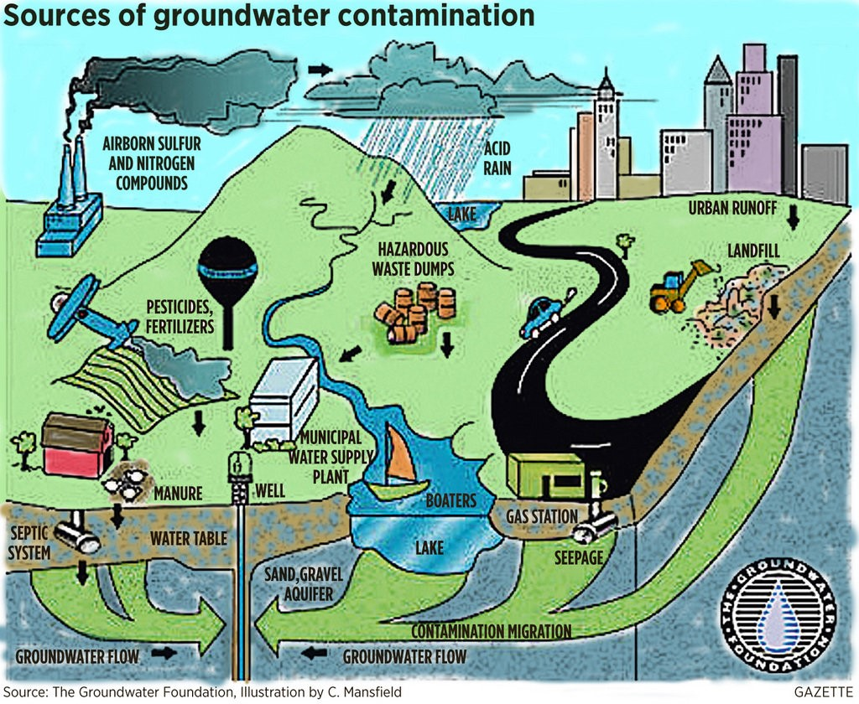
SOURCES OF CONTAMINATION
IRRIGATION
LANDFILLS
UNDERGROUND STORAGE TANKS
SEPTIC TANKS
INDUSTRIES
OIL SPILLS
URBAN RUNOFF
ETC

Slide 5
PROCESS OF CONTAMINATION TRANSPORT

Slide 6
sorption
It refers to the mass transfer between the contaminant dissolved in GW (aqueous phase) and the contamination sorbed on the porous medium (solid phase).
Three types of equilibrium controlled sorption isotherms (linear, Freundlich and Langmuir) are considered in MT3DMS transport model.

Slide 7
2. Need for Study
To understand the need of current study we have different aspects to look for some of which are mentioned below
Contamination of groundwater has the potential to damage human health, the environment, and socioeconomic growth. Several research have revealed, that high amounts of Metals, fluoride, nitrate, and tenacious organic contaminants are threat to human being.(Wu, Zhang and Zhou, 2020).
Land and forest quality is also compromised by GW pollution. Also polluted GW can cause soil pollution and land degradation. In many agricultural areas & flat terrain, high groundwater salinity influences soil salinization.
To achieve the sustainable economic growth globally there should be a balance between natural resources and their requirement & demand.

Slide 8
3. Objectives of the Study
To do a comprehensive study about fate of contaminant and its transport.
To study the behavior of contaminant transport incorporating with equilibrium controlled nonlinear sorption (Freundlich isotherm sorption) and to gain the knowledge about how sorption affects the transport of contaminant with subsurface water.

Slide 9
4.Methodology
Advance Solute Transport Numerical Models
The advanced solute transport models, also known as extended solute transport models or fully coupled (hybrid) models, are applied to solve complex problems, either one- or multidimensional, that often involve multiple chemical species, diverse transport processes, material heterogeneity, complex boundary conditions, and time-varying stresses.
Examples- MT3D, MT3DMS, GMS , HYDRUS and Processing Modflow etc.

Slide 10
MT3DMS
The abbreviation for MT3DMS is “The modular three-dimensional multispecies Transport model” It was developed by Chunmiao Zheng in 1990. It was a USEPA financed development and after development the USEPA made it public.
MT3DMS can be used to simulate various physical and chemical changes undergoing solute transport process also there is independency to selection of different boundary conditions. The basic chemical package for this software can simulate for single contaminant but for multi species and additional package named RT3D is given separately. The basic chemical reaction package named RCT is capable of solving single species with conditions like equilibrium-controlled or rate-limited or non-linear sorption and 1st order kinetic reactions.

Slide 11
Mathematical background of MT3DMS
Governing equations for solute transport.
Since for sorption generally local equilibrium is assumed, the governing equation for the transport model of solute is given as:
$Rθ\frac{∂\overline{C}}{∂C}=\frac{∂}{∂x_{i}} \left\{θDⅈj\frac{∂C}{∂x_{j}}\right\}−\frac{∂}{∂x_{i}}\left(θν_{i}C\right)+q_{s}Cs−q_{s}^{′}C−λ_{1}θC−λ_{2}ρ_{b}\overline{C}$
Darcy’s law relates transport and flow equations.
$v_{i}=\frac{q_{i}}{θ}=−\frac{k_{i}}{θ}\frac{∂h}{∂x_{i}}$

Slide 12
Solution Technique
MT3DMS applies FDM , TVD( The ultimate scheme )and Mixed approaches counter the errors and to improve the efficiency of model and to improve the accuracy of the solution results.
At nodal concentration a third order polynomial interpolation is used by the ultimate scheme to determine the concentration at the interface.
Now for a FDM grid with similar spacing with a coordinate system originated at point j with velocity ‘v’ (left to right). At time level n+1 on point j concentration caused by advection only can be given as;
$C_{j}^{n+1}=C\left(0,∆t\right)=C(−v∆t,0)$ ; ∆t = time step for transport

Slide 13
Chemical reaction package (RCT)
Since our study is based on Freundlich sorption isotherm which is a non-linear isotherm empirical model/equation is described as:
$\overline{c}=K_{f}c^{a}$
Here, K_{f} = Freundlich constant/Adsorption capacity, (L³M⁻¹)ª
a = Freundlich exponent/ adsorption intensity, dimensionless.
The chemical reaction package is named as RCT package and for selecting the type of isotherm the value of their coefficient the instruction is given in MT3DMS manual. Kf=SP1 and a=SP2

Slide 14
Major steps taken for Simulation
1. Data processing
- Transport model creation
- Input files generation
- Run the simulation
2. Data visualization
- Export The Output observation files to excel
- BTCs plotting and trend analysis.

Slide 15
Transport model Formation
For this study the same problem is taken as illustrated in (Grove and Stollenwerk, 1984) considering the Freundlich isotherm.
Model parameters were taken as;
Grid-space(∆X) = 0.160 cm, Dispersity(α_{L}) = 1.0 cm, GW seepage-velocity(v)= 0.1 cm/s, Porosity(θ) = 0.37,
Bulk density(ρb) =1.587 g/cm3, Source concentration (Co) = 0.05 mg/l, Pulse Input time (t_{o})= 160 seconds.
Initial and Boundary conditions for our model is provided as;
$C\left(x,0\right)=0$
$−θD\left(\frac{∂C}{∂x}\right)+qC⃒\left(x=0\right)=\left\{\begin{aligned}fo 0<t<to \\ 0 t>to\end{aligned}\right.$
$\frac{∂C}{∂x}\left(∞,t\right)=0 t>0$

Slide 16
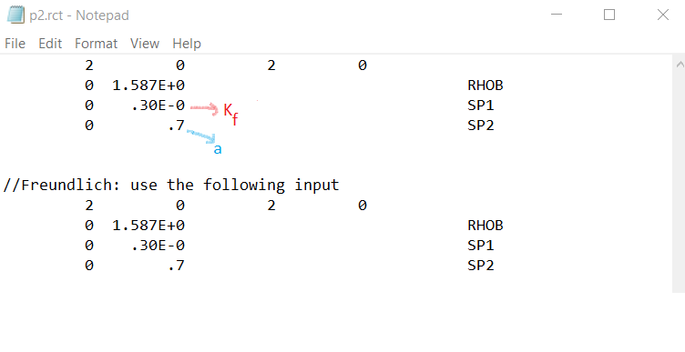
RCT input file
For the current study we need to generate input file for chemical reaction package (.RCT file) every single time with a different value of K_{f} and a, for this the generated input .RCT file is modified each time before a new simulation is being run
For the it mainly in three sets of values to analyze the behavior of BTCs of contaminant at 8 cm distance from the input source point keeping all other parameters identical to the original problem.
SET-1 SP1= K_{f} = varies between 0.2 to 1.4 and SP2=a=0.7,
SET-2 SP1= K_{f}= varies between 0.2 to 1.4 and SP2=a=0.6,
SET-3 SP1= K_{f}= varies between 0.2 to 1.4 and SP2=a=0.8.

Slide 17
5. RESULTS
For this study all the breakthrough curves are plotted at a distance of 8 cm from the initial source point of the concentration for a concentration pulse input for t₀=160 seconds and the initial concentration C_{o}=0.05 mg/l and the total time for simulation is taken as 1500 seconds.
Here C/Co shows the relative aqueous phase concentration at that point with respect to initial concentration and time unit of simulation is taken in seconds.
In this section we will do a trend analysis for the breakthrough curves for different 3 sets of K_{f} and a by varying the values of these parameters.

Slide 19
.

Slide 20
.

Slide 21
Comparison of Relative concentration values at a point 8 cm from the input source for different K_{f} and a Values.

Slide 22
CONCLUSION
A porous medium has ability to adsorb contaminants from an aqueous solution is directly proportional to its adsorption capacity. As a result, the concentration of contaminants in the aqueous phase decreases when the adsorption capacity of the porous medium is higher, since more of the contaminant is adsorbed onto the solid phase. This leads to a reduction in the peak relative aqueous phase concentration and a slower rate of pollutant migration.
However, a higher adsorption intensity can have an adverse effect on pollution migration. When the adsorption intensity is high, the concentration of contaminants in the aqueous phase increases compared to the concentration for a lower adsorption intensity, even when the adsorption capacity is the same. These critical parameters can be used to design a customized media with a suitable pollution removal process to treat targeted pollution.

Slide 23
Future scope
In the same problem we can take high initial pulse input concertation and check how the solute transport behaves also 3-D modelling will help in better understanding the plume spreading behaviour rather than 1-D.
Also the effect of pressure and temperature may be incorporated in model for better analysis and predicting and simulating actual GW solute transport process.

Slide 24
References
1. https://www.usgs.gov/software/mt3d-usgs-groundwater-solute-transport-simulator-modflow
2. Applied contamination transport modelling, CHUNMIAO, ZHENG
3. R.K. ROWE AND JK BOOKER :-“A FINITE LAYER TECHNIQUE FOR CALCULATION OF 3 D POLLUTANT MIGRATION IN THE SOIL
4. BEN ABDELGHAM F. :-“NUMERICAL ANALYSIS OF UNSATURATED WATER FLOW AND CONTAMINATION TRANSPORT AROUND MINING WASTES DISPOSAL IN FRACTURED SOILD MASS
5. Ajwa, H. et al. (2007) Properties of Soil Fumigants and Their Fate in the Environment. Third Edit, Hayes’ Handbook of Pesticide Toxicology. Third Edit. Elsevier Inc. doi: 10.1016/B978-0-12-374367-1.00009-4.
6. Grove, D. B. (1985) ‘Modelling the rate-controlled Sorption of Hexavalent Chromium’, 21(11), pp. 1703–1709.
7.Grove, D. B. and Stollenwerk, K. G. (1984) Computer model of one-dimensional equilibrium controlled sorption processes, Water-Resources Investigations Report. doi: 10.3133/wri844059.
8.Hulagabali, A. M., Solanki, C. H. and Dodagoudar, G. R. (2014) ‘Contaminant Transport Modeling through Saturated Porous Media Using Finite Difference and Finite Element Methods’, Mechanical and Civil Engineering, 2014, pp. 29–33.
9.Igwe, J. C. and Abia, A. A. (2007) ‘Adsorption isotherm studies of Cd ( II ), Pb ( II ) and Zn ( II ) ions bioremediation from aqueous solution using unmodified and EDTA-modified maize cob’, 32(Ii), pp. 33–42.
10. CPGB (2006) No Title. Available at: http://cgwb.gov.in/.

