Slide 1
Magdalena Świder Paulina buda Piotr Michalski paweł Wojciech bogdał Beniamin oskar garabrek
Cyclosporine A changes the expression profile of genes and proteins related to the JAK/STAT signaling pathway in keratinocytes treated with lipopolysaccharide A

Slide 2
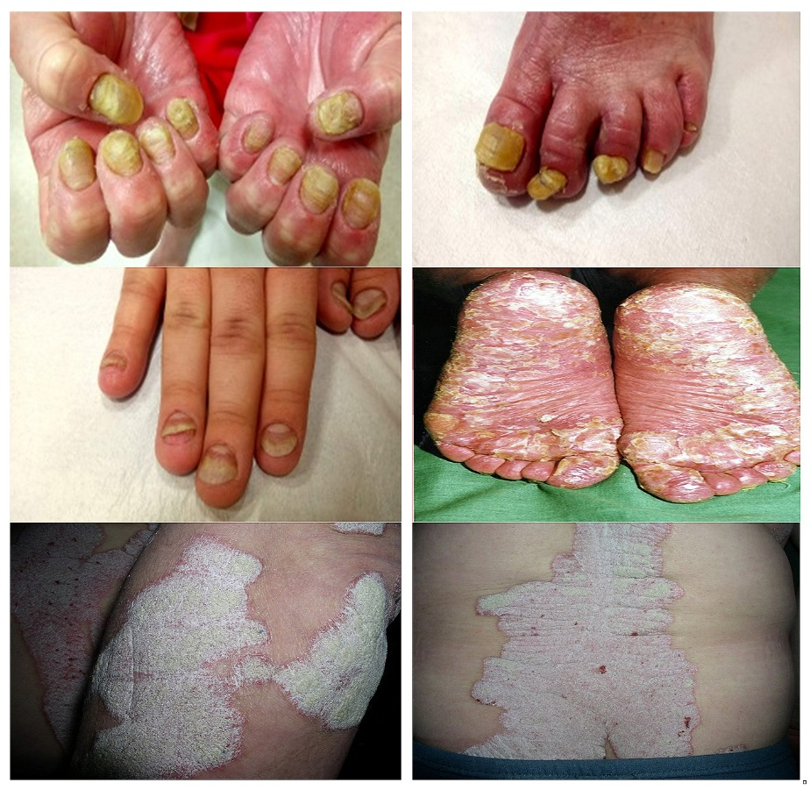
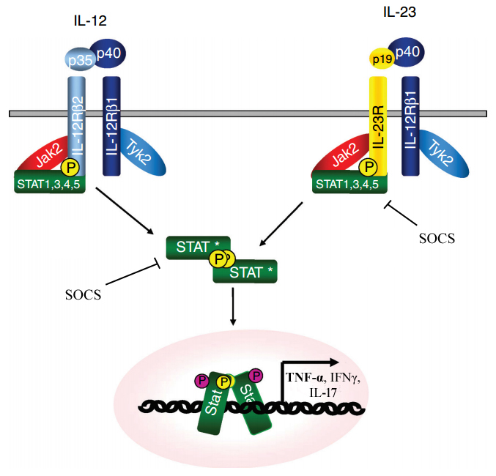
Introduction

Slide 3
AIM OF THE STUDY
The study aimed to determine the expression pattern of mRNAs and miRNAs related to the IL12/23 signaling pathways in human keratinocytes culture exposed to liposaccharide A (LPS) and next CsA in comparison with the untreated cells.

Slide 4
Material and methods
LPS
HaCaT cell culture
Control (C)
Cyclosporin A
Quantitative assessment
Total RNA extraction
Qualitative assessment
Total RNA
Microarray
mRNA HG-U133A
Analysis of microarray’s results

Slide 5
Results

Slide 6
Conclusion
During therapy with cyclosporin A, it was confirmed the activation of the JAK/STAT cascade, and STAT3 might be a complementary molecular marker in monitoring the effectiveness of cyclospo therapy.

