Slide 1
Toxicity and toxin profile on Ocean Indian fish containing CTX-like compounds
Lourdes Barreiro¹; Sandra Gimeno¹; Andres Sanchez-Henao¹, Jean Turquet²; Fanny Maillot²; Cintia Flores³, Jorge Diogène¹ and Maria Rambla-Alegre¹
¹IRTA, Ctra Poble Nou km 5.5, 43540, La Ràpita, Spain
²Centre Technique de Recherche et de Valorisation des Millieux Aquatiques (CITEB), La Réunion, France
³Mass Spectrometry Laboratory, Organic Pollutants, IDAEA-CSIC, Jordi Girona 18, 08034, Barcelona, Spain

Slide 2
INTRODUCTION
Ciguatoxins (CTX) are potent marine neurotoxins produced by dinoflagellates of the genera Gambierdiscus and Fukuyoa (Roeder et al.2010) that cause ciguatera poisoning (CP) (Spielmeyer et al., 2022).
CP occurs mainly in the tropical and subtropical Indo-Pacific region and Caribbean Sea affecting approximately between 50.000 and 500.000 consumers annually (Pearn, J. 2001).
Poisoning in humans Ingestion of contaminated fish products
Gastrointestinal problems (diarrhea, vomiting…)
Respiratory problems
Neurological problems (seizures, amnesia, coma…)
Cardiovascular problems (brachycardia…)
Death
Fishing industry
Closures of production areas
Retention of fish stocks
Distrust generated in consumers
ECONOMIC LOSSES
CFP is one of the most relevant seafood-borne diseases worldwide.

Slide 3
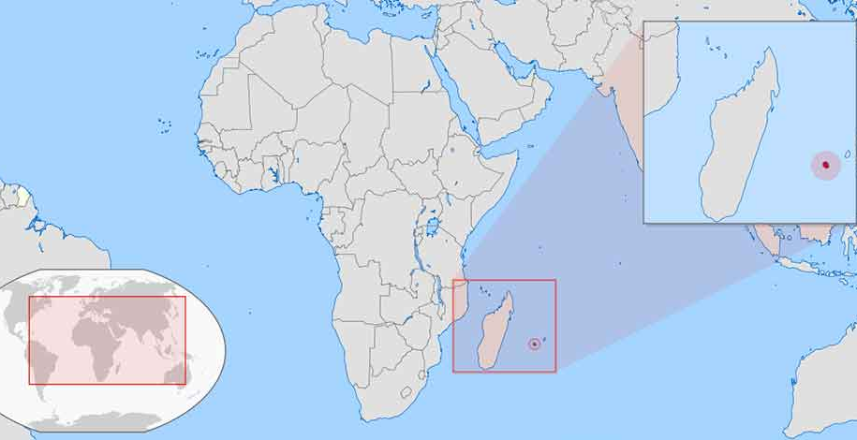
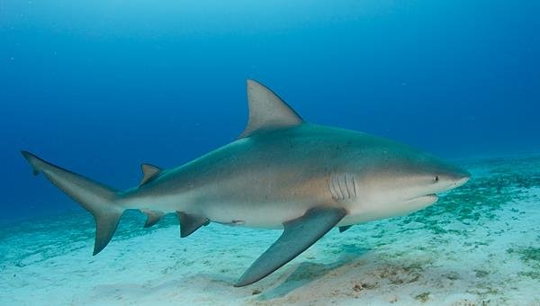
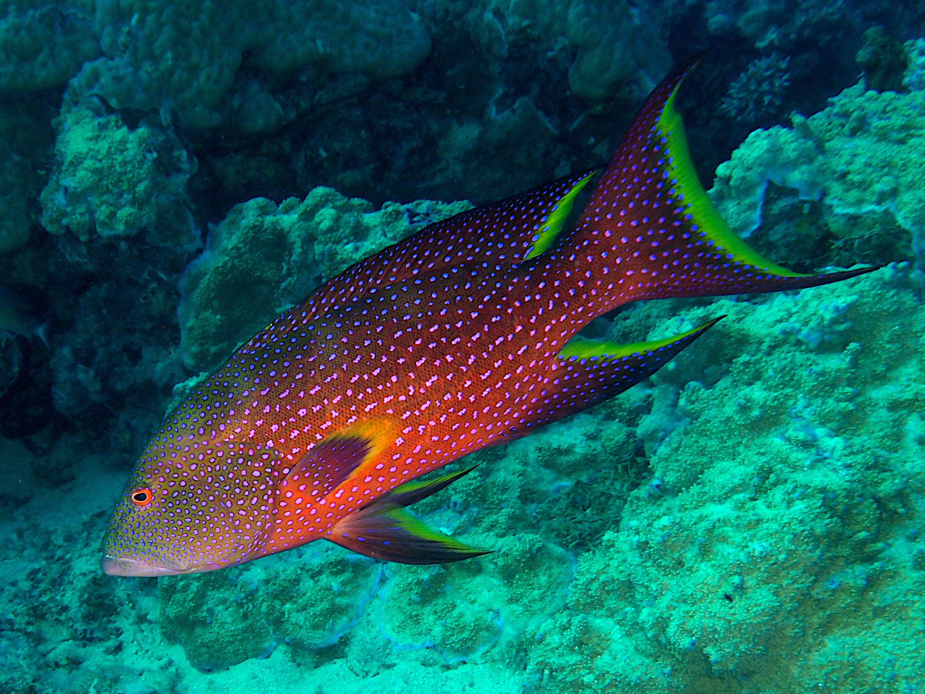
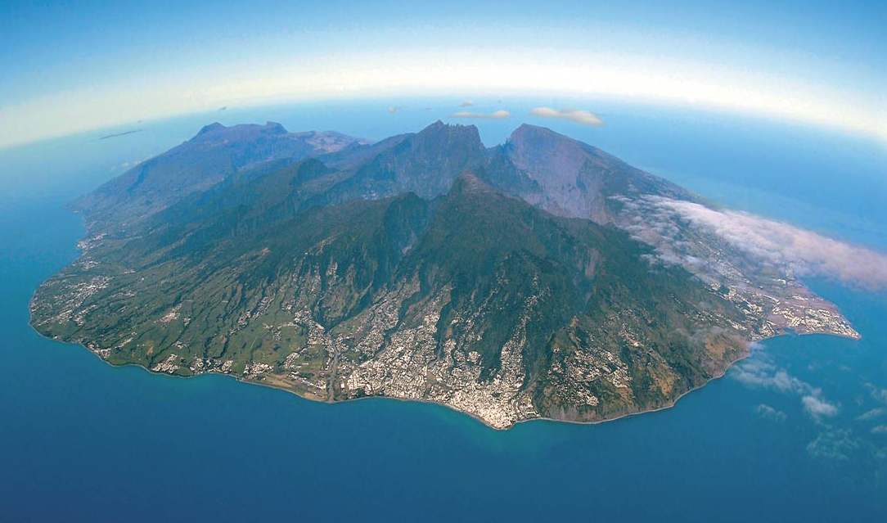
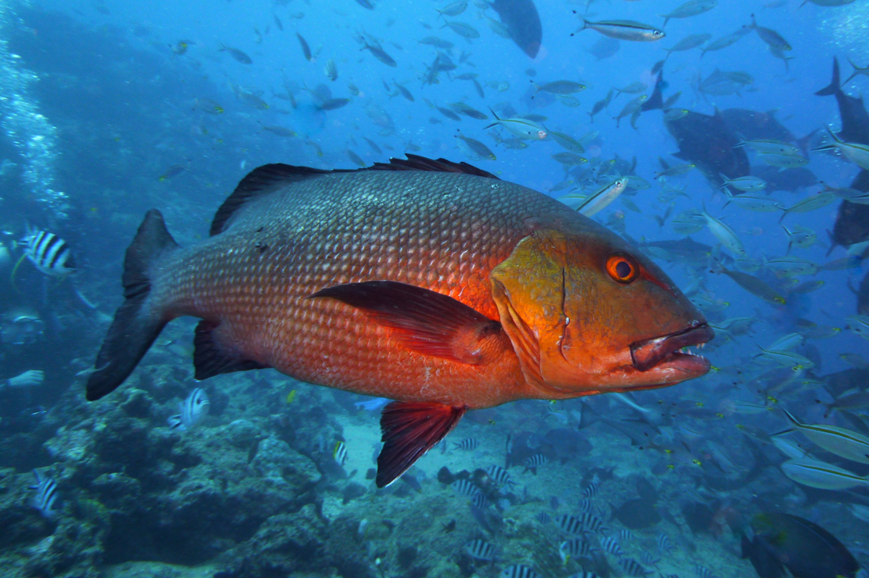
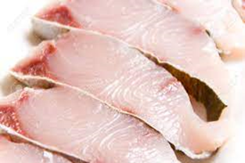
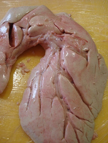
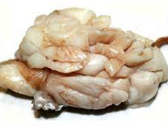
OBJECTIVES
Carcharhinus leucas
Reunión Island (France). Indian Ocean
Variola louti
Lutjanus bohar
3 species of fish (C. leucas, V. louti and L. bohar)
4 fishes: one L. bohar, two V. louti and one C. leucas
3 tissues for each fish:
Flesh, liver and viscera L. bohar
Flesh, liver and viscera V. louti 1
Flesh, liver and viscera V. louti 2
Flesh, liver and viscera C. leucas
Tissue 1: Flesh
Tissue 2: Liver
Tissue 3: Viscera

Slide 4
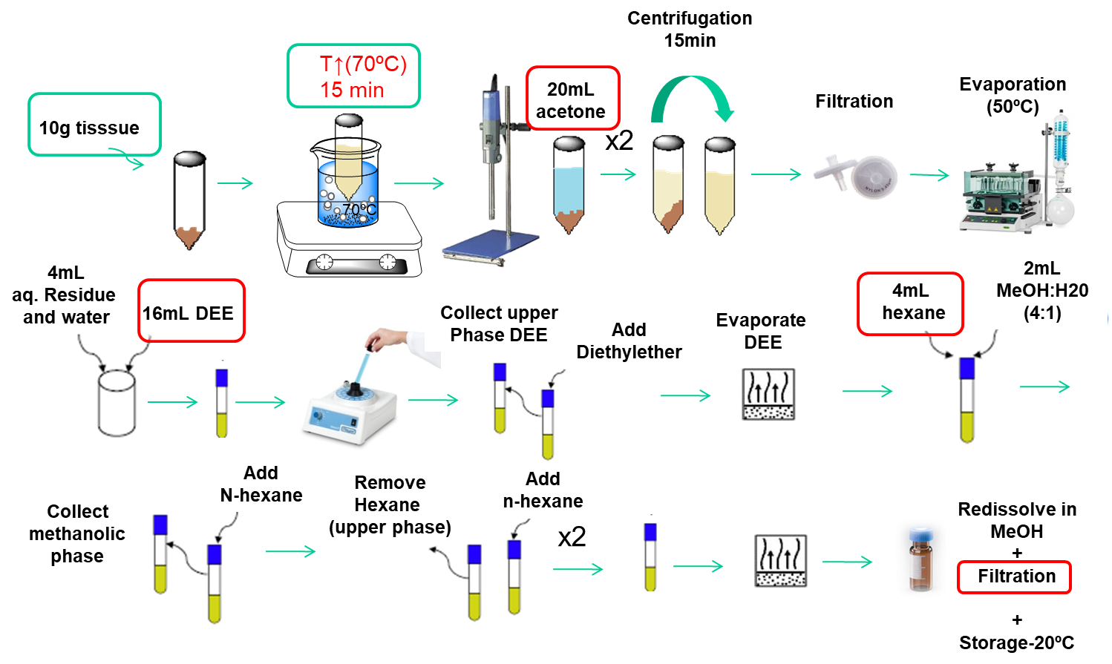
METHODOLOGY
EXTRACTION

Slide 5
TOXICITY BY Neuro-2a
ng equiv CTX1B/g
Specie | Tissue | N2A CITEB | LOQ CITEB | N2A IRTA | LOQ IRTA
V. louti 1 | Flesh | 0,3870 | 0,0070 | 0,683 | 0,36
 | Liver | 2,8795 | 0,0380 | 1,605 | 0,010
 | Viscera | 3,1231 | 0,1216 | 4,771 | 0,038
L. bohar | Flesh | 1,2678 | 0,0133 | 2,690 | 0,060
 | Liver | 2,5552 | 0,0426 | 2,306 | 0,038
 | Viscera | 1,8722 | 0,0096 | 1,001 | 0,021
V. louti 2 | Flesh | 0,5896 | 0,0188 | 1,23 | 0,229
C. leucas | Flesh | 0,0135 | 0,0021 | 0,011 | 0,005
 | Liver | 16,4052 | 0,1516 | 6,505 | 0,084
 | Viscera | 0,5112 | 0,0151 | 0,072 | 0,003

Slide 6
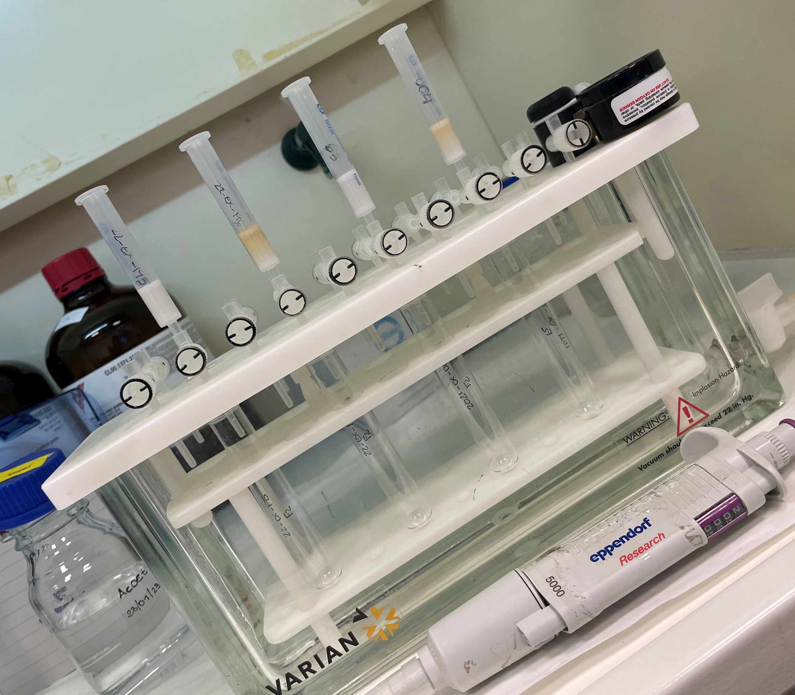
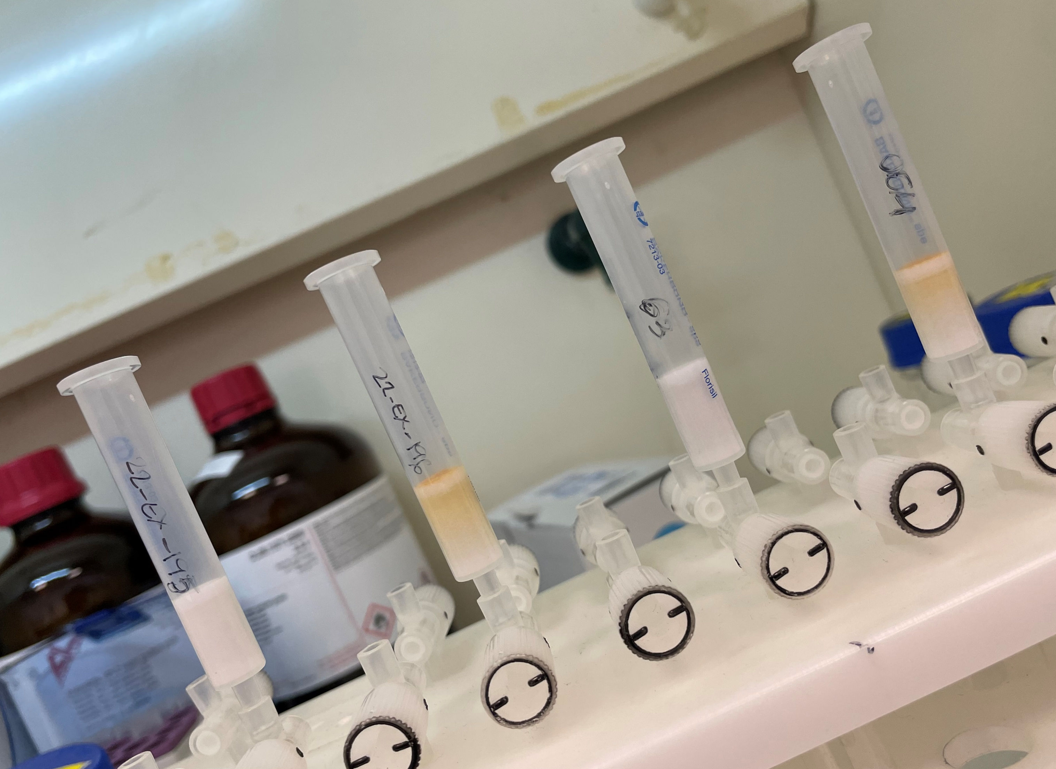
CLEAN UP (INDIVIDUALLY AND COMBINED)
SPE1
Condition: 3 mL EtOAc
Load: 2 mL sample extract in EtOAc
Elution: 10 mL EtOAC:MeOH (9:1)
Collect load and elution fractions
Condition: 3 mL MeOH: water (60%)
Load: 2 mL sample extract in MeOH:water (60%)
Wash: 3 mL MeOH: water (60%)
Elution: 10 mL MeOH: water (90%)
SPE2
SPE-Florisil
Bakerbond SPE
500mg, 3mL
SPE-C18
Bakerbond SPE
500mg, 3mL

Slide 7
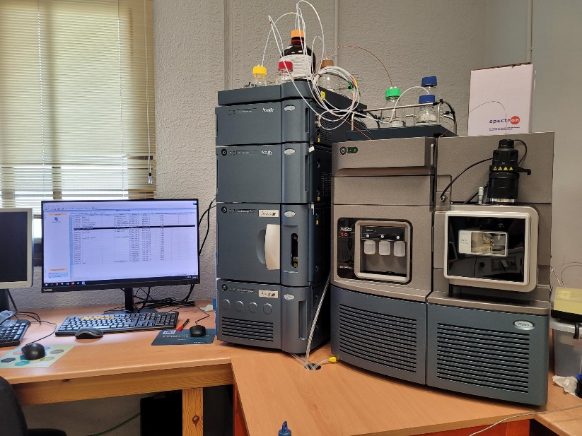
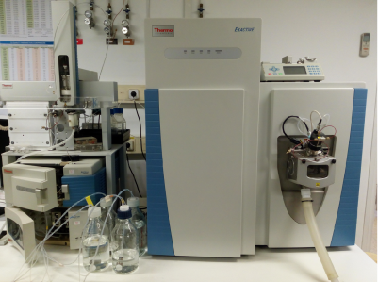
LC-MS/MS + HRMS
XEVO TQ-XS. Triple Quadrupole with mass spectrometer detector. (IRTA, La Ràpita, Tarragona)
ORBITRAP EXACTIVE HCD (IDAEA-CSIC, Barcelona)
LC Conditions:
Column: 1.7 μm C18 Acquity BEH (50 × 2.1 mm, Waters)
Linear Gradient at 400 μL/min. at 40°C.
Eluent A: water + 2mM ammonium formate + 0.1% HCOOH
Eluent B: acetonitrile + 2mM ammonium formate + 0.1% HCOOH
LC Conditions:
Column: 1.9 μm C18 Hypersil Gold column (100 × 2.1 mm, Thermo)
Linear Gradient at 250 μL/min. at 40°C.
Eluent A: water + 2mM ammonium formate + 0.1% HCOOH
Eluent B: acetonitrile + 2mM ammonium formate + 0.1% HCOOH

Slide 8
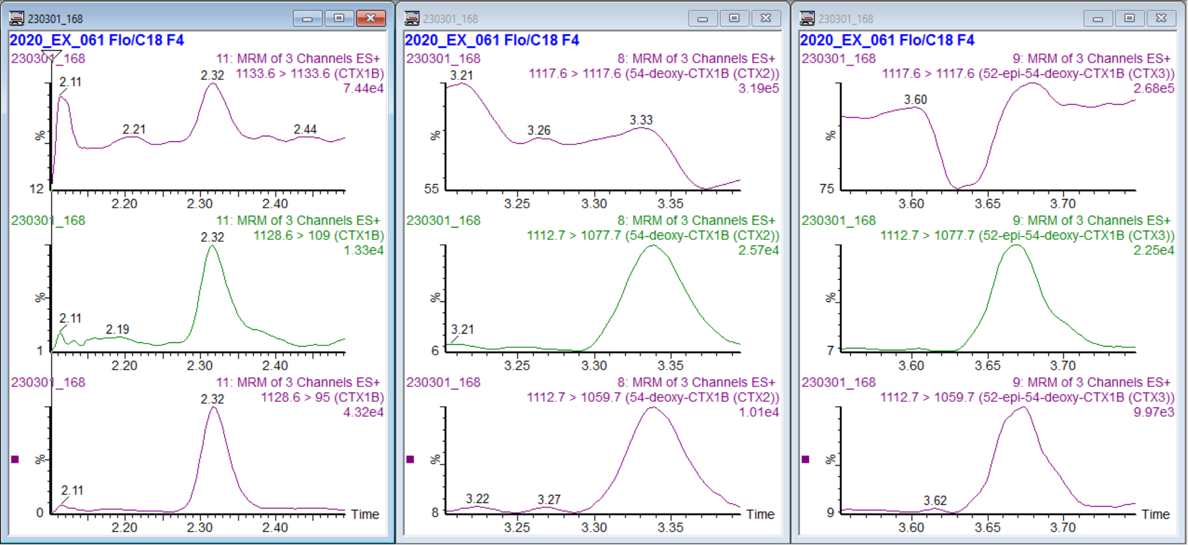
Flesh L. Bohar (22-EX-145)
RESULTS
ng equiv CTX1B/g |  |  |  | ng equiv CTX1B/g
Specie | Tissue | LC-MS/MS (no SPE) | LC-HRMS (no SPE) | LC-MS/MS (after SPE)
V. louti 1 | Flesh | CTX1B | CTX1B | CTX1B (0,075 ng/g), CTX2 (0,052 ng/g)
 | Liver | nd | nd | CTX1B (0,027 ng/g)
 | Viscera | nd | nd | CTX1B (0,0143 ng/g)
L. bohar | Flesh | CTX1B | CTX1B | CTX1B (0,0624 ng/g)
 | Liver | nd | nd | CTX1B (0,0581 ng/g)
 | Viscera | nd | nd | CTX1B (0,002 ng/g)
V. louti 2 | Flesh | CTX1B, CTX2, CTX3 | CTX1B, CTX2, CTX3, 2,3-diOH-CTX3C | CTX1B (0.1189 ng/g), CTX2, CTX3,
C. leucas | Flesh | CTX3C | nd | CTX3C
 | Liver | nd | nd
 | Viscera | CTX3C | nd | CTX3C
Flesh C. Leucas (22-EX-195)
Flesh V. Louti 2 (20-EX-061)

Slide 9
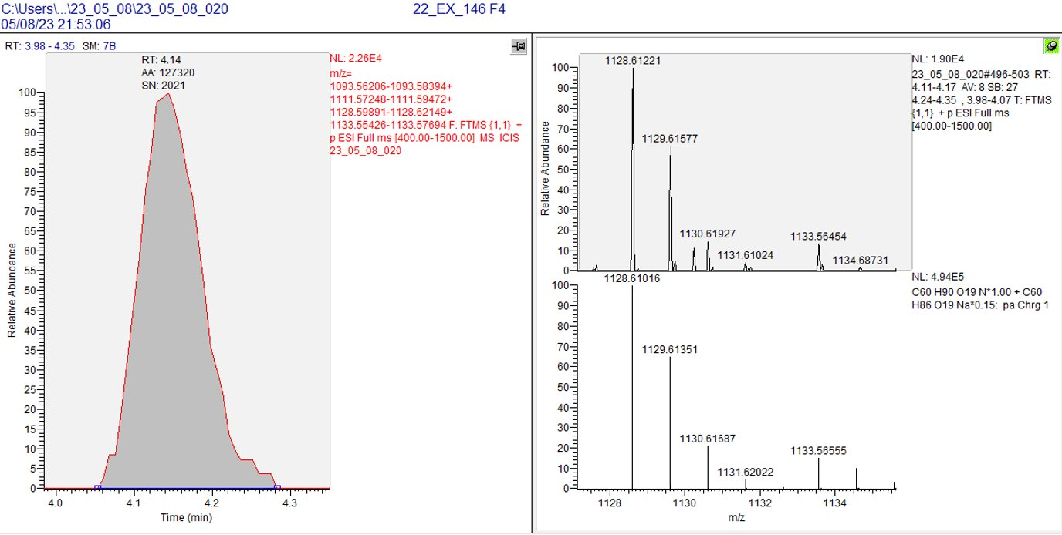
Liver L. Bohar (22-EX-145)
Flesh of the V. louti after a CP incident in La Réunion Island confirmed the presence of CTX 1B, (0.12 µg equiv CTX 1B/kg),
52-epi-54-deoxy CTX 1B (CTX3) and 54-deoxy CTX 1B (CTX2).
In the second V. louti individual and the L. bohar, CTX 1B was identified in the three tissues (0,01 – 0,07 ng equiv CTX 1B/g) and CTX2 was identified for flesh of V. louti (0,05 µg/kg).
The C. leucas samples revealed the presence of a complex CTX contaminant profile showing congeners of the CTX 3C group.

Slide 10
CONCLUSION
1. Four fishes from the Réunion Island presented CTX-like toxicities in the different tissues.
2. Toxicities were higher in liver followed by viscera and flesh in all fishes except for V. louti 1. Cell-based assay (Neuro-2a) was performed in two laboratories and results were consistent between both.
3. CTX 1B was found in all tissues for three fishes (L. bohar and two V. louti); CTX2 and CTX3 was founded in V. louti flesh and congeners of the CTX 3C group were found in C. leucas flesh and viscera.
4. Combined use of SPE Florisil + C18 is more effective minimizing the matrix effect.
5. Liquid chromatography coupled to high-resolution mass spectrometry is an emerging and very attractive approach that combines qualitative and quantitative analyses and reducing the inaccuracies.
6. The combined use of neuro-2a CBA + LC-HRMS + HRMS can be a good method for detection and evaluation of CTX and determination of toxin profiles.

Slide 11
ACKNOWLEDGEMENTS
Direction de l'Alimentation, de l'Agriculture et de la Forêt (DAAF), Ministry of Agriculture and Food, which supports the action plan on marine biotoxins of Reunion Island.
CERCA Programme / Generalitat de Catalunya.
CIGUARISK Project
LB acknowledges IRTA-URV-Banco Santander for the Ph.D. grant (2020 PMF-PIPF-07)
AS-H was funded by the research staff training aid program Catalina Ruiz from Canary Islands Research Agency (ACIISI)(APCR2022010011)
Thanks for your attention!

