Slide 1
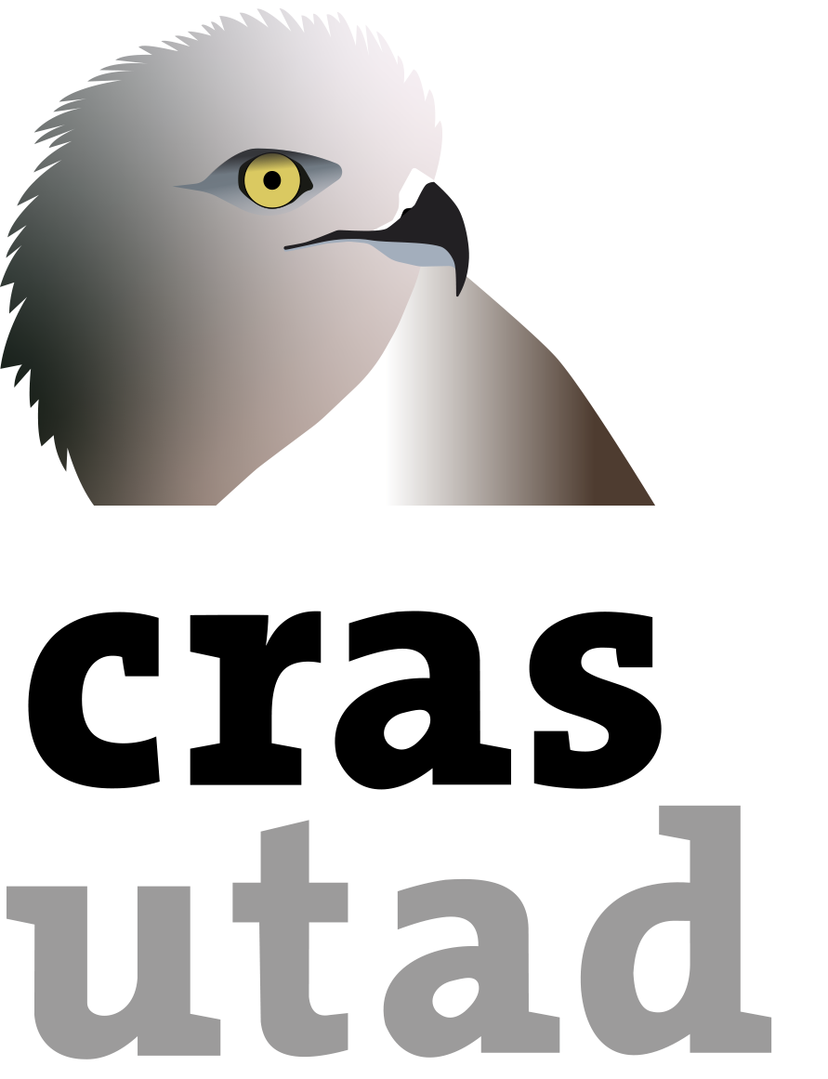
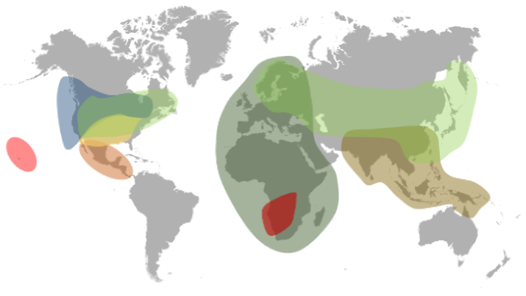
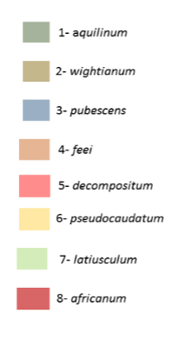
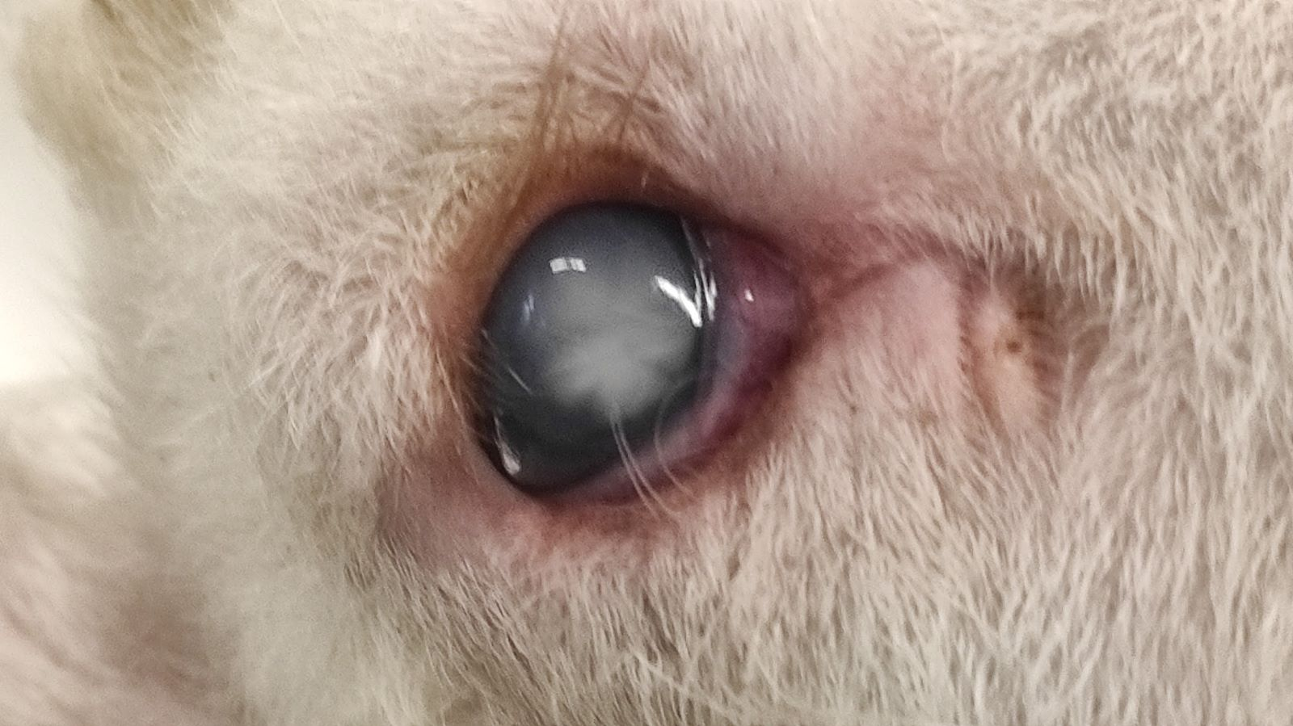
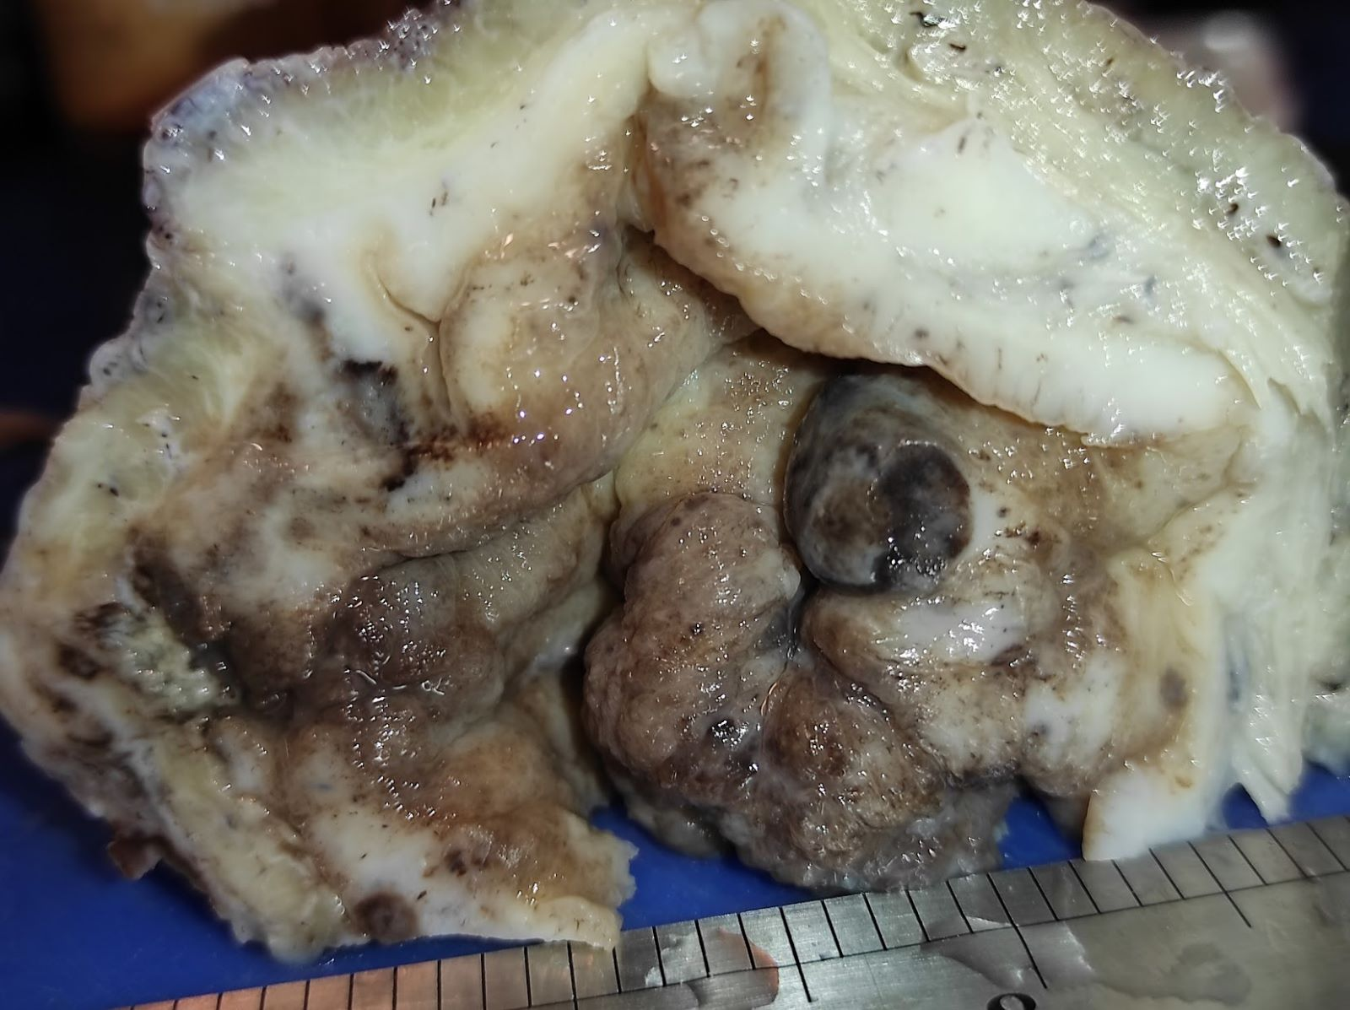
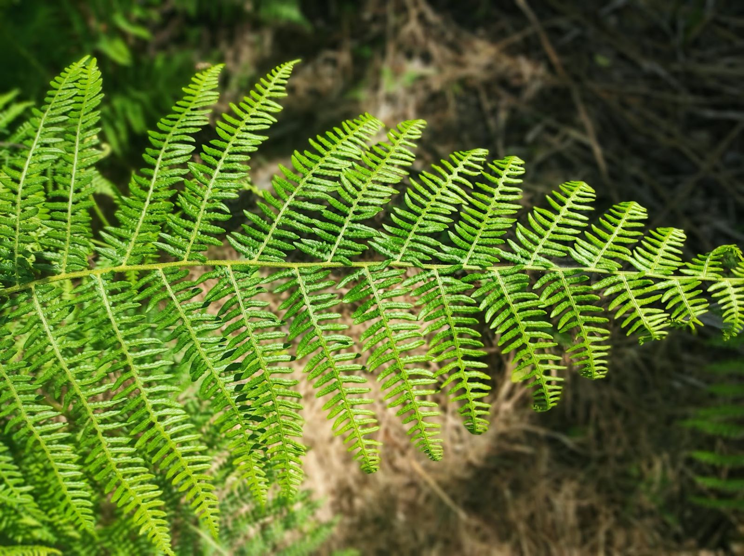
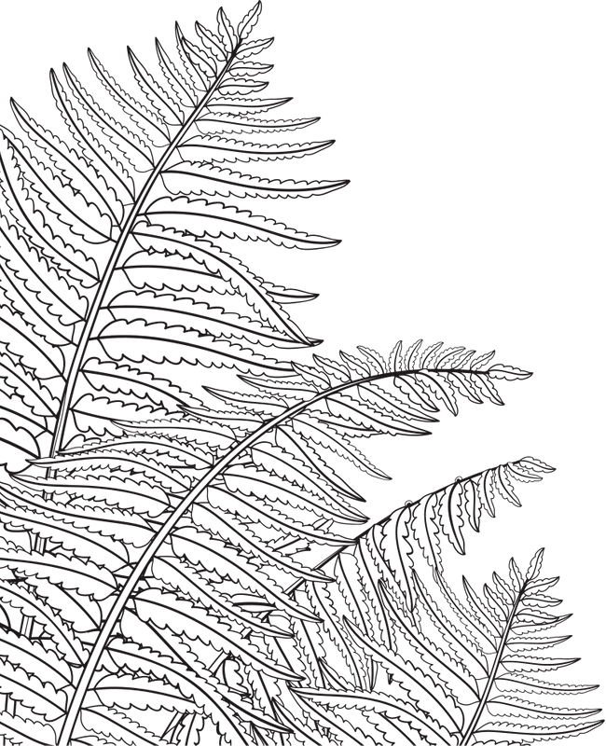
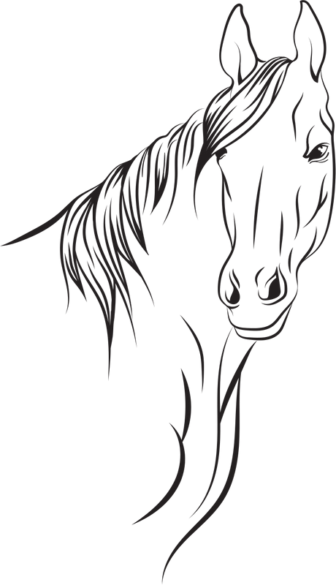
Diseases in ruminants associated with Pteridium aquilinum ingestion
Filipe Silva ^{1,4} , Andreia Garcês ^{1,2}, Catarina Magalhães ³, Isabel Pires ⁴
1 Exotic and Wildlife Service University of Trás-os-Montes and Alto Douro, Vila Real, Portugal;
2 CITAB, University of Trás-os-Montes and Alto Douro, Vila Real, Portugal;
3 Direção Geral de Alimentação e Veterinária, Portugal;
4 CECAV, University of Trás-os-Montes and Alto Douro, Vila Real, Portugal.
1. Introduction
Blindness in sheep
Bladder tumours in cattle
Pteridium aquilinum (L.) Kuhn, commonly referred as common fern, fento or fern of the mountains, or female fern of apothecary, is a cosmopolitan species, absent only in the polar and desert regions [1-2].
The global presence of Pteridium aquilinum can be attributed to its remarkable adaptability to various environmental conditions (Figure 1). This plant exhibits a highly opportunistic nature and employs a range of mechanisms to sustain its dominance. [1,3].
In sheep, ingestion of Pteridium aquilinum appears to be associated with blindness due to progressive retinal atrophy (Figure 3) [14]. The animals experience permanent blindness and remain generally alert. The responsiveness of their pupils to light is typically diminished. Histologically, the affected animals exhibit severe degeneration of retinal rods, cones, and the outer nuclear layer, which is most prominent in the tapetal portion of the retina [15-13] [16]. Additionally, these animals often present other lesions including bone marrow suppression, hemorrhage, immunosuppression, and urinary tract neoplasia [17].
Associated with fern carcinogens are bladder neoplasms (Figure 4), usually with enzootic hematuria and upper alimentary tract neoplasms in cattle [21]. The major carcinogenic compound of Pteridium is known as ptaquiloside (PTA), wich contain the potent carcinogen dienone 2 that exhibits significant alkylating activity, leading to the cleavage of deoxyribonucleic acid (DNA). When animals consume it in high doses can cause DNA damage, resulting in programmed cell death and cell cycle arrest even at lower doses [7] .
Fortunately, hydrothermal methods have been discovered to degrade PTA into a stable form, potentially reducing its toxicity. However, there is a need for further specific research [4].
Figure 1. Geographical distribution of Pteridium aquilinum subspecie aquilinum (Adapted from Page, 1976).
The morphology of the plant can be categorized into three main parts: roots, rhizomes, and fronds, with the fronds featuring fiddleheads in their immature stage (Figure 2). As the Bracken fern (BF) develops, the fiddlehead progressively unfurls, eventually giving rise to mature fronds responsible for the dispersal of essential spores required for reproduction [4-5].
Figure 3. Blindness in sheep
Figure 4. Bladder tumor in cattle
Acute or subacute poisoning
Ingestion of bracken fern can lead to acute poisoning and produce various clinical symptoms, including fever, apathy, drooling, hemorrhages in organs such as the gums, nostrils, and gastrointestinal tract. Hematuria and blood in the milk may also occur. Necropsy findings often include red infarcts in the liver and significant bone marrow aplasia [19-21] .
Figure 2. Bracken Fern.
2. Material and Methods
4. Conclusions
Based on the cases received at the Histology and Anatomical Pathology and at the Veterinary Hospital of UTAD (Vila Real, Portugal), the authors describe the main animal syndromes associated with the ingestion of P. aquilinum in ruminants, based on the literature
Pteridium aquilinum, also known as bracken fern, is rapidly spreading worldwide, posing a significant threat in Portugal due to favorable environmental conditions. The spread is aided by abandoned crops and forest fires. The fern's extensive rhizome system allows it to survive fires and produce spores in exposed areas, easily dispersed by wind. It quickly colonizes burned areas. Bracken fern intoxication is incurable, except in cases of thiamin deficiency. Controlling exposure through improved grazing management and alternating grazing areas can minimize poisoning risk. Measures like cutting mature plants and deep tillage can stop its growth. Climate change contributes to its proliferation, It is important to recognize the negative consequences this fern can bring to both humans and animals. Therefore, caution must be exercised to prevent excessive exposure to its hazardous chemicals.
3. Results and Discussion
The primarily associated syndromes observed in animals that consume this plant were thiamine deficiency, blindness in sheep, acute or subacute poisoning with bone marrow depression, and consequently, leucopenia and bladder tumours in cattle. The plant in question possesses various toxic constituents, namely illudane and il-ludalane sesquiterpenes, nor-sesquiterpenes, benzoic acid derivatives, cinnamic acid derivatives, enzymes, and thiaminases, flavonoid antioxidants such as quercetin and kaempferol, along with an unstable glycoside and also prominent carcinogenic compound known as ptaquiloside [6-7].
Thiamine deficiency
Acknowledgments
Thiamine deficiencies are frequent, due to the type 1 thiaminase present in this plant. They are mainly affected in monogastric herbivores such as horses since the microbial flora can synthesize this vitamin from its derivatives in ruminants [8-10]. Typical cases of poisoning from bracken fern require relatively high doses (hay contaminated with 20%–25% bracken fern) over an extended period (three months at least). In horses, the condition known as equine bracken staggers are characterized by symptoms including anorexia, weight loss, lack of coordination, a hunched posture with an arched back and neck, and a wide stance with feet apart. In severe cases, tachycardia and arrhythmias may occur, and death usually follows within 2–10 days after the onset of symptoms. Thiamine therapy is commonly employed. [11-13].
Poisoning in pigs is relatively rare and presents anorexia and weight loss. In the terminal phase, the condition may resemble heart failure, and sudden death can occur following recumbency (lying down) and difficulty breathing (dyspnea) [12].
However, in sheep fed Pteridium aquilinum together with other thiaminase-rich plants, polioencephalomalacia associated with thiamine deficiency has been diagnosed [8]-10].
The participation of Pires I, Silva F. was supported by the projects UIDB/CVT/00772/2020 and LA/P/0059/2020, funded by the Portuguese Foundation for Science and Technology (FCT). (Project UIDB/CVT/0772/2020). The participation of Garcês A. was supported by National Funds from FCT Portuguese Foundation for Science and Technology, under the project UIDB/04033/2020.
References
1. Antiquário, M. de C.-L. Iconographia selecta florae azoricae; Secretaria Regional da Cultura Autotoma dos Açores, 2015; 2. Durão, J. Aspectos Anatomopatológicos e Clínicos Da Hematúria Enzoótica Dos Bovinos. Revista Portuguesa de Ciências Veterinárias 1995, 131–137.
3. GLIESSMAN, S.R. Allelopathy in a Broad Spectrum of Environments as Illustrated by Bracken. Botanical Journal of the Linnean Society 1976, 73, 95–104, doi:10.1111/j.1095-8339.1976.tb02015.x.
4. Kim, M.K.; Kang, J.S.; Kundu, A.; Kim, H.S.; Lee, B.-M. Risk Assessment and Risk Reduction of Ptaquiloside in Bracken Fern. Toxics 2023, 11, 115, doi:10.3390/toxics11020115.
5. Biological Flora of the British Isles: Pteridium Aquilinum (L.) Kuhn - MARRS - 2006 - Journal of Ecology - Wiley Online Library Available online: https://besjournals.onlinelibrary.wiley.com/doi/full/10.1111/j.1365-2745.2006.01177.x (accessed on 31 May 2023).
6. Ugochukwu, I.C.I. Bracken Fern Toxicity and Its Associated Clinicopathological Effects in Humans and Animals: A Review. Comp Clin Pathol 2019, 28, 593–597, doi:10.1007/s00580-018-2636-2.
7. EVANS, W.C. Bracken Thiaminase-Mediated Neurotoxic Syndromes. Botanical Journal of the Linnean Society 1976, 73, 113–131, doi:10.1111/j.1095-8339.1976.tb02017.x.
4. Bakker, H.J.; Dickson, J.; Steele, P.; Nottle, M.C. Experimental Induction of Ovine Polioencephalomalacia. Vet Rec 1980, 107, 464–466, doi:10.1136/vr.107.20.464.
9. Chick, B.F.; Carroll, S.N.; Kennedy, C.; McCleary, B.V. Some Biochemical Features of an Outbreak of Polioencephalomalacia in Sheep. Aust Vet J 1981, 57, 251–252, doi:10.1111/j.1751-0813.1981.tb02680.x.
10. Plumlee, K.H. Clinical Veterinary Toxicology; Elsevier - Health Sciences Division, 2007; ISBN 978-0-323-05455-3.
11. Fenwick, G.R. Bracken (Pteridium Aquilinum)—Toxic Effects and Toxic Constituents. Journal of the Science of Food and Agriculture 1989, 46, 147–173, doi:10.1002/jsfa.2740460204.
12. Caloni, F.; Cortinovis, C. Plants Poisonous to Horses in Europe. Equine Veterinary Education 2015, 27, 269–274, doi:10.1111/eve.12274.
13. Smith, B.L. Bracken Fern and Animal Health in Australia and New Zealand. AIAS Occasional Publication 1990, 227–232.
14. Hirono, I.; Ito, M.; Yagyu, S.; Haga, M.; Wakamatsu, K.; Kishikawa, T.; Nishikawa, O.; Yamada, K.; Ojika, M.; Kigoshi, H. Reproduction of Progressive Retinal Degeneration (Bright Blindness) in Sheep by Administration of Ptaquiloside Contained in Bracken. J Vet Med Sci 1993, 55, 979–983, doi:10.1292/jvms.55.979.
15. Stegelmeier, B.L.; Field, R.; Panter, K.E.; Hall, J.O.; Welch, K.D.; Pfister, J.A.; Gardner, D.R.; Lee, S.T.; Colegate, S.; Davis, T.Z.; et al. Chapter 40 - Selected Poisonous Plants Affecting Animal and Human Health. In Haschek and Rousseaux’s Handbook of Toxicologic Pathology (Third Edition); Haschek, W.M., Rousseaux, C.G., Wallig, M.A., Eds.; Academic Press: Boston, 2013; pp. 1259–1314 ISBN 978-0-12-415759-0.
16. Kigoshi, H.; Niwa, M.; Ohashi, H.; Tanaka, H.; Hirokawa, J.; Ishiwata, H.; Yamada, K. Synthesis of Bracken Ultimate Carcinogen Analogues Possessing a DNA Binding Moiety and Their DNA Cleaving Activities. Tetrahedron Letters 1995, 36, 5349–5352, doi:10.1016/0040-4039(95)00984-K.
17. Tourchi, M. Múltiples Efectos Del Helecho Macho En Condiciones in Vivo e in Vitro (En Inglés). Asian Pacific Journal of Cancer Prevention 2014, 5349–5352.
18. Anjos, B.L.; Irigoyen, L.F.; Fighera, R.A.; Gomes, A.D.; Kommers, G.D.; Barros, C.S.L. Intoxicação aguda por samambaia (Pteridium aquilinum) em bovinos na Região Central do Rio Grande do Sul. Pesq. Vet. Bras. 2008, 28, 501–507, doi:10.1590/S0100-736X2008001000010.
19. Gil da Costa, R.M.; Bastos, M.M.S.M.; Oliveira, P.A.; Lopes, C. Bracken-Associated Human and Animal Health Hazards: Chemical, Biological and Pathological Evidence. J Hazard Mater 2012, 203–204, 1–12, doi:10.1016/j.jhazmat.2011.12.046.
20. Pires, I.; Silva, F.; Queiroga, F.L.; Rodrigues, P.; Henriques, R.; Pinto, C.A.; Lopes, C. Epithelioid Hemangiosarcomas of the Bovine Urinary Bladder: A Histologic, Immunohistochemical, and Ultrastructural Examination of Four Tumors. J Vet Diagn Invest 2010, 22, 116–119, doi:10.1177/104063871002200124.
21. Pires, I.; Magalhães, A.; Diez, J.; Saraiva, C.; Silva, F. Enzootic Bovine Hematuria.; Academic Publications, 2020;

