Slide 1
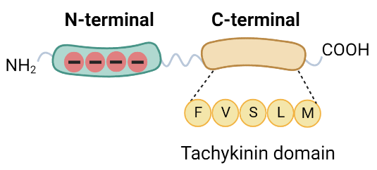
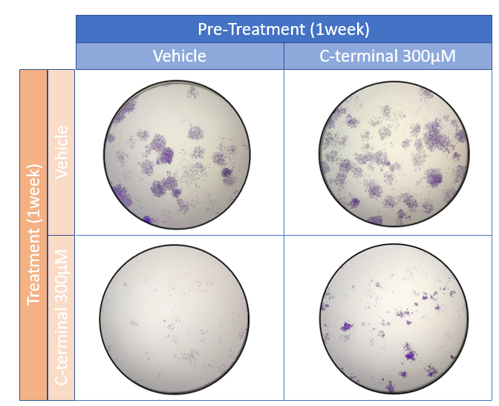
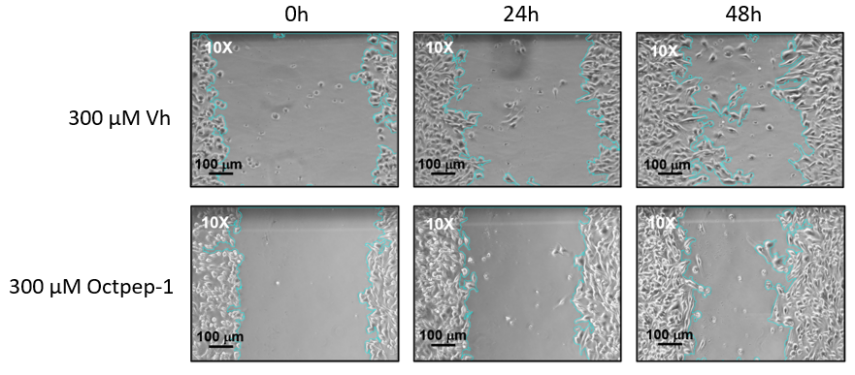
Metabolism and mitochondria alterations in melanoma cells induced by Octpep-1
Isabel Fernández-Carrasco¹, Javier Moral-Sanz¹, Claudia Camarero-Hoyos¹, Maria Ikonomopoulou^{1,2}
1. Translational Venomics Group, Institute IMDEA Food, Crta. de Canto Blanco nº 8, E – 28049, Madrid, Spain
2. The University of Queensland, St. Lucia, QLD 4072, Australia
INTRODUCTION
METHODS
Octpep-1 is a novel venom-derived tachykinin-peptide from Octopus kaurna, with an antiproliferative profile against melanoma, the deadliest form of skin cancer worldwide. Current therapies have been associated with drug resistance, followed by a fast deterioration and death. Therefore, there is a medical need for new efficient targeted therapies against advanced or metastatic melanoma.
Cell culture. Human melanoma cells (MM96L) were cultured in RPMI-1640 media supplemented with 10% FBS, 1% non-essential amino-acids and 1% penicillin/streptomycin. Seahorse. Investigation of Oxygen Consumption Rates (OCR) was performed in Seahorse XF base medium containing. Measurements were performed after 24 hours incubation with Octpep-I in melanoma cells. Fluorescence microscopy. Mitochondrial staining was performed with MitoTracker Red, following fixation with PFA. To stain the nucleus, a Fluoroshield Mounting Medium containing DAPI was used. Images were obtained 24 and 48 hours after treatment with a Leica DMIL microscope. An ImageJ/Fiji® automated analysis was used to evaluate the morphology of mitochondria networks. Cell viability. We assessed cytotoxicity with the MTT assay. Cells were treated for 48h with Octpept-1 and absorbance was measured at 570 nm. Flow cytometry was performed using a BD LSR Fortessa 5 analyser (BD Biosciences). Reactive Oxygen Species (ROS). Cells were incubated with Carboxy-H2DCFDA for 30 min prior to ROS detection. Cell cycle. Cells were resuspended, washed and fixed with 70% ethanol. Ethanol was washed and cells were then treated with RNAse. Cell pellets were stained with propidium iodide (PI). All data were analysed using FlowJo v10.06. Scratch Assay. A wound was mechanically scratch in a monolayer of cells with a pipette tip and pictures were taken at 0, 24 and 48 hours to observe closure of the wound under conditions of 1% FBS and at different in a Leica DMIL microscope. The analyses were performed using an ImageJ/Fiji® plugin. β-Gal staining. Cells treated for 1 week with 300 μM Octpep-1, its vehicle 0.2% DMSO and 10 μM Palbociclib were seeded in coverslips and stained with a β-Galactosidase Staining Kit (Cell Signaling Technology). Coverslips were mounted and visualized under a Leica DM2000 LED microscope. Western blot. Cells were lysed in cold RIPA buffer containing protease and phosphatase inhibitors. Samples were subjected to SDS-PAGE and blotted according to standard procedures. Antibodies were obtained from Cell Signaling Technology. Statistical analysis. Statistical analysis was performed using Graphpad Software. Data are expressed as mean ± SEM as the statistical test used is indicated in each figure legend. Statistical significance was considered at *P < 0.05, **P < 0.01, ***P < 0.001.
The main melanoma mutation consists of the substitution of a valine to glutamine in codon six hundred (V600E) of the serine-threonine kinase BRAF. Octpep-1 impairs melanoma cellular viability without triggering apoptosis in human melanoma BRAF(V600E)-mutated cells, while is innocuous in healthy fibroblast [1]. In addition, Octpep-1 diminishes tumor progression in in vivo animal xenograft melanoma models [1]. The C-terminal region holds the active site of the peptide, while the N-terminal end modulates the potency and selectivity (Figure 1). Altogether, support Octpep-1 as an optimal candidate in combination therapies for melanoma BRAF(V600E) mutations.
Octpep-1
Figure 1. Octpep-1 structure
OBJETIVE
The main objective of this study was to assess whether Octpep-1 modulates melanoma progression by interfering with mechanisms related to cell proliferation, cell migration or cellular senescence.
RESULTS
CONCLUSIONS
Figure 2. Mitochondrial respiration, content and dynamics in melanoma cells after treatment with Octpep-1
Using the SeaHorse technology, we observed that Octpep-1 treated MM96L cells increased oxygen consumption rates and mitochondrial respiration (Figure 2A), without changes in glycolysis (not shown). These alterations were not linked to changes in mitochondrial ATP production (Figure 2B), suggesting that Octpep-1 promotes an uncoupled state of mitochondrial respiration [2]. Hyperactivity of mitochondrial metabolism correlates generation of reactive oxygen species (ROS) in Octpep-1 treated cells (Figure 2C) and without leading to cell apoptosis [1].
We studied, using MitoTracker™ Red to selectively label mitochondria, if this effect could be due to a higher mitochondrial content or to changes in the mitochondrial dynamics. Pictures taken after 48 hours of treatment demonstrated that Octpep-1 treated cells presented fused accumulation of mitochondrial clusters present in the perinuclear area of MM96L cells, whilst in control-treated, they appeared scattered (Figure 2D). Octpep-1 did not alter neither cell area nor mitochondrial area (Figures 2E-F). Nevertheless, it produced a significant diminution in the number of mitochondrial clusters and in the ratio cluster number/cell area (Figure 2G).
Figure 4. Mitochondrial fusion might affect proliferation
To examine whether Octpep-1 impacts proliferation, cells were grown in RPMI media under different percentages of Fetal Bovine Serum (FBS): 10% (proliferative conditions), 1% and 0% (serum starvation). After 48 hours, a stall in proliferation was observed by MTT for both 0% and 1% FBS, compared to the active growth in 10% FBS (Figure 4A), as expected. Octpep-1 did not produce an effect neither with 0% nor with 1% FBS; whilst it did produce a noticeable effect only in the 10% FBS-medium (Figure 4A). In contrast, AgGomesin, a spider venom-derived peptide, was similarly cytotoxic at 24 and 48 hours, in line with the reported data [3], and thus, was used here as a positive death control. In the 10% FBS-medium, only 300 μM Octpep-1 produced a significant decrease in proliferation at 48 hours (p value <0.05). Nonetheless, we can still see a clear trend to a decreasing viability for Octpep-1 at concentrations close to its IC50 (150 μM).
Moreover, when comparing the effect of each treatment in the proliferation endured by non-treated cells after 48 hours in 10% FBS medium, both 150 and 300 μM Octpep-1 displayed a significant decrease in viability as compared to their respective controls, 0.1% and 0.2% DMSO (p value for 150 μM <0.05; for 300 μM <0.01) (Figure 4B). In addition, the effects of Octpep-1 (150 μM), but not DMSO (0.1%), showed a significant correlation with the percentage of proliferation reported in the non-treated replicates (Pearson’s correlation, Octpep-1, R=-0.8 and DMSO, R=-0.46; p<0.05) (Figure 4C). The effects of Octpep-1 in cell cycle confirmed a stagnation in GO/G1 phase comparable to serum starvation conditions (Figure 4D). Altogether, suggested that this toxin hampers proliferation in melanoma cells, without apoptosis.
Next, we assessed whether the active region of Octpep-1 (C-terminal) affects the colony formation of MM96L cell. Colony formation evaluates the adhesion-independent cell proliferation of cancer cells. Preliminary results are shown in Figure 4E, suggesting that in the presence of C-terminal region, tumor cells lose the ability to form colonies. Furthermore, cells formed colonies once the C-terminus was removed from the medium.
Figure 5. Octpep-1 as an inducer of cellular senescence
Octpep-1 increased ROS production whilst reduced cellular viability, but without inducing apoptosis [2]. Hence, we examined whether cellular senescence, a permanent phase of cell cycle arrest in cells was a possible mechanism of action for Octpep-1. Therefore, we assessed β-galactosidase staining as a marker of cellular senescence in MM96L treated with Octpep-1 (300 μM, 7 days) as compared to vehicle (DMSO 0.2%, 7 days) or Palbociclib (10 μM, 7 days) (a chemical inducer of senescence [4]). Palbociclib increased β-galactosidase activity as a marker of senescence and was used as a positive control (Figure 6A). Results showed that both vehicle and Octpep-1 presented significantly low percentages of positive cells compared to Palbociclib (P<0.0001) (Figures 6 A-B). Comparison of DMSO with Octpep-1 marked a significant difference (p P<0.001) (Figure 6B).
The dysfunction of mitochondrial dynamics is caused by a mitochondrial hyperfusion triggered by Octpep-1 in melanoma cells.
Octpep-1 does not affect cellular migration and fails to exhibit all the characteristic markers associated with cellular senescence.
Octpep-1 inhibits melanoma proliferation via mitochondrial hyperfusion, ROS generation and metabolic alterations but without apoptosis; thus, displays a distinct (not cytotoxic) mechanism of action.
A
B
REFERENCES
A
B
C
[1] Moral-Sanz, J. et al. The structural conformation of the tachykinin domain drives the anti-tumoural activity of an octopus peptide in melanoma BRAFV600E. Br J Pharmacol, 179, 20, 4878–4896 (2022).
[2] Moral-Sanz, J. et al. ERK and mTORC1 Inhibitors Enhance the Anti-Cancer Capacity of the Octpep-1 Venom-Derived Peptide in Melanoma BRAF(V600E) Mutations. Toxins, 13, 146 (2021).
[3] Ikonomopoulou, M.P. et al. Gomesin inhibits melanoma growth by manipulating key signaling cascades that control cell death and proliferation. Sci Rep. 8, 1-14 (2018).
[4] Niu, Y. et al. Oxidative stress alters global histone modification and DNA methylation. Free Radic Biol Med. 82. 22-8 (2015).
[5] Shimoda, H. et al. Inhibition of the H3K4 methyltransferase MLL1/WDR5 complex attenuates renal senescence in ischemia reperfusion mice by reduction of p16INK4a. Kidney Int. 96, (5), 1162-1175 (2019).
C
D
E
F
G
A
Figure 3. Mitochondrial fusion might affect migration
In order to test whether these observed changes in mitochondria dynamics induced by Octpep-1 have any effect on migration, a scratch assay was performed mechanically in a monolayer of MM96L cells. Changes in mitochondria dynamics induced by Octpep-1 were observed (Figure 3A). The wound size compared to its initial measurements decreased with time, but neither 150 nor 300 μM Octpep-1 produced a significant reduction compared to vehicle (Figure 3B).
E
We then studied the protein expression of different senescence markers (p16, p53, H3, phosphorylation of p-53(Ser15) and trimethylation of H3, H3K4me3) (Figure 5C). Palbociclib- treated cells, contrary to what is expected during cellular senescence [4], showed inhibited protein expression levels of p16, p53, p-p53 and H3, while Lamin B1 was increased. These implied that Palbociclib-treated MM96L cells might not be a good model to study cellular senescence in our experimental conditions. Additionally, Octpep-1 did not alter Lamin B1, p53 or p-p53(Ser15). However, it augmented the expression of p16 and H3K4me3. Literature reports that the accumulation of p16 can mediate Histone 3 Lysine 4 trimethylation [5]. This suggests that there are many different mechanisms when regulating gene expression, and that not the simultaneously activation of all induces cellular senescence. Overall, Octpep-1 induced the expression of several senescence markers but does not alter others, such as β-galactosidase activity, indicating that it does not recapitulate all the characteristic markers for cellular senescence, leaving the door open to the study of another type of cell cycle arrest, such as quiescence.
B
C
A
B
ACKNOWLEDGMENTS
D
We thank the AMAROUT Marie Curie program (Nº 291803-AMAROUT II), the TALENTO Program by the Regional Madrid Government (2018-T1/BIO-11262), Youth Funding Program by the Regional Madrid Government (#PEJ-2020-AI/BIO-17904) and the National Plan by the Spanish Government (#PID2021-126691OB-I00).
Contact information: isabel.fernandez@imdea.org

