Slide 1
Exploring the Photophysical Properties and Self-Assembly of a Spiropyran/Merocyanine Amphiphile in Different Solvents V. Savchenko, O. Guskova
The 2nd International Electronic Conference on Chemical Sensors and Analytical Chemistry
Notes:
Hallo

Slide 2
Outline
Introduction
Spiropyrans – another example of photoresponsive molecules and molecular switches. SP and MC isomers
Photoresponsive amphiphiles. What we think we know, how do they work?
Research questions
Details of experiments and simulations (will be provided on each slide)
Results
Comparison and explanation of the experimental results
What is the most stable isomer in water SP or MC? Why?
Which micellar shape is the most probable for the amphiphile in water?
Thermodynamics of solvation
Bonus: Assemblies in water. What to expect if solution concentration goes above CMC?
Conclusions

Slide 3
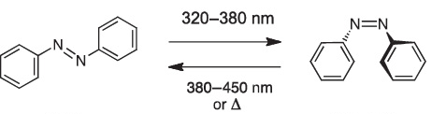
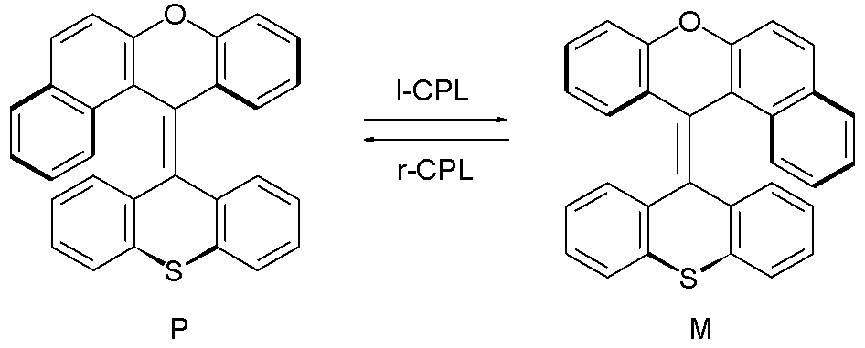
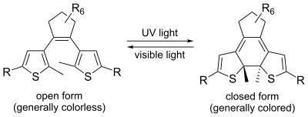
Spiropyrans – another example of molecular switches
Azobenzene
Chiroptical molecular switches
Dithienylethenes
Spiropyrans

Slide 4
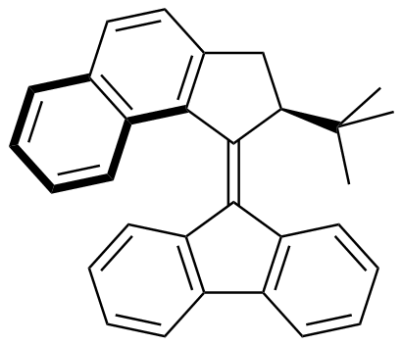
Spiropyrans – another example of molecular switches
Azobenzene
Chiroptical molecular switches
Dithienylethenes
A way to molecular motors
Spiropyrans

Slide 5
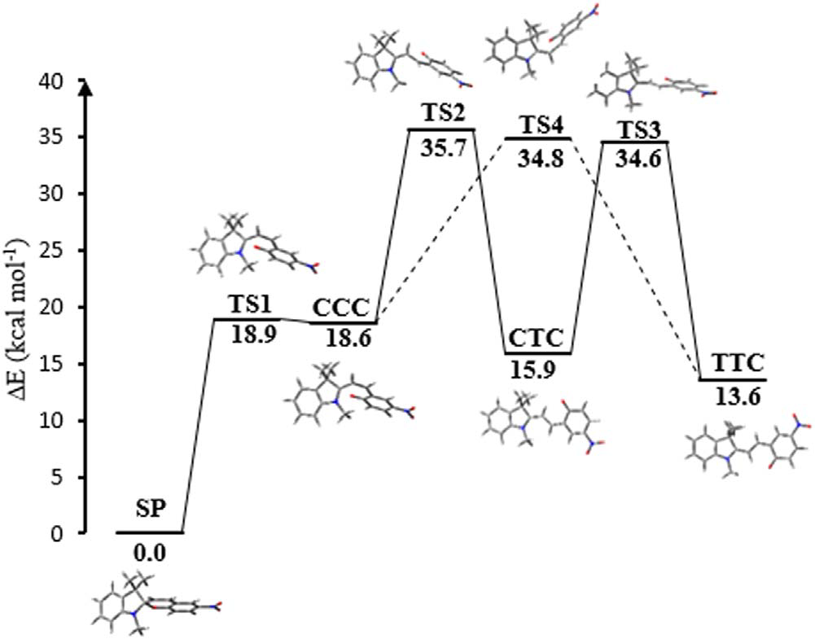
Spiropyran (SP) and merocyanine (MC) isomers
Conventional MCs are less stable isomers
SP
MC
Closed form
colorless
Open form
colored
Conventional SPs are more stable isomers
TS – different transition states
CCC, CTC, TTC – MC states
O. Kovalenko, M. Reguero, Phys. Scr. 95 (2020) 055402 (11pp)

Slide 6
How to make SP amphiphilic? Some thoughts about structures

Slide 7
How to make SP amphiphilic? Some thoughts about structures
Is water a trigger?
Is water a trigger?

Slide 8
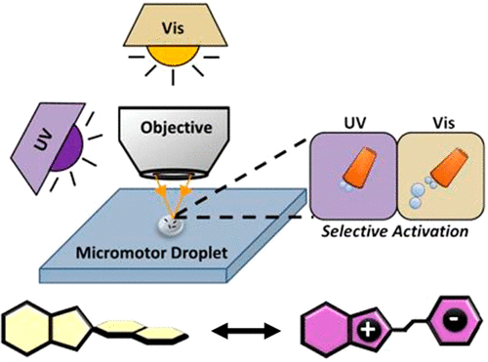
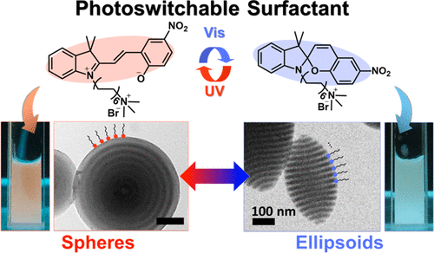
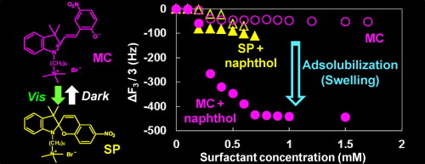
SP amphiphiles that have found their applications
for a controllable change of the physicochemical properties of the micellar solutions, e.g. adsolubilization
(long alkyl chain between the head and SP C12)
for the construction of the reversible shape and color-changing block copolymer particles
(long alkyl chain between the head and SP C12)
for the spatiotemporal control of bubble-propelled micromotors
(SP is a head of the surfactant, C1, C8 and C18 are studied)
Sakai et al. Colloids Surf. A 2012, 410, 119
Kim et al. J. Am. Chem. Soc. 2021, 143, 33, 13333
Moo et al. ACS Nano 2016, 10, 3, 3543

Slide 9
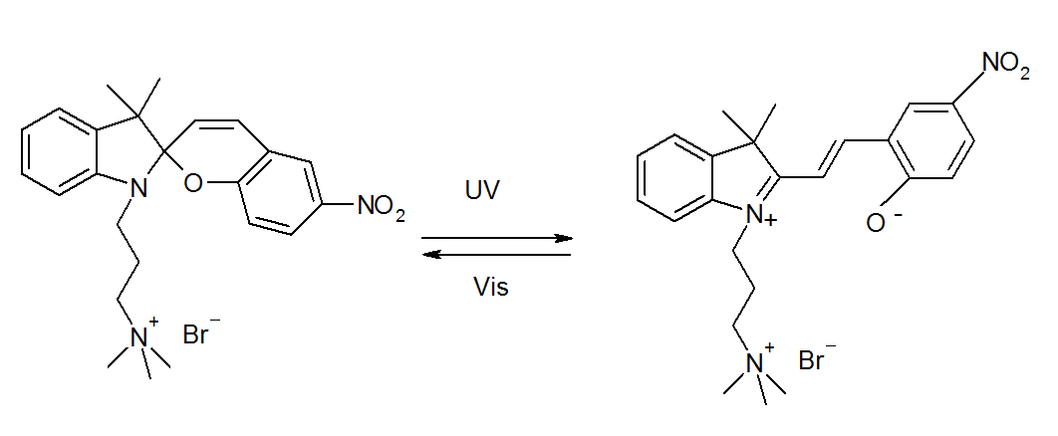
Object of the study: why do we need it?
Properties:
positively charged head (microgel’s compatible)
the shortest C3 (propyl) chain between the head and the SP part
the counterion is Br⁻¹
is soluble in water, acetonitrile, chloroform, DMSO, ethanol
optical properties are measured for the solution concentration below CMC
Microgel‘s particle = micropump
Zakrevskyy et al. Adv. Funct. Mater. 2012, 22, 23, 5000
The SPs showed negligible toxic effects on the cells up to millimolar concentrations. Fagan et al. Front. Chem. 2021, 9, 720087

Slide 10
Research questions
can we reproduce/prove/explain in the simulations MC isomer is appearing in water upon SP dissolution?
which self-assembling morphologies can be predicted for this amphiphile?
what is the behavior of SP/MC in other solvents?
what happens in aqueous solution at a concentration above CMC?

Slide 11
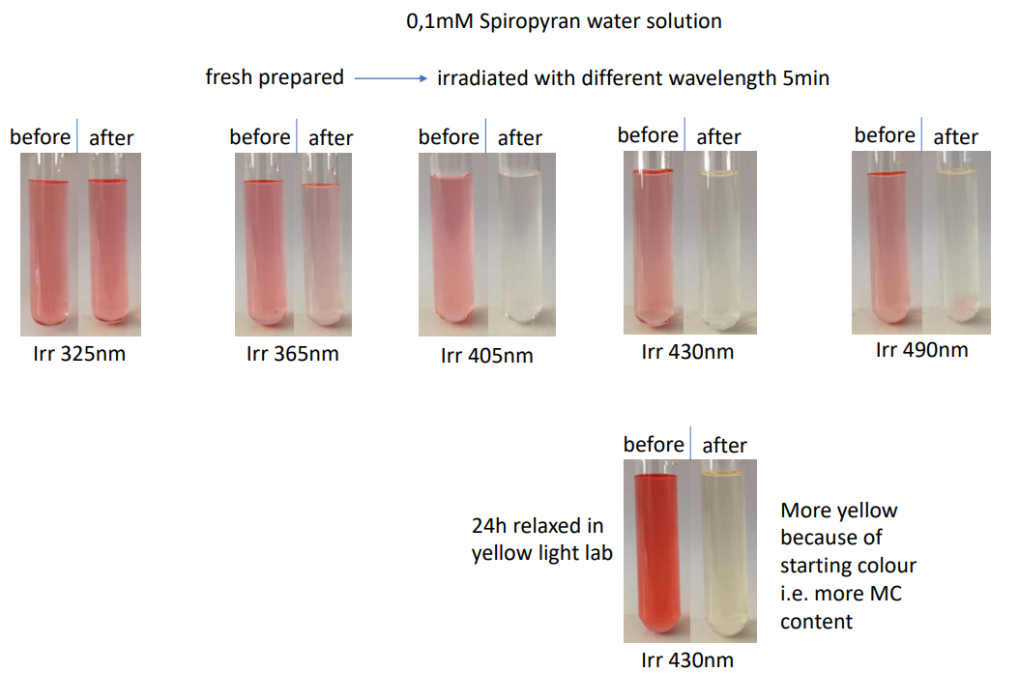
Experimental results. Aqueous systems
UV UV violet indigo blue-green
MC MC SP SP SP
MC: colored
SP: colorless
MC SP

Slide 12
Experimental results. Aqueous systems
Relaxation in dark
Sample dissolved in water and placed directly in the spectrometer

Slide 13
Experimental results. Aqueous systems
dark relaxed state to UV irradiated photostationary state
without taking out from spectrometer

Slide 14
Experimental results. Aqueous systems
Relaxed state (24h yellow light lab) to blue (455nm) irradiated photostationary state, I=2mW/cm²
max MC

Slide 15
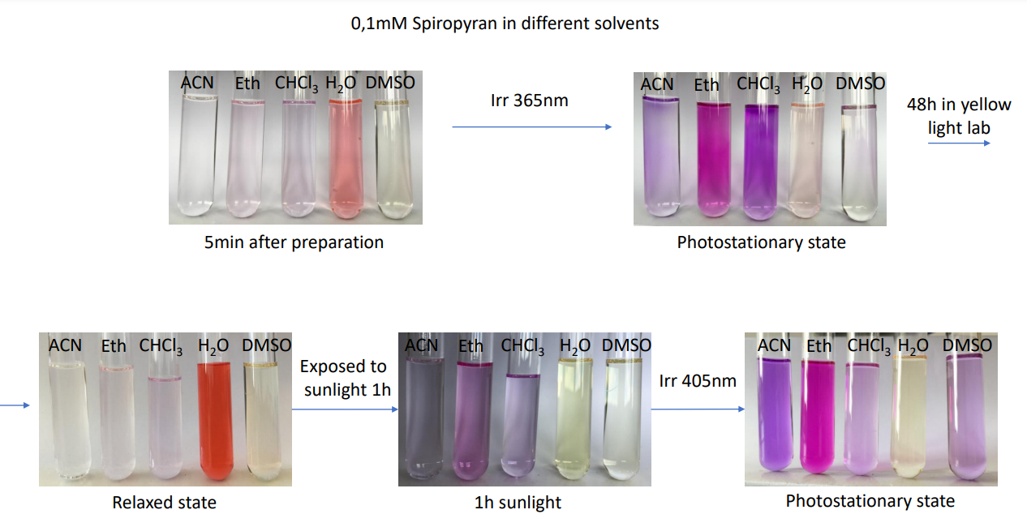
Experimental results. Organic solvents
PSS of a reversible photochemical reaction is the equilibrium chemical composition under a specific kind of electromagnetic irradiation.
Notes:
Sunlight (2% UV, 47% Vis and 51% IR)

Slide 16
Experimental results. Organic solvents
Normalized absorption spectra of 0,1mM SP before irradiation: sample dissolved in appropriate solvent and measured after one hour standing in yellow light lab
Normalized absorption spectra of 0,1mM SP after irradiation: samples irradiated with UV light until photostationary state achieved

Slide 17
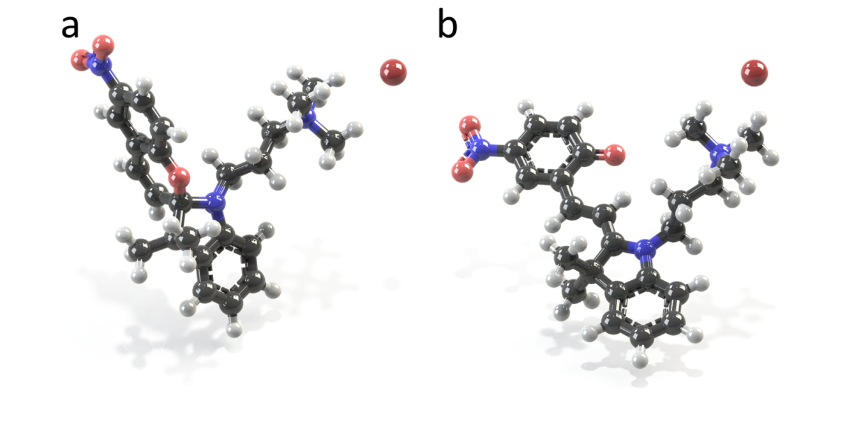
Simulation results. Molecular geometries. Relative energies
SP MC
Solvent | ε | MC (reference) | SP ΔΕ [kJ mol⁻¹]
Chloroform | 4.7 | 0 | +58.0
Ethanol | 24.9 | 0 | +67.5
Acetonitrile | 35.7 | 0 | +68.8
DMSO | 46.8 | 0 | +68.8
Water | 78.4 | 0 | +70.2
B3LYP/DGDZVP, IEFPCM/UFF solvent
Gaussian 09 Rev. A01

Slide 18
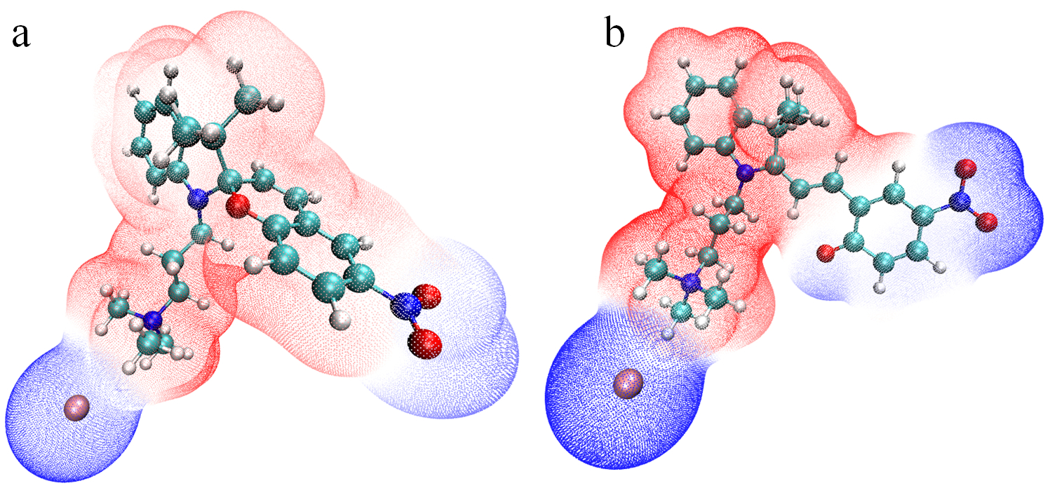
Simulation results. ESP and dipole moments.
Dipole moments μ [D]
SP 21.8 D
MC 28.7 D
The main difference is here
SP MC
Merz-Singh-Kollman procedure, ESP is mapped onto a surface with an electron density isovalue of 0.02 au
Illustration: Multiwfn, Version 3.8 and VMD, Version 1.9.3.

Slide 19
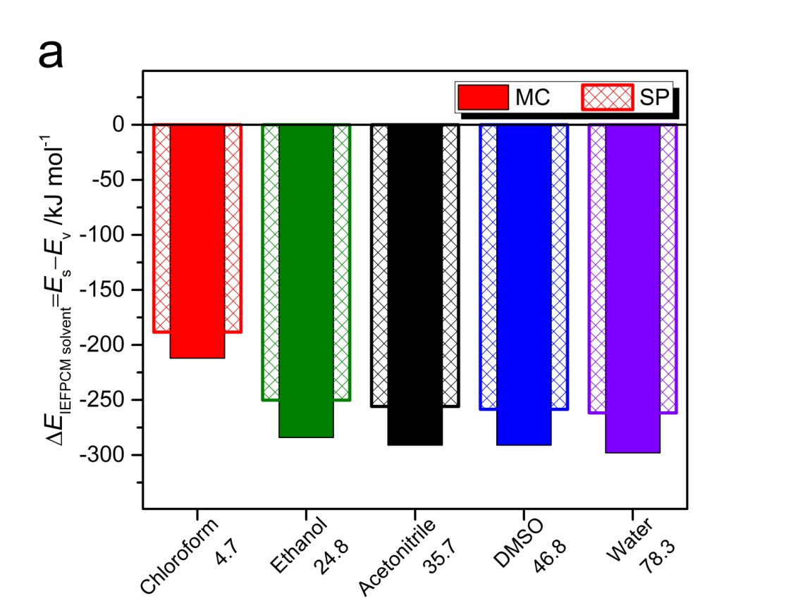
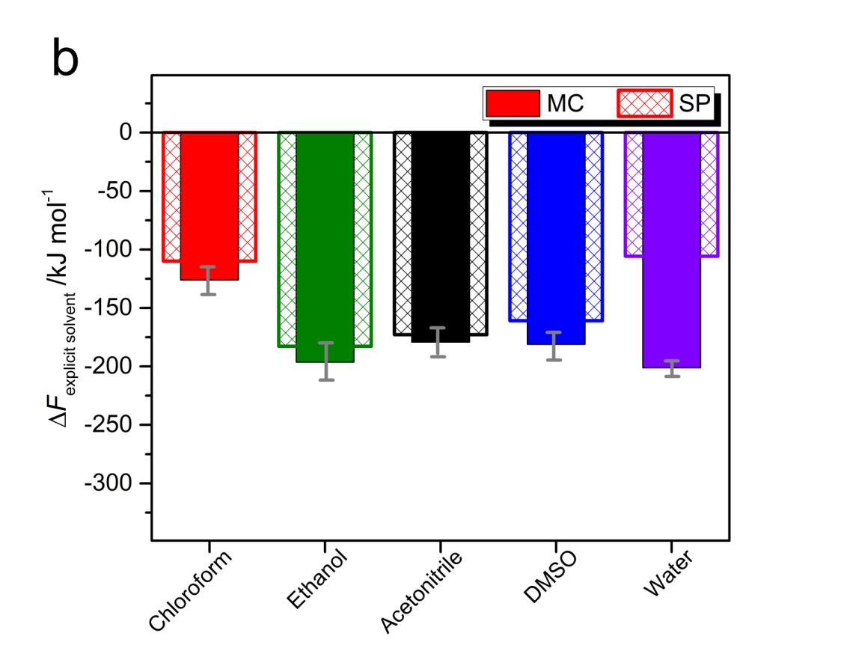
Simulation results. Thermodynamics of SP/MC cation solvation
The main difference is here
t r e n d
Implicit solvation, B3LYP/DGDZVP, IEFPCM/UFF solvent Explicit solvation, Materials Studio, Thermodynamic Integration (21 λ values ), UFF, NVT (averaged values of the Helmholtz free energy),
T=298 K, 3 independent MD runs
MC is preferably hydrated, numerous hydrogen bonds with water. E.g. pyran oxygen of MC has three HBs on average, ℓ_{HB}=1.94±0.06 Å
Oxygen in SP structure is not connected to water (sterics, weaker donor)

Slide 20
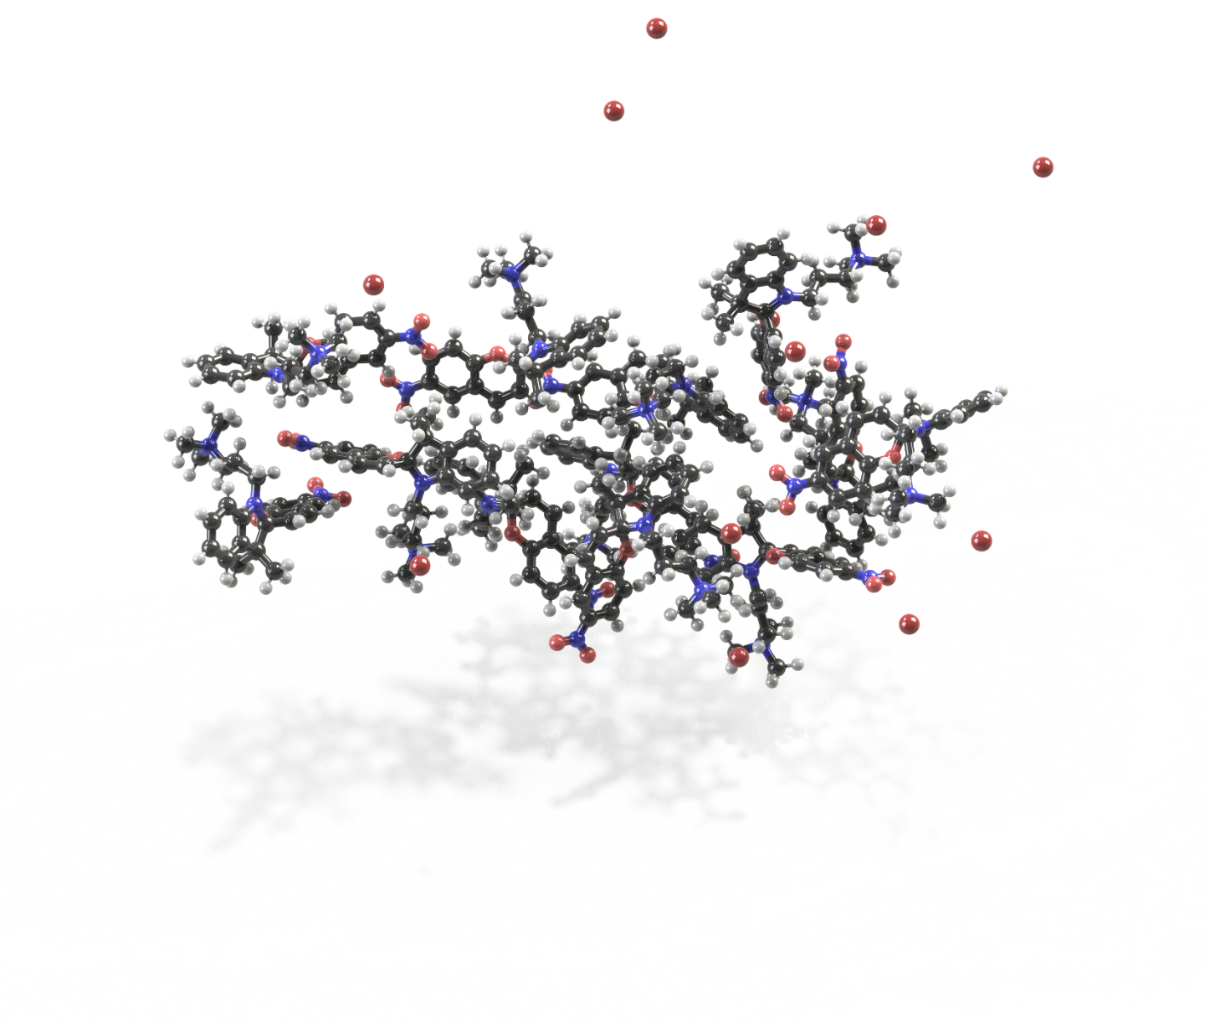
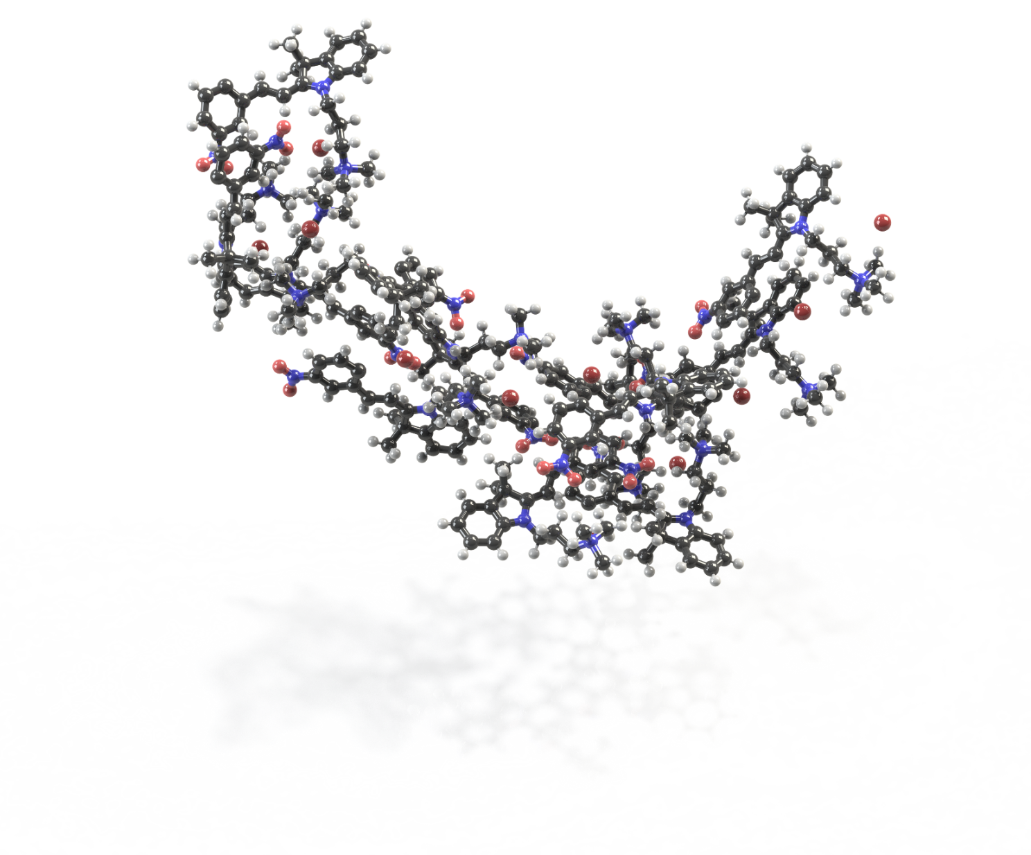
Simulation results. P values. Assemblies in water (C=0.4mM)
Connolly occupied volume of 5201.3 Å³ and the surface area of 4238.0 Å²
SP MC
Connolly occupied volume of 5621.3 Å³ and the surface area of 4066.4 Å²
SP P=0.95 MC P=0.97
Both SP and MC are prone to form lamellar structures or bilayer vesicles
P is Israelachvili’s critical packing parameter. SASA values are used to define v and a₀

Slide 21
Conclusions
MC isomer is spontaneously appearing in water. Simulations explain that it is more stable in water, has larger dipole moment, the free energy of hydration is noticeably lower as compared to SP.
Experiments show the isomerization from SP to MC in water without UV stimulus. UV converts SP to MC as well, blue light transforms MC to SP.
Calculated optical spectra for MC in water coincide with experimental data. Spectrum for SP reproduces only a band at shorter wavelength.
Israelachvili’s packing parameter predicts lamellar ordering in the solutions above CMC. MD simulations of 0.4 mM solution show the formation of the elongated layers.
UV
blue

Slide 22
Acknowledgements
for financial support GU1510/5-1
for computational resources
for informational support

