Slide 1
Bridging Virtual and Real: Testing Design of Experiment Procedures with Simulated and Experimental Data
Agnieszka Królicka, Anna Szczurkowska
Department of Building Materials Technology, Faculty of Materials Science and Ceramics
Akademia Górniczo-Hutnicza im. Stanisława Staszica w Krakowie
AGH University of Kraków

Slide 2
Outline
Comparison of Central Composite Design (CCD) and Box-Behnken Design (BBD) using data provided by virtual determination of indium employing ICP-MS TuneSim software
Response surface profiles
Predictions versus experimental data
Optimal parameters
Application of CCD for optimization of real-life experiments
Optimization of plating process of bismuth film electrode used for voltammetric determination of germanium
Extraction of Ginkgo biloba to maximise the antioxidant properties of the resultant infusion

Slide 3
IC – MS
Optimization of ICP torch position – Virtual experiments employing IC-MS TuneSim software

Slide 4
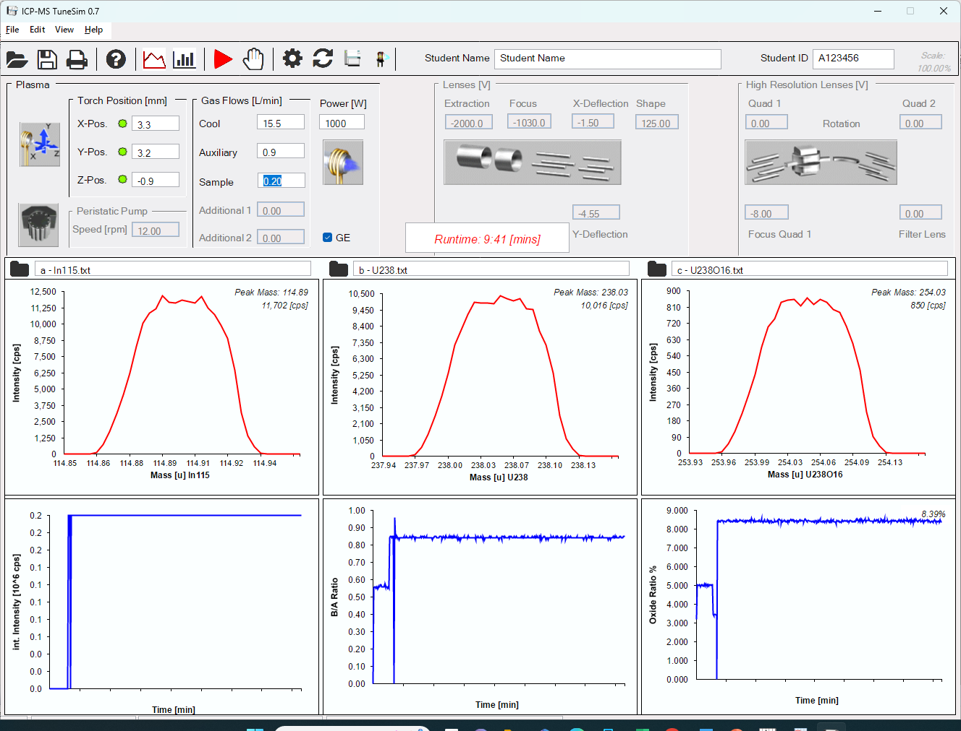
ICP-MS TuneSim software
Torch position
X – from -4.5 to 4.5 mm
Y – from -4.5 to 4.5 mm
Z – from -2.5 to 2.5 mm
Analyte – ¹¹⁵In
J. Chem. Educ. 2018, 95, 11, 2059–2063

Slide 5
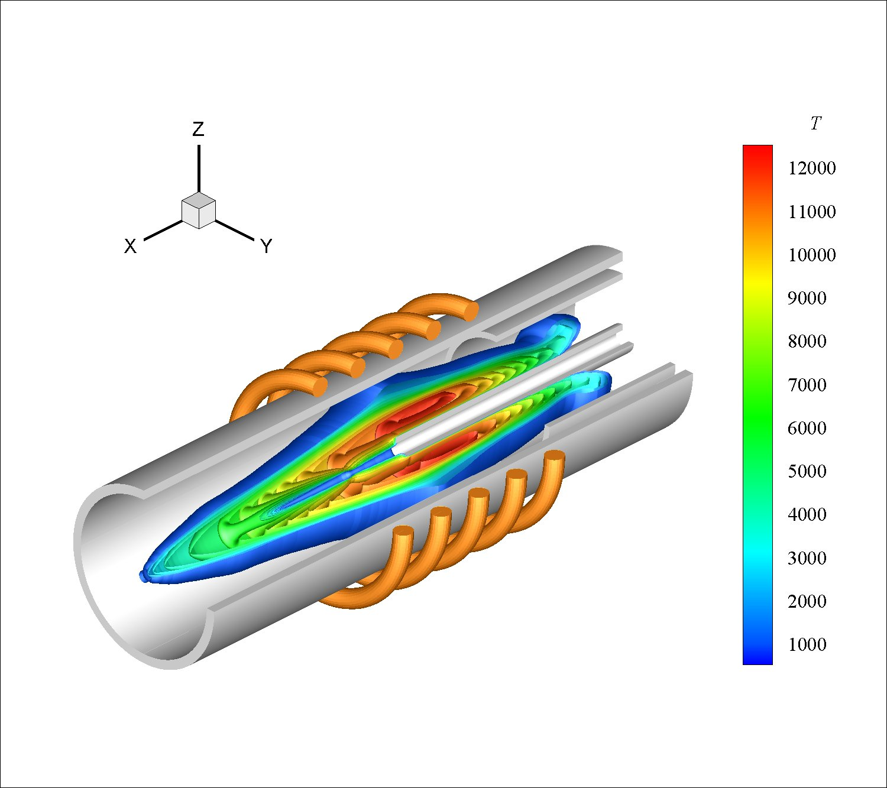
Torch position
ICP – MS
torch
Coded
-1.68
-1
0
1
1.68
Uncoded
1.12
1.8
2.8
3.8
4.48
(mm)
x, y
Coded
-1.68
-1
0
1
1.68
Uncoded
-0.88
-0.2
0.8
1.8
2.48
(mm)
z
- star points
$$α=2^{k/4}$$
For 3 factors (x,y,z): α ≈ 1.68
https://twitter.com/Tecplot/status/1063532269481144321

Slide 6
Box-Behnken Design
BBD

Slide 7
Box-Behnken Design BBD 1
X (mm) | 3.2
Y (mm) | 3.0
Z (mm) | 0.3
Intensity (cps) predicted | 10463±346
Intensity (cps) measured | 10417±43
z = 0.3 mm

Slide 8
BBD 1
Design | X (mm) | Y (mm) | Z (mm) | Intensity (cps)
1 | 1.8 | 1.8 | 0.8 | 4912.00
11 | 2.8 | 1.8 | 1.8 | 5763.00
13 | 2.8 | 2.8 | 0.8 | 10372.00
6 | 3.8 | 2.8 | -0.2 | 9480.00
5 | 1.8 | 2.8 | -0.2 | 6550.00
15 | 2.8 | 2.8 | 0.8 | 9864.00
3 | 1.8 | 3.8 | 0.8 | 5148.00
2 | 3.8 | 1.8 | 0.8 | 6435.00
17 | 2.8 | 2.8 | 0.8 | 9835.00
14 | 2.8 | 2.8 | 0.8 | 9769.00
12 | 2.8 | 3.8 | 1.8 | 7115.00
8 | 3.8 | 2.8 | 1.8 | 7729.00
10 | 2.8 | 3.8 | -0.2 | 9265.00
16 | 2.8 | 2.8 | 0.8 | 9906.00
9 | 2.8 | 1.8 | -0.2 | 7465.00
7 | 1.8 | 2.8 | 1.8 | 5191.00
18 | 2.8 | 2.8 | 0.8 | 9746.00
4 | 3.8 | 3.8 | 0.8 | 8806.00
N = 2k(k+1) + N₀

Slide 9
Box-Behnken Design BBD 2
X (mm) | 3.2
Y (mm) | 3.0
Z (mm) | 0.1
Intensity (cps) predicted | 10496±3472
Intensity (cps) measured | 10506±65
z = 0.1 mm

Slide 10
BBD 2
Design | X (mm) | Y (mm) | Z (mm) | Intensity (cps)
17 | 2.8 | 2.8 | 0.8 | 9767.00
11 | 2.8 | 1.8 | 1.8 | 5746.00
2 | 3.8 | 1.8 | 0.8 | 6496.00
15 | 2.8 | 2.8 | 0.8 | 9800.00
1 | 1.8 | 1.8 | 0.8 | 4873.00
13 | 2.8 | 2.8 | 0.8 | 9941.00
4 | 3.8 | 3.8 | 0.8 | 8814.00
8 | 3.8 | 2.8 | 1.8 | 7780.00
16 | 2.8 | 2.8 | 0.8 | 9877.00
3 | 1.8 | 3.8 | 0.8 | 5121.00
10 | 2.8 | 3.8 | -0.2 | 9244.00
14 | 2.8 | 2.8 | 0.8 | 9847.00
18 | 2.8 | 2.8 | 0.8 | 9667.00
6 | 3.8 | 2.8 | -0.2 | 9984.00
7 | 1.8 | 2.8 | 1.8 | 5215.00
5 | 1.8 | 2.8 | -0.2 | 6671.00
12 | 2.8 | 3.8 | 1.8 | 7111.00
9 | 2.8 | 1.8 | -0.2 | 7419.00

Slide 11
Box-Behnken Design BBD 3
X (mm) | 3.2
Y (mm) | 3.0
Z (mm) | 0.2
Intensity (cps) predicted | 10458±354
Intensity (cps) measured | 10432±54
z = 0.2 mm

Slide 12
BBD 3
Design | X (mm) | Y (mm) | Z (mm) | Intensity (cps)
6 | 3.8 | 2.8 | -0.2 | 9909
5 | 1.8 | 2.8 | -0.2 | 6664
10 | 2.8 | 3.8 | -0.2 | 9264
2 | 3.8 | 1.8 | 0.8 | 6449
13 | 2.8 | 2.8 | 0.8 | 9795
7 | 1.8 | 2.8 | 1.8 | 5200
8 | 3.8 | 2.8 | 1.8 | 7666
3 | 1.8 | 3.8 | 0.8 | 5192
11 | 2.8 | 1.8 | 1.8 | 5700
12 | 2.8 | 3.8 | 1.8 | 7192
14 | 2.8 | 2.8 | 0.8 | 9830
15 | 2.8 | 2.8 | 0.8 | 9831
4 | 3.8 | 3.8 | 0.8 | 8729
1 | 1.8 | 1.8 | 0.8 | 5101
17 | 2.8 | 2.8 | 0.8 | 9882
18 | 2.8 | 2.8 | 0.8 | 9916
16 | 2.8 | 2.8 | 0.8 | 9721
9 | 2.8 | 1.8 | -0.2 | 7414

Slide 13
Box-Behnken Design BBD 1 - incorrect data
Poor correlation
X (mm) | 2.9
Y (mm) | 3.4
Z (mm) | 0.9
Intensity (cps) predicted | 10162
z = 0.9 mm

Slide 14
BBD 1 – with incorrect data
Design | X (mm) | Y (mm) | Z (mm) | Intensity (cps)
1 | 1.8 | 1.8 | 0.8 | 4912.00
11 | 2.8 | 1.8 | 1.8 | 5763.00
13 | 2.8 | 2.8 | 0.8 | 10372.00
6 | 3.8 | 2.8 | -0.2 | 948.00
5 | 1.8 | 2.8 | -0.2 | 6550.00
15 | 2.8 | 2.8 | 0.8 | 9864.00
3 | 1.8 | 3.8 | 0.8 | 5148.00
2 | 3.8 | 1.8 | 0.8 | 6435.00
17 | 2.8 | 2.8 | 0.8 | 9835.00
14 | 2.8 | 2.8 | 0.8 | 9769.00
12 | 2.8 | 3.8 | 1.8 | 7115.00
8 | 3.8 | 2.8 | 1.8 | 7729.00
10 | 2.8 | 3.8 | -0.2 | 9265.00
16 | 2.8 | 2.8 | 0.8 | 9906.00
9 | 2.8 | 1.8 | -0.2 | 7465.00
7 | 1.8 | 2.8 | 1.8 | 5191.00
18 | 2.8 | 2.8 | 0.8 | 9746.00
4 | 3.8 | 3.8 | 0.8 | 8806.00
incorrect

Slide 15
Central Composite Design

Slide 16
Central Composite Design CCD - centred star points
X (mm) | 3.3
Y (mm) | 3.1
Z (mm) | -0.9
Intensity (cps) predicted | 10837±1160
Intensity (cps) measured | 11877±65
z = -0.9 mm

Slide 17
CCD - centred star points
Design | X (mm) | Y (mm) | Z (mm) | Intensity (cps)
3 | 1.8 | 3.8 | -0.2 | 5529
17 (C) | 2.8 | 2.8 | 0.8 | 9920
14 | 2.8 | 2.8 | 1.8 | 8075
10 | 3.8 | 2.8 | 0.8 | 9261
16 (C) | 2.8 | 2.8 | 0.8 | 9785
11 | 2.8 | 1.8 | 0.8 | 7042
6 | 3.8 | 1.8 | 1.8 | 5232
1 | 1.8 | 1.8 | -0.2 | 5137
7 | 3.8 | 3.8 | -0.2 | 9288
9 | 1.8 | 2.8 | 0.8 | 6301
2 | 1.8 | 1.8 | 1.8 | 4067
13 | 2.8 | 2.8 | -0.2 | 10486
12 | 2.8 | 3.8 | 0.8 | 8607
4 | 1.8 | 3.8 | 1.8 | 4260
18 (C) | 2.8 | 2.8 | 0.8 | 9952
15 (C) | 2.8 | 2.8 | 0.8 | 9691
8 | 3.8 | 3.8 | 1.8 | 7167
5 | 3.8 | 1.8 | -0.2 | 6904
19 (C) | 2.8 | 2.8 | 0.8 | 9804

Slide 18
Central Composite Design CCD
X (mm) | 3.3
Y (mm) | 3.2
Z (mm) | -0.9
Intensity (cps) predicted | 11043±1098
Intensity (cps) measured | 11879±69
z = - 0.9 mm

Slide 19
CCD
Design | X (mm) | Y (mm) | Z (mm) | Intensity (cps)
13 | 2.8 | 2.8 | -0.9 | 11455
5 | 3.8 | 1.8 | -0.2 | 6673
11 | 2.8 | 1.1 | 0.8 | 4249
9 | 1.1 | 2.8 | 0.8 | 3516
1 | 1.8 | 1.8 | -0.2 | 5148
12 | 2.8 | 4.5 | 0.8 | 7120
8 | 3.8 | 3.8 | 1.8 | 7135
15 (C) | 2.8 | 2.8 | 0.8 | 9926
3 | 1.8 | 3.8 | -0.2 | 5524
19 (C) | 2.8 | 2.8 | 0.8 | 9833
18 (C) | 2.8 | 2.8 | 0.8 | 9644
17 (C) | 2.8 | 2.8 | 0.8 | 9703
7 | 3.8 | 3.8 | -0.2 | 9365
2 | 1.8 | 1.8 | 1.8 | 4032
14 | 2.8 | 2.8 | 2.5 | 7132
16 (C) | 2.8 | 2.8 | 0.8 | 9801
6 | 3.8 | 1.8 | 1.8 | 5311
10 | 4.5 | 2.8 | 0.8 | 7627
4 | 1.8 | 3.8 | 1.8 | 4262
z
y
x
y
z
x
N = 2^{k} + 2k + N₀

Slide 20
BBD versus CCD optimization of torch position
virtual determination of In by ICP-MS
Intensity of indium signal obtained after optimisation performed by BBD and CCD

Slide 21
Bismuth plating
Preparation of bismuth film electrode for catalytic adsorptive stripping voltammetry – real experiments

Slide 22
Central Composite Design CCD - centred star points
E_{plat} (V) | -1.156
Q (mC) | 42.8
C (mM) | 16.7
Peak current (µA) predicted | 5.42±0.48
c_{Bi} = 16.7 mM

Slide 23
CCD BiFE
Design | E_{plat} (V) | Q (mC) | C (mM) | Peak current (µA)
1 | -0.9 | 10.0 | 13.0 | 3.80
2 | -0.9 | 10.0 | 43.0 | 2.70
3 | -0.9 | 50.0 | 13.0 | 4.70
4 | -0.9 | 50.0 | 43.0 | 6.00
5 | -1.5 | 10.0 | 13.0 | 4.10
6 | -1.5 | 10.0 | 43.0 | 5.00
7 | -1.5 | 50.0 | 13.0 | 4.70
8 | -1.5 | 50.0 | 43.0 | 5.80
9 | -0.9 | 30.0 | 28.0 | 4.40
10 | -1.5 | 30.0 | 28.0 | 5.10
11 | -1.2 | 10.0 | 28.0 | 4.00
12 | -1.2 | 50.0 | 28.0 | 5.30
13 | -1.2 | 30.0 | 13.0 | 5.30
14 | -1.2 | 30.0 | 43.0 | 5.30
15 (C) | -1.2 | 30.0 | 28.0 | 5.00
16 (C) | -1.2 | 30.0 | 28.0 | 4.95

Slide 24
Extraction of antioxidants from herbs
Optimisation of temperature and time for Ginkgo biloba infusions – real experiments

Slide 25
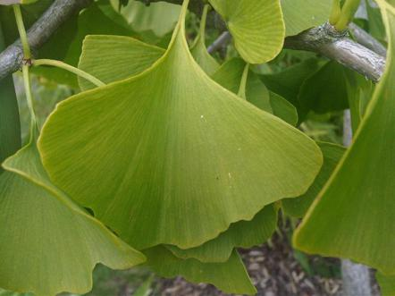
Voltammetry of Ginkgo biloba infusions
0.15 g/ 50 g water
75°C, 11.7 min
(point 8th of design table)
0.15 M acetic acid, GC 3 mm,
E_{acc} = 0 V, t = 5 s, 0.1 V/s (CV), ΔE = 50 mV (DPV)

Slide 26
Central Composite Design CCD
Design | Temperature (°C) | Time (min) | Peak current (µA)
5 | 53.8 | 6.0 | 0.11
13 (C) | 75.0 | 6.0 | 0.21
2 | 60.0 | 10.0 | 0.18
6 | 96.2 | 6.0 | 0.19
8 | 75.0 | 11.7 | 0.26
4 | 90.0 | 10.0 | 0.26
3 | 90.0 | 2.0 | 0.15
10 (C) | 75.0 | 6.0 | 0.15
7 | 75.0 | 0.3 | 0.05
9 (C) | 75.0 | 6.0 | 0.20
12 (C) | 75.0 | 6.0 | 0.21
1 | 60.0 | 2.0 | 0.11
11 (C) | 75.0 | 6.0 | 0.21
Temperature (°C) | 98.5
Time (min) | 16.5

Slide 27
Conclusions
Virtual experiments using the ICP-MS TuneSim software yield useful results that can be used as test data to assess the applicability of various design of experiments (DOE) procedures and DOE software.
The central composite design (CCD) provided superior results compared to the Box-Behnken design (BBD), without a significant increase in the number of measurements
For 3 factors + 3 additional central points: 19 for CCD vs. 18 for BBD.
The expertise in DOE acquired during virtual experiments can be successfully implemented in real-life experiments in the field of analytical chemistry.

Slide 28
Thank you for your attention!

