Slide 1
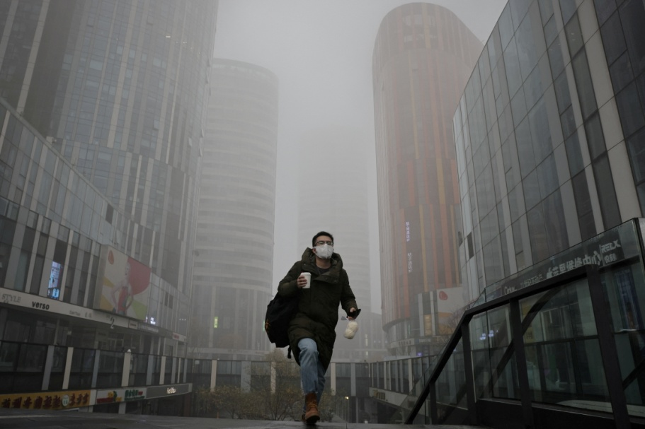
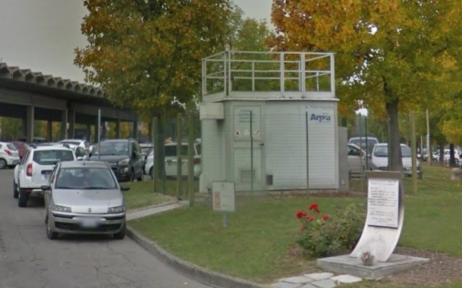
Air quality monitoring in a near-city industrial zone by low-cost sensor technologies: a case study
The issue:
Several studies have demonstrated the existence of a direct link between exposure to air pollutants and issues concerning the public health
Air pollution levels are monitored by the equipment of governmental agencies, but they are characterized by high costs due to their purchasing, maintenance, and logistical issues
ENEA-Italian National Agency for New Technologies, Energy and Sustainable Economic Development
Laboratory Functional Materials and Technologies for Sustainable Applications
Brindisi Research Centre

Slide 2
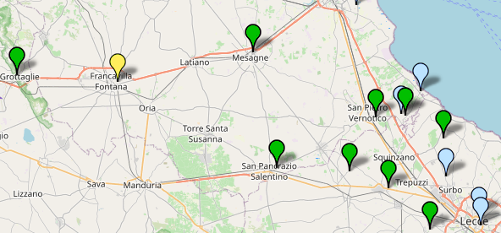
Air quality monitoring in a near-city industrial zone by low-cost sensor technologies: a case study
The consequence:
few monitoring points are deployed on the territory, causing the impossibility to build air pollutant maps having an adequate spatio-temporal resolution

Slide 3
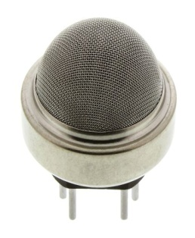
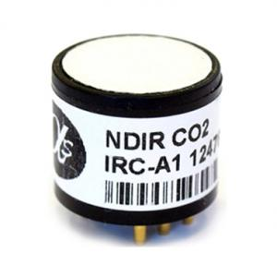
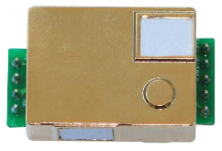
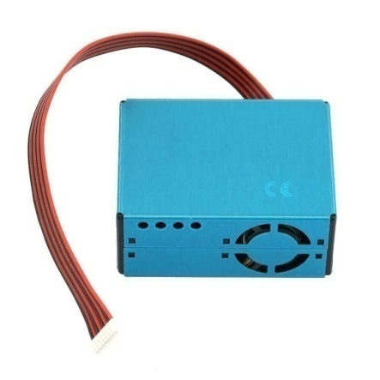
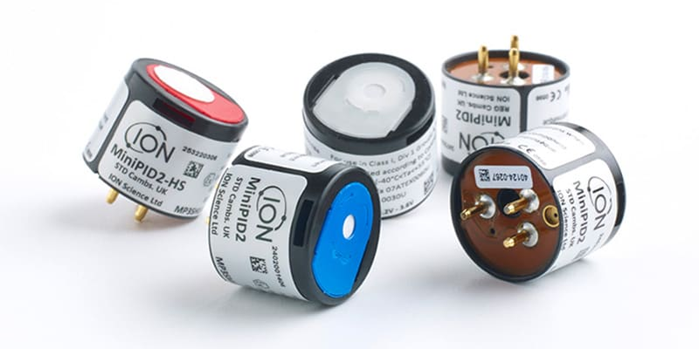
Air quality monitoring in a near-city industrial zone by low-cost sensor technologies: a case study
The potential solution:
Low-cost miniaturized gas sensors (LCSs) and Low-cost air quality Monitors (LCMs) based on LCSs
chemoresistive
Non Dispersive Infrared Radiation (NDIR)
Optical sensors (Laser beam)
Photo Ionization Detection (PID)
Electrochemical cells

Slide 4
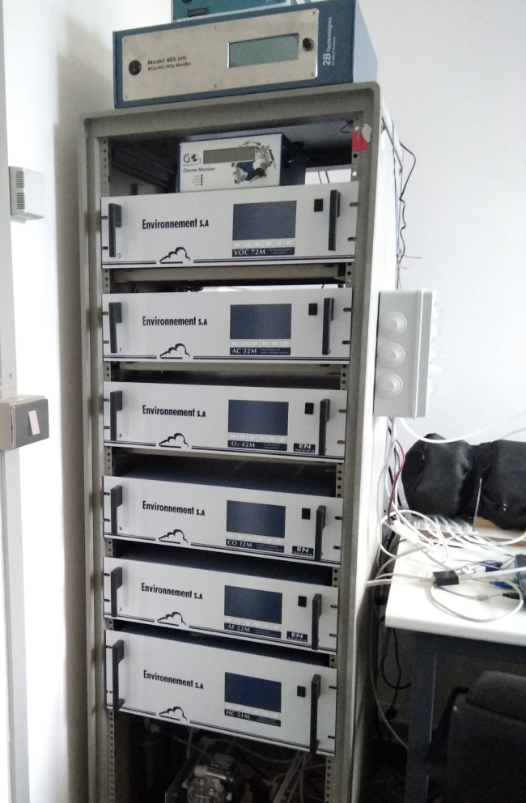
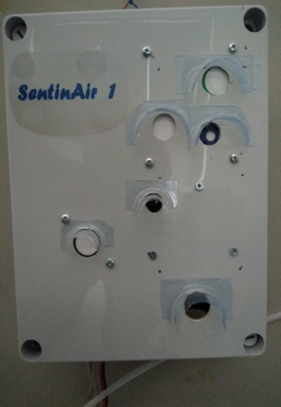
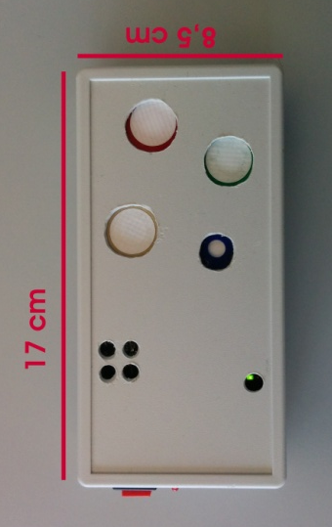
Air quality monitoring in a near-city industrial zone by low-cost sensor technologies: a case study
The potential solution: obstacles to overcome
Regulatory-grade equipment (of governmental agencies for air pollutant concentration measurements) VS Low-cost air quality monitors (LCMs)
LCSs or LCMs
PROS
Very cheap
Miniaturized
Low power consumption
User-friendly
CONS
Less accurate than regulatory-grade equipment
Regulatory-grade equipment
PROS
Very accurate
CONS
bulky
expensive
Power demanding
NOT user-friendly
28 cm
20 cm
!!!!!

Slide 5
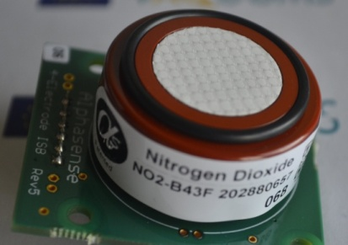
Air quality monitoring in a near-city industrial zone by low-cost sensor technologies: a case study
The present study and the tools used
(the low-cost technology)
28 cm
20 cm
NO2B43F
Low-cost gas sensor (electrochemical cell) for NO₂ concentration measurements
PMS5003
Low-cost optical sensor (Laser beam scatering) for PM_{2.5} PM₁₀ PM₁ concentration measurements
SentinAir
Low-cost air quality monitor (LCM)
ENEA-Italian National Agency for New Technologies, Energy and Sustainable Economic Development
Laboratory Functional Materials and Technologies for Sustainable Applications
Brindisi Research Centre

Slide 6
Air quality monitoring in a near-city industrial zone by low-cost sensor technologies: a case study
The present study and the tools used
(the reference instrumentation)
Nox 405 nm by 2Btech as reference for NO₂ concentration measurements
APM-2 by Comde-Derenda as reference for PM₁₀ and PM_{2.5}

Slide 7
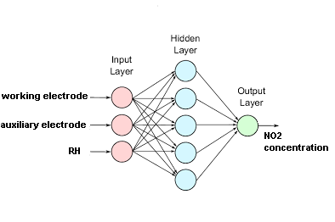
Air quality monitoring in a near-city industrial zone by low-cost sensor technologies: a case study
The methodology of the present study (1/2)
Measurement of the real NO₂ , PM₁₀ , and PM_{2.5} concentrations by reference instruments along with the relative humidity (RH)
Measurement of the NO2B43F output voltage levels and reading of PMS5003 sensor outputs
Building of the dataset made of reference measurements and sensor readings
Splitting of the dataset in two parts: the training dataset for sensor calibration, and the dataset validation for validating the calibration model/algorithm
For NO₂ monitoring:
Training of the MultiLayer Perceptron (MLP)
Validation of MLP
For PM₁₀ , and PM_{2.5} monitoring:
Data collection of sensor raw concentration measurements
Correction of raw measurements through the calibration of sensors by a Multivariate Linear Regression (MLR) algorithm
Validation of the MLP

Slide 8
Air quality monitoring in a near-city industrial zone by low-cost sensor technologies: a case study
The methodology of the present study (2/2)
Computation of the coefficient of determination (R²), Mean Absolute Error (MAE), and Root Mean Squared Error (RMSE) as performance indicators
(r_{i} represents the i_{th} measurement of the reference, s_{i} is the i_{th} concentration value given by the sensor, N is the number of observations, represents the average of the sensor concentration measurements, and is the average of the reference measurements)
For NO₂ monitoring:
Evaluation of the MLP training by R² , MAE, RMSE
Validation of MLP model by R² , MAE, RMSE
For PM₁₀ , and PM_{2.5} monitoring:
Evaluation of sensor raw concentration measurements by R² , MAE, RMSE
Evaluation of the MLR calibration by R² , MAE, RMSE
Validation of the MLR model by R² , MAE, RMSE

Slide 9
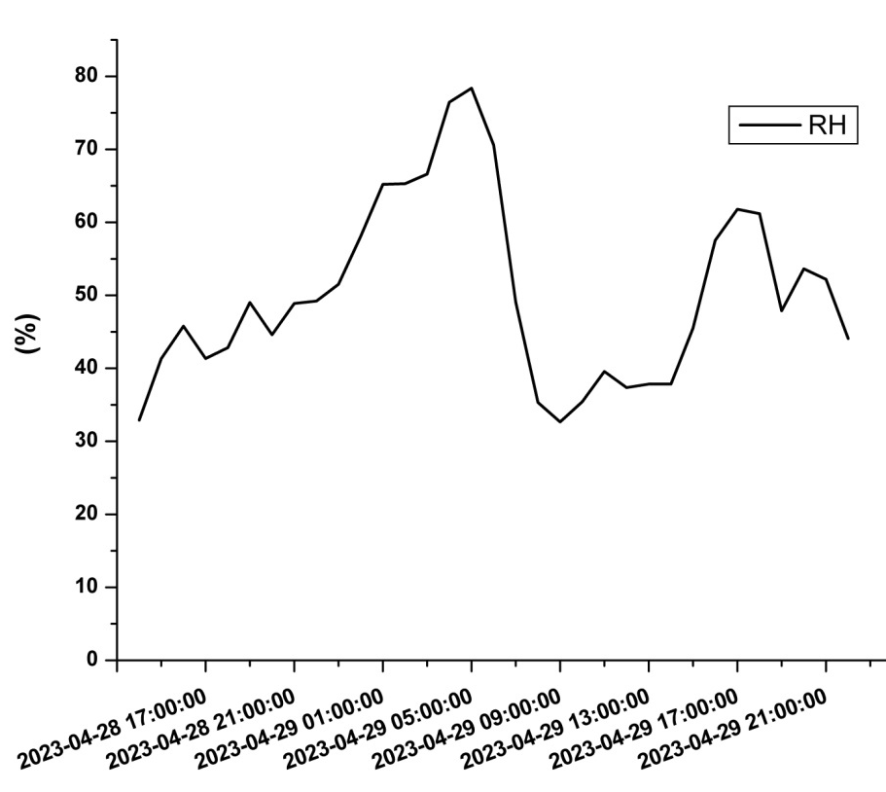
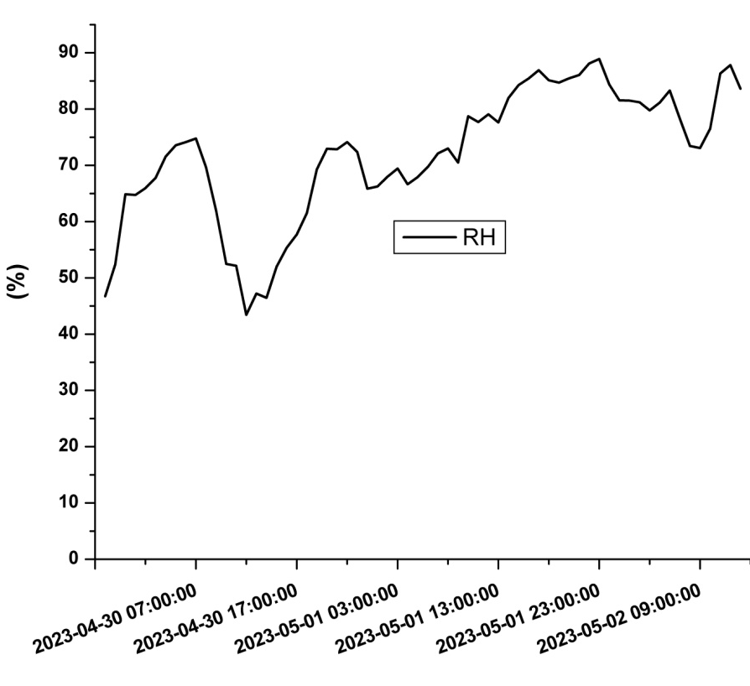
Air quality monitoring in a near-city industrial zone by low-cost sensor technologies: a case study
The results
NO₂ monitoring: the RH trends
 | Calibration period |  |  | Validation period
 | Min | Max | Median | Min | Max | Median
NO₂ [ppb] | 3.3 | 20.6 | 10.4 | 2.8 | 20.9 | 6.3
T [°C] | 12 | 26 | 20 | 13 | 26 | 17
RH[%] | 32 | 78 | 49 | 43 | 88 | 73
Training or calibration period
Validation period

Slide 10
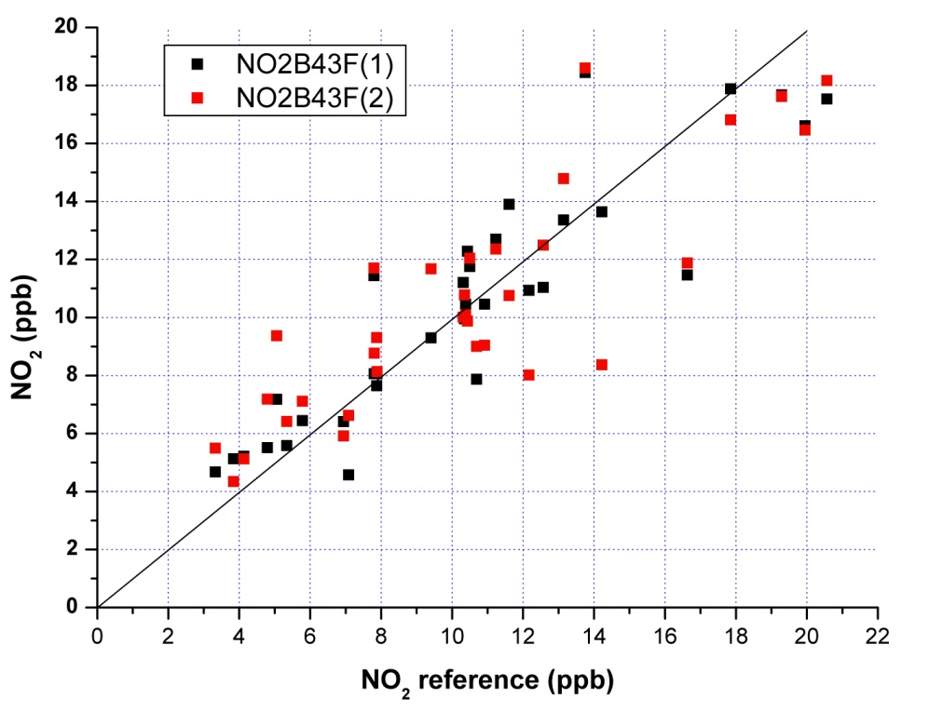
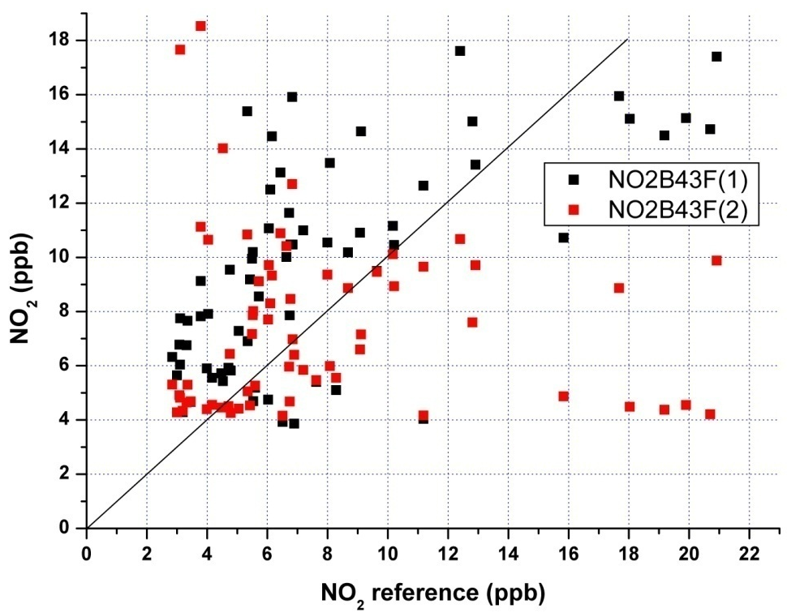
Air quality monitoring in a near-city industrial zone by low-cost sensor technologies: a case study
The results
NO₂ monitoring: the coefficient of determination (R² )
Training or calibration period
NO2B43F(1): R² = 0.818
NO2B43F(2): R² = 0.727
Validation period
NO2B43F(1): R² = 0.439
NO2B43F(2): R² = 0.005

Slide 11
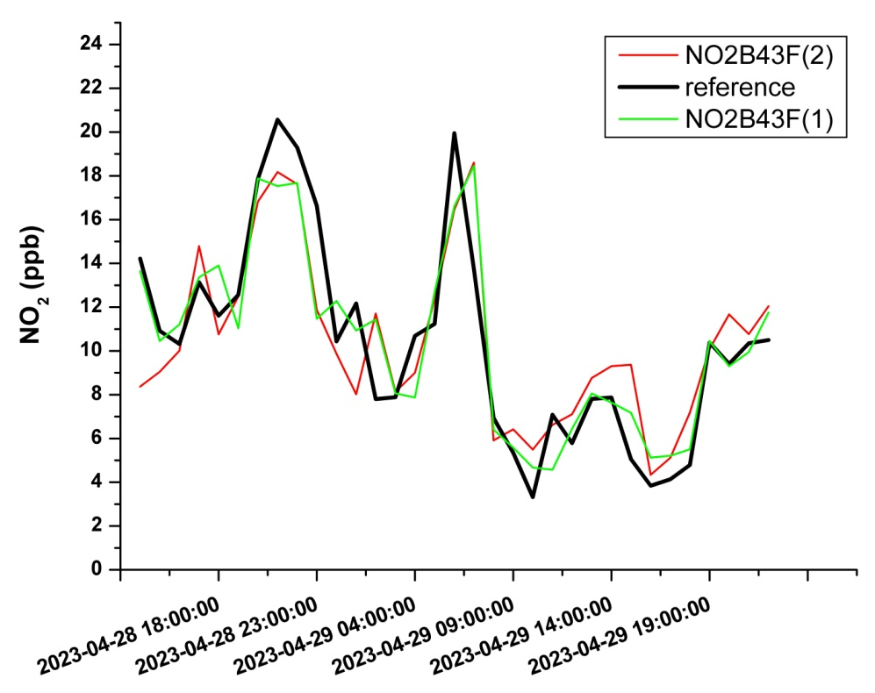
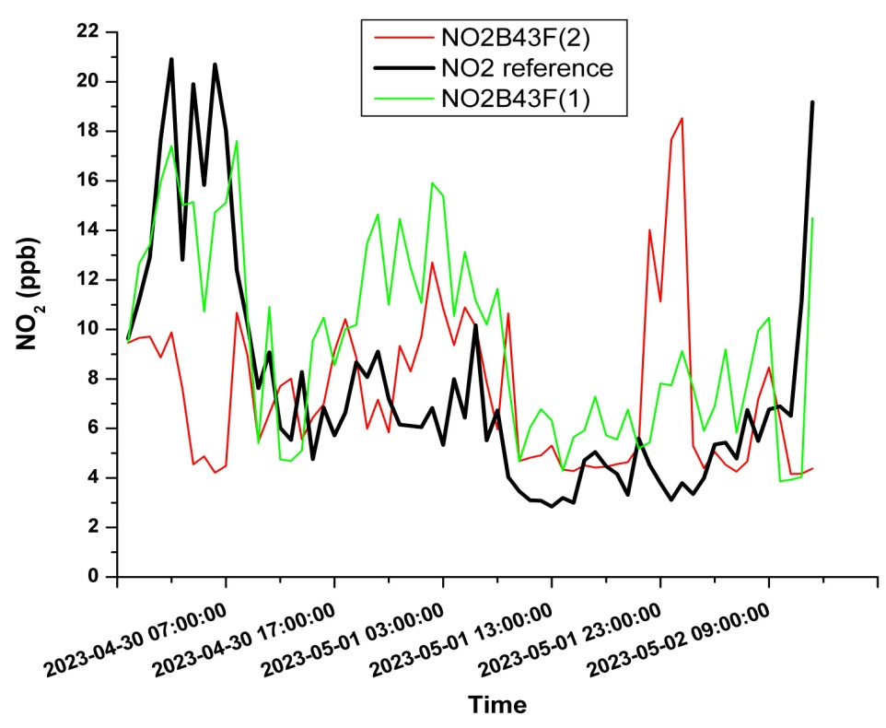
Air quality monitoring in a near-city industrial zone by low-cost sensor technologies: a case study
The results
NO₂ monitoring: the MAE and the RMSE
Training or calibration period
NO2B43F(1): MAE = 1.4 ppb; RMSE = 2.0 ppb
NO2B43F(2): MAE = 1.9 ppb; RMSE = 2.4 ppb
Validation period
NO2B43F(1): MAE = 3.4 ppb; RMSE = 3.6 ppb
NO2B43F(2): MAE = 3.8 ppb; RMSE = 5.9 ppb

Slide 12
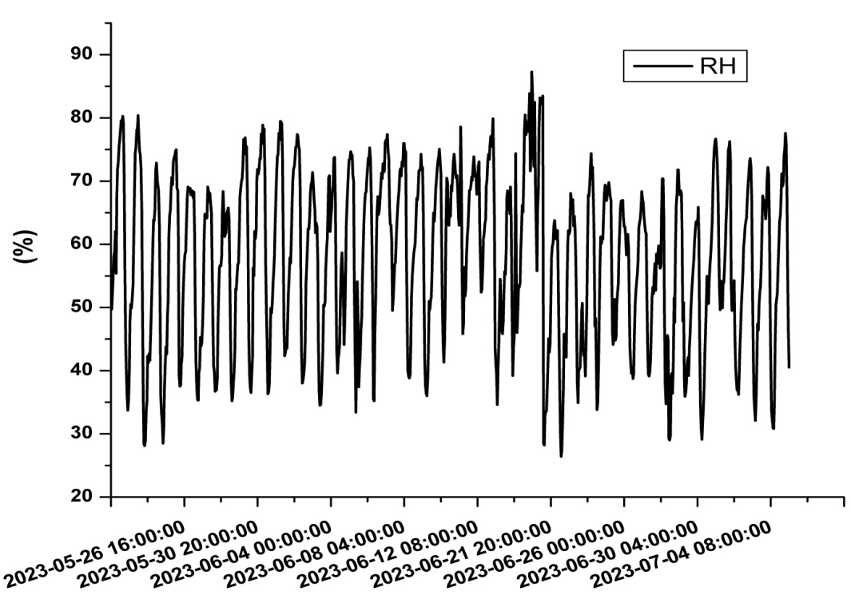
Air quality monitoring in a near-city industrial zone by low-cost sensor technologies: a case study
The results
 | Min | Max | Median
PM_{2.5} [µg/m³] | 0.3 | 43.8 | 9.0
PM₁₀ [µg/m³] | 4.6 | 94.9 | 22.8
T [°C] | 17 | 38 | 25
RH[%] | 26 | 88 | 60
PM monitoring: the RH trend
The RH trend over all the period of PM observations

Slide 13
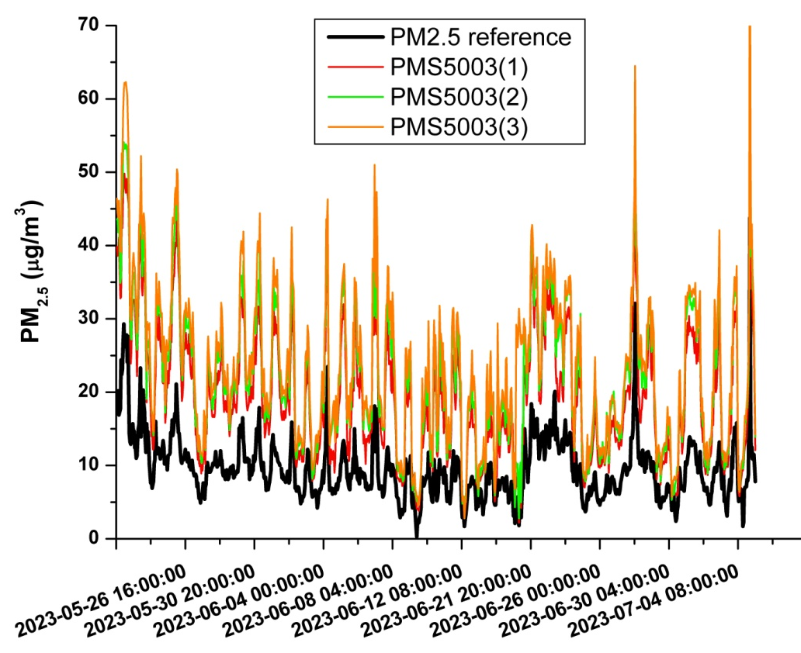
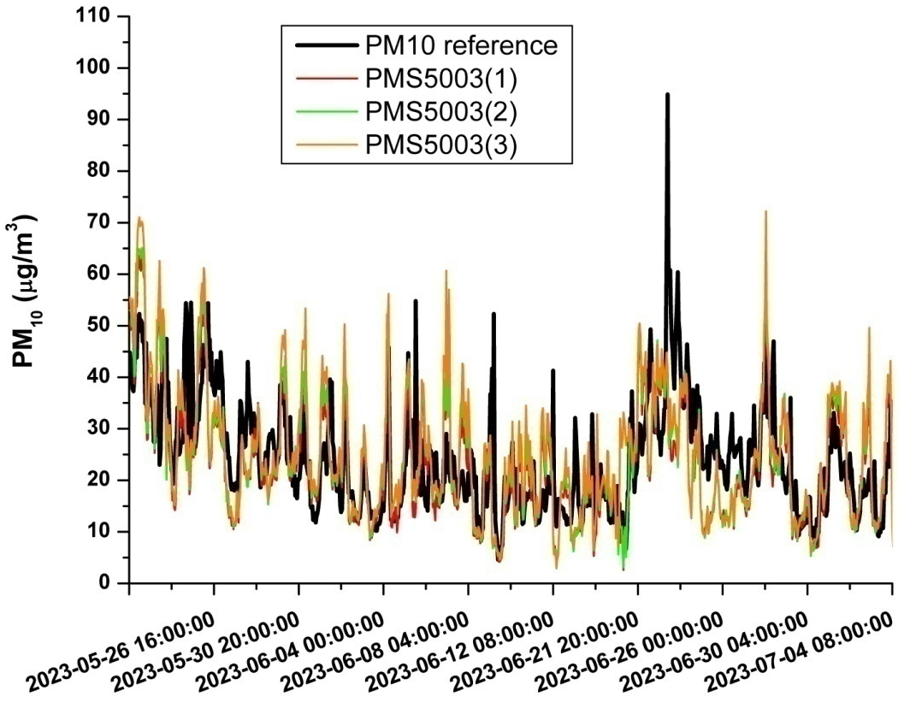
Air quality monitoring in a near-city industrial zone by low-cost sensor technologies: a case study
The results
PM monitoring: MAE and RMSE of the raw (or uncorrected) measurements
 |  | MAE[µg/m³] | RMSE[µg/m³]
PMS5003(1) | PM₁₀ | 7.9 | 9.6
PMS5003(2) |  | 7.5 | 10.0
PMS5003(3) |  | 8.3 | 10.8
PMS5003(1) | PM_{2.5} | 9.9 | 11.3
PMS5003(2) |  | 12.5 | 14.0
PMS5003(3) |  | 14.2 | 15.8

Slide 14
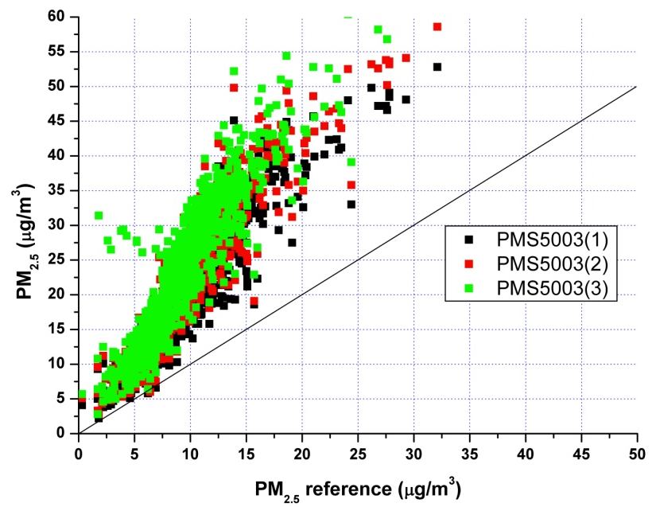
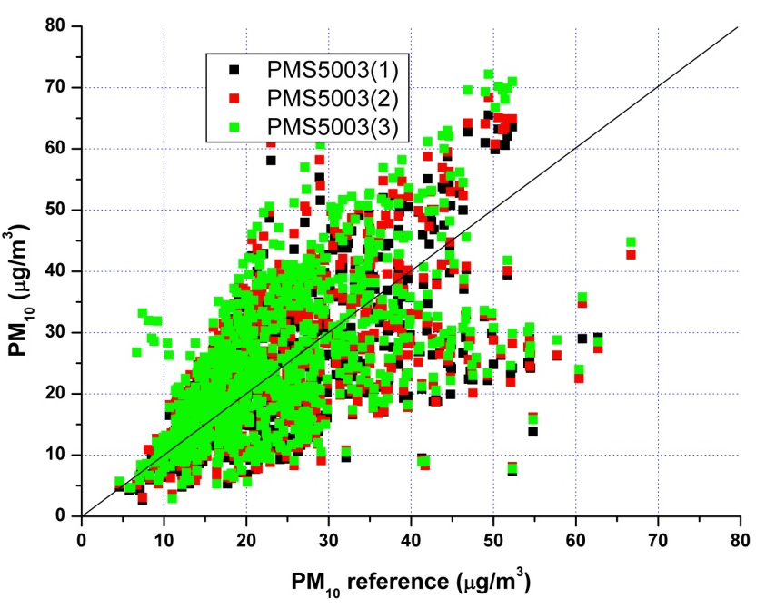
Air quality monitoring in a near-city industrial zone by low-cost sensor technologies: a case study
The results
PM monitoring: R² of the raw (or uncorrected) measurements
 |  | R²
PMS5003(1) | PM₁₀ | 0.411
PMS5003(2) |  | 0.391
PMS5003(3) |  | 0.359
PMS5003(1) | PM_{2.5} | 0.859
PMS5003(2) |  | 0.854
PMS5003(3) |  | 0.835

Slide 15
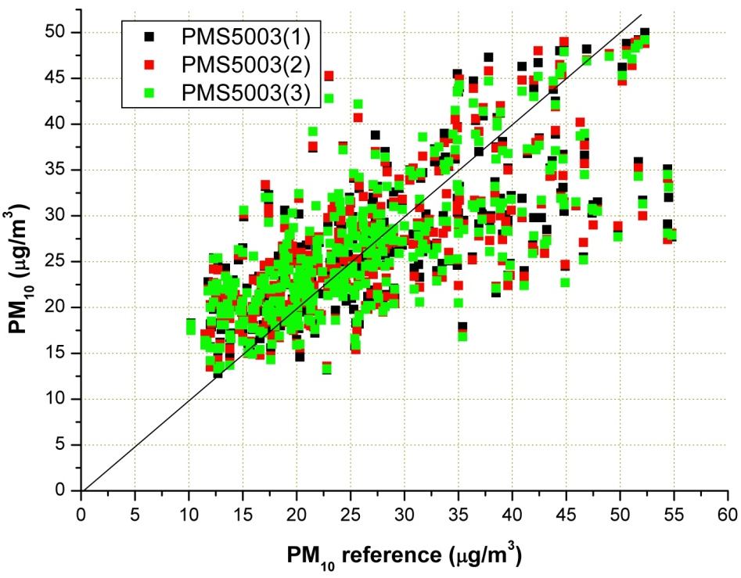
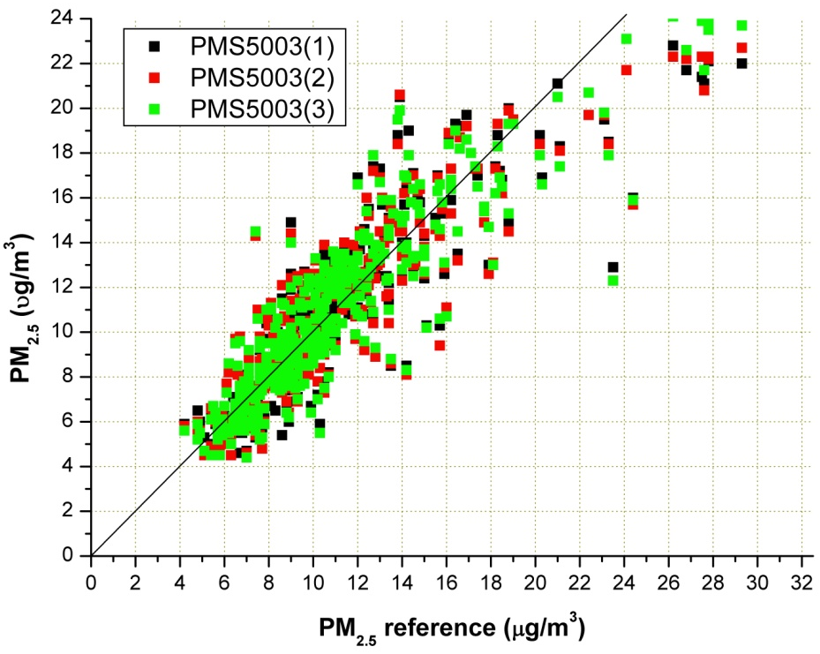
Air quality monitoring in a near-city industrial zone by low-cost sensor technologies: a case study
The results
PM monitoring: improving measurements by taking into account the humidity effect
The MLR calibration model
R² values related to the calibration period
Sensor | Pollutant | β₁ | β₂ | β₃
PMS5003(1) | PM₁₀ | 0.788 | -0.331 | 25.2
PMS5003(2) |  | 0.761 | -0.343 | 25.6
PMS5003(3) |  | 0.689 | -0.348 | 26.8
PMS5003(1) | PM_{2.5} | 0.472 | -0.053 | 3.3
PMS5003(2) |  | 0.446 | -0.058 | 2.9
PMS5003(3) |  | 0.409 | -0.063 | 3.4
PMS5003(1) |  | 0.567
PMS5003(2) | PM₁₀ | 0.541
PMS5003(3) |  | 0.533
PMS5003(1) |  | 0.843
PMS5003(2) | PM_{2.5} | 0.834
PMS5003(3) |  | 0.863

Slide 16
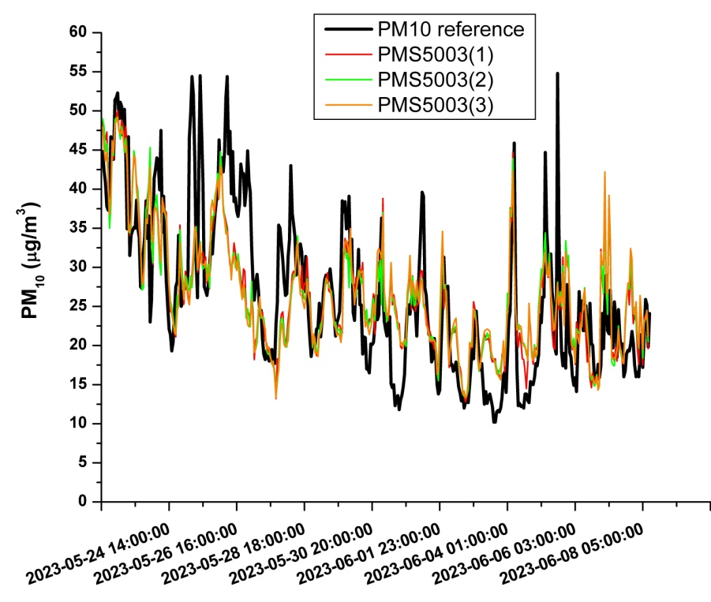
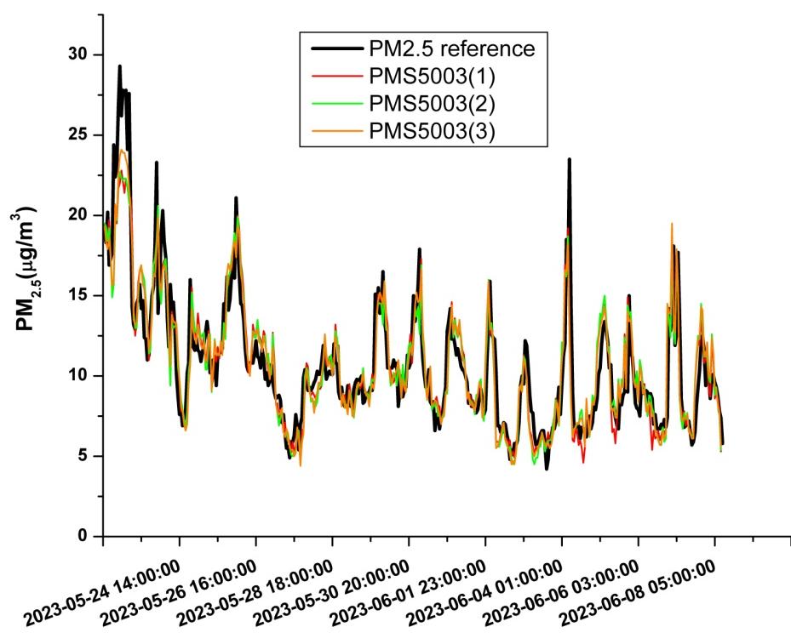
Air quality monitoring in a near-city industrial zone by low-cost sensor technologies: a case study
The results
PM monitoring: improving measurements by taking into account the humidity effect (the MAE and the RMSE in the calibration period)
 |  | MAE[µg/m³] | RMSE[µg/m³]
PMS5003(1) |  | 4.9 | 6.8
PMS5003(2) | PM₁₀ | 5.1 | 6.9
PMS5003(3) |  | 5.2 | 7.0
PMS5003(1) |  | 1.2 | 1.7
PMS5003(2) | PM_{2.5} | 1.2 | 1.7
PMS5003(3) |  | 1.0 | 1.5
Time series plots related to the calibration period

Slide 17
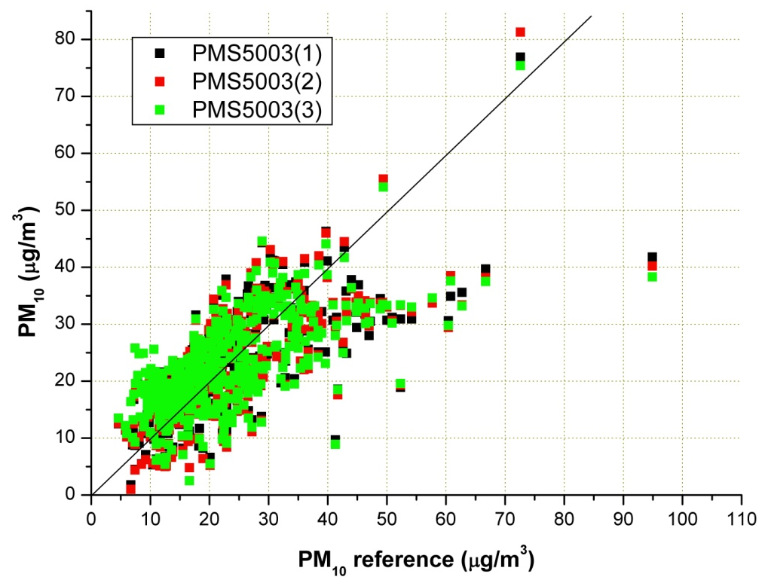
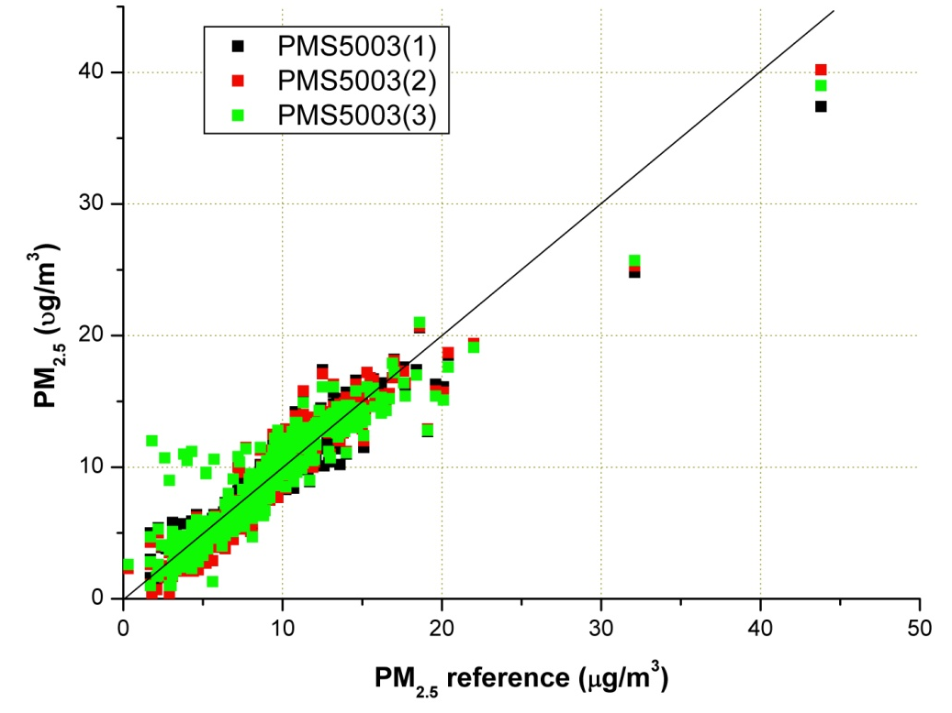
Air quality monitoring in a near-city industrial zone by low-cost sensor technologies: a case study
The results
PM monitoring: validation of the MLR model (the R² values)
PMS5003(1) |  | 0.495
PMS5003(2) | PM₁₀ | 0.481
PMS5003(3) |  | 0.448
PMS5003(1) |  | 0.906
PMS5003(2) | PM_{2.5} | 0.907
PMS5003(3) |  | 0.863
Scatter plots related to the validation period

Slide 18
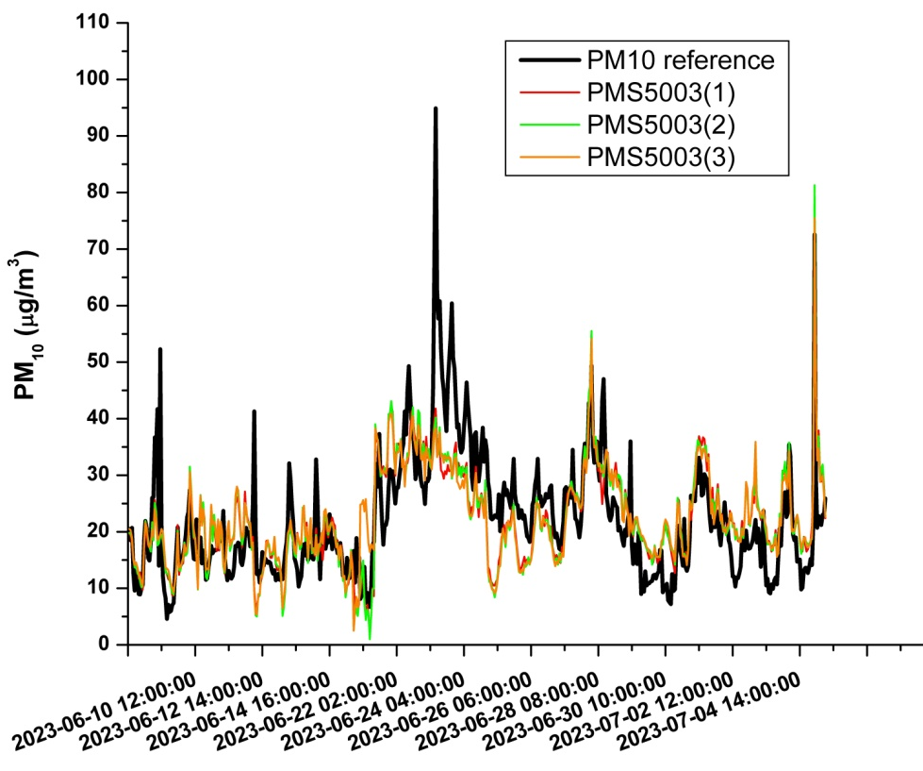
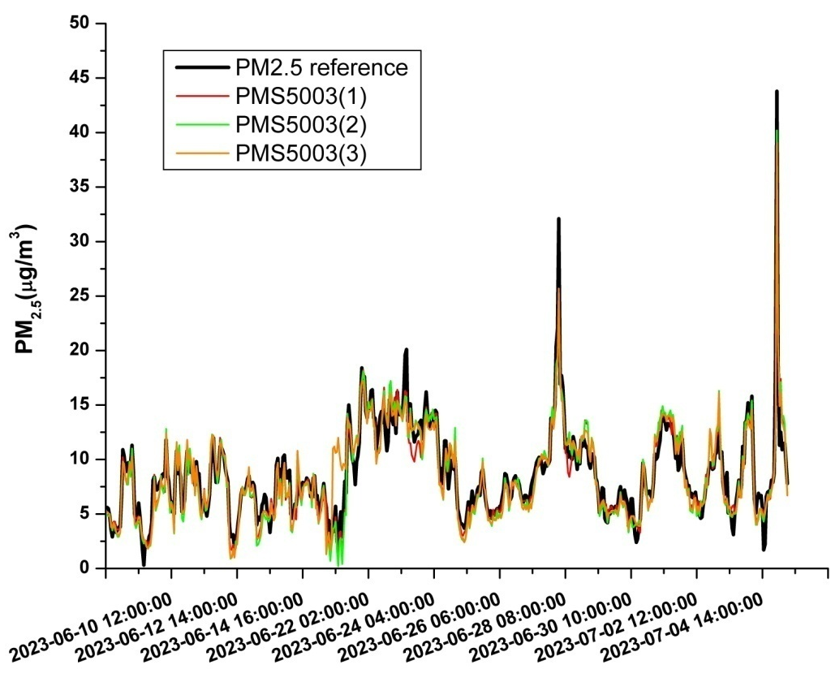
Air quality monitoring in a near-city industrial zone by low-cost sensor technologies: a case study
The results
PM monitoring: validation of the MLR model (the MAE and the RMSE values)
 |  | MAE[µg/m³] | RMSE[µg/m³]
PMS5003(1) |  | 5.8 | 7.8
PMS5003(2) | PM₁₀ | 5.9 | 7.9
PMS5003(3) |  | 6.1 | 8.1
PMS5003(1) |  | 0.9 | 1.3
PMS5003(2) | PM_{2.5} | 1.0 | 1.3
PMS5003(3) |  | 1.0 | 1.5
Time series plots related to the validation period

Slide 19
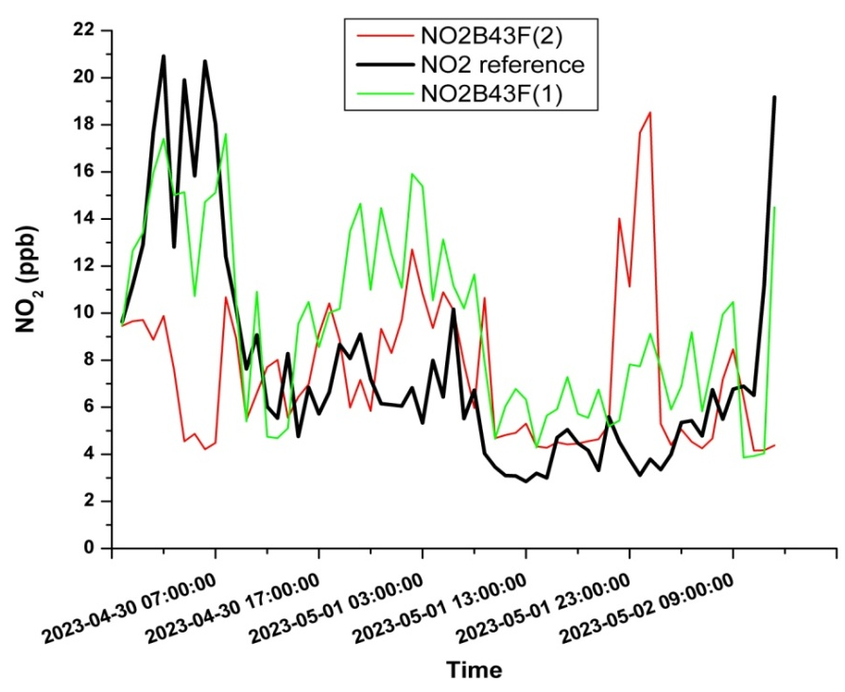
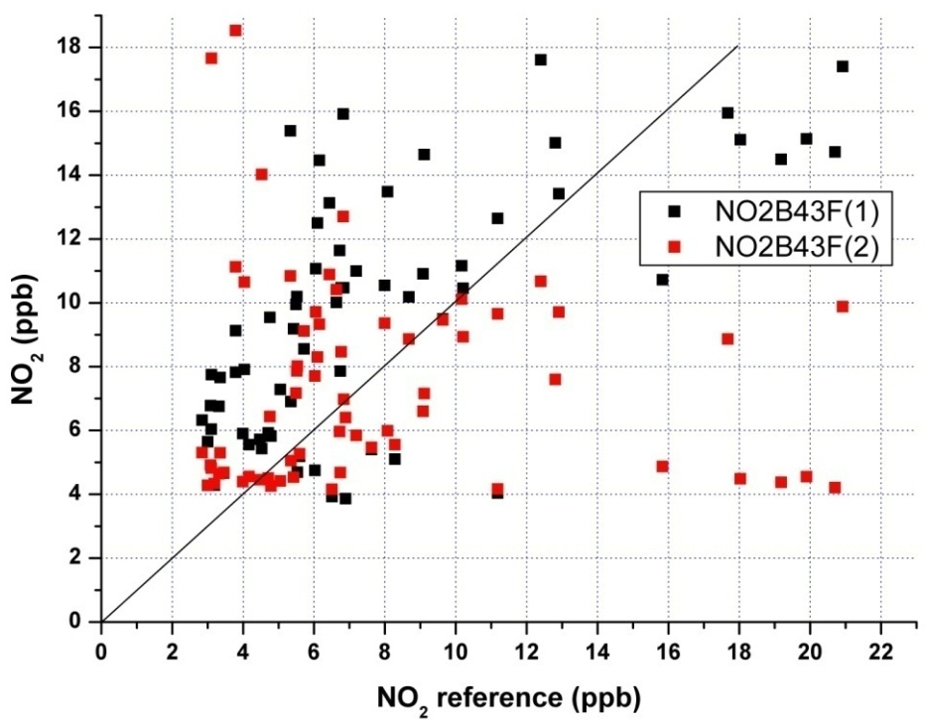
Air quality monitoring in a near-city industrial zone by low-cost sensor technologies: a case study
Discussion and conclusion
The performance of the NO₂ sensors is quite different due to differences in sensor sensitivities
NO₂ sensors have limited or modest capability to follow the reference measurement trends in low NO₂ polluted environments
 | Calibration period |  |  | Validation period
 | R² | MAE[ppb] | RMSE[ppb] | R² | MAE[ppb] | RMSE[ppb]
NO2B43F(1) | 0.818 | 1.4 | 2.0 | 0.439 | 3.4 | 3.6
NO2B43F(2) | 0.727 | 1.9 | 2.4 | 0.005 | 3.8 | 5.9
 | Calibration period |  |  | Validation period
 | Min | Max | Median | Min | Max | Median
NO₂ [ppb] | 3.3 | 20.6 | 10.4 | 2.8 | 20.9 | 6.3
T [°C] | 12 | 26 | 20 | 13 | 26 | 17
RH[%] | 32 | 78 | 49 | 43 | 88 | 73

Slide 20
Air quality monitoring in a near-city industrial zone by low-cost sensor technologies: a case study
Discussion and conclusion
The performance of the PM sensors is very good in the case of PM_{2.5} measurements, while for PM₁₀ their capability to follow the reference is modest
Taking into account the effect of the humidity through the MLR calibration model can bring substantial improvements
PM measurements without the MLR calibration
PM measurements with the MLR calibration
 |  | R² | MAE[µg/m³] | RMSE[µg/m³]
PMS5003(1) | PM₁₀ | 0.411 | 7.9 | 9.6
PMS5003(2) |  | 0.391 | 7.5 | 10.0
PMS5003(3) |  | 0.359 | 8.3 | 10.8
PMS5003(1) | PM_{2.5} | 0.859 | 9.9 | 11.3
PMS5003(2) |  | 0.854 | 12.5 | 14.0
PMS5003(3) |  | 0.835 | 14.2 | 15.8
 |  | R² | MAE[µg/m³] | RMSE[µg/m³]
PMS5003(1) |  | 0.495 | 5.8 | 7.8
PMS5003(2) | PM₁₀ | 0.481 | 5.9 | 7.9
PMS5003(3) |  | 0.448 | 6.1 | 8.1
PMS5003(1) |  | 0.906 | 0.9 | 1.3
PMS5003(2) | PM_{2.5} | 0.907 | 1.0 | 1.3
PMS5003(3) |  | 0.863 | 1.0 | 1.5

