Slide 1



Milk analysis by a new optical multisensor system based on lanthanide(III) complexes
Anastasiia Surkova ¹, Andrey Bogomolov ¹, Aleksandra Paderina ², Viktoria Khistiaeva ², Ekaterina Boichenko ², Elena Grachova ², Dmitry Kirsanov ²
¹ Samara State Technical University, Samara, Russia
² Institute of Chemistry, St. Petersburg State University, St. Petersburg, Russia

Slide 2
Optical multisensor system (OMS)
Multisensor system – an analytical device
  composed of two or more sensors
  optimized for a particular analytical task
  employs chemometrics to maintain accuracy
OMS composed of
  light sources
  photodetectors
  optical fibers
  3D-printed parts, etc.
Advantages
  inexpensive
  portable
  on-site/on-line implementation

Slide 3

Purpose of this study
To develop OMS prototype based on Nd(III) and Yb(III) complexes as a tunable light source
To study a real-life applicability of the developed prototype for quantitative determination of fat in milk and for detection of milk adulteration with urea

Slide 4
Molecular emitters as a light source
Properties
  laser diode excites the emission of molecular emitters
Requirements to choose emitters
  absorption spectrum must not overlap with emission spectrum
  excitation radiation must fit into the absorption maximum
  brightness (quantum yield of emission)
  emission wavelength in solid phase
Advantages
  high versatility
  short analysis time
  adjustment of the emission wavelength for a specific application

Slide 5
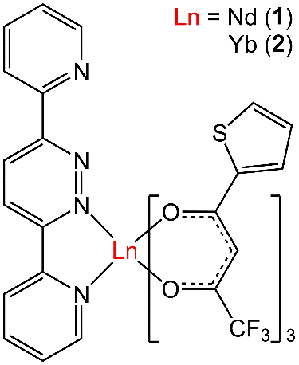
Lanthanide(III) complexes
Lanthanide complexes were chosen based on the following reasons:
Predictability of NIR emission energy;
Nd(III) and Yb(III) complexes are the most popular NIR emitters for working with biological objects, because their photoemission is within the transparency window of most biological objects (700–1100 nm);
The luminescence of Ln(III) is not sensitive to oxygen that allows to work without sample degassing;
Tris(beta-diketonate) heteroleptic Ln(III) complexes are air-, moister- and photostable.
  [Nd(tta)₃(dppn)] (1)
  [Yb(tta)₃(dppn)] (2)
Htta = thenoyltrifluoroacetone;
dppn = 3,6-di(2-pyridyl)pyridazine

Slide 6
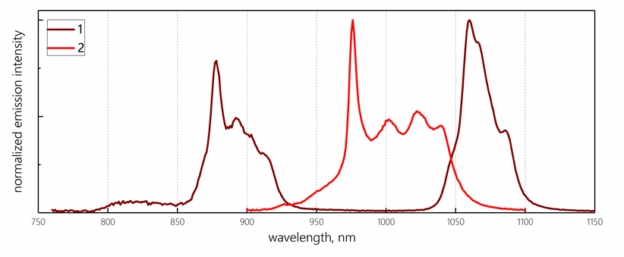
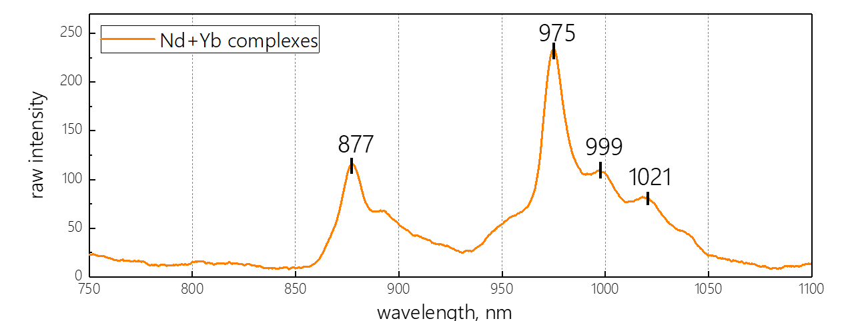
Molecular emitters as a light source
Individual spectra of the complexes
Emission spectrum of the mixture

Slide 7
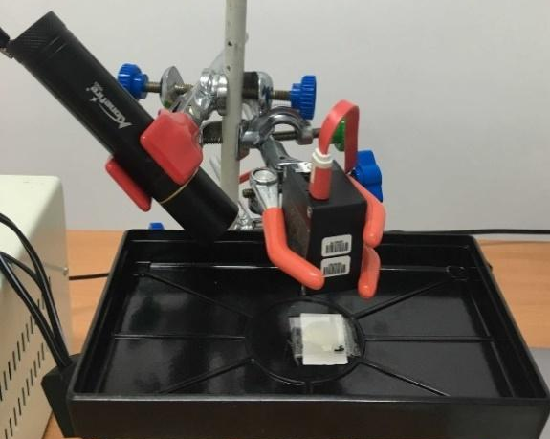
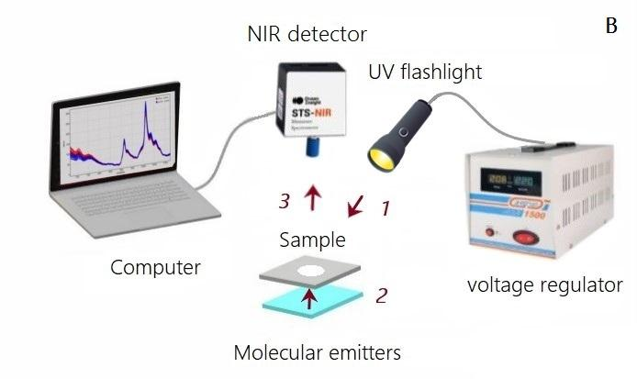
Experimental SETUP
Sample volume | 40 µL dried drop
Sample placement | a coverslip
Excitation source | UV flashlight (λ_{exct} = 365 nm)
Detector | STS-NIR Miniature Spectrometer (Ocean Optics, USA)

Slide 8
MILK Samples
Calibration series | F-series | U1-series | U2-series
Defined parameter | Fat content | Urea content | Presence of high urea level
Concentration range | 2.5–3.3% | 0–2100 mg/L | 0–9000 mg/L
Number of samples | 5 | 12 | 10
Model | PLS, MLR | PLS, MLR | PLS DA

Slide 9
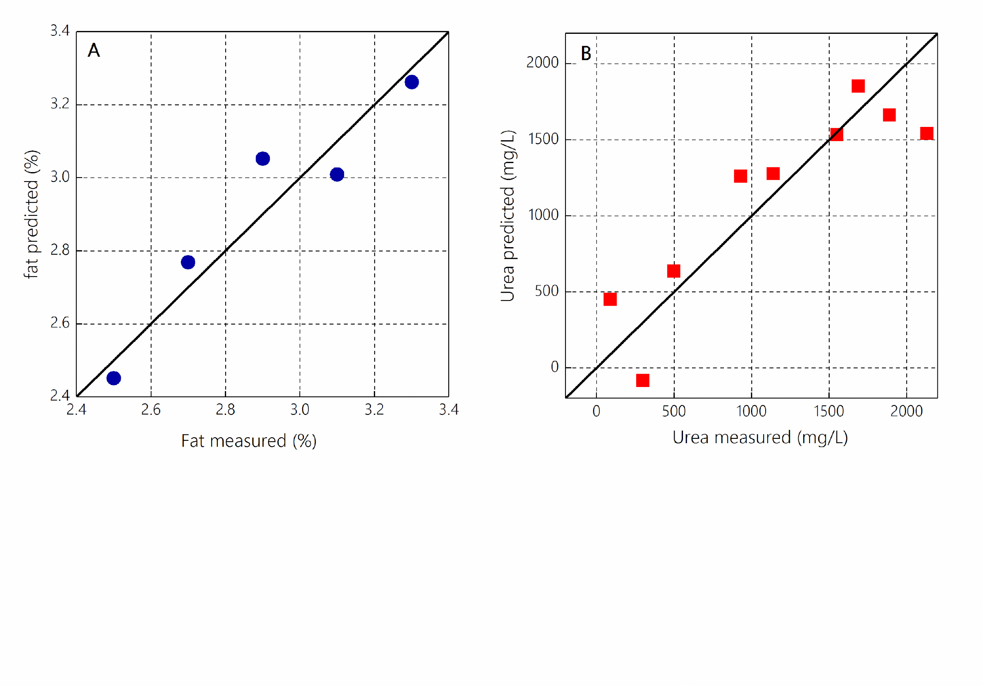
Results: DETERMINATION OF FAT CONTENT
 | Wavelength range (nm) | Calibration |  | CV
 |  | RMSE (%) | R² | RMSE (%) | R²
PLS | 850–1100 * | 0.04 | 0.98 | 0.09 | 0.94
 | 877, 975, 999, 1021 * | 0.06 | 0.96 | 0.13 | 0.87
MLR | 975, 999 | 0.05 | 0.96 | 0.10 | 0.88
* LV = 2, concentration range: 2.5–3.3%

Slide 10
Results: DETERMINATION OF Urea CONTENT
 | Wavelength range (nm) | Calibration |  | CV
 |  | RMSE (mg/L) | R² | RMSE (mg/L) | R²
PLS | 850–1100 | 212.21 | 0.91 | 307.56 | 0.84
 | 877, 975, 999, 1021 | 293.01 | 0.81 | 358.53 | 0.79
MLR | 877, 975 | 275.65 | 0.84 | 342.65 | 0.75
* LV = 1, concentration range: 0–2100 mg/L

Slide 11
Detection of urea-adulterated milk
NIR spectrum of dry urea powder
Urea concentrations in natural milk are in the range of 180–400 mg/L
Regulated upper limit of 700 mg/L
A higher amount of urea in milk may indicate adulteration
PLS-DA results
Calibration |  |  | CV
Spec, % | Sens, % | Ac, % | Spec, % | Sens, % | Ac, %
100 | 100 | 100 | 88 | 90 | 89
850–1100 nm range, preprocessing – SNV

Slide 12
Conclusions
Nd(III) and Yb(III)-based complexes are suitable light sources in short-wave NIR region for OMS construction.
Developed OMS allows determination of fat content in homogenized milk with sufficiently high accuracy.
The rough estimation of milk adulteration by urea addition with the developed OMS prototype is possible.
The presented concept is promising for development of OMS applicable for assessment of food quality or other analytical challenges in the food industry.

Slide 13


Acknowledgements
the Ministry of Science and Higher Education of the Russian Federation (theme No. FSSE-2023-0003)
the grant #MK-2192.2021.4
Samara State Technical University
St. Petersburg State University
CSAC2023 organizers
Thank you for your attention!

